Slide 1
Internship Presentation 8/22/2017
Stephen Wang

Slide 2
Outline (not part of presentation)
Introduction (1 minute)
Talk about sync/async languages (30 secs)
Talk about project 1 (2 minute)
Talk about databases (30 secs)
Talk about project 2 (2 minute)
Outro (30 secs)
Total: 6 mins 30 secs

Slide 3
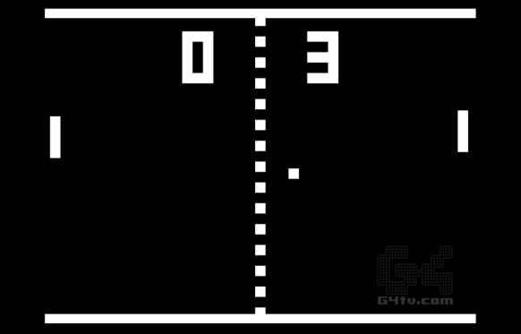

About Me

Slide 4
Software Update Application
JavaScript, HTML

Slide 5
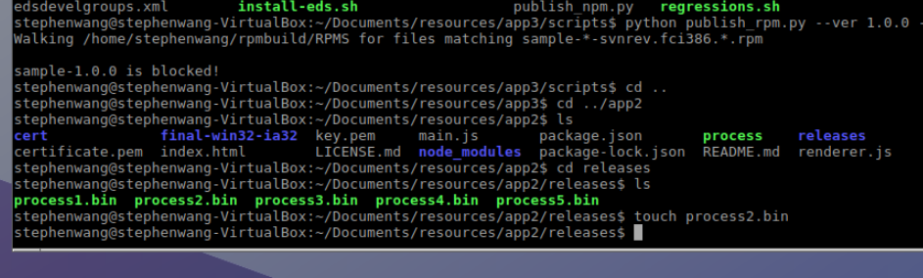
1. Update installation file

Slide 6
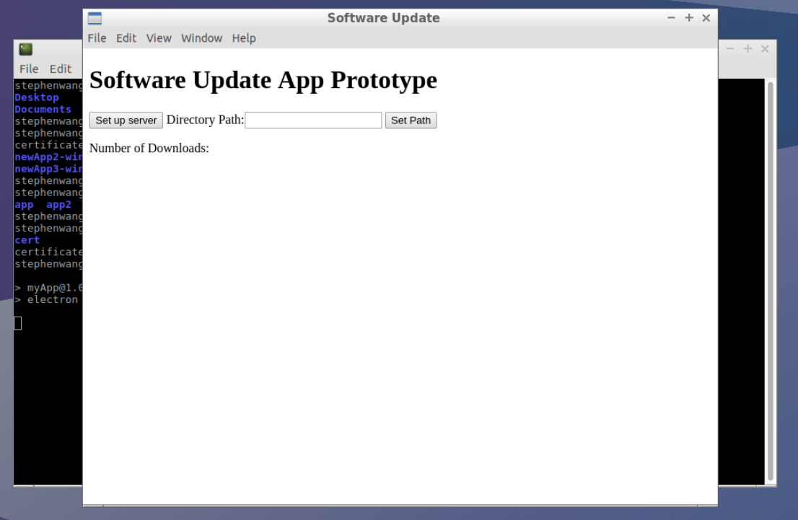
2.

Slide 7
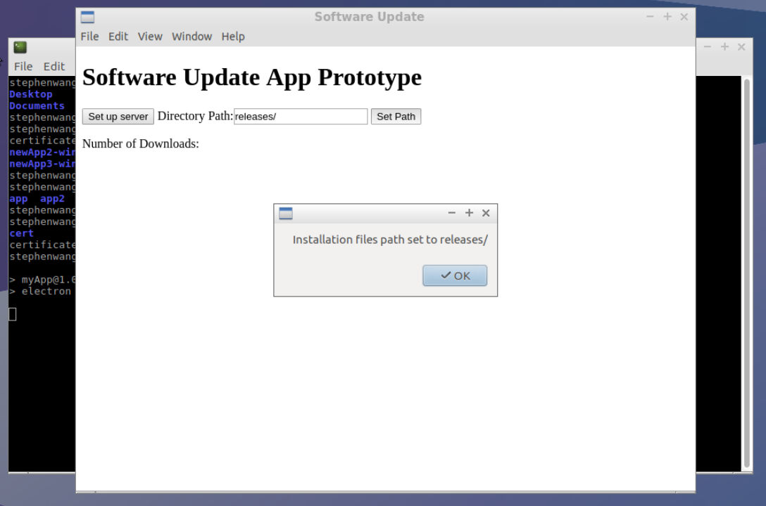
3.

Slide 8
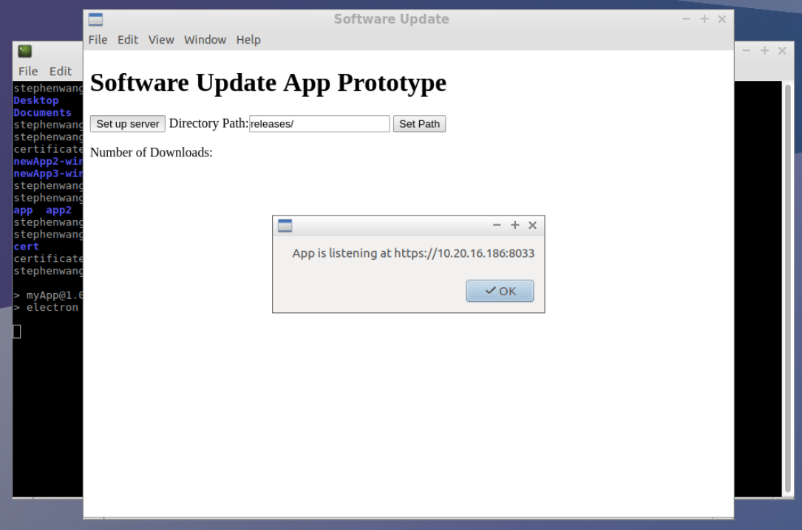
4.

Slide 9
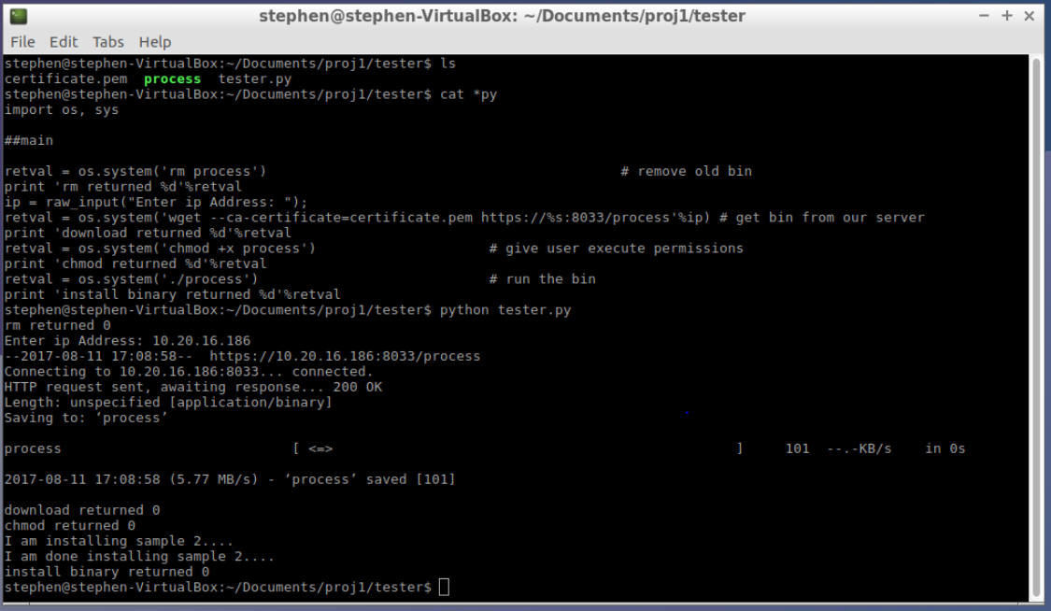
5. On second computer, run testing script.

Slide 10
Publish Filter
JavaScript, HTML

Slide 11
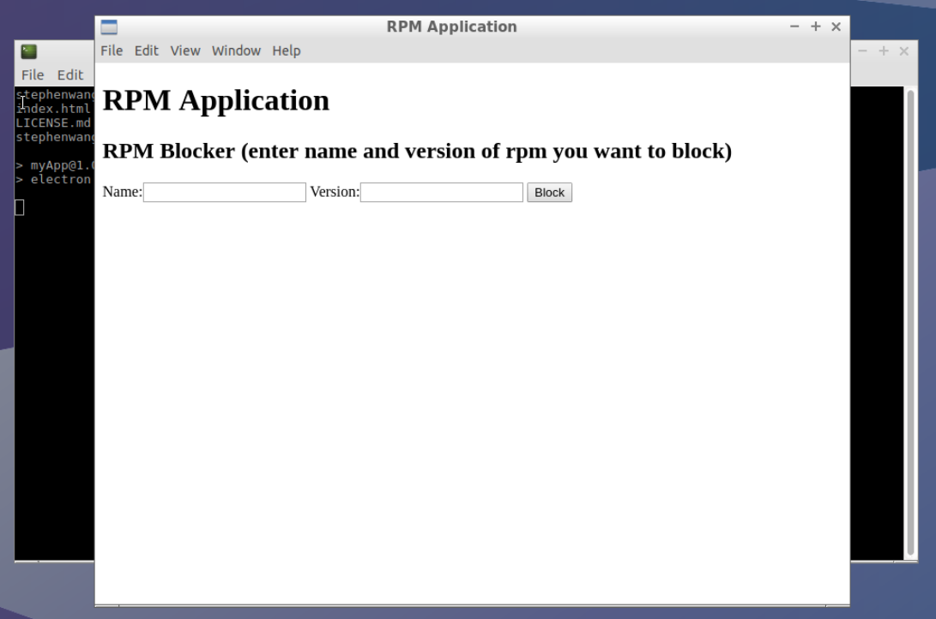
1. Start-up

Slide 12
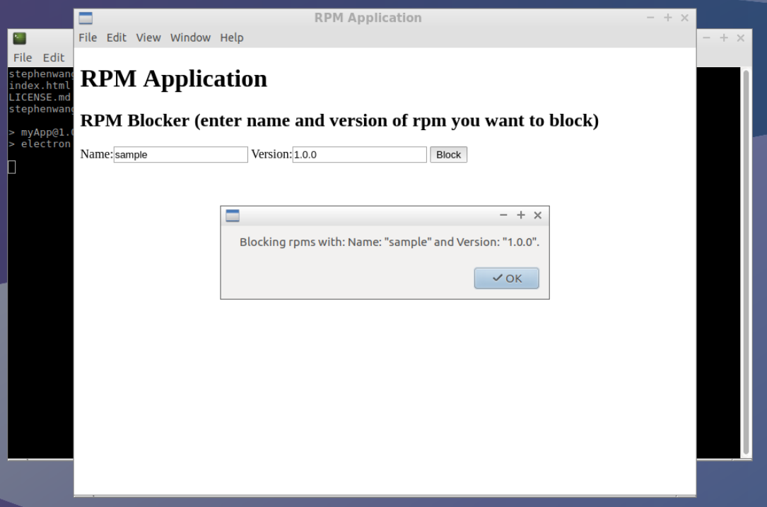
2.

Slide 13
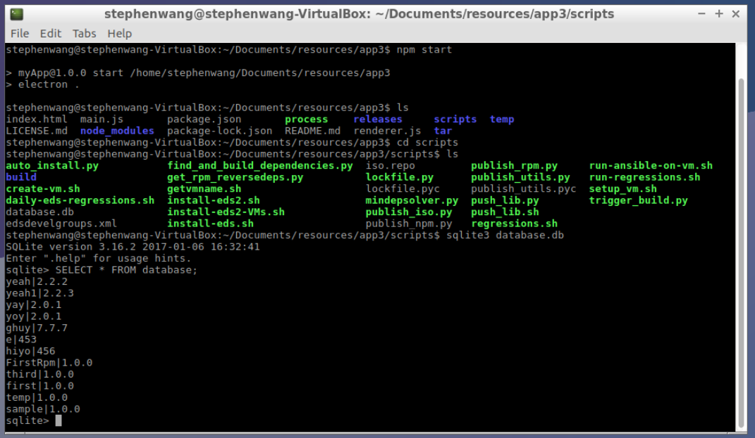
3.

Slide 14
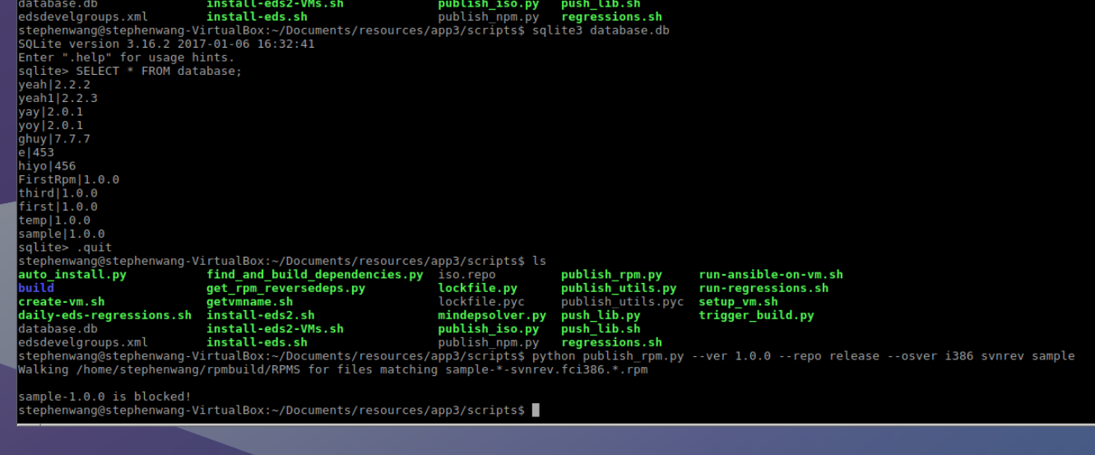
4.

Slide 15
Acknowledgements
Paul Korn
Natarajan Subramanian
Clement Lan
Monty Virdi
Evelyn Lara Lopez
Summer Interns

Slide 16
Thank You

