Slide 1
Software Engineering Internship Presentation 8/22/2017
Stephen Wang

Slide 2

About Me

Slide 3
Asynchronous
Synchronous
int main() {
cout << “One”;
cout << “Two”;
cout << “Three”;
}
function one(){
alert(“One”);
}
function two(){
alert(“Two”);
}
function three(){
alert(“Three”);
}

Slide 4
Software Download Application
JavaScript, HTML
What it does:
Sets up a server on your computer.
Users from other computers can download files from your computer.

Slide 5
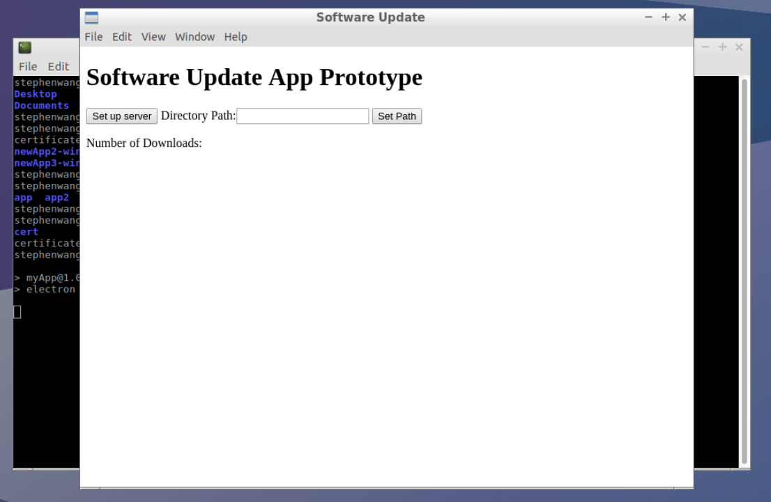
1.

Slide 6
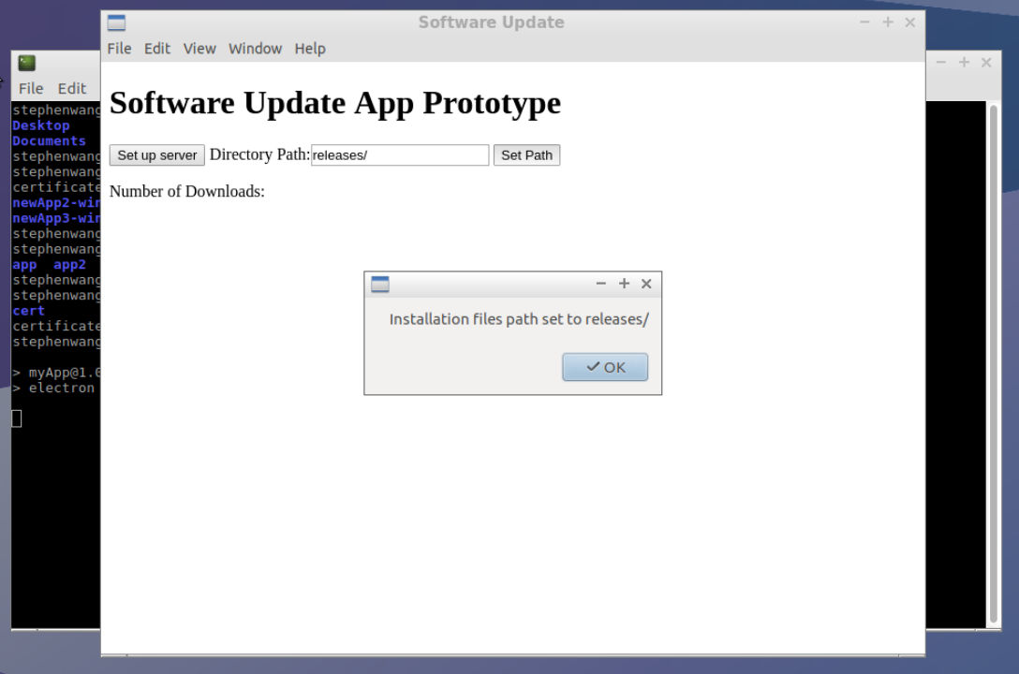
2.

Slide 7
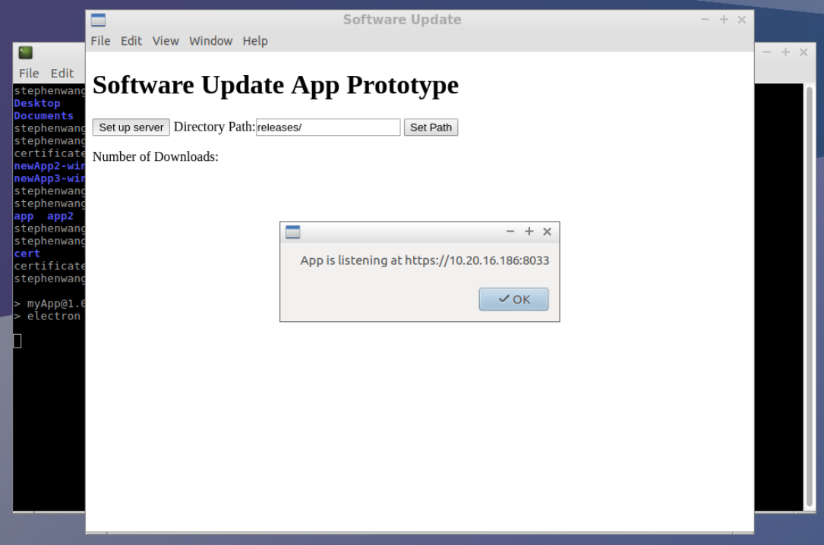
3.

Slide 8
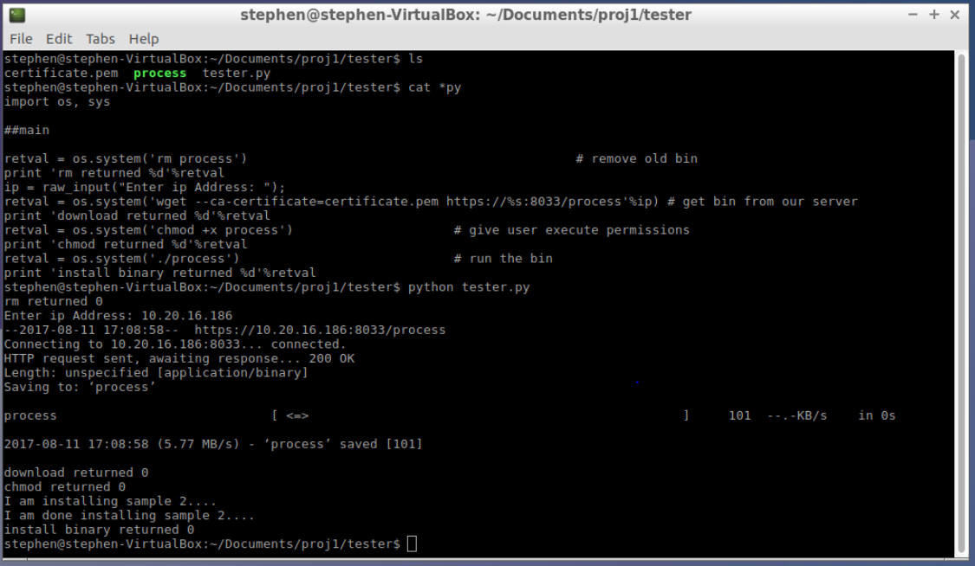
4. (On a different computer)

Slide 9
Publishing Filter
JavaScript, HTML
What it does:
Blocks certain files from being published.

Slide 10
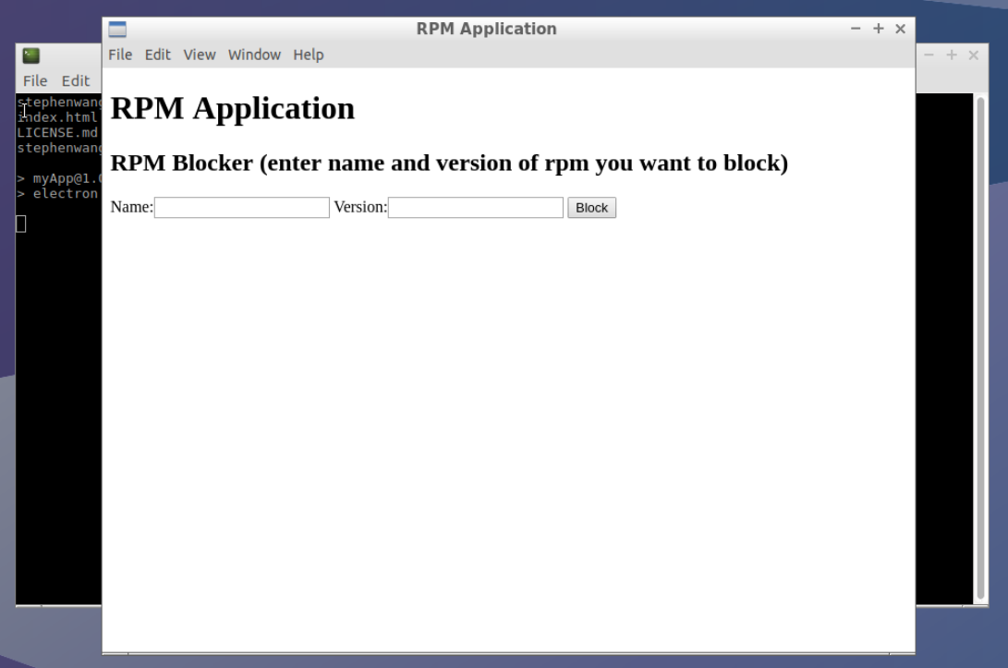
1. Start-up

Slide 11
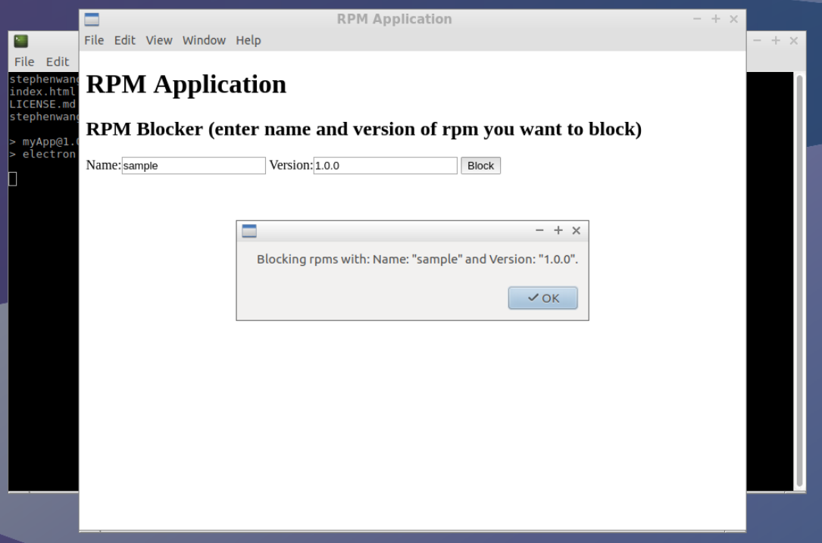
2.

Slide 12
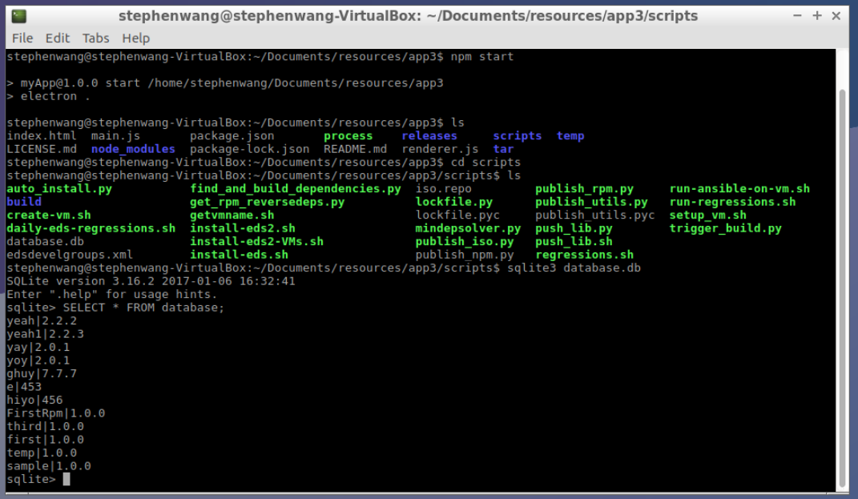
3.

Slide 13
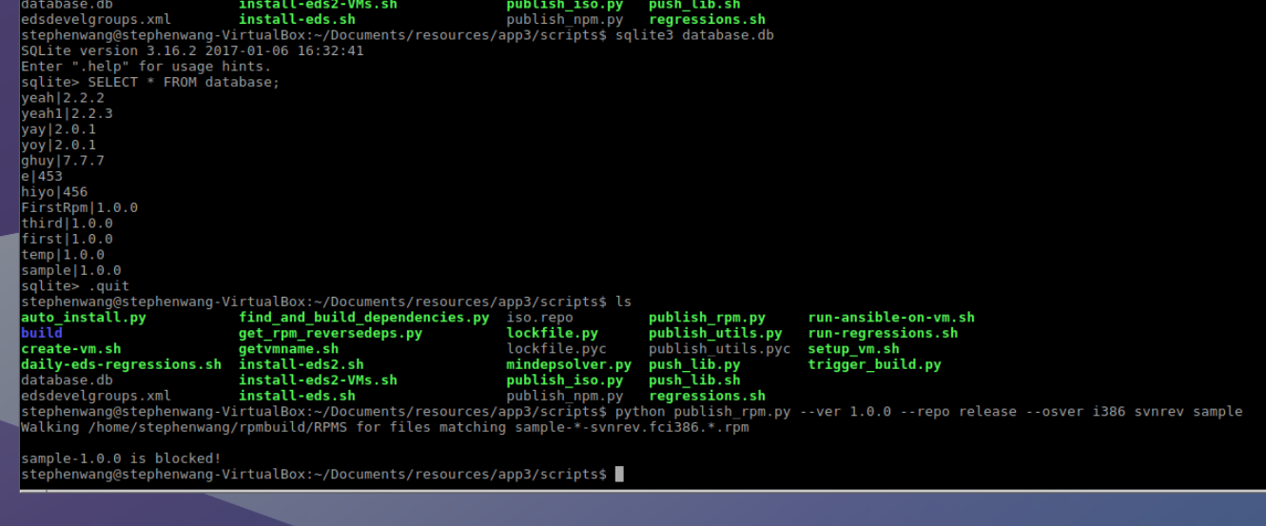
4.

Slide 14
Acknowledgements
Paul Korn
Shiv Peparthi, Dan Liu
Natarajan Subramanian
Clement Lan
Monty Virdi
Evelyn Lara Lopez
Summer Interns

Slide 15
Pros/Suggestions
Pros:
Gained a lot of JavaScript experience
Made a lot of connections
Was fun
Suggestions:
-

Slide 16
Thank You!

