Slide 1
Internship Presentation 8/22/2017
Stephen Wang

Slide 2

About Me

Slide 3
Synchronous (C++)
int main() { // STARTS HERE
cout << “One”;
cout << “Two”;
cout << “Three”;
}

Slide 4
Asynchronous (JavaScript)
Function one(){ // NO STARTING POINT
alert(“One”);
}
Function two(){
alert(“Two”);
}
Function three(){
alert(“Three”);
}

Slide 5
Software Download Application
JavaScript, HTML
What it does:
Sets up a server on your computer.
Users from other computers can download files from your computer.

Slide 6
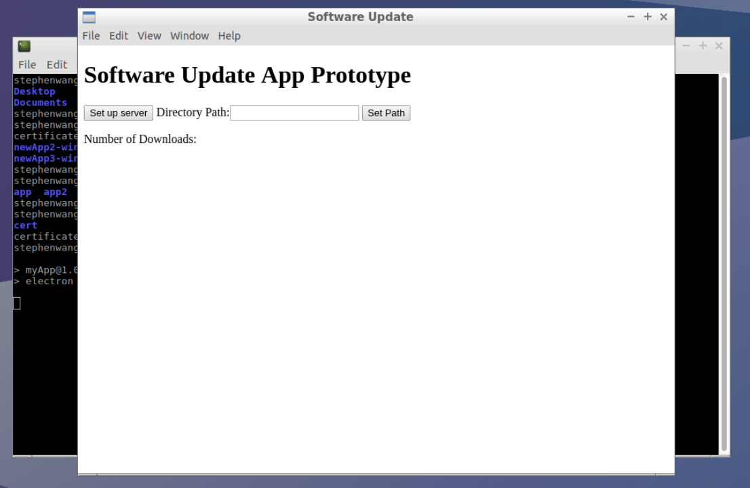
1.

Slide 7
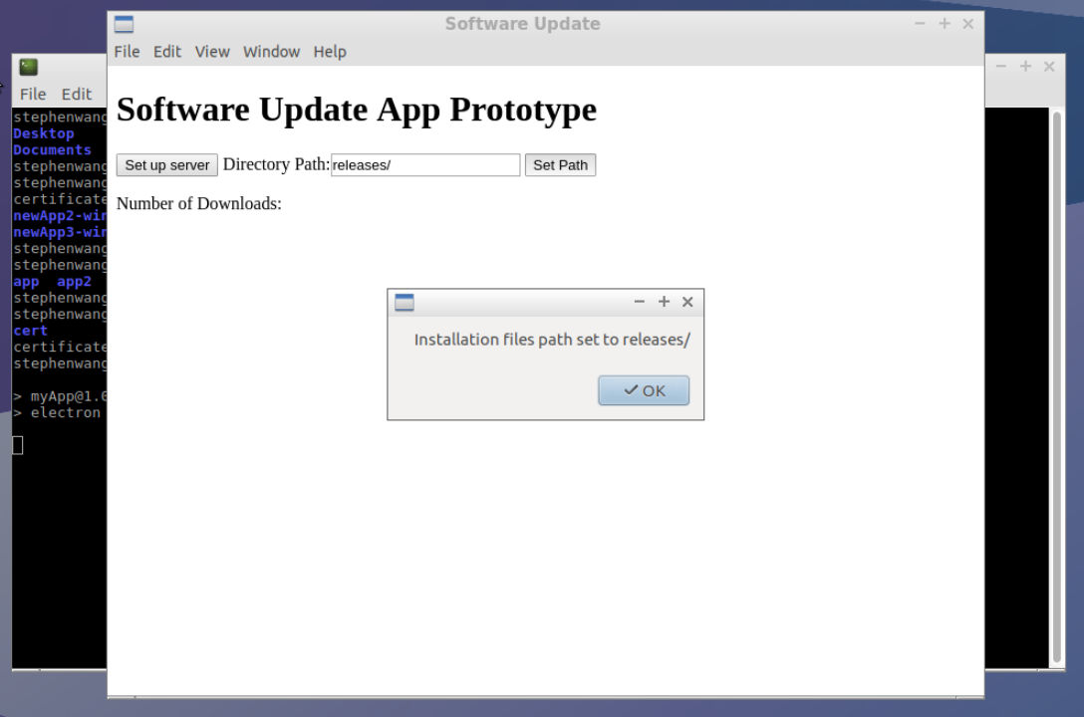
2.

Slide 8
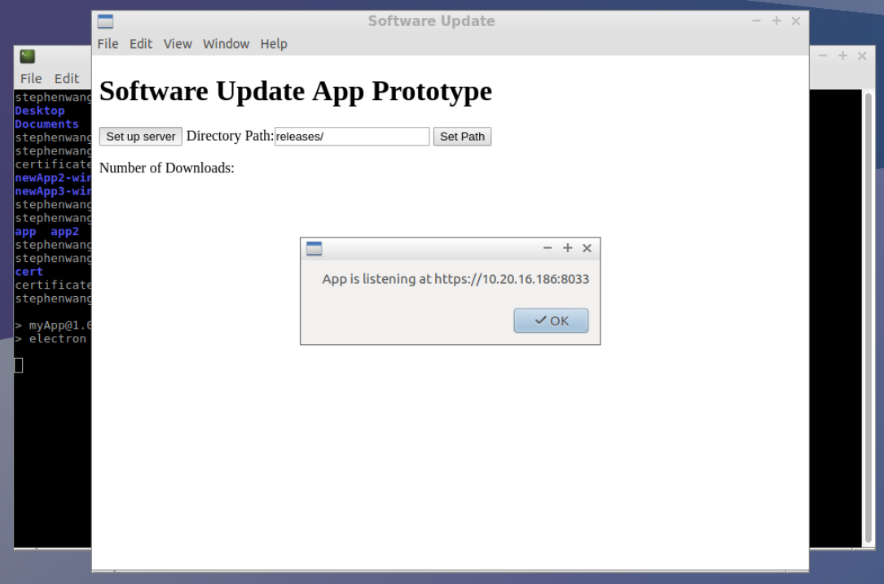
3.

Slide 9
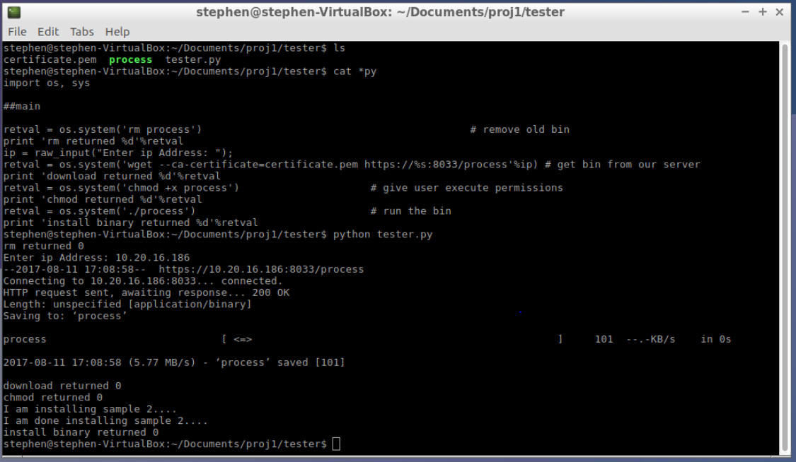
4. (On a different computer)

Slide 10
Publishing Filter
JavaScript, HTML
What it does:
Blocks certain files from being published.

Slide 11
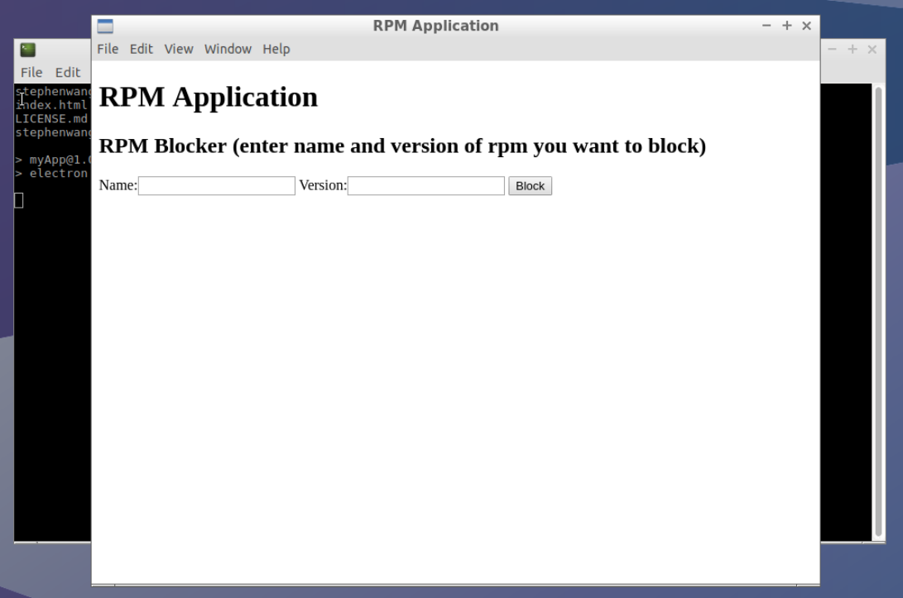
1. Start-up

Slide 12
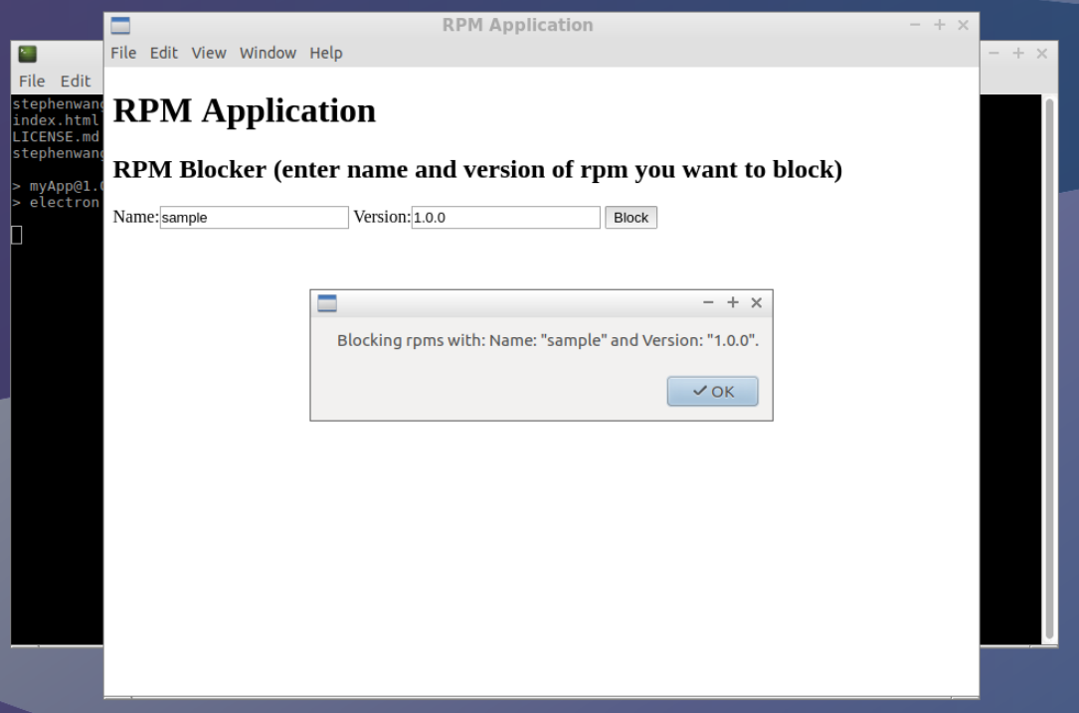
2.

Slide 13
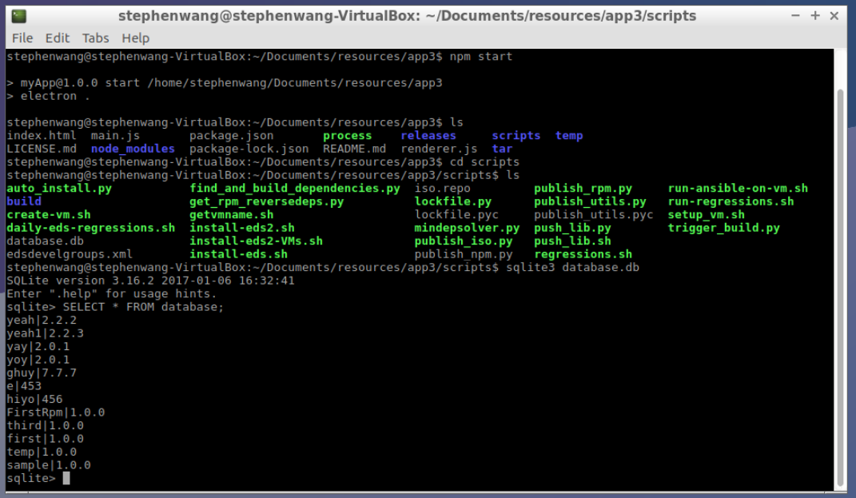
3.

Slide 14
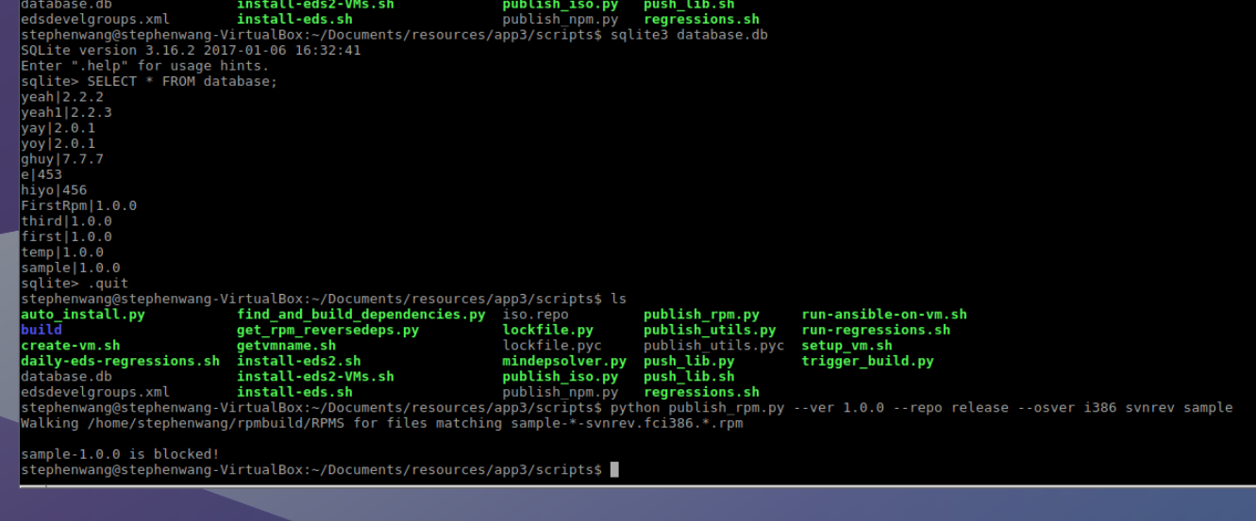
4.

Slide 15
Acknowledgements
Paul Korn
Shiv Peparthi, Dan Liu
Natarajan Subramanian
Clement Lan
Monty Virdi
Evelyn Lara Lopez
Summer Interns

Slide 16
Thank You!

