Slide 1
Cryptography & Encryption
Carl Ellis

Slide 2
Presentation Outline
History Of Cryptography
Modern Encryption
Uses of Encryption
Identity and the Web of Trust
Practical examples
Further Reading
Questions

Slide 3
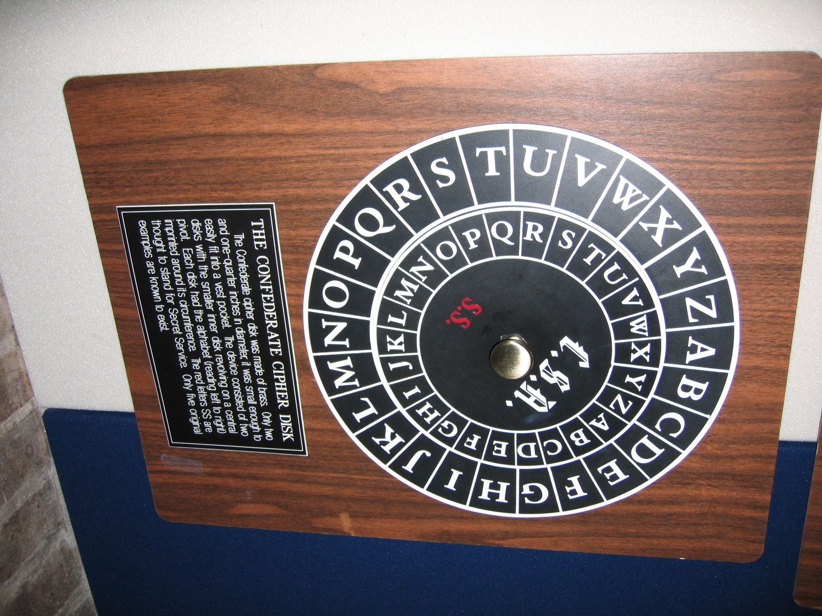
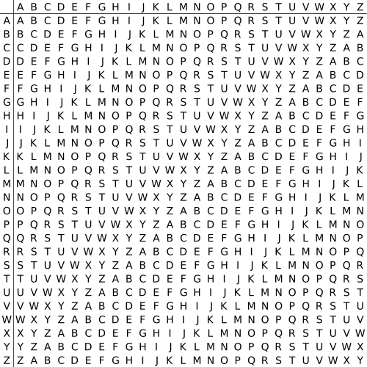
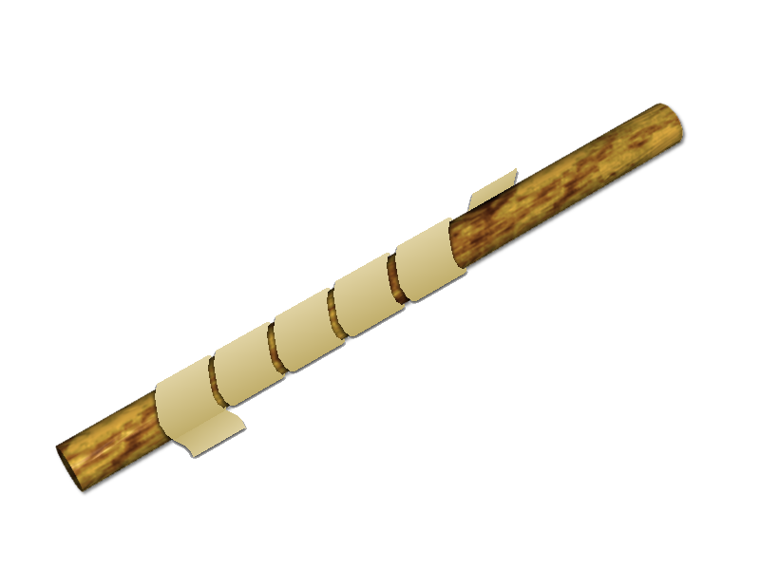
History of Cryptography
Cryptography was first discovered in cultures as old as Ancient Egypt and Rome.
You may be fairly familiar with the Caesar Cipher, but there were some other encryption devices.
Notes:
Cryptology is an ancient art and until recently only really contained the fields of encryption, and its counter part, decryption.
Some of the earliest forms of encryption were generally used to send orders to armies, and a common one used was the caesar cipher.
Before this though, there were simpler forms, called displacement ciphers, like the scytale which was used (apparantly) by the Spartans.
Caesar ciphers are a form of monoalphabetic substitution ciphers, one of the simplest even.
More advanced forms exist called polyalphabetic substitution ciphers, which were used by the confederancy and formalised by Giovan Battista Bellaso with the Vigenere Square, which shifted the alphabet with each word.
After the dark ages, and spurred by political and religious necessity, cryptology sprung up from the ashes to be born again, most notably in Italy with the Papal states and the Roman catholic church, and the Babbington Plot.
But all of these were foiled by ...

Slide 4
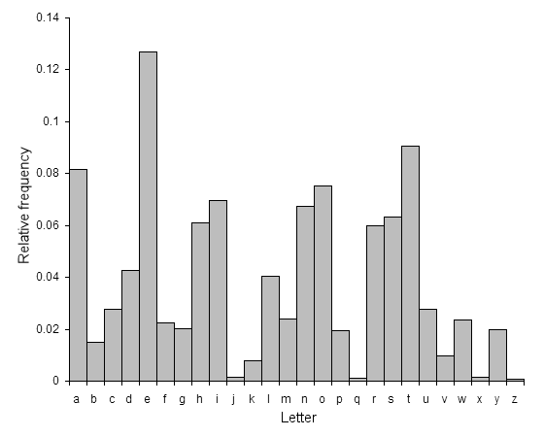
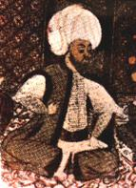
History of Cryptography
Frequency Analysis
  First discovered by the Arab Mathematician Abu Yusuf Ya'qub ibn Ishaq al-Kindi at around 800 CE.
Cracks every known monoalphabetic substitution cipher.
Notes:
Frequency anaylsis brought forth an era of understanding when it came to decryption.
Frequency anaylsis takes the distribution of single letters, digrams, and trigrams from the source language (English, Arabic etc).
It then does the same from the cipher text. Then, using statistical methods, or trial and error, attempts to decrypt the cipher text.
Extending some of these techniques, Charles Babbage managed to break polyalphabetic ciphers, including the autokey cipher.

Slide 5
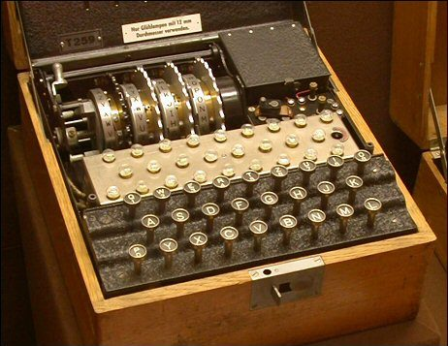
History of Cryptography
With basic polyalphabetic substitution ciphers broken, a more deviant method was produced.
Introducing:
The Enigma Machine
Notes:
At the end of World War I, a German engineer called Arthur Scherbius invented the enigma machine. This machine boasted unbreakable encryption, and was adopted by the Nazi Party in World War II, and spurred on Allied research into Cryptology and help fund the first computers.
So, why didn't standard frequency analysis methods work on Enigma?

Slide 6
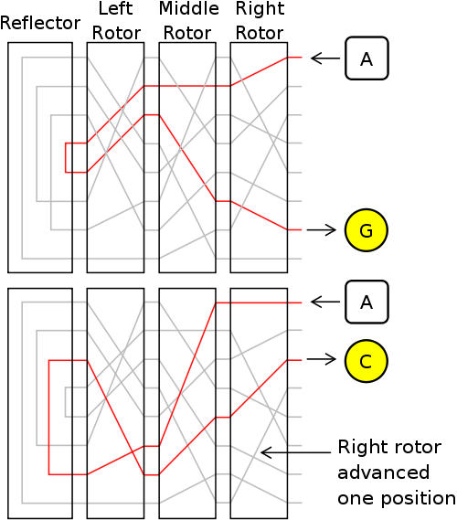
History of Cryptography
The enigma machine address the problem of old polyalphabetic substitution ciphers.
Alphabets are never repeated.
Notes:
Fequency analysis only cracked polyalphabetic substitution due to the use of a tabula recta, or some other form of repeating alphabet.
The enigma machine used 4 rotors. The right, middle and left. It also had a reflector rotor.
Each rotor would have 26 inputs, and 26 ourputs, on each side of the cog, with the conenctions between them set up at random.
This means that current would go through the right, middle then left rotor, hit the reflector and then back through the right middle and left into the machine.
This meant that when a key was pressed, a light bulb corresponding to the cipher text would light up.
With each keypress, the right rotor would rotate, changing the connections. Every 10 or so, the middle would rotate, and every 20 or so, the left rotor would. These were, of course, variable, and meant that different cogs made different substitutions, and different starting positions made different substitutions.
The beauty with the machine, was that the enigma machine had 17.5k alphabets, and for normal message sizes, ideal for military messages.

Slide 7
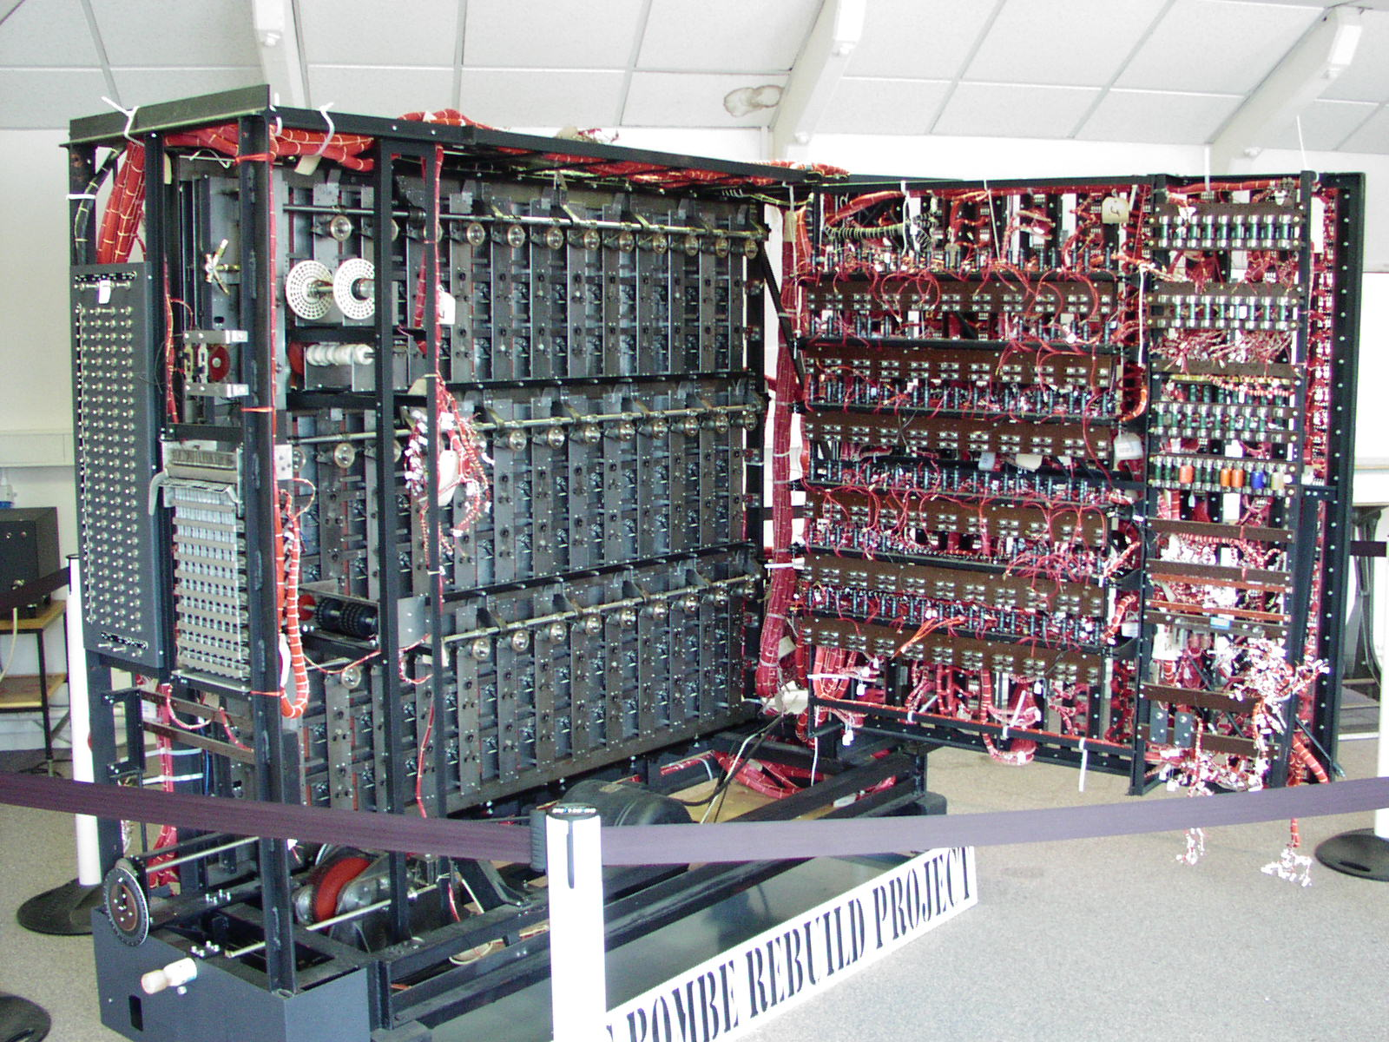
History of Cryptography
Turing's bombe was one of the forefathers of modern computers.
Enabled brute force and frequency anaylsis attacks on a large scale.
Notes:
With help from the Polish intellegence agencies, French intellegence, enough of enigmas operating manuals were obtained to make a reasonable guess at its workings. Mathamaticians were gathered to help crack this beast at Bletchly Park.
Once the possible wirings were known, the keys could be discovered using methods such as cribs, flaws in the enigma machinery and poor operator procedures.
The bombe allowed multiple keys to be tested very fast, and war time messages were eventually decoded, even with the German Navy taking rather sequitus methods in their encryption schemes.

Slide 8
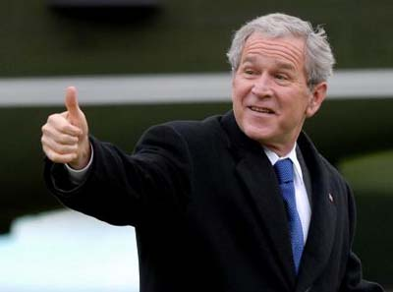

Modern Cryptography
Post war, cryptography dissappeared into government.
Increased electronic communications by banks and other such entities called for an encryption standard.
Enter DES(Data Encryption Standard)
Notes:
After the war, cryptography flowed back into the depths of the secret government branches, and became the norm for sensitive military and diplomatic communications.
However, with the advent of banks becoming electronic, and wire transfer systems, IBM was approached by an american standards agency to provie a standard encryption scheme.
With advice and mathematical assurances from the NSA, IBM produced a symetric block cipher with a 56bit key.

Slide 9
Modern Cryptography
DES was probably not the first modern cipher.
First standard cipher.
Works on binary data streams.
Very fast to encrypt and decrypt.
High adoption rate.
Brought and explosion of commercial and academic interest
Notes:
This was the first standard digitialcipher. It allowed communications between two entities to be encrypted automatically for the first time ever, so long as a common key was used.
The endorsement by the NSA brought a boom in academic and commercial iterest in cryptography.
This lead to a few principles and types of crytoraphy, but for now I shall show you how DES works, as it is a simple example of a symetric encryption algorithm.

Slide 10
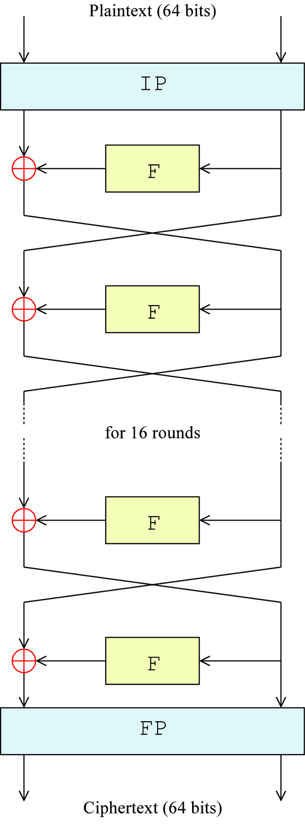
Modern Cryptography
DES is a fairly simple algorithm.
It breaks plaintext into chunks and puts them through 16 rounds of operations.
This creates the cipher text.
This process is completely reversable.

Slide 11
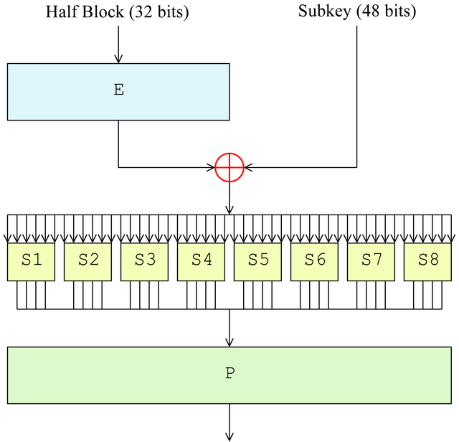
Modern Cryptography
Each operation is called a F (Feistel) function.
This XORs an expanded block with a subkey, and then splits the bitstream into chunks of 6bits.
These are put through S-boxs, which perform a non linear substitution into 4bit outputs, and are put through a final permutation before leaving the F function.

Slide 12

Modern Cryptography
The subkeys are generated by the key scheduler, which splits the given key 64 bit (8 thrown away) into 16 subkeys to be used by the F functions.
The keys are generated by left shifting them continuously, then permutating them.
This keeps the algoirhtm symetric.

Slide 13
Modern Cryptography
This algorithm was one of the first widely used symettric algorithms.
It was replaced by AES(Advanced Encryption Standard) due to fears of it being brute forced.
A major problem with symetric encryption is key distribution, and that all keys must be secret.

Slide 14
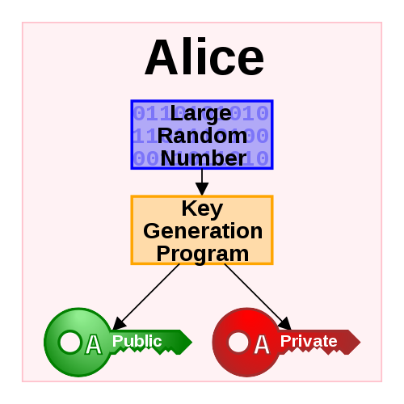
Modern Cryptography
In the 1970s, this was solved with the advent of 'Public Key' encryption.
An algorithm would output two different, but mathematically linked, numbers.
The public key could be distributed everywhere, for all to see, the private key must be kept hidden for the owner.

Slide 15
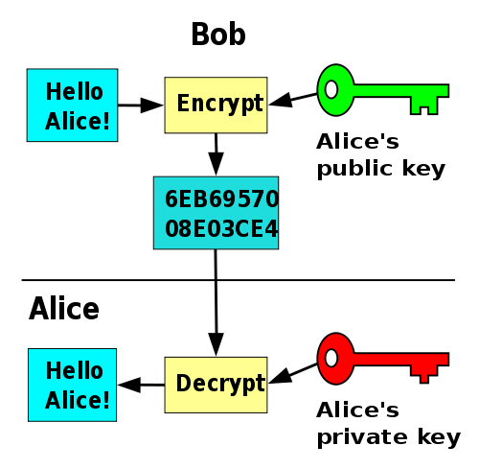
Modern Cryptography
One key will encrypt text which can only be decrypted by the other.
So, publicise your public key, and anyone can encrypt messages which only you can decrypt with your private key

Slide 16
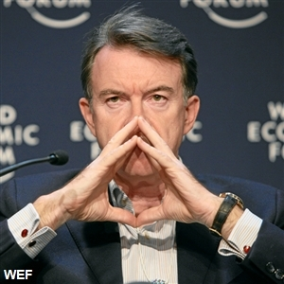
Uses of Cryptography
Well, um, to keep things private.
And to protect yourself against this man. Bloody Lord Mandelson doesn't want your internets to be free and uncensored. He wants to know what your doing .. hes a complete and total bastard. A person who wishes for an orwellion society where he is big brother, the pupet master. Hide, Hide your data!

Slide 17
Uses of Cryptography
My rant aside...
Public key encryption means anyone can leave a message solely for you.
Handy for diplomacy, intellegence, and warfare.
And for proving who you are ...

Slide 18
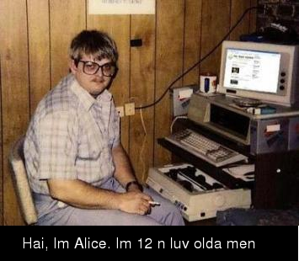
Identity and the Web of Trust
In the world of the internet how can you prove who you are?
Alice and Bob's dilemma aside, it is especially important in diplomatic contexts.

Slide 19
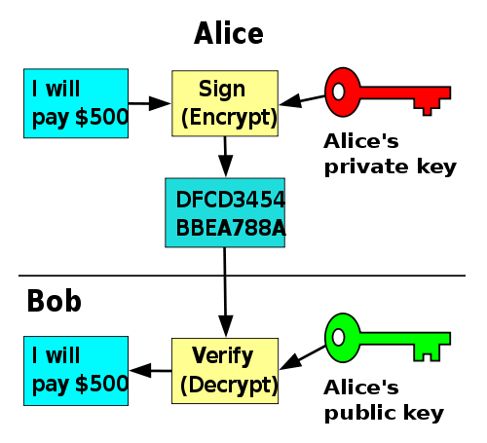
Identity and the Web of Trust
Using the public key system, its easy!
Simply encrypt the message, or a hash of the message with your private key. This can only be decrypted with the public key and proves it came from you.

Slide 20
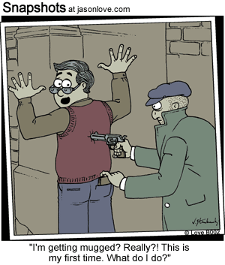
Identity and the Web of Trust
Well, prove it is from a key which claims to be you, nothing more.
This is where key signing comes in.
Some companies have risen to facilitate this, like Verisign.
However, there are cheaper alternatives.

Slide 21
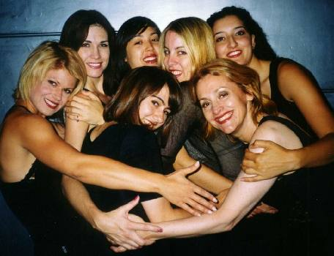
Identity and the Web of Trust
Rather than having a central authority, decentralise it!
You know your friends, get them to print out their public keys and then verify its theirs.
Then you sign their key, they sign yours.
This means if an unknown key contacts you, but is signed by people you trust, it is inherently more trustworthy than an unsigned key.

Slide 22
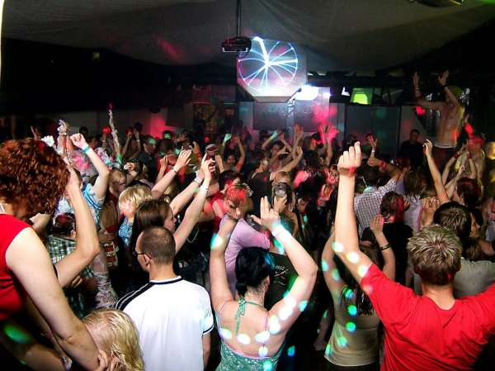
Identity and the Web of Trust
Key signing parties are made to facilitate this.
Find them at conferences or really geeky parties.
Probably not this one ->

Slide 23
Practical Examples
LOOK MA' I'm encryptin'!

Slide 24
Further Reading
http://en.wikipedia.org/wiki/History_of_cryptography
http://en.wikipedia.org/wiki/Frequency_analysis
http://en.wikipedia.org/wiki/Data_Encryption_Standard
http://en.wikipedia.org/wiki/Asymmetric_key_algorithm
http://en.wikipedia.org/wiki/Enigma_machine
And an excellent ebook which has some web of trust stuff in it
  http://craphound.com/littlebrother/Cory_Doctorow_-_Little_Brother.pdf

Slide 25
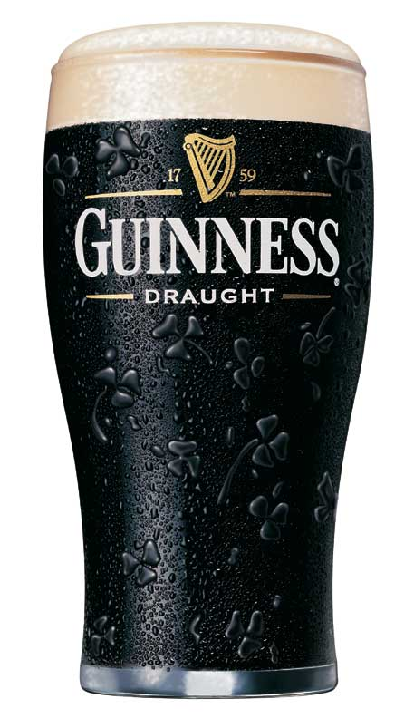
Questions
Although not many, it's St. Patricks day and all!
Marshmallow
Tar

