Slide 1
Game Programming
( Theory – Examples – Libraries )
Steve Wattam ― Carl Ellis

Slide 2
Topics
What's in a game (engine, resources, etc)
  Theory (FSMs, AI, physics, game loop, overview of some games)
Big games (dev, structure, apis)
  Console/PC (libraries, languages)
  Studios and history
Indie gaming (contrast, link to prototyping/rapid dev, dev, apis, iphones etc)
  Homebrew (consoles), PC competitions
  Some examples (coding competition, rapid dev)
XNA, DirectX, SDL, OpenGL overview
Look for the hilarious smiley

Slide 3
What's in a Game?
fun.

Slide 4
Types of Game
Art vs. Entertainment
(monetary gain or for the sake of it)
Interactive vs. Passive
(game vs. movie)
Goal-oriented vs. Abstract
(SimCity vs. Pac-man)
Conflict vs. Puzzle
(WoW vs. Peggle)
Direct vs. Indirect Conflict
(CounterStrike vs. Forza)
We need some technical base to support this lot...
Src - [Chris Crawford On Game Design]

Slide 5
Technical Challenges
Game behaviour changes a lot over time
  This needs tracking and maintaining
Many require fast, complex rendering
  60fps required for playability
Complex logic and immersion
  Physics etc. are inherently intricate

Slide 6
Components of a Game
Game logic (what does what when)
Rendering (how to present it)
Resources (what to present)
HCI (how to control it)
NPC Interfaces (how others play)
Engine Logic (how it reacts)
Artificial Intelligence (how it competes)

Slide 7
Components: Logic & State
FSMs
  Used to keep track of game logic

Slide 8
Components: Logic & State
Game loops
  Used to service various bits of the game
  Manages all the other stages
  Controls when a user moves through the FSM

Slide 9
Components: Rendering
X-treem hardware and 12 year olds
3D, overlays, tiling,

Slide 10
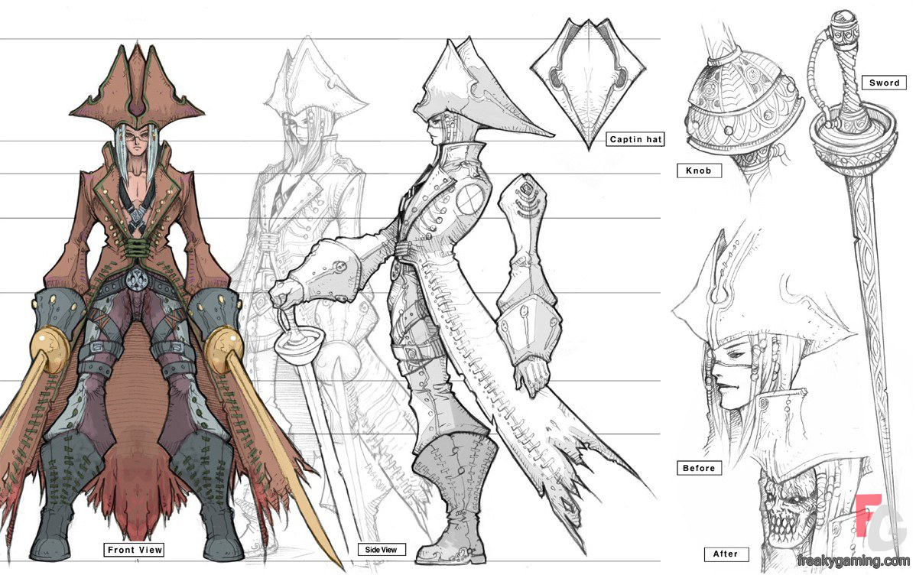
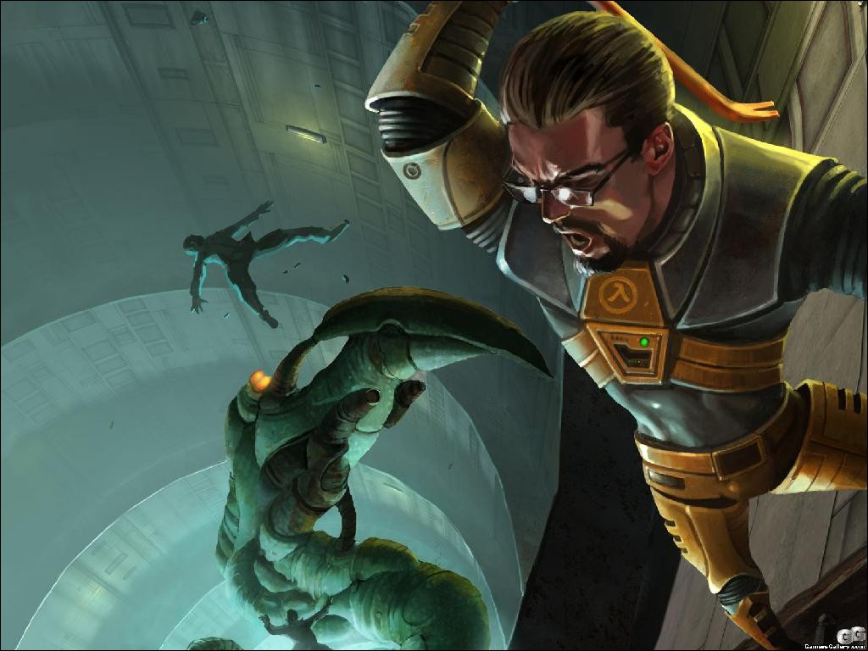
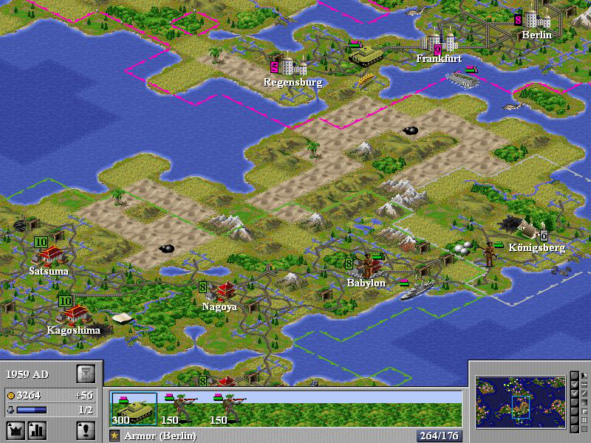
Components: Resources
Artwork
  Must be stored efficiently in memory/gfx RAM
  Must be displayable quickly, so
    Artwork prepared full res
    Often optimised and simplified for release

Slide 11

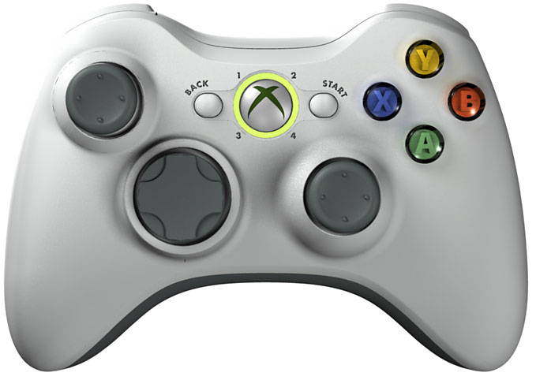
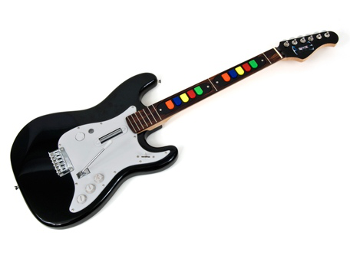
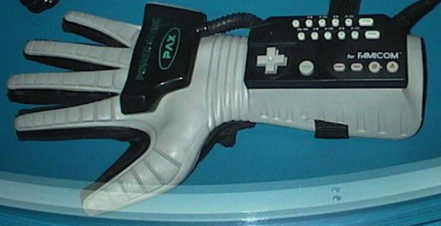
Components: HCI
What types of controller to support
  Button remapping
  Analog/digital input
Smoothing/processing input
Resolving input relative to animations/rendering

Slide 12
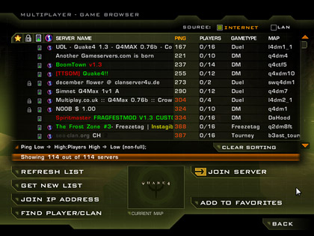
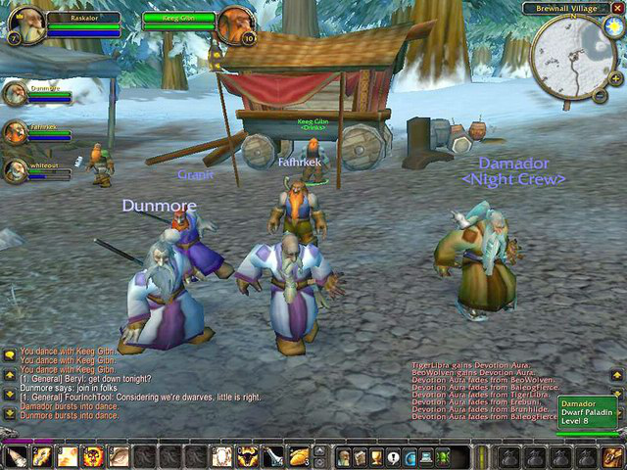

Components: Networking
Syncing many players over the network
  Dealing with lag
Rules for user interaction
  Promotion/ban systems
  Security, anti-cheat stuff
Server browsing and game finding

Slide 13
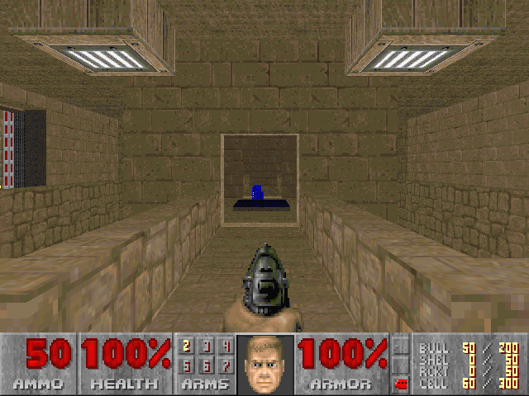
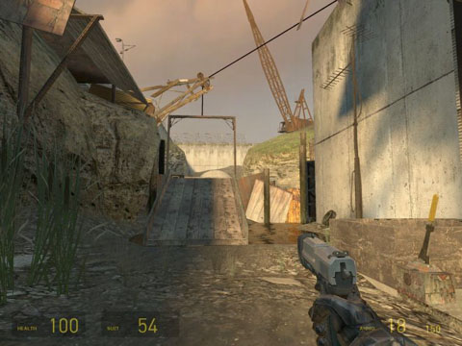
Components: Engine Logic
Physics
  Various types (walking, driving etc)
Rules of the environment
  Doors, puzzles, buttons etc.

Slide 14


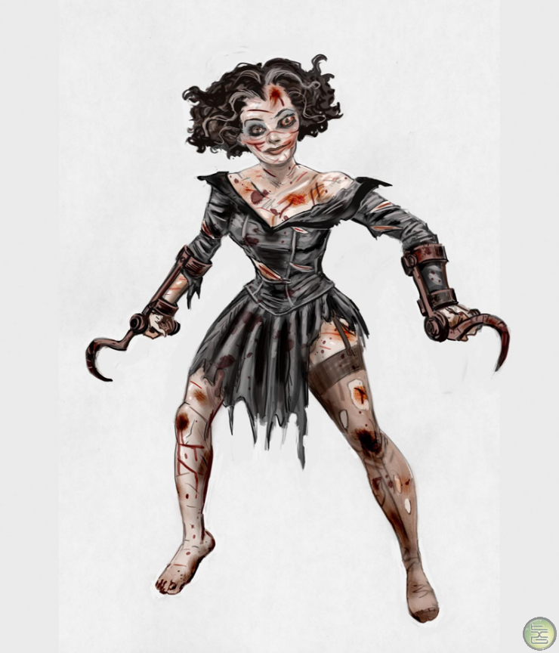
Components: AI
Combative AI
  Must react like a real person
Puzzle AI
  Must present a synthetic challenge (may be very simple)
Often this must be bespoke --- no-one else has produced your game before
  But the goal of the game may be fuzzy

Slide 15
An Example
Game logic
Rendering
Resources
HCI
NPC Interfaces
Engine Logic
Artificial Intelligence
Notes:
Get people to suggest one for each category
Suggest an FPS

Slide 16
Big Places (EA et al)
Can afford the APIs from the console devs
  So can dev for consoles
Run in-house engines with powerful graphics, input libraries
Notably still produce shit (superman 64, ET)

Slide 17
'Big' Development
Large teams
Often outsourced art studios
Long dev times ( > 1 year), based on existing tech
Languages: C, C++, no managed code
Crunch times and labour reinforcement (hundreds of folks)
Hard deadilnes (published, trade shows, holiday period)

Slide 18
Console Revenue Streams
i.e. why you're fucked.
Console makers lose on hardware
Sold based on attach rate & developer return
APIs fund console makers through game sales
  Unless you're nintendo
No free stuff and they hate you hacking consoles

Slide 19
Small Devs and History
Back in the good old days games woz less complex, like, so smaller teams were successful
Acclaim, 3D realms, Team17, black isle studios, id games, bioware, midway, clickBOOM,
Now they've been bought and amalgamated into EA, Microsoft Studios
Smaller folk led smaller teams based on the ideas and focus of a couple of people

Slide 20

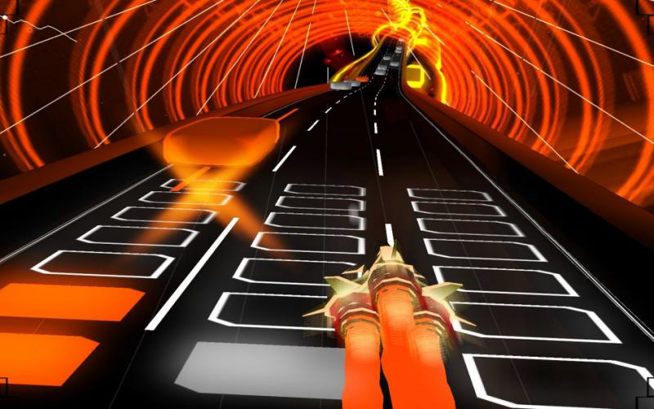
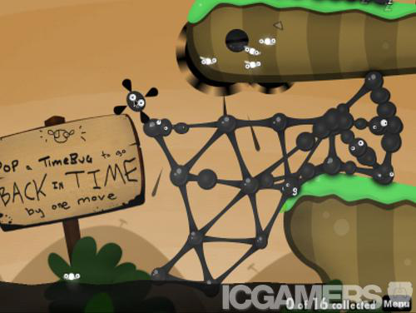
However!!!!!!!!!!!!1eleventy
La plage in vitro der stadt
Availability of professional quality libraries makes rapid dev easy
Mobile gaming is now popular
  Often requires less specialised game systems

Slide 21
Indie Development
Focus on rapid dev (prototyping)
Often only one or a few people
Driven by vision of final product,
Informal, use personal time (oft. unpaid)
Based on open libraries (for fast dev)
  Many of these are as good as or better than in-house
Community Driven (often mods)

Slide 22
Consoles
Homebrew
Often unreliable, undocumented, questionably legal
However, some promote semi-pro small games using homebrew methods (Nintento's channels, MS XNA, GPH)
These offer a decent revenue stream for small developers

Slide 23
Examples
Robot Dinosaurs that shoot beams when they roar
Enviro-bear 2000
Braid
AAAAAAAAAAAAAAaaaaaarg!
Eufloria
FlOw
Osmos

Slide 24
So, Actual APIs 'n' HowTos
Bear in mind those components earlier
This lot ought to be usable to construct a game
We have focused on indie/rapid dev
  Suited to iphones (moneys a plenty.. s.)
  Various communities for more info
More accessible, cool ideas rather than months of coding

Slide 25
Rendering
OpenGL
Open standard
Main job to rasterise vertices and other primatives (Now supports quads! ;-) )
Render Pipeline process.
Can modify pipeline process with shader language
Extensionalisous
Hardware accelleration in mobile devices

Slide 26
Rendering
Direct3D
Propreity standard made by MS
Windows only (or wine)
Render pipe line based on devices
Pipeline modifiable via shader language
Stateless, unlike OpenGL, which is stateful

Slide 27
OpenGL vs Direct3D
Practically identical in function
OpenGL is portable, can run in other languages than C++/C#
OpenGL can poll hardware for bleeding edge features.
Direct3D has a more stable API, one point of control
OpenGL works on phones/weird devices

Slide 28

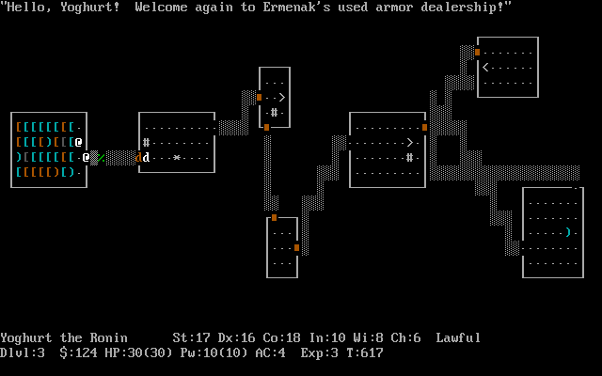
Non 3D Rendering
Tiling and simple 2D libraries
  Pygame, java's AWT libs
Pretty limited graphically, but good for prototyping or simple games
Real speed requires '2D in 3D' setup
Text rendering (nethack, bb!)

Slide 29
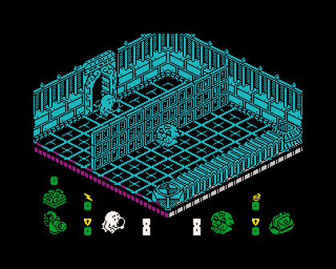
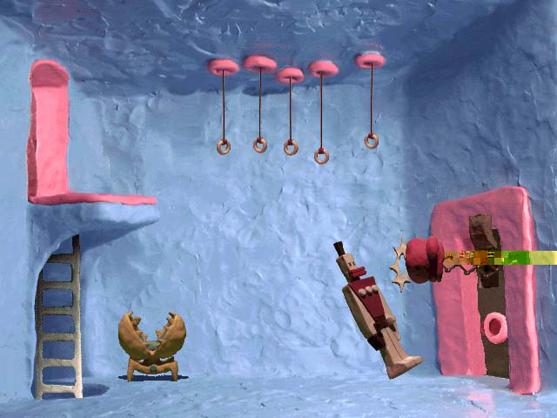
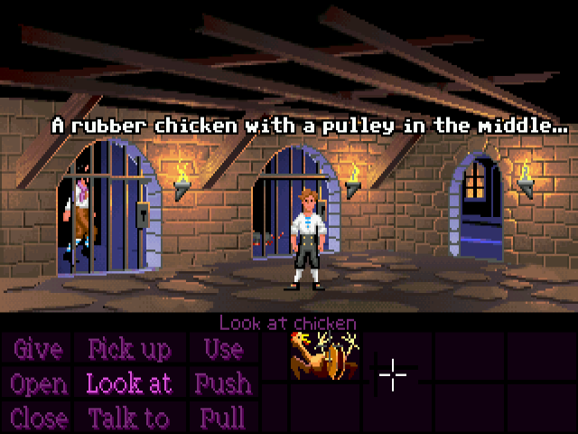
Non 3D rendering
Tiling and layers! Good ol' 2D nostalgia
Isometric games can be 2.5D
Most Graphics libraries support tiling with the use of the depth buffer and alpha buffers
Often many libraries for things like python, java, C# as less speed is necessary

Slide 30
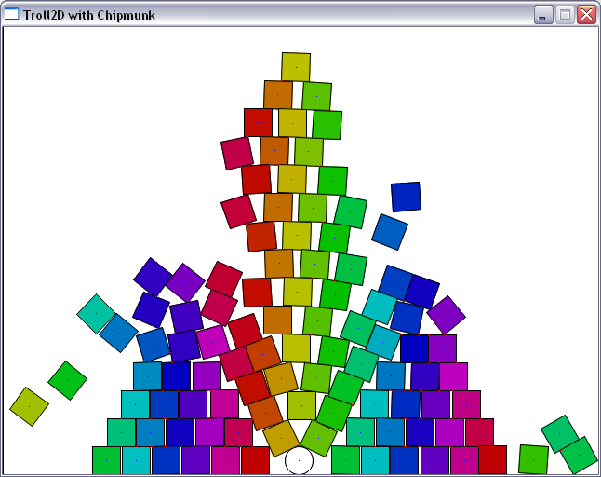
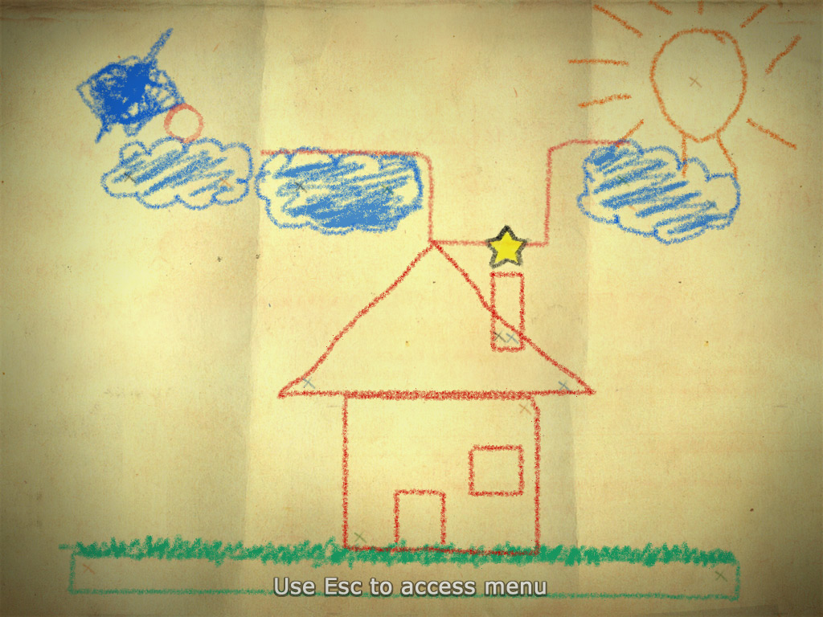
The 'new' 2D
With the popularity of flash and such, a new form of 2D has appeared.
Troll2D and other engines are completely 2.0D, and follow the sideways look so familiar with flash games

Slide 31
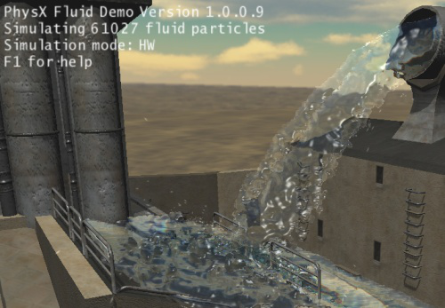
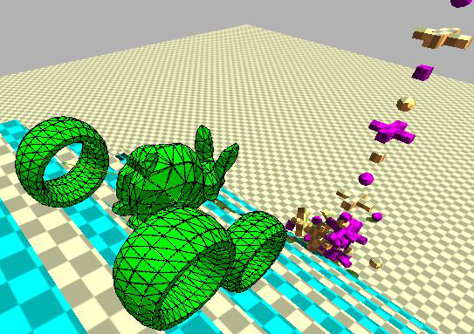
Physics engines
This lets you get the cool 'cup falling of a bench' feel.
3D: Bullet, Tokamak Havoc, PhysX
2D: Chipmonk, Box2D, Farseer, Physics2D

Slide 32
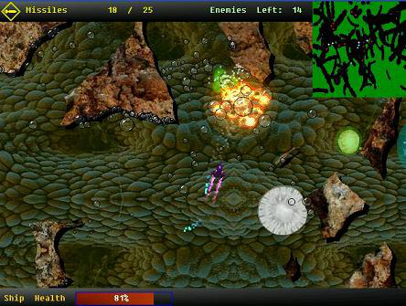
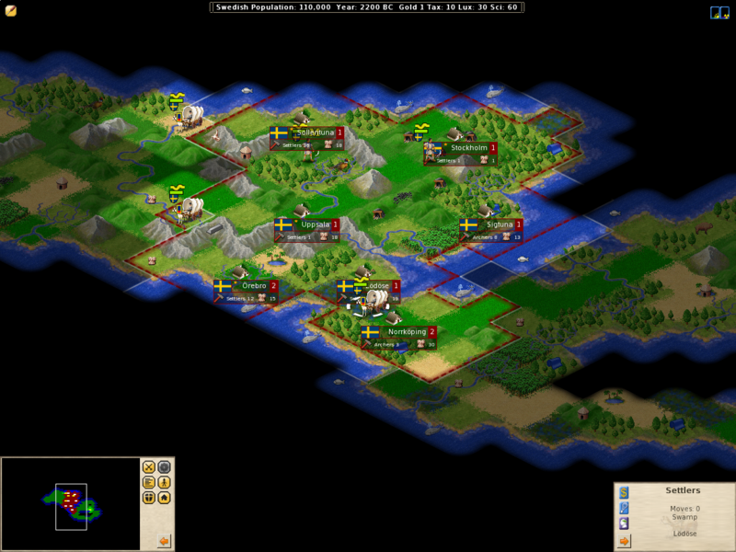
A slice of ham
Libraries exist which allow you to abstract the render device and other IO.
SDL works very well with OpenGL
Allegro is another established one, with Full support by Troll2D

Slide 33
The glorious slice of cheese
Some libraries go even further up the sandwich of abstraction.
Programs like XNA allow you to not worry about the render process and simply add the game logic.
GameMaker also lets you do this, but you will have to pay your pound of flesh and then actually monies for the pro version. Even then the production looks like you have raped a luimp of dogshit.

