Slide 1
Presentation Ideas
Steve Wattam ― Carl Ellis

Slide 2

Format etc.
Every 2 weeks
'fun'
Cool shit wot no-one else will teach you
Various topics...

Slide 3

1: Randomness
Why do we need random stuff?
How do we get random data?
Verification of randomness

Slide 4
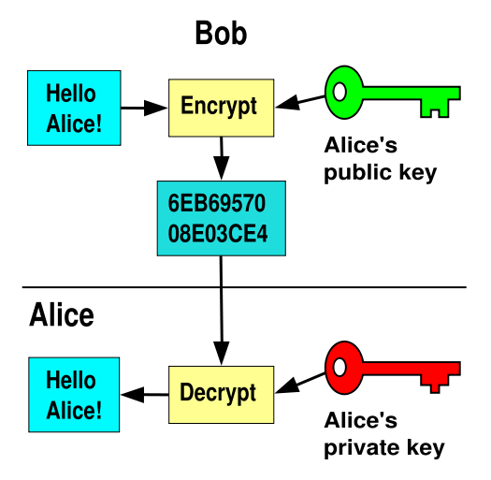
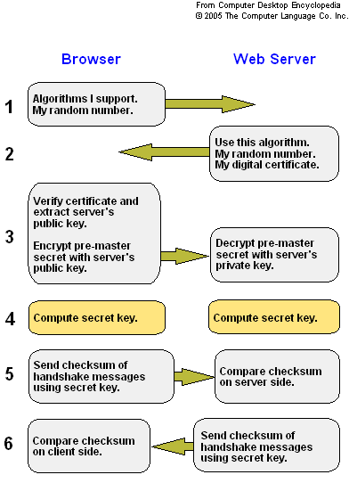
2: Encryption
Basic principles & types of encryption
Where they're used in everyday life
Famous failures and insecurities
Why you should care

Slide 5
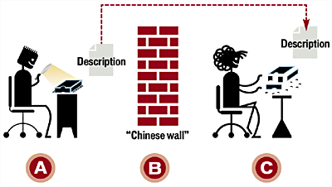
3: Reverse Engineering
Hardware and cheap chinese goods
Software
Fuzzing and vulnerabilities
Historical examples

Slide 6
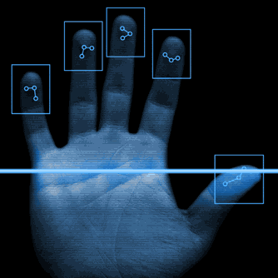

4: Security + Cracking
How t'is done
How it's protected against
Famous failures and methods
Cracking Wifi, email

Slide 7
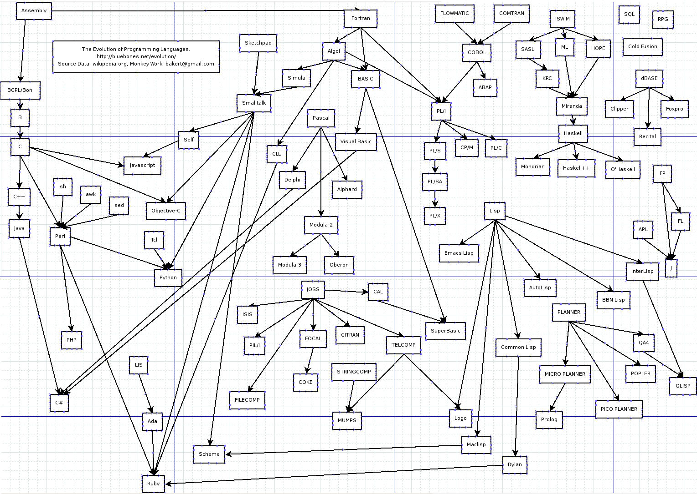

5: Languages + Paradigms
A brief history
Specialities and suitability
Paradigms and applications

Slide 8

6: Determinism
Determinism in solutions
The benefits of nondeterminism
Uses and real-world examples
Chaos theory and emergent behaviour

Slide 9
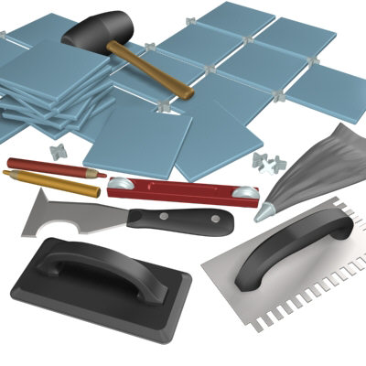
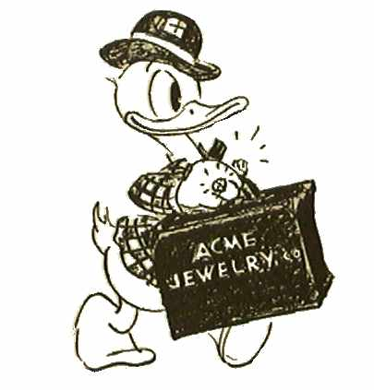
7: Complexity & P=NP
Historical justification and derivation
The theoretical limits of computation
Uses and considerations
In your code
In other situations

Slide 10
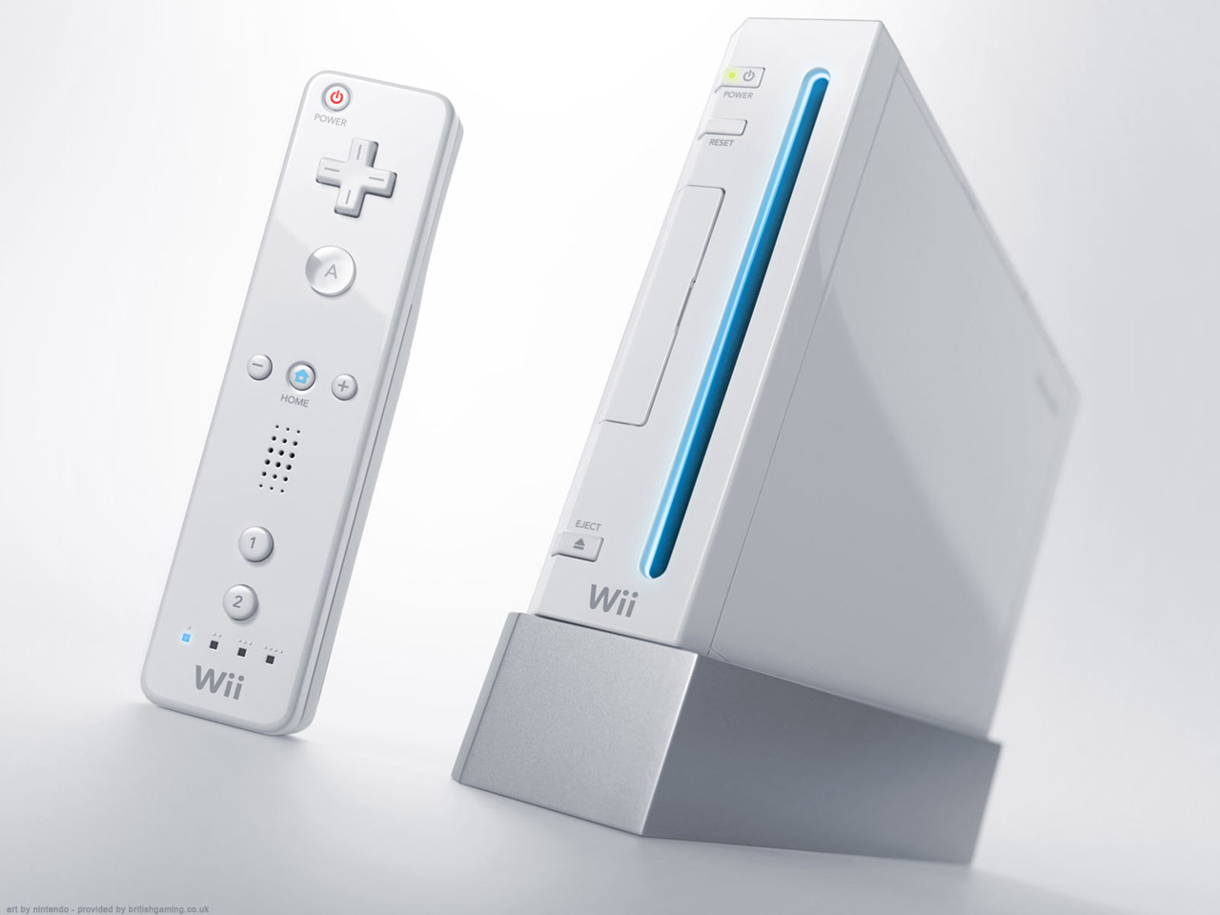

8: Game Code
Getting speed and fancy graphics
How studios and developers do it
Useful tools and techniques
Resources and a first step to game coding

Slide 11

9: IP & Licensing
Why you should care
The variation in licenses
Implications and examples
EFI and Professional organisations

Slide 12
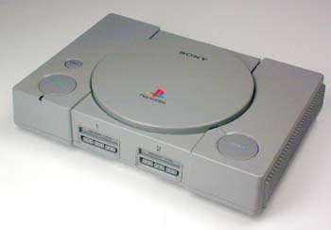
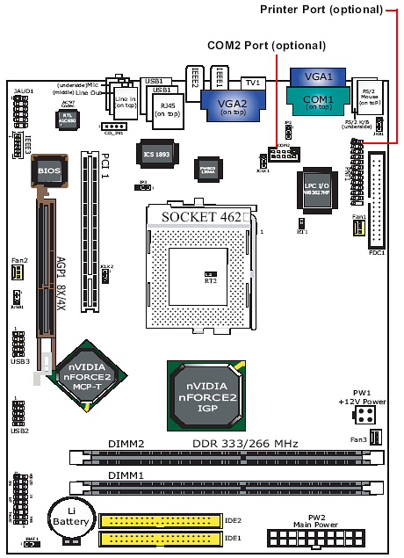
10: Hardware Architecture
How x86 machines move data around
And why it'll be handy
Other architectures and uses
Games consoles and
embedded platform

Slide 13
Pick'em
Randomness
Encryption
Reverse Engineering
Security + Cracking
Languages + Paradigms
Determinism
Complexity & P=NP
Game Code
IP & Licensing
Hardware Architecture

