Slide 1
Reverse Engineering
( Software – Hardware )
Steve Wattam ― Chris Richardson

Slide 2
Oyster Card (MIFARE)
Some dudes broke it pretty badly
MIFARE uses a propriety cryptographic implementation
:'(
(this makes me cry)

Slide 3
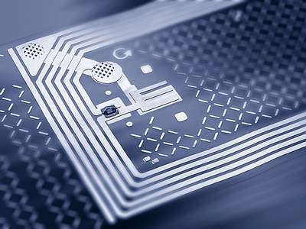
What is RFID?
  RFID - Radio Frequency Identification
      Active
      Passive
      Semi-active
  Contactless Smart Cards - e.g. MIFARE
      Memory
      Processor
      Antenna

Slide 4
Kerckhoffs principle
[A cipher] must not depend on secrecy, and it must not matter if it falls into enemy hands.
August Kerckhoffs, La Cryptographie Militaire, January 1883 [13

Slide 5
MIFARE Classic
Developed by NXP - most widely used RFID tag
Operates up to 100mm from reader
Transaction typically: < 100 ms
EEPROM - 1 KB to 4 KB
Unique serial number
Crypto-1 algorithm for encryption

Slide 6
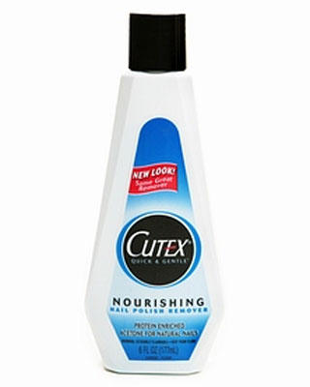
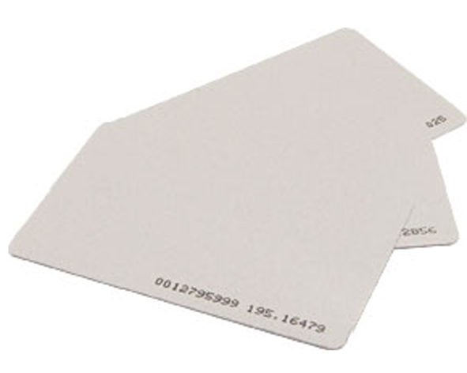
How?
              +

Slide 7
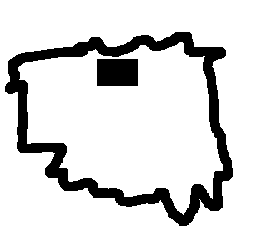
=
Chip

Slide 8
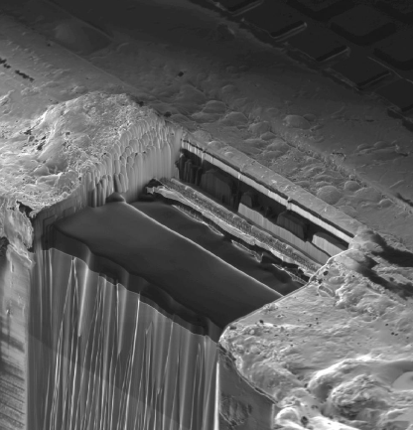
Chip then embedded in plastic

Slide 9
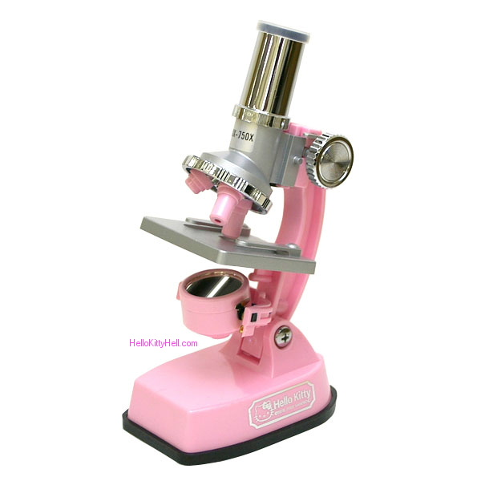
Sandpaper time
Surprisingly sandpaper can give shave off chip layers with 0.04um accuracy!

Slide 10
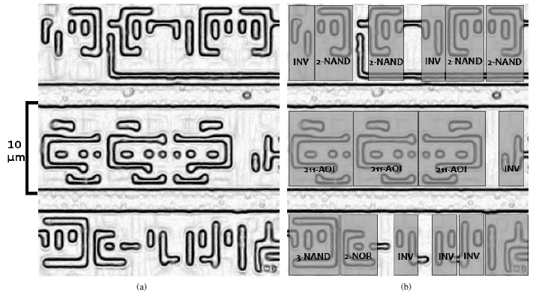
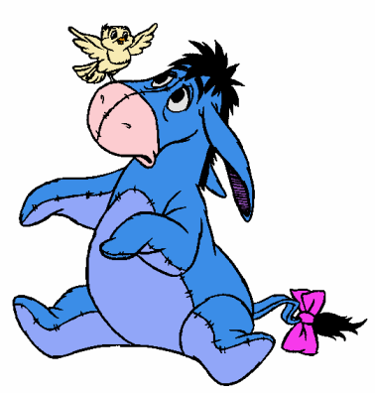
How did they find the crypto part of the circuit?
Search of E-OR

Slide 11
“The cryptography on the Mifare tags is also very fast and outputs 1 bit of key stream in every clock cycle.
The AES circuit, by comparison, takes 1000 clock cycles for one 128-bit AES operation (10 milliseconds on a tag running at 106 kHz).”

Slide 12
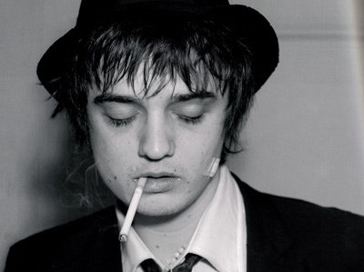
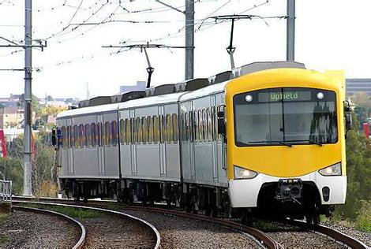
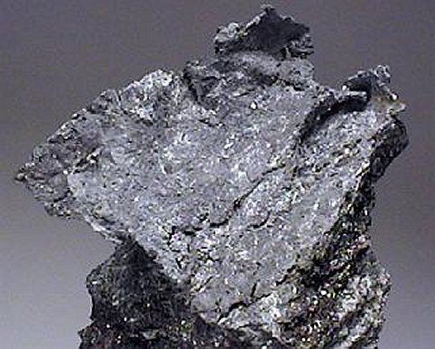
Attacks
Doherty with his Oyster card
Relay
  Cannot determine when card is being accessed
  Preventative measures –
Distance bounding protocols, Switches, Protective shields

Slide 13
Authentication
PRNG:
  Numbers depend on time of power up to time of communication
  32 bits number – only 16 Bit entropy
  Repeats every ~0.6 Seconds

Slide 14
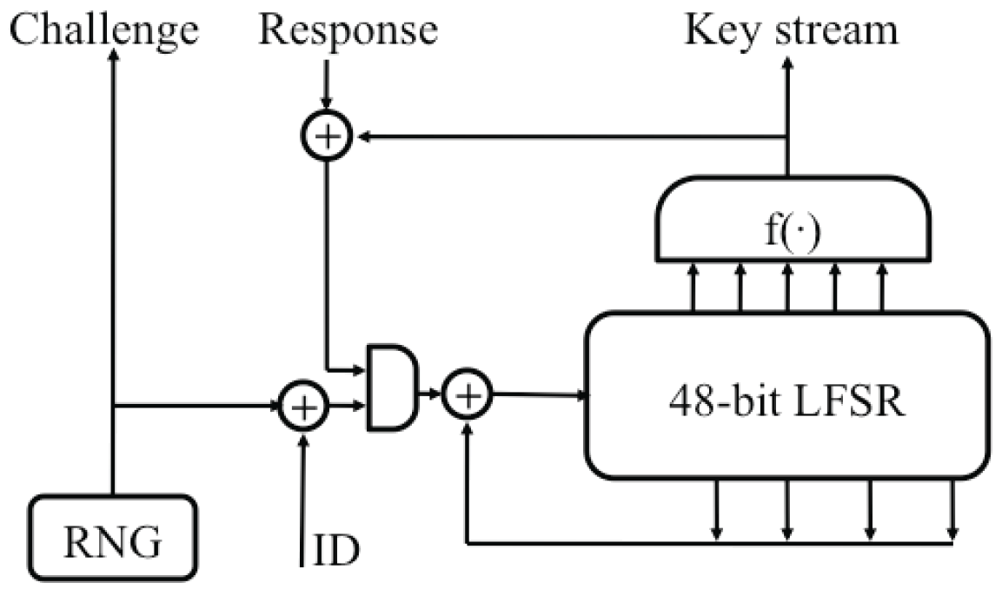
MIFARE Crypto 1
48 Bit key
Stream cipher

Slide 15
MIFARE Crypto 1
F function – generates key stream
G(x) –
Generates inputs for LFSR its outputs

Slide 16
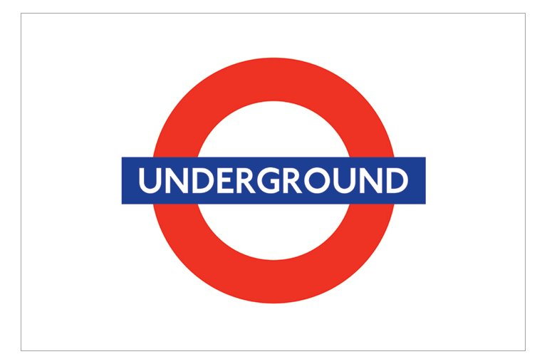
Exploits
Crypto-1 flaws means possible to clone card
Using emulator
Able to ignore commands - Unlimited travel

Slide 17
Conclusion
Don't buy an Oyster card when you can travel for free

