Slide 1
Reverse Engineering
( Software – Hardware )
Steve Wattam ― Chris Richardson

Slide 2
What is Reverse Engineering?
Finding out how something works.
  Identify design decisions behind the result
    Which algorithms, components, methods were used
    What differences there are between the possible solutions, why is this one chosen?
    What does this tell you about the problem the thing solves?
    Can modifications be made to improve/fix things?

Slide 3
Why?
Fixing or working around bugs in closed-source code/hardware
Unlocking or discovering extra functionality
Stealing trade secrets or learning of new methods
Understanding the issues driving development
Making compatible products
Understand and optimise compilation

Slide 4
What is open to RE methods?
Hardware (almost every aspect, even non-electronic things)
APIs/protocols
Monolithic software (games etc)
Devices and embedded software platforms
  Often harbour hidden APIs used to manipulate the thing

Slide 5
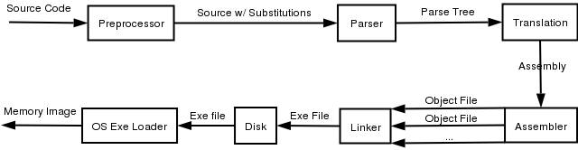
Software Methods
Get as far back along this chain as possible
  Recognise compiler & code patterns
  Understand program flow and large-scale design
  Generally done with an aim in mind
    Find APIs, data, change program flow etc.
http://www.acm.uiuc.edu/sigmil/RevEng/index.html [+]

Slide 6
Software Methods
Mostly, the only code you can rely on is ASM
  It can even be grabbed straight from RAM, bypassing encryption etc. (ipods...)
This can be displayed using a debugger, with various levels of help
Important to recognise common structures, function calls, etc.
  Some will do this 'for' you, using heuristics.
  Obfuscation can complicate the process
http://www.brandonparker.net/code_obf.php [+]

Slide 7
Heuristics
Compilers produce patterns for common structure
These can be recognised and followed
Can reveal choices of data structure
http://en.wikibooks.org/wiki/Reverse_Engineering/Data_Structures

Slide 8
Network/Protocol snooping
Protocols and network use are quite separate from the code
  But they still behave in distinctive ways
Can be reversed from many sides
  Wireshark
  MiTM, logging
Even possible where no control is possible
  Honeypot APs, promisc mode can capture data from others
Easy to exploit --- inherently public

Slide 9
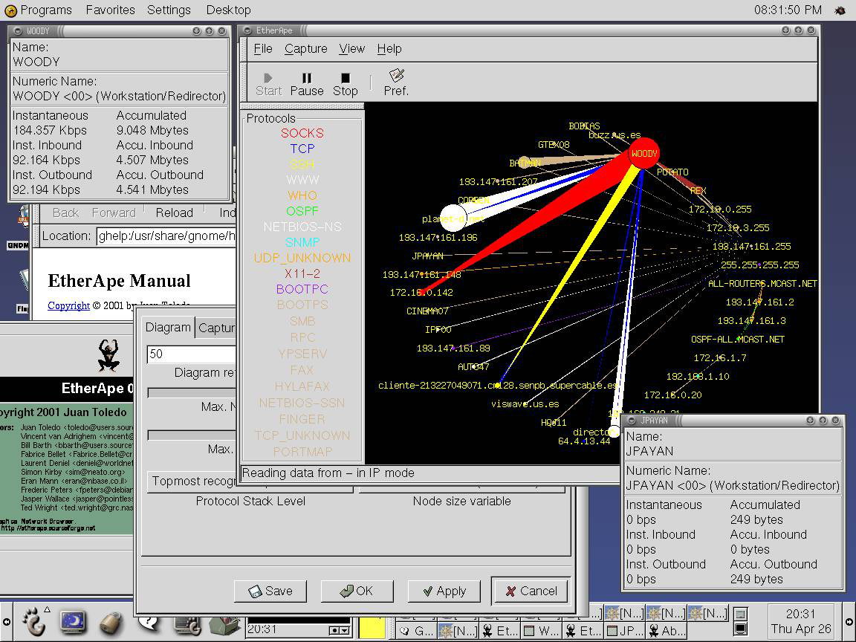
Network/Protocol
Protocols are often very time-sensitive
Ideally, see both sides of comms, though this may not be possible

Slide 10
Hardware Decombobulating
JTAG
stuff

Slide 11
Oyster Card (MIFARE)
Some dudes broke it pretty badly
MIFARE uses a propriety cryptographic implementation
:'(
(this makes me cry)

Slide 12
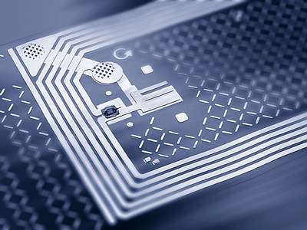
What is RFID?
  RFID - Radio Frequency Identification
      Active
      Passive
      Semi-active
  Contactless Smart Cards - e.g. MIFARE
      Memory
      Processor
      Antenna

Slide 13
Kerckhoffs principle
[A cipher] must not depend on secrecy, and it must not matter if it falls into enemy hands.
August Kerckhoffs, La Cryptographie Militaire, January 1883 [13

Slide 14
MIFARE Classic
Developed by NXP - most widely used RFID tag
Operates up to 100mm from reader
Transaction typically: < 100 ms
EEPROM - 1 KB to 4 KB
Unique serial number
Crypto-1 algorithm for encryption

Slide 15

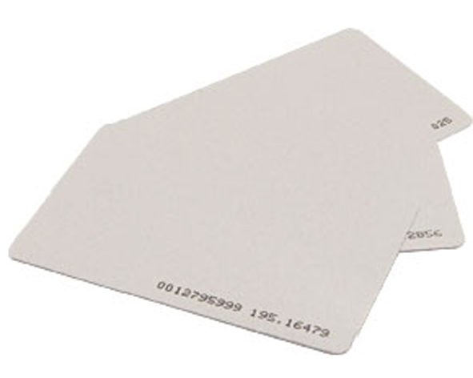
How?
              +

Slide 16
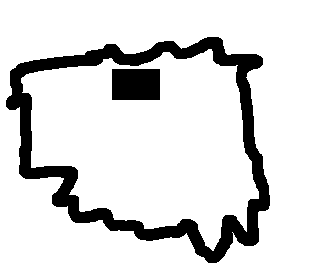
=
Chip

Slide 17
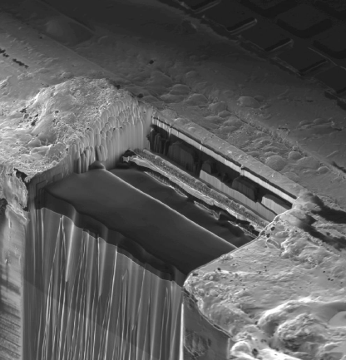
Chip then embedded in plastic

Slide 18
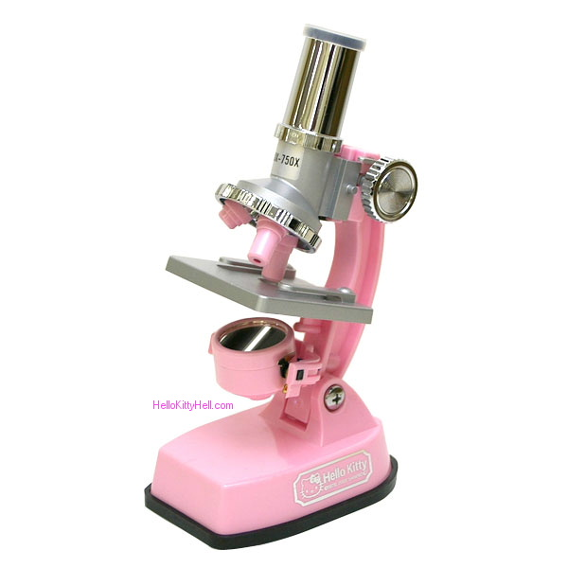
Sandpaper time
Surprisingly sandpaper can give shave off chip layers with 0.04um accuracy!

Slide 19
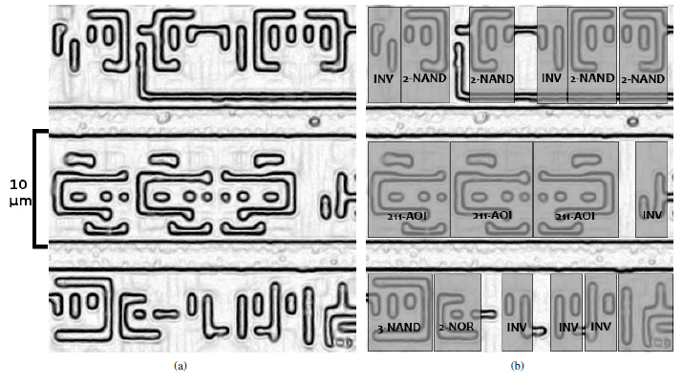

How did they find the crypto part of the circuit?
Search of E-OR

Slide 20
“The cryptography on the Mifare tags is also very fast and outputs 1 bit of key stream in every clock cycle.
The AES circuit, by comparison, takes 1000 clock cycles for one 128-bit AES operation (10 milliseconds on a tag running at 106 kHz).”

Slide 21
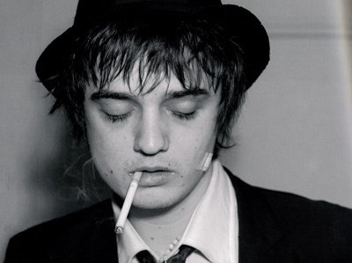
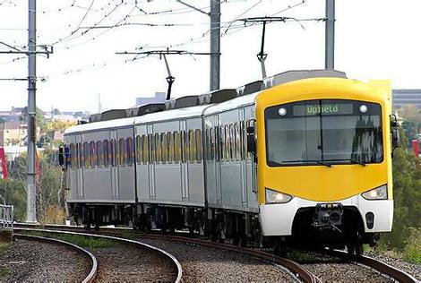
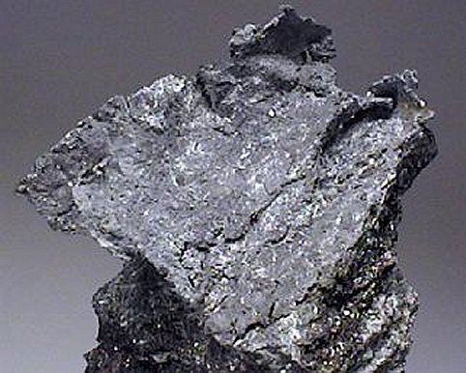
Attacks
Doherty with his Oyster card
Relay
  Cannot determine when card is being accessed
  Preventative measures –
Distance bounding protocols, Switches, Protective shields

Slide 22
Authentication
PRNG:
  Numbers depend on time of power up to time of communication
  32 bits number – only 16 Bit entropy
  Repeats every ~0.6 Seconds

Slide 23
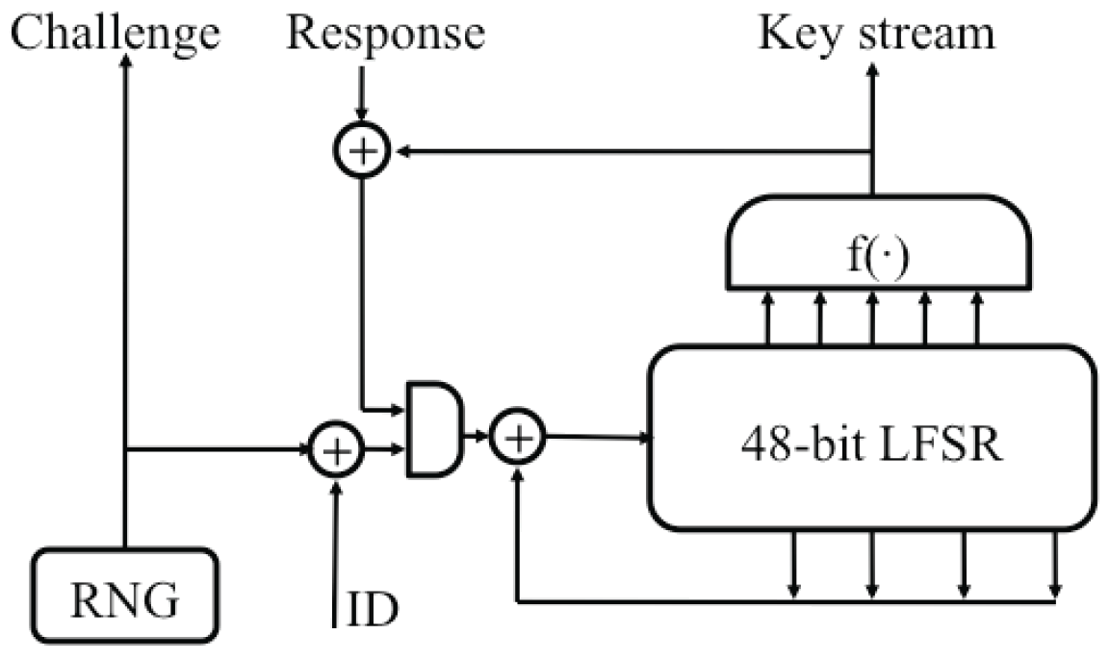
MIFARE Crypto 1
48 Bit key
Stream cipher

Slide 24
MIFARE Crypto 1
F function – generates key stream
G(x) –
Generates inputs for LFSR its outputs

Slide 25

Exploits
Crypto-1 flaws means possible to clone card
Using emulator
Able to ignore commands - Unlimited travel

Slide 26
Conclusion
Don't buy an Oyster card when you can travel for free

