Slide 1
Security
( Theory – Practice – Examples )
Steve Wattam
&
Matt “my nickname is rediculously long” Edwards

Slide 2

Topics
High Level
  Overview
  Defence
  Attack
Low[er] Level
  Defence
  Attack
Examples
  Attack, 'cause it's more fun.

Slide 3
Overview

Slide 4
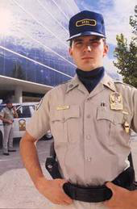
What is Security?
Keep bad guys out
  But let the good ones still do useful stuff
Methods of regulating access
Weakest component is the only meaningful one

Slide 5
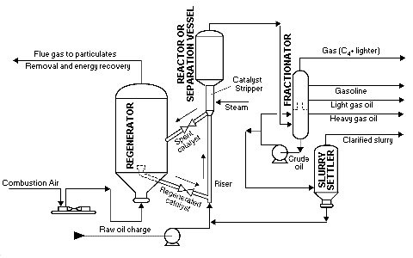
What is Cracking?
Not Hacking
  Though cracking requires hacking
Defeating security systems
  For fun and profit, and war

Slide 6

The Concept of Trust
Access controlled by trusting people (like life)
Mechanisms of trust can be abused:
  a) Untrusted folks can acquire 'trust'
  b) Trusted folks may be unworthy
This man may be trusted to make a “Your Mother” joke
But he should not be left alone in a room with a child.

Slide 7
Real life bollocksing up
The rules in real life are complex and frequently based on human judgement
  Harold Shipman
    In a position of trust, was actually a bastard
  Catholic Priests
    This one's now wrong in the other direction
  I am Prince of Nigeria
    Honest, guv.
  We will soon be landing in... WTC 1
    Rules for this one are hard to develop

Slide 8
Security Models
(defence, high level)

Slide 9
Managing Trust
DeMilitarised Zones
Trust everyone within
Trust no-one without
Check at the door
One tiny error breaks everything
Used for networks where users have a login
Used for most buildings (lock on the door only)
Airports like to think their checks are awesome
Pervasive
Check everything
Trust no-one
Every action requires specific and relevant justification
Slow and awkward for most things
One tiny omission leads to only one tiny mistaken ability
Mixed with DMZ for extra security (locking things to desks)
DVLA uses this for licensing

Slide 10
Security Policy
Domain Specific policy for trust assignment
Requires identification of key assets and risks
  Thus a knowledge of threats
Requires detailed knowledge of the thing to be protected

Slide 11
Unwise things
Assume security without proof
  Often based on people's judgement
Enforce rules without sufficient specification
  'You must have a password' is NOT the same as 'You must have a secure password'
Rely on uncontrollable and unverifiable processes
  Like uninspected code, another authority
Rely on the assumption people simply don't want to attack (obscurity)

Slide 12
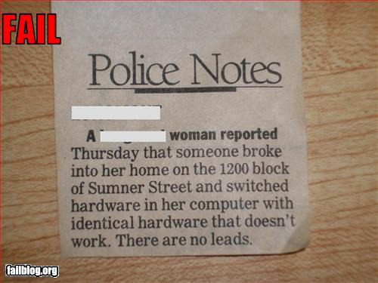
Physical Security

Slide 13
Attack Process
(attack, high level)

Slide 14
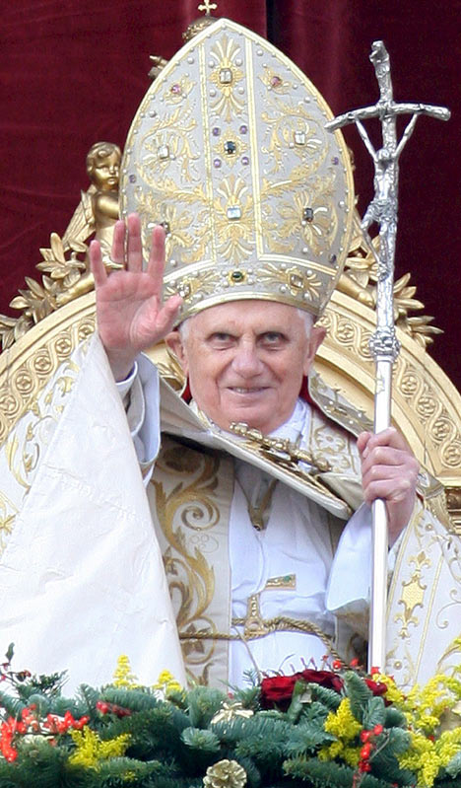

Cracking as Failure
Failure models emphasise coincidence
  Swiss cheese model
Cracking is the process of engineering this coincidental failure 'active failures'
  Finding and connecting holes in the cheese
Some things are holier than others

Slide 15
Attack Procedure (1/5)
Learn how the system works
  Reverse Engineering techniques often useful
  Kowledge of standards and technology used
Identify principles of design used
  Security model, data structures, network layout etc
Passive vs. Active Reconissance

Slide 16
Attack Procedure (2/5)
Identify weak points in the security model
  This often requires a very in depth knowledge of systems
Plan attacks that will work against flaws
  And taylor them to the purpose of the intrusion

Slide 17
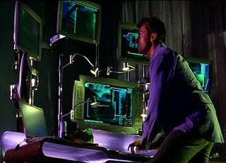
Attack Procedure (3/5)
Exploit the system
Break in and deploy attack payload
Try not to be noticed
  Or removed

Slide 18
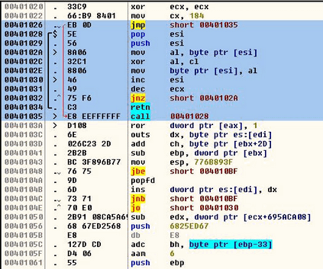
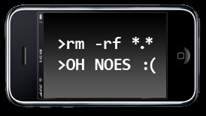
Attack Procedure (4/5)
Maintain access/abilities
Place measures to ensure continued access
  Trojans, shellcode, etc

Slide 19

Attack Procedure (5/5)
Cover ye tracks
Prevent intrusion detection
  Permits continued (ab)use of the system

Slide 20
Design for Defence
(defence, low level)

Slide 21
Security by Design
Split critical systems into smaller components.
    Easier to perform code review and test unit cases.
    “breaking many small hurdles does not necessarily mean you have jumped a large one”
Make your uber secure system completely open source.
    “Many eyes make bugs shallow”
    “A system is only as secure as its key”

Slide 22
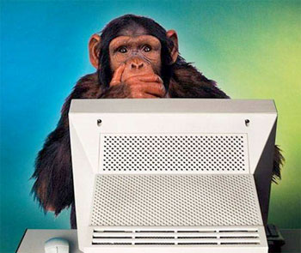
Security by Design
Your users are monkeys
  Always sanitise their input
  (injection attacks etc)
Audit trails
  Every action is logged and sent to a remote service
  Append only, covering up near impossible

Slide 23
Secure operating systems
For banks, countries, armies
    Heavily reviewed against a set a international security standards
    *-protection – No read up, write down
    Pervasive security model
Secure networks
    Intrusion detection used on the network nodes
    Open source programs like Snort perform lots of stats to pick out bad traffic and block/report them them

Slide 24
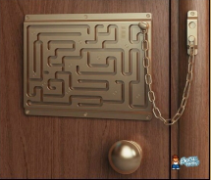
Securing Systems
Remove logical holes
  CSP/Z formal provers
  Proper testing procedure
Remove practical holes
  Regression testing
  Fuzzing
  Red team testing
  Defensive code
Difficult, Expensive & Boring

Slide 25
Security through Obscurity
Obscurity is a form of shared secret
BUT
People can (and do) guess it
And that also means you, yes, you!
Cryptography mathematically proves that guessing is hard (we have another presentation on that)
Obscurity is as good as no defence
http://www.google.com/search?q=intitle:"Live+View+/+-+AXIS"+|+inurl:view/view.shtml^

Slide 26
Attack Methods
(attack, low level)

Slide 27

The Best Case
Your attack will be undetectable
  Look like normal use when inspected in detail
  Stay largely within the bounds of the system
Your attack will be untraceable
Your victim won't know it's happened
  So won't fix the problem you exploited

Slide 28
Common Tricks
Replay attacks
  Replay modified communications from a valid source
MITM “Man in the Middle”
  Intercept communications and steal from/modify them
Brute Forcing
  Guess all of the possible secrets to gain trust
DoS “Denial of Service”
  Break the system by overloading it
Social Engineering
  Get a trusted user to do things

Slide 29
More Common Tricks
Code Injection
  Run code from input using field separators
  Overrun buffers to write into runnable memory
Keylogging
  Steal the secret when entered insecurely
Statistical cryptanalysis
  Defeat the design, not the flaws
Honeypots
  The user thinks they're using the real system

Slide 30
People Fuck Up
Computer systems are complex
  The rules are never going to be perfect
Many systems use weak architectures
  Like assuming physical users are trustworthy
  ...or trusting everyone on a P2P network
Id Est:
Networks trust the packet header's FROM field.
Phone users trust call ID
Email users trust, well, it's all insecure.

Slide 31
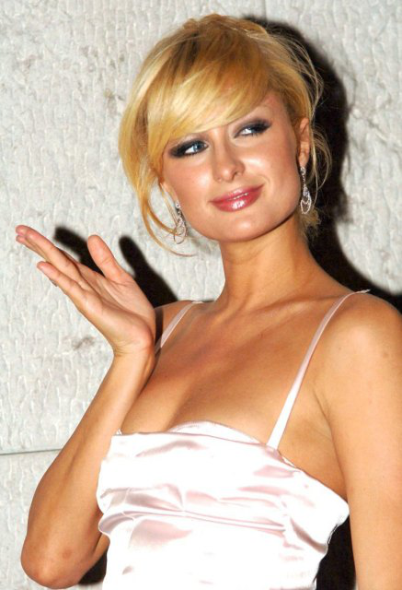
Exploiting Idiots
Understand the System
  Better than the designers
  Possible using Reverse Engineering
Social engineering
  The user is often the weak link
  Society has poor security too, and the system exists within society.
Happen across stuff
  Be “The better idiot”
BUT:

Slide 32
Examples

Slide 33
Notable Examples
WEP “Wired Equivalent Privacy”
  Can be broken in ~15sec, insecure crypto.
CSS “Content Scramble System”
  ~17 Lines of code, insecure crypto.
SMTP “Simple Mail Transfer Protocol”
  Headers are trusted by most systems, even now
Website Auth (session maintenance)
  How do we know request 2 is same person as #1?
People put 'lost' flash keys in their own PC
  This happens in the library

Slide 34
WEP
WEP was the original wifi security
  Limited in strength (RC4 cipher)
IV (Initialisation Vector) + WEP key used as seed for RC4 cipher
  But IV sent partially in every packet
  … so reconstruction is possible
Errors in other protocols allow for more attacks

Slide 35
XSS, Replay
XSS:
  Generally well protected against
  http://extremetomato.com/browse/inject
Replay Attacks
  Traffic for many protocols may simply be repeated
  Keeping state is hard, so this works well
  SSL, TLS makes this hard (but not impossible)
  Session keys, link-rewriting, UA checks common nowadays

Slide 36
Closing Notes

Slide 37
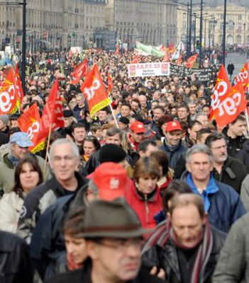
Look ma, I'm a 1337 4aX0r
Using others' cracks is easier than ever
  But everyone will hate you for it, stupid script kiddie.
Many tools to develop new ones
  Metasploit
  Aircrack
  Kismet
  Driftnet/[something]snarf
Demonstration Time!

Slide 38
The Law
Uhh, most of this shit is illegal.

