Slide 1
Maze Solving
( Control theory – Determinism – Rule based AI
Graph theory – Limits of Computation )
Steve Wattam ― Carl Ellis

Slide 2
Topics
Mazes – an overview
Mice – an overview
Control theory and AI
  Stateful vs. Stateless (FSMs)
  Limits
  Determinism
Our Framework – demo and introduction
Suggested work (inc. info on maze types)
Competition
Reading/ further stuff

Slide 3
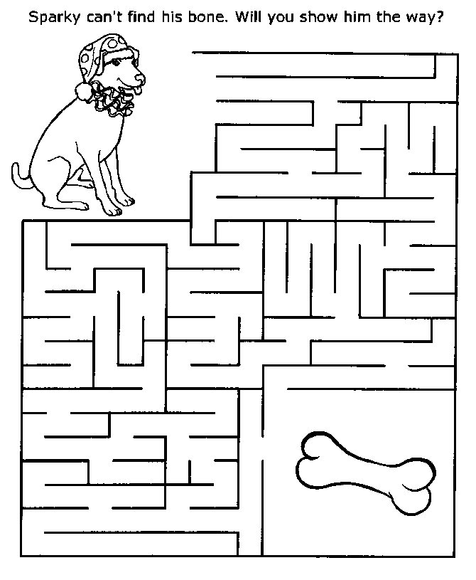
What is a Maze?
Space with Walls;
Start and Finish
(or Entrance/Exit);
Stops you finding
your bone.

Slide 4
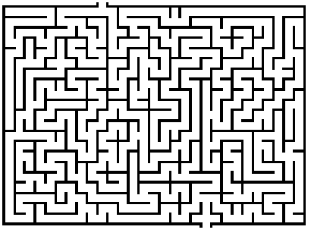
Types of Maze - Perfect
This type of maze has no loops or inaccessible areas.
There is a route to all areas of the maze.

Slide 5
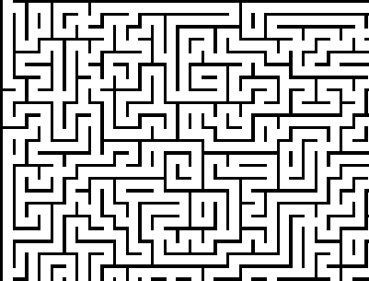
Types of Maze - Braid
This type of maze has no dead ends.
Uses passages that coil around and run back into each other.
Much harder to solve (and generate).

Slide 6
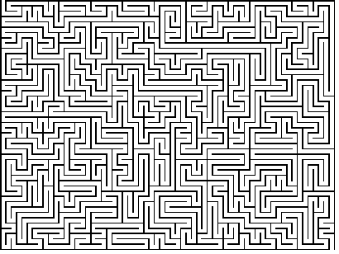
Types of Maze - Unicursal
Has no junctions, sometimes called a Labyrinth.
Trivial to solve with a bot, hard as a person as you get turned around.

Slide 7
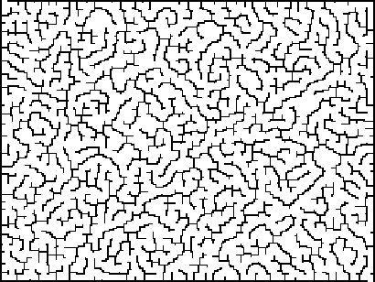
Types of Maze - Sparseness
Irregular layout of rooms: can be very heterogeneous
Also classed as an irregular maze with wide passages (a bit like a relationship with your mother).

Slide 8
Properties of mazes
Bias
  A biased maze tends to have more passages in a horizontal or vertical direction. This makes it hard for a bot to travel 'against the grain'.
Run
  A large run is when the maze passages are longer than four rooms.
Elitism
  The elitism rating is the length of the optimum path in relation to maze length.

Slide 9
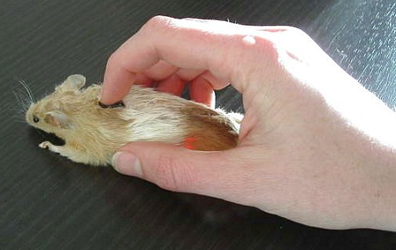
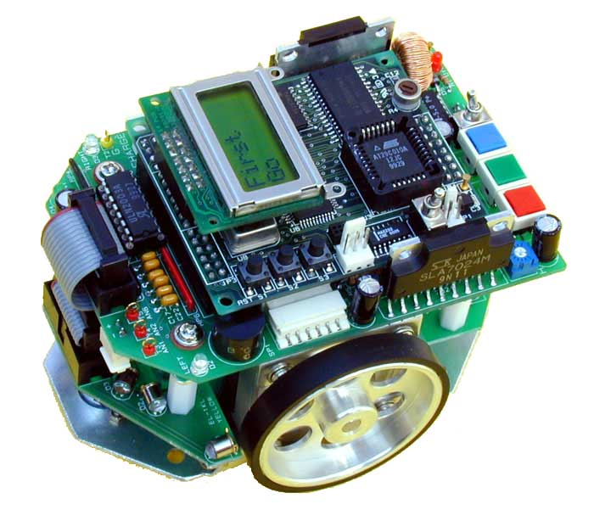
Mice
Maze-solving bots (micromice)
Micromouse competition
16x16 maze
Limited view, processing power
No awareness of maze other than
what is observed

Slide 10
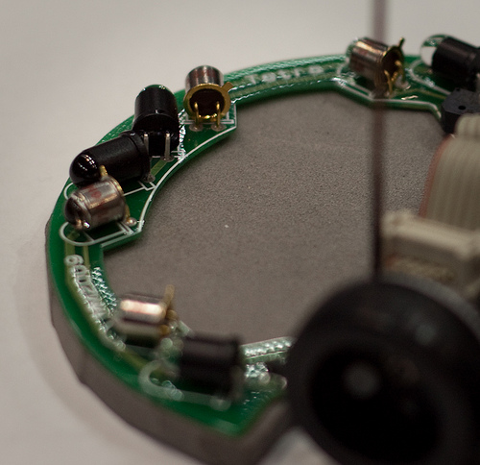
Mice 2 – Abilities
Solving a maze algorithmically is not so hard – if you have the whole map
MicroMice rely on 'practical' input, like us in hedge mazes.
Click 'ere
Sets of IR emitters and sensors on the front of a maze-solving robot.

Slide 11
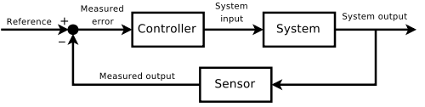
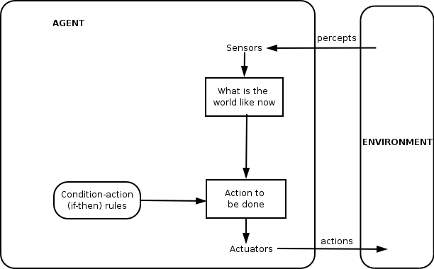
Some theory
Each mouse is an 'Intelligent Agent'
Similar to control theory (but cooler)
Measure – model – respond loop
Plate balancing

Slide 12
Types of Agent
Stateful or Stateless
  Does the bot remember information about its actions? (i.e. 'I am looking for the exit', 'I am backtracking')
Deterministic or Stochastic
  Will the bot do the same thing under the same conditions?
  Determinism is reliable, but can be reliably shite
Discrete or Continuous
  Does the bot have to infer things like movement?
  Can it react 'smoothly'?

Slide 13
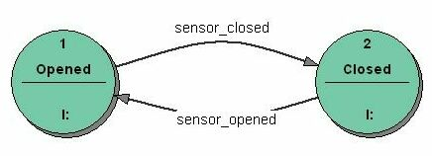
Keeping State – Finite State Machines
Model state based on events
  Making a coherent view of how the world is, rather than how it has changed
Can be interrogated at any point, even if there is no sensor data
Make state changes based on arbitrary rules
  Including probabilities and 'fuzzy' rules

Slide 14
Determinism
Will this bot always perform the same actions if in the same situation
Determinism results in reliable bots
  But if the rules are flawed then they can be poor
Non-determinism is closer to human judgement
  But can be very hard to get 'right'

Slide 15
Discrete and Continuous
All computerised agents are discrete
Some may be able to run their actuators continuously (i.e. open valve until flow balances)
This can offer better control, better feedback
  'Unsure' bots can creep slowly and check more
  Confident ones can rush ahead blithely

Slide 16
Demos!
Deterministic vs. Stochastic
  DaveBot is stochastic, has no rules
  LeftBot is deterministic, has only rules
Discrete vs. Continuous response
  LeftBot is discrete, moves and re-assesses
  AdvancedBot is faux-continuous, may queue up
Stateful vs Stateless
  AdvancedBot is stateful, in order to do more complex actions
  LeftBot is not

Slide 17
Limits to bot ability
The best solution is to simply take the right path every time, but:
The maze is a big tree of choices
Without enumerating every choice, the best option is thus equivalent to a binary tree search algorithm.
O(log(n)) complexity for most good searches

Slide 18
Our Framework
Bots get only a small amount of sensor data
  Their immediate surroundings
  Bot co-ordinates, orientation
  Finish point co-ordinates
(Those in yellow are not necessary except for advanced techniques)
Bots can only move in limited ways
  Left, Right, Forward, Back only (but it's enough!)

Slide 19
Our Framework 2 – Bot Classes
Bot
  Interface, simplest API available
  Makes decisions every time it's called
AdvancedBot
  May queue up sequences of moves
    (But they are only done once per tick)
  Makes decisions each time it runs out of queue items

Slide 20
Demo of Bot Code
This should be a quick intro to the bots we've made
http://extremetomato.com/projects/maize/

Slide 21
Challenges
Beat DaveBot on any maze type
  An EmptyMaze may be easiest, a FullDFSMaze may be hardest
Solve a DFS Maze without using a wall follower
  Requires modelling the choices
Write a wall follower that can also solve empty, scatter mazes.
Write a wall follower that, through heuristics, can beat left/right following bots.

Slide 22
Getting Started
Decide which maze(s) to run on
  Not all bots will beat all mazes (probably)
Decide which technique to use
  Or to improve one of our bots
Code, or pair up with someone who wishes to
Submit to us for a glorious battle of awesome.

Slide 23
References
http://en.wikipedia.org/wiki/Agent-based_model
http://en.wikipedia.org/wiki/Intelligent_agent
http://micromouse.cs.rhul.ac.uk/

