Slide 1
Stephen Alex Ngo
Section - S11
Video:

Slide 2
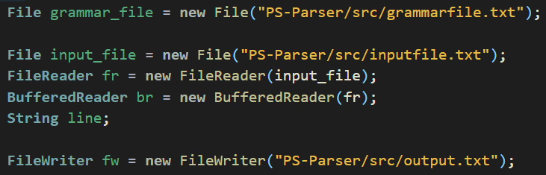
Syntax Analysis
First, I read the file which contains the sample input test cases given then put all the texts in a buffered reader and another file for grammar rules in antlr grammar notation format then,

Slide 3
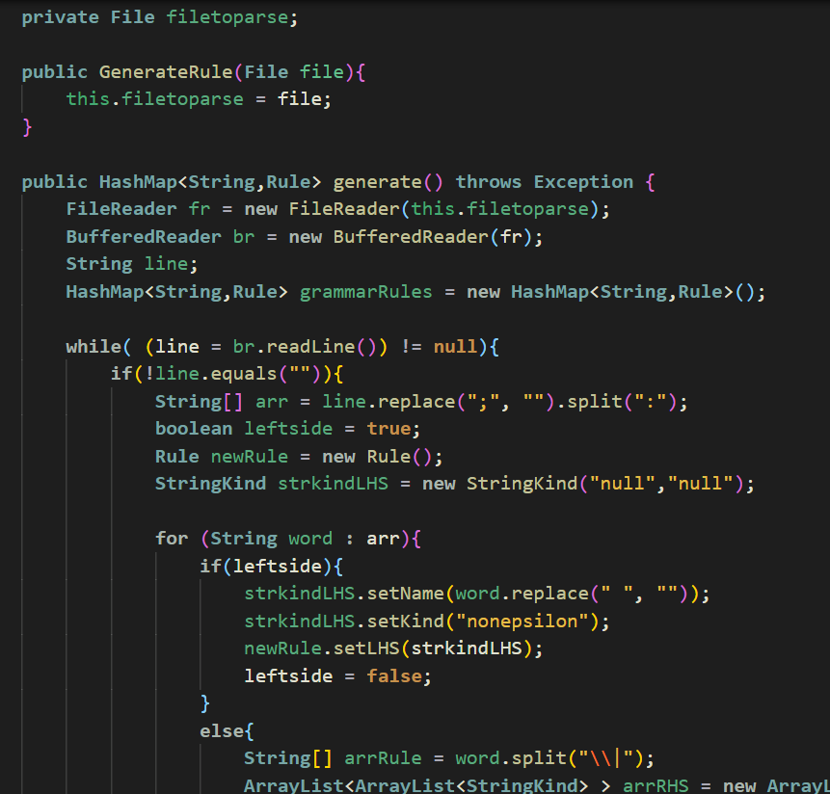
GenerateRule Class
Put it in a BufferedReader. After that , I separated the LEFTHANDSIDE and RIGHTHANDSIDE of the grammar and create a Rule class for every parser and lexer grammar rule then put in a
HashMap<String, Rule>

Slide 4
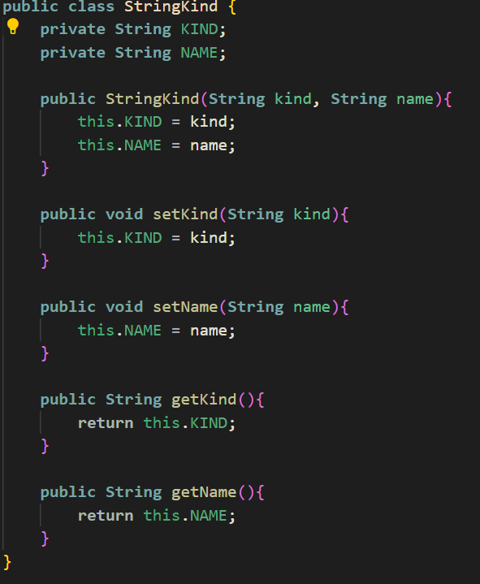
Additional Class
This is my StringKind class, this class checks if the specific String is a Kleene star, ?, or * for right hand side, and for the left hand side, I just mark it as epsilon or non epsilon if contains epsilon for its right hand side

Slide 5
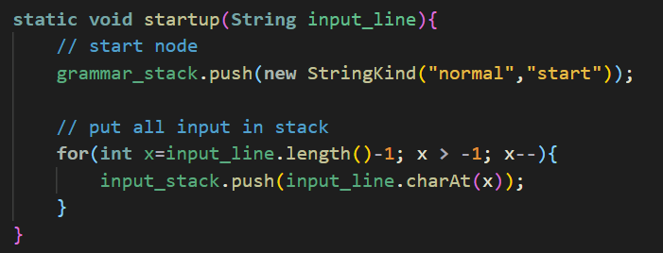
startup() method
Before I do the recursive descent parsing, I push the “start” grammar rule in the grammar_stack which is the start node, and put all the input in the input_stack. Then,

Slide 6
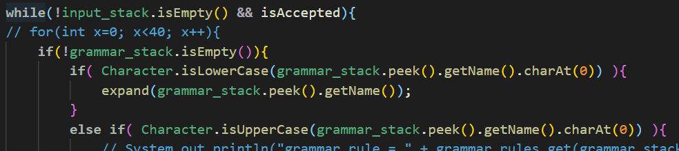
Recursive-Descent Parser
I loop until there’s no input_stack already and the grammar rule is still accepted, then check the first character of the grammar stack if its lowercase it means it is a parser, otherwise it’s a terminal node. After that,

Slide 7
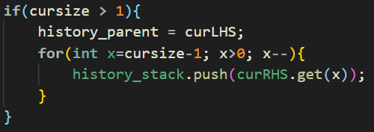
expand() method
If it’s a parser then expand the grammar rule to its right hand side, if the right hand side rule of the grammar is multiple then put the other RHS rule in the history stack in order to backtrack if the previous rule does not match the top of the input_stack and assign the current LHS to the history_parent so if the RHS does not have match but the LHS contains epsilon so that we can just remove that rule in the grammar stack.

Slide 8
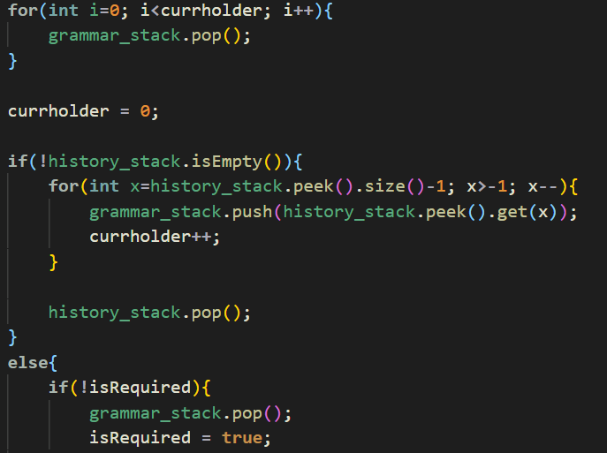
performBacktrack() method
So if the top of the grammar stack is a terminal node, then it is not equal to the input_stack then perform backtraking, the backtracking will do is to pop all the current rhs production then push the next history_stack rhs production for the current lhs then check again, until it finds the right grammar production, if not then it will be is Accepted=false.

Slide 9
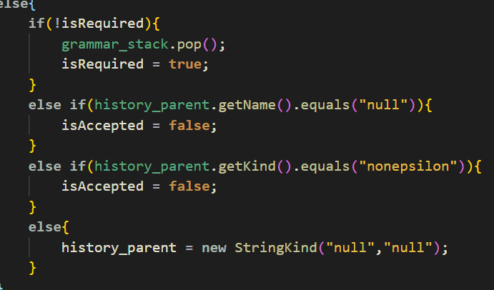
Error Recovery
First recovery is when the history_stack is empty then check if its required or history_parent is null or the parent is not epsilon then result is the input has an error

Slide 10
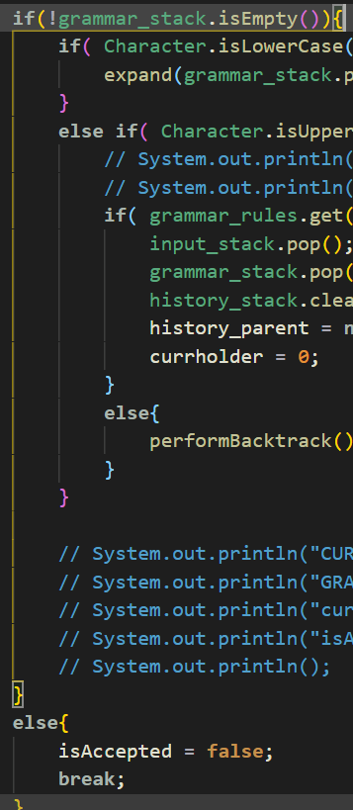
Error Recovery
Second recovery is when the input_stack is not empty but the grammar is empty so it will result to an error then it will terminate already.

Slide 11
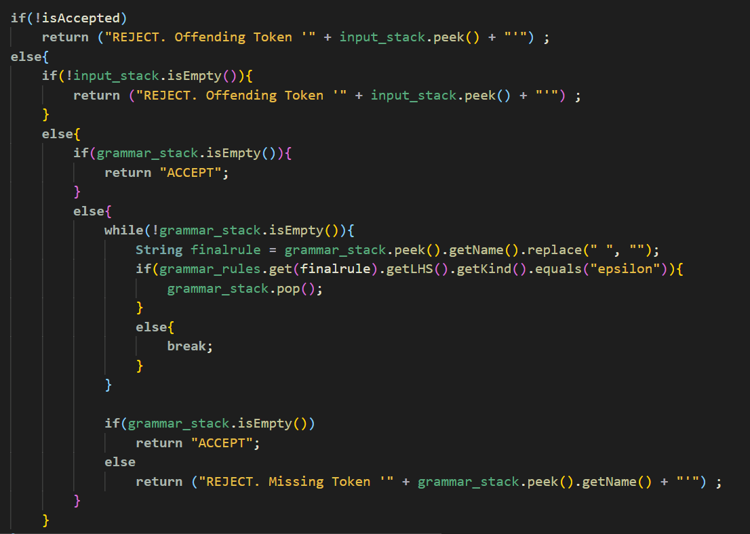
Error Recovery
Lastly, if its not accepted and input_stack is not empty then Offending Token will be found else if the grammar_stack is not empty the check the remaining grammar rule are epsilon or not, then when the grammar stack is not empty then There will be a missing token in the input.

Slide 12
THANK YOU! :D

