Slide 1
Stephen Alex Ngo
Section - S11
Video -

Slide 2
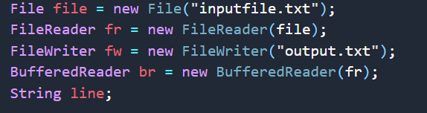
Lexical Analysis
First, I read the file which contains the sample input test cases given. Put all the texts in a buffered reader. After that,

Slide 3
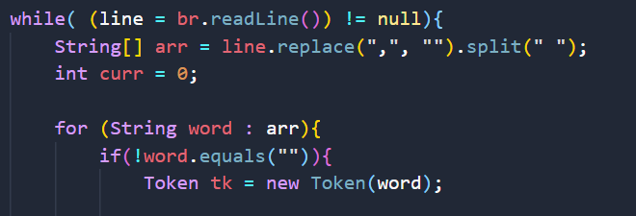
I loop it line per line until EOF(end of file) then per line I replace all the commas (delimiter) into empty string, then split all by whitespace so I can get all single words independently which will be my tokens.

Slide 4
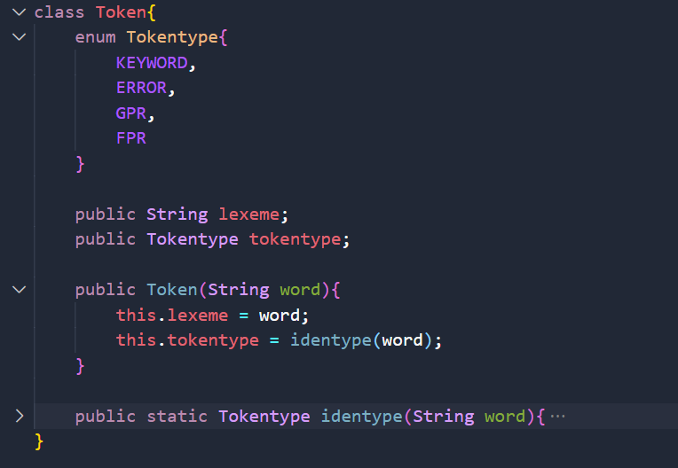
Additionally – Token Class
This is my Token class wherein creating my token will automatically identify its type.

Slide 5
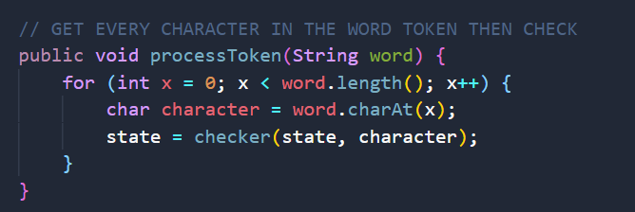
Maximal Munch Implementation
This is where I implement the maximal munch, wherein I check all the characters in the word so if its “DMULTU”, I didn’t stop at DMULT since we have to find the longest possible path even though I reached the final state, I keep checking until it reaches the most final state.

Slide 6
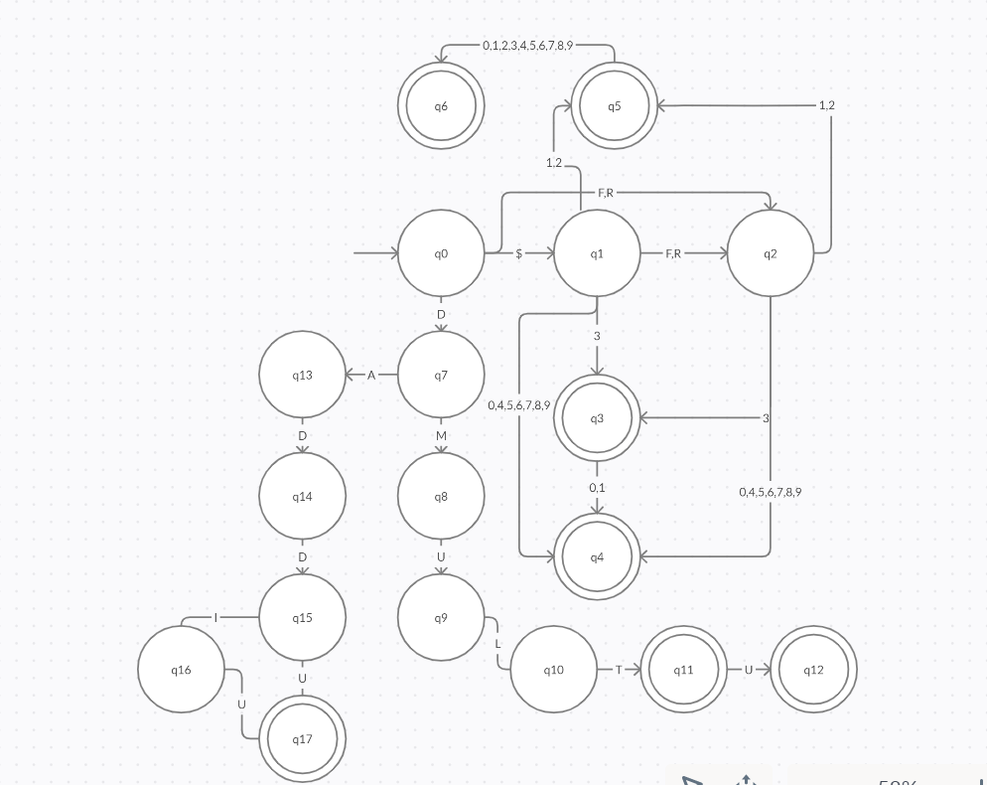
DFA

Slide 7
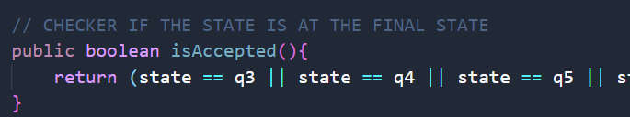
Unrecognizable Tokens
If the current state is not the final state wherein the tokenization process is finish.

Slide 8
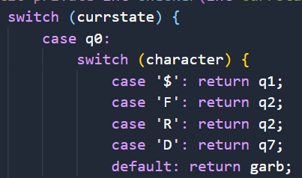
Unrecognizable Tokens
If the current state reached the “garb state”, this means there are some invalid characters in the word or not part of any valid transitions.

Slide 9
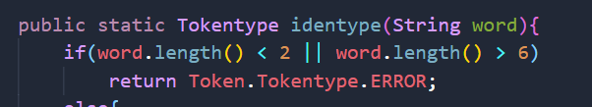
Unrecognizable Tokens
Lastly since I observed that all the valid tokens only consists of 2 – 6 characters, anything greater than or less than it will be considered as ERROR.

Slide 10
Thank you!! :D

