Slide 1
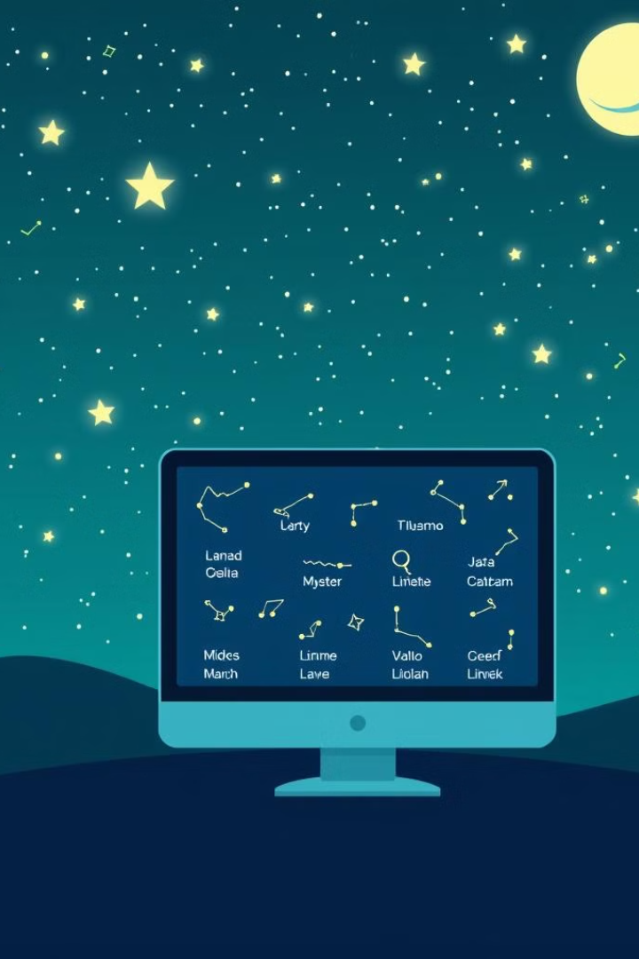
Starlight Tracker: An OpenCV Model to Trace Constellations
TEAM MEMBERS
Bennett Furtado | 4SO21CB011
Oliver D’Souza | 4SO21CB031
Prajwal Pinto | 4SO21CB038
Stephen D’Souza | 4SO21CB056

Slide 2
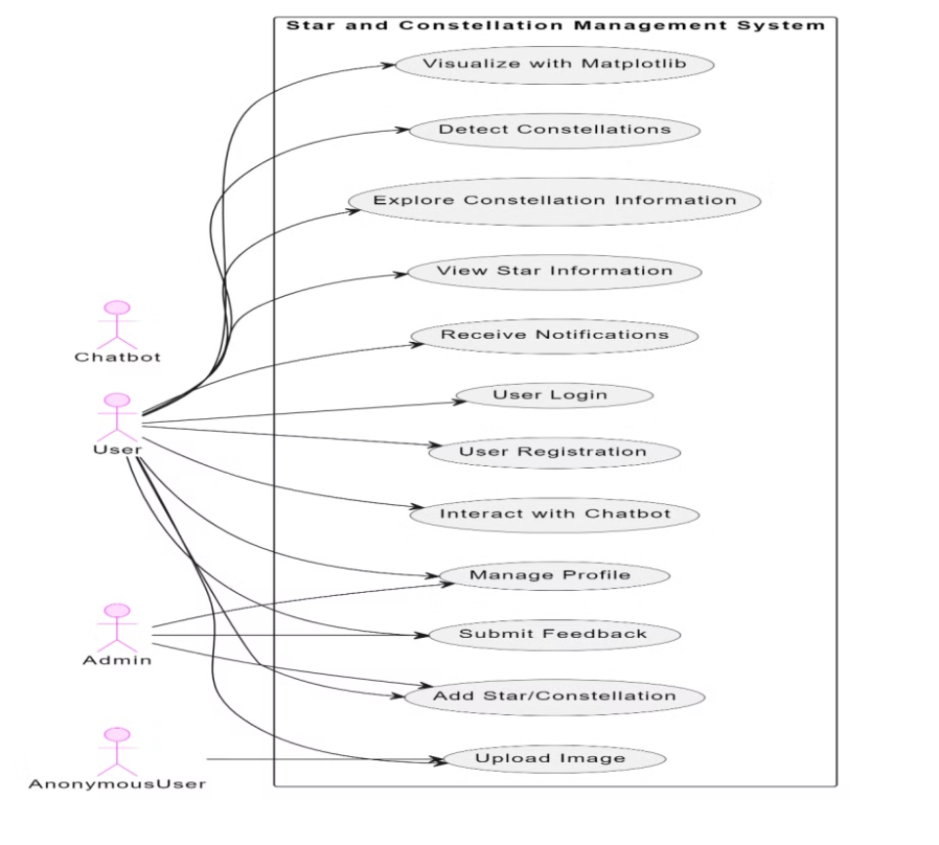
Use Case Diagram

Slide 3
Use Case Diagram
User Interactions
Admin Functions
Registered users can visualize stars, detect constellations, and manage their profiles.
Administrators can add stars/constellations and manage system content.
Chatbot Assistance
Anonymous Access
An AI-powered chatbot helps users with queries and system navigation.
Unregistered users can explore limited features and register for full access.

Slide 4
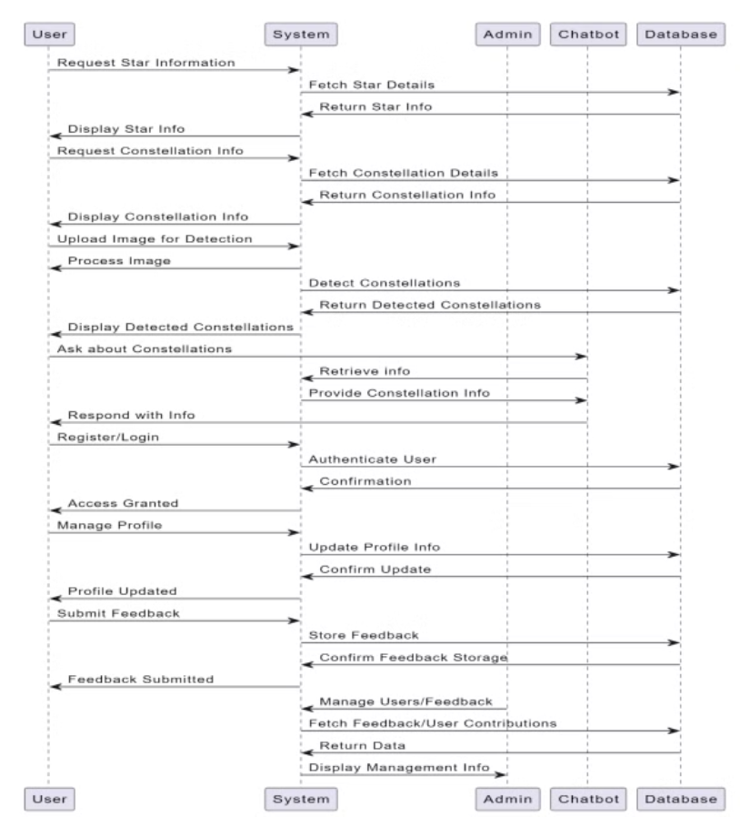
Sequence Diagram

Slide 5
1
User Requests
2
System Processing
3
User Interaction
Users can request star information, constellation details, or upload images for detection.
The system fetches data from the database or processes uploaded images to detect constellations.
Users can manage profiles, submit feedback, and interact with the chatbot for assistance.
4
Admin Management
Administrators can manage user data and review submitted feedback.

Slide 6
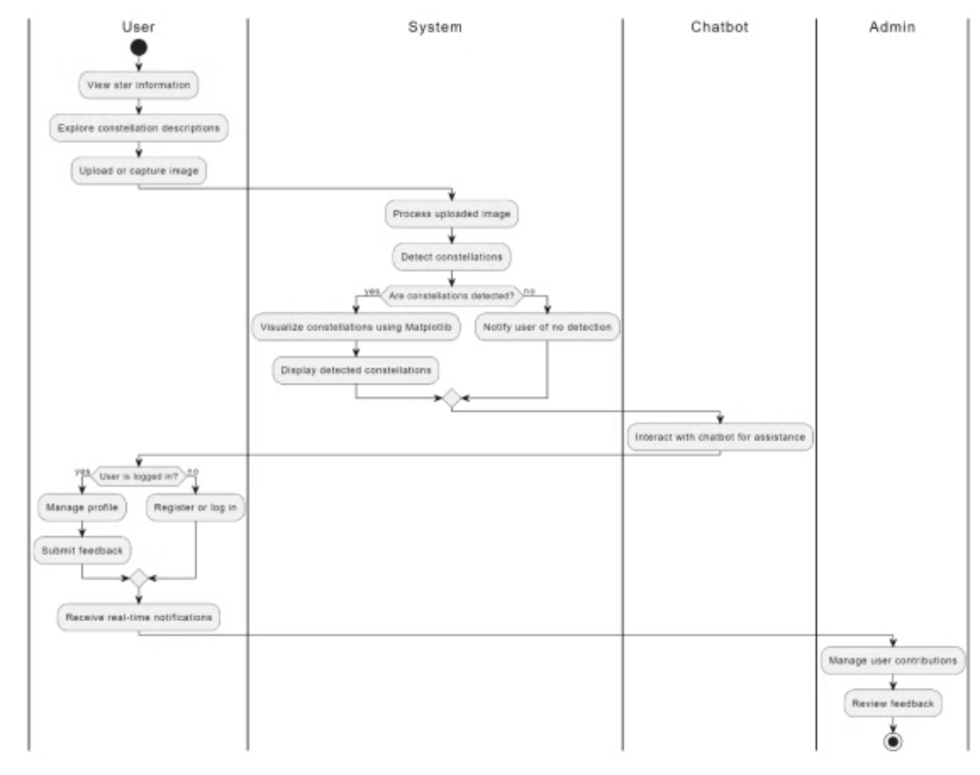
Activity Diagram

Slide 7




Activity Diagram
Image Upload
Users upload or capture sky images for constellation detection.
Detection Process
System processes images to identify constellations using OpenCV.
Result Visualization
Detected constellations are displayed using Matplotlib.
User Interaction
Users can manage profiles, submit feedback, and receive assistance from the chatbot.

Slide 8
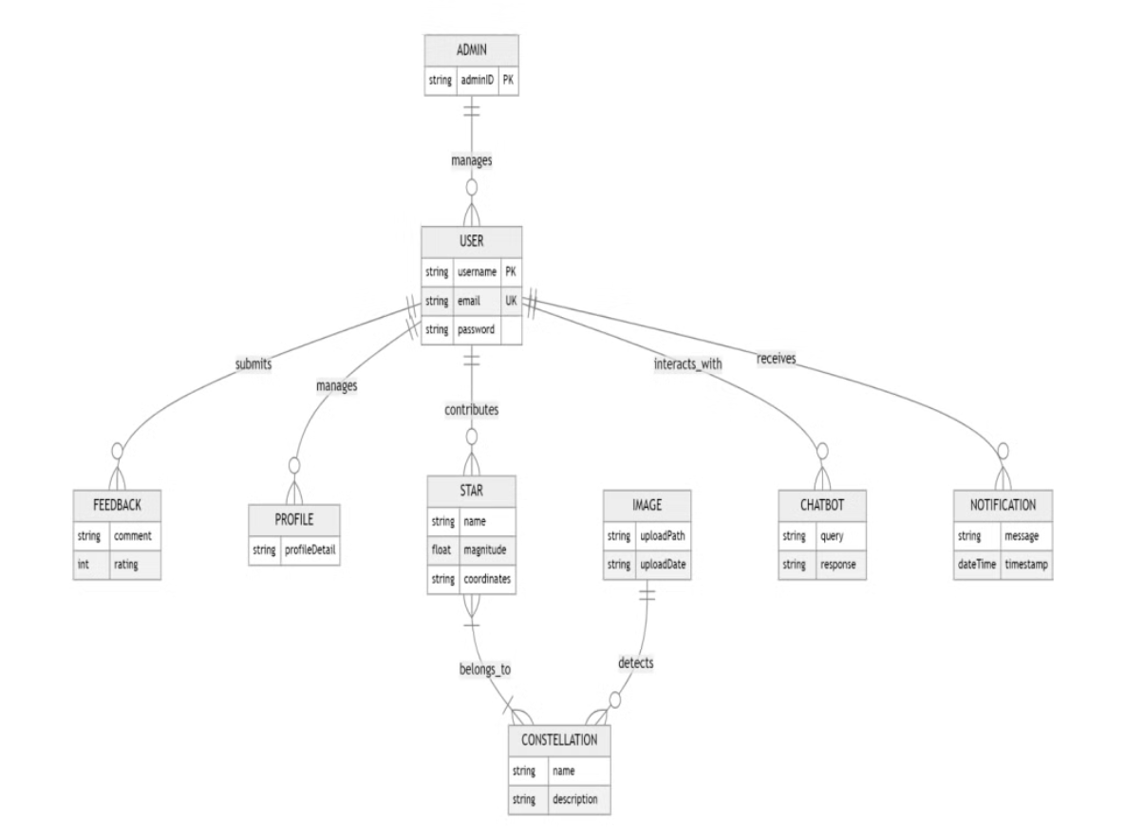
Database Schema

Slide 9
Database Schema
Entity
Key Attributes
Constellation
ID, Name, Brightness
User
Username, Email
Star
Name, Magnitude, Coordinates
Image
Path, Upload Date

Slide 10
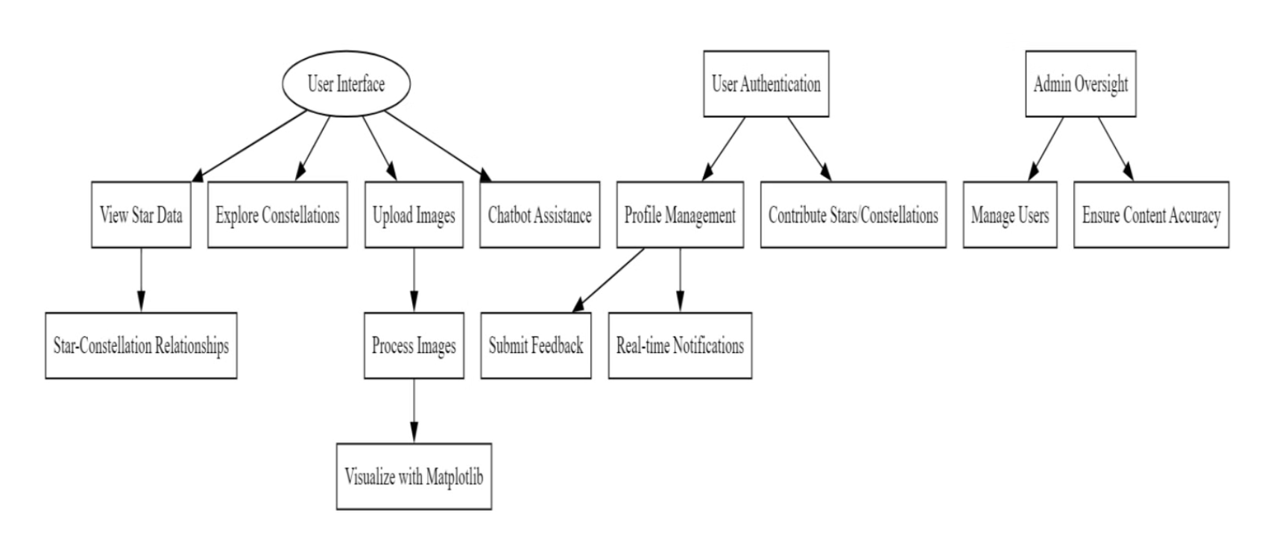
User Interface Form Design

Slide 11
User Interface Form Design
Control Panel
Image Display
Settings
Help
Manage tracking actions and adjust sensitivity.
View captured sky images and detected constellations.
Configure model parameters and display options.
Access user guide and contact support.

Slide 12
Conclusion
Starlight Tracker is a powerful astronomy app that leverages computer vision to detect and trace constellations from night sky photos. By automating the star identification process, the app makes astronomy more accessible and engaging for casual users and enthusiasts alike.
Overall, Starlight Tracker represents a significant step forward in making astronomy more accessible and approachable for a wide range of users. With its powerful computer vision capabilities and planned feature enhancements, the app is poised to revolutionize the way people explore and engage with the wonders of the night sky.

Slide 13
Thank You

