Slide 1

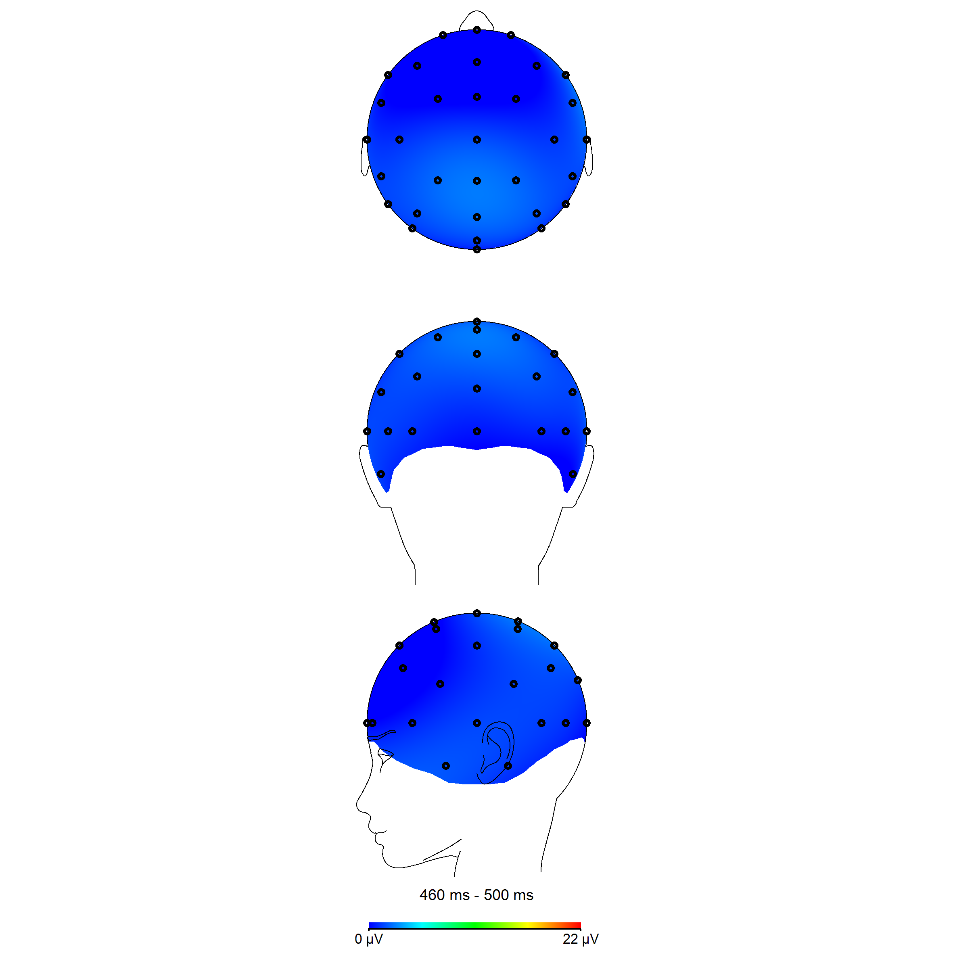
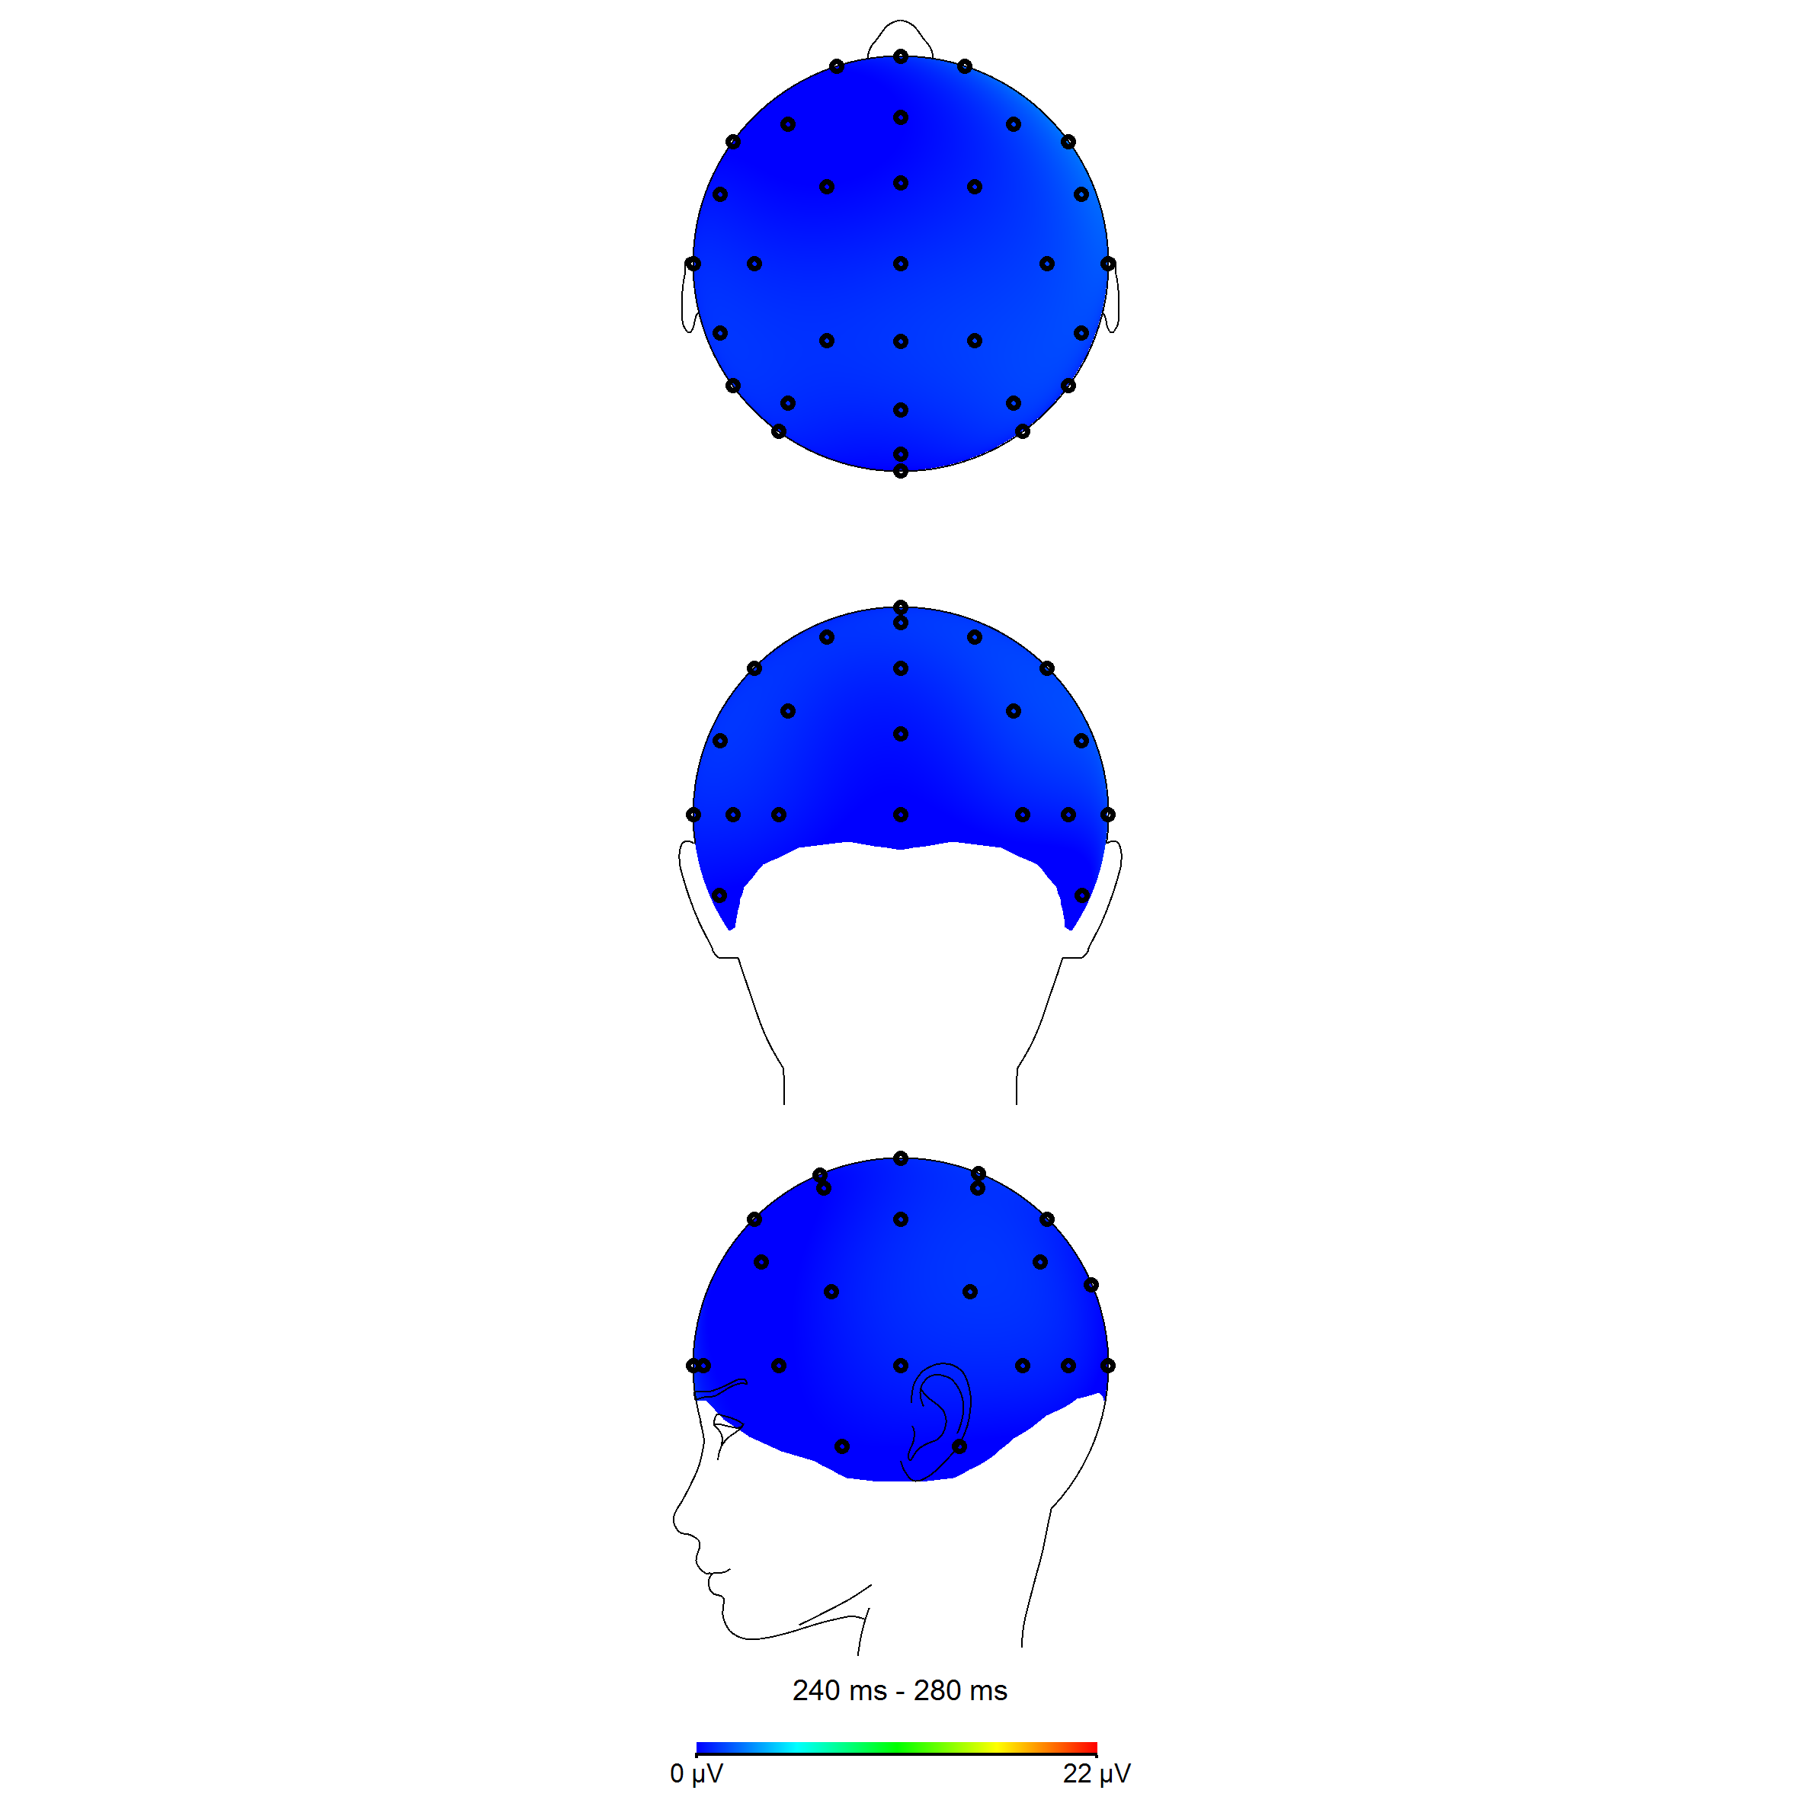
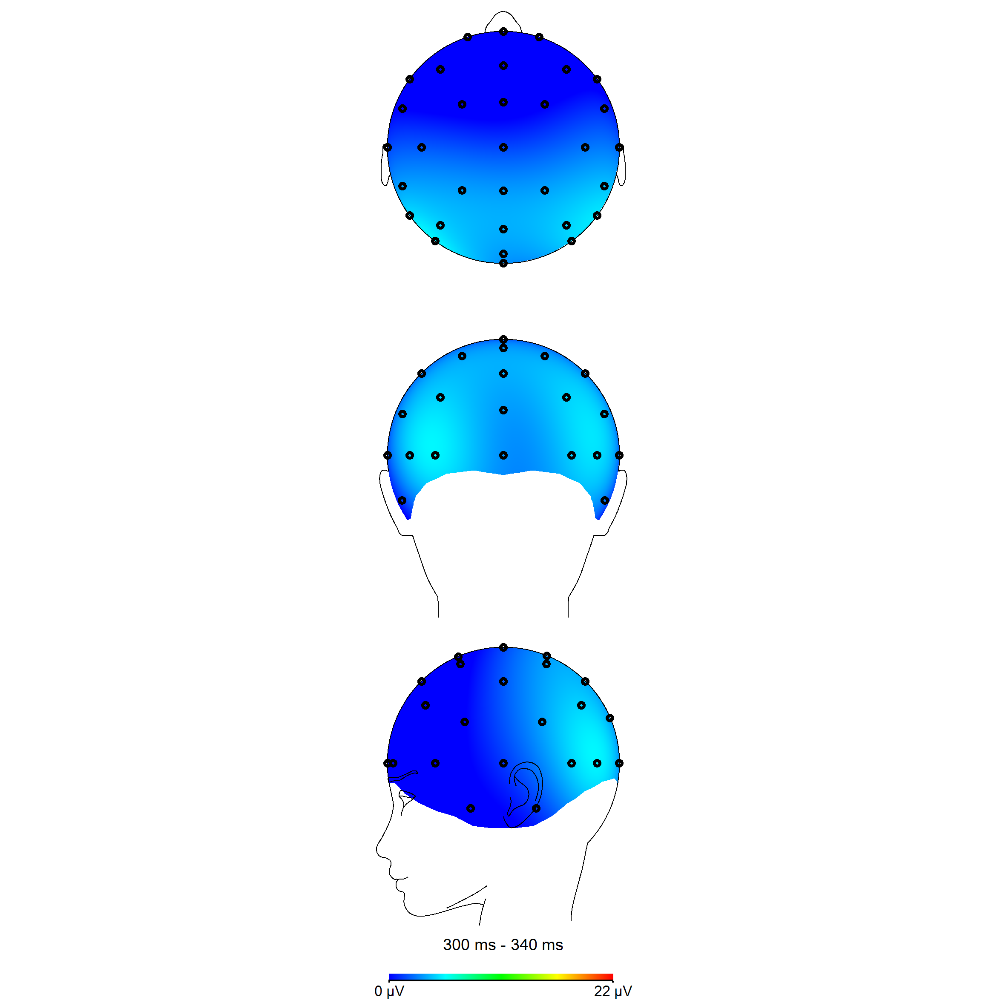
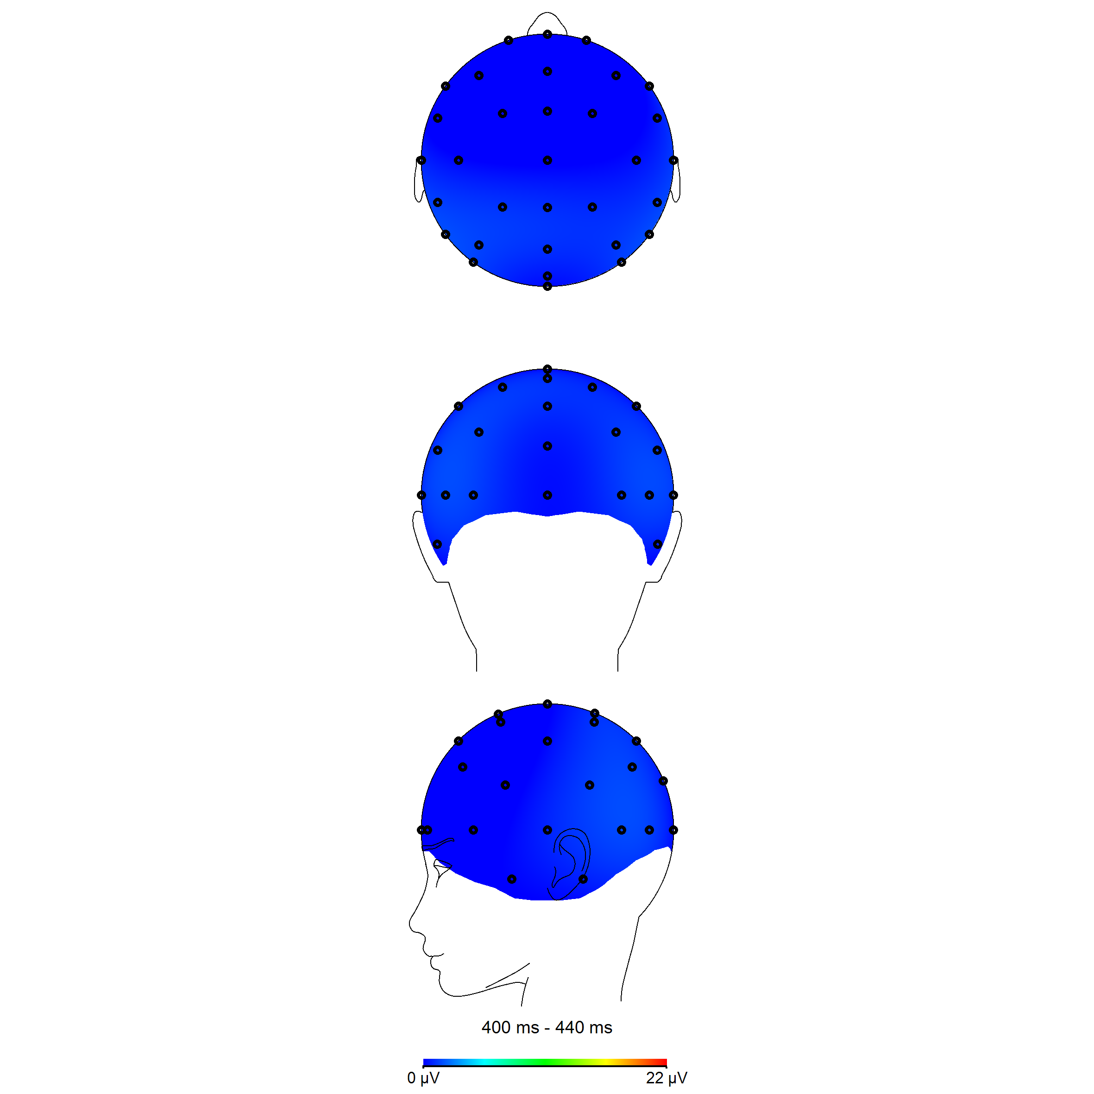
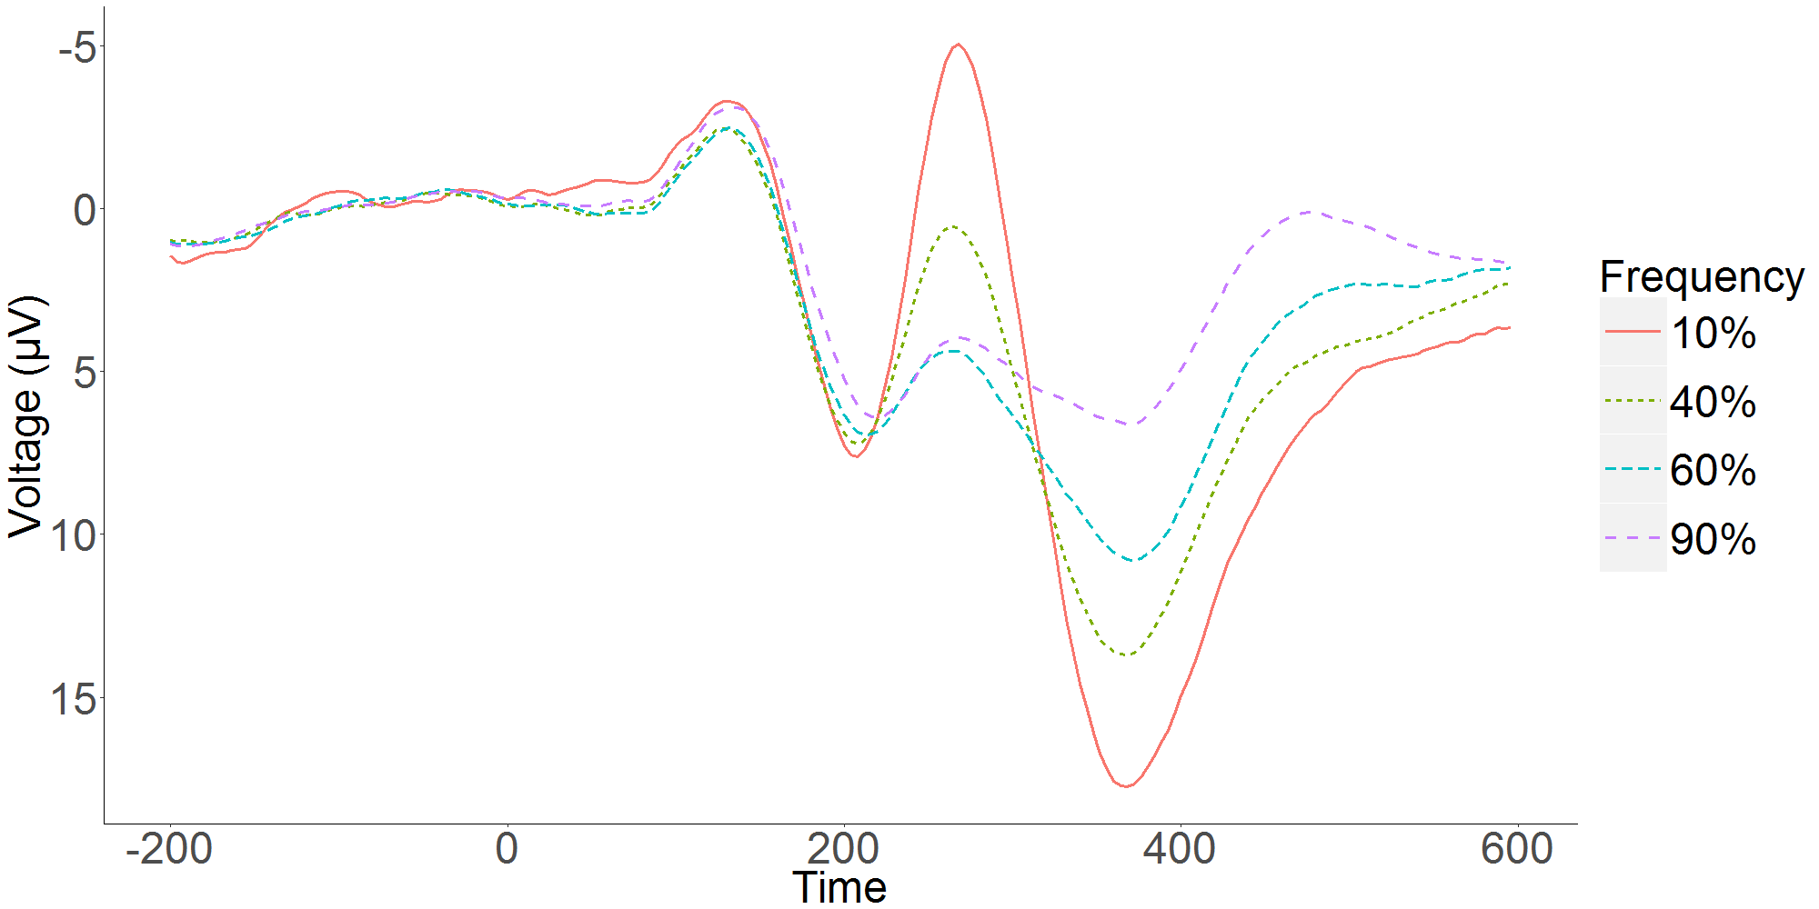
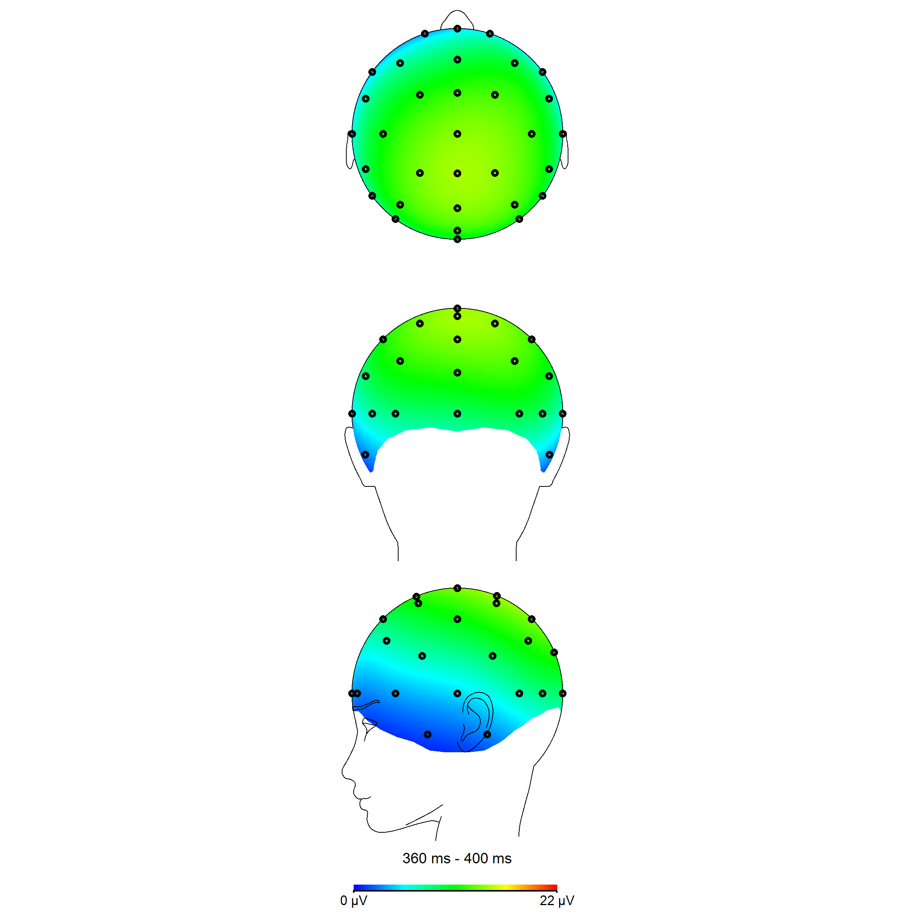
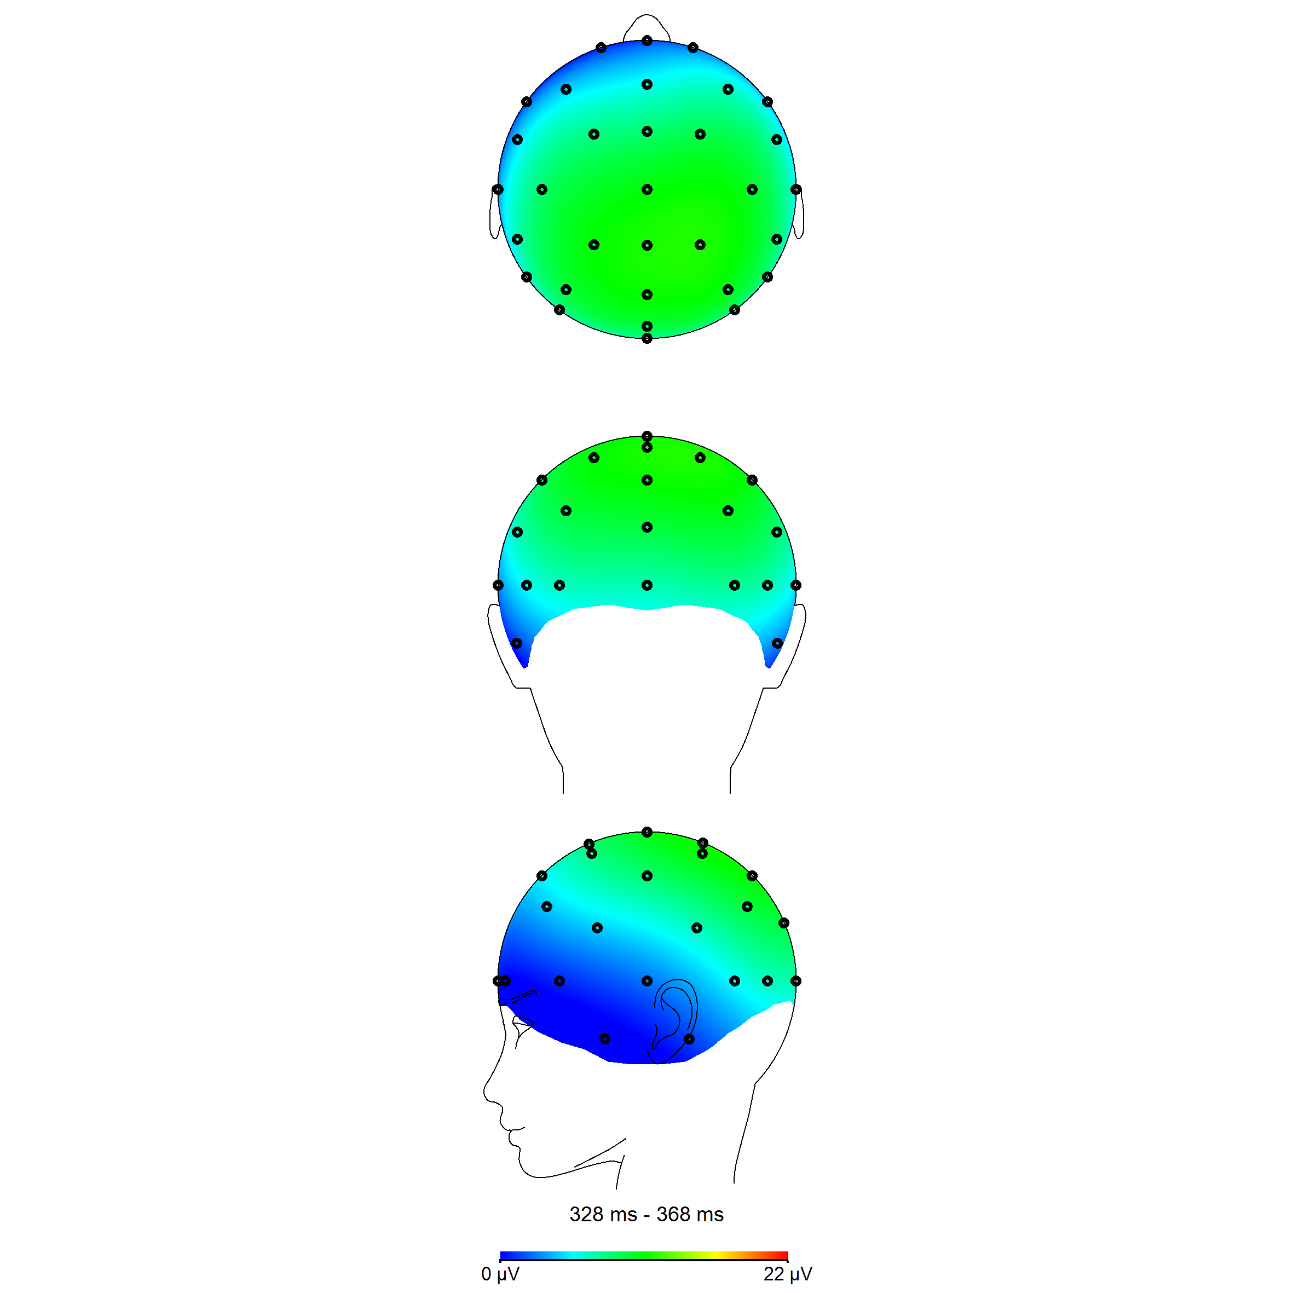
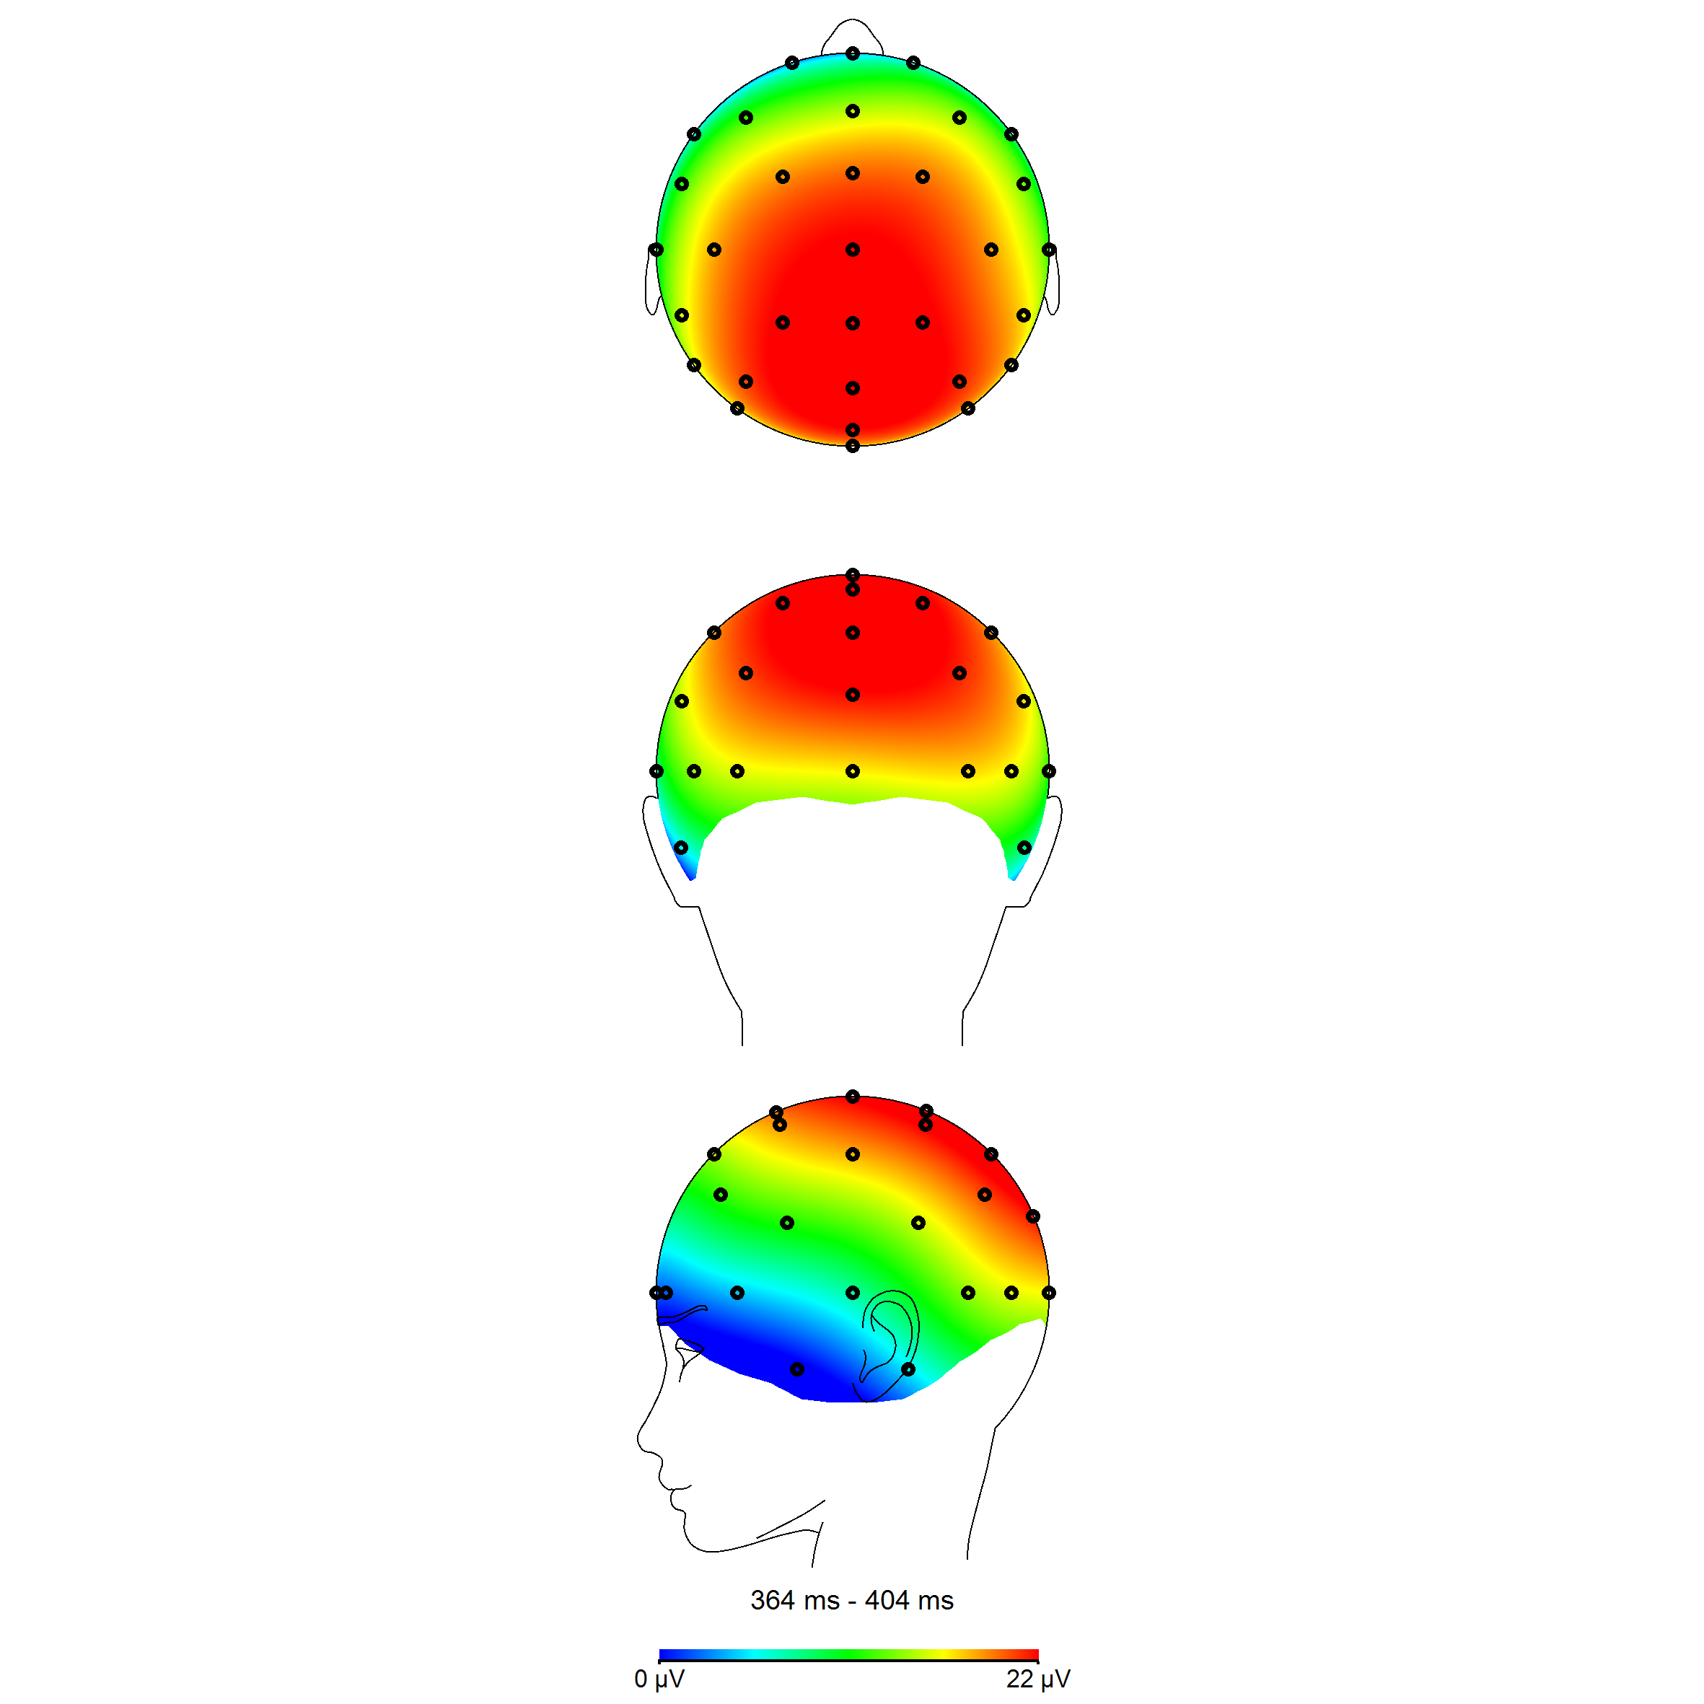
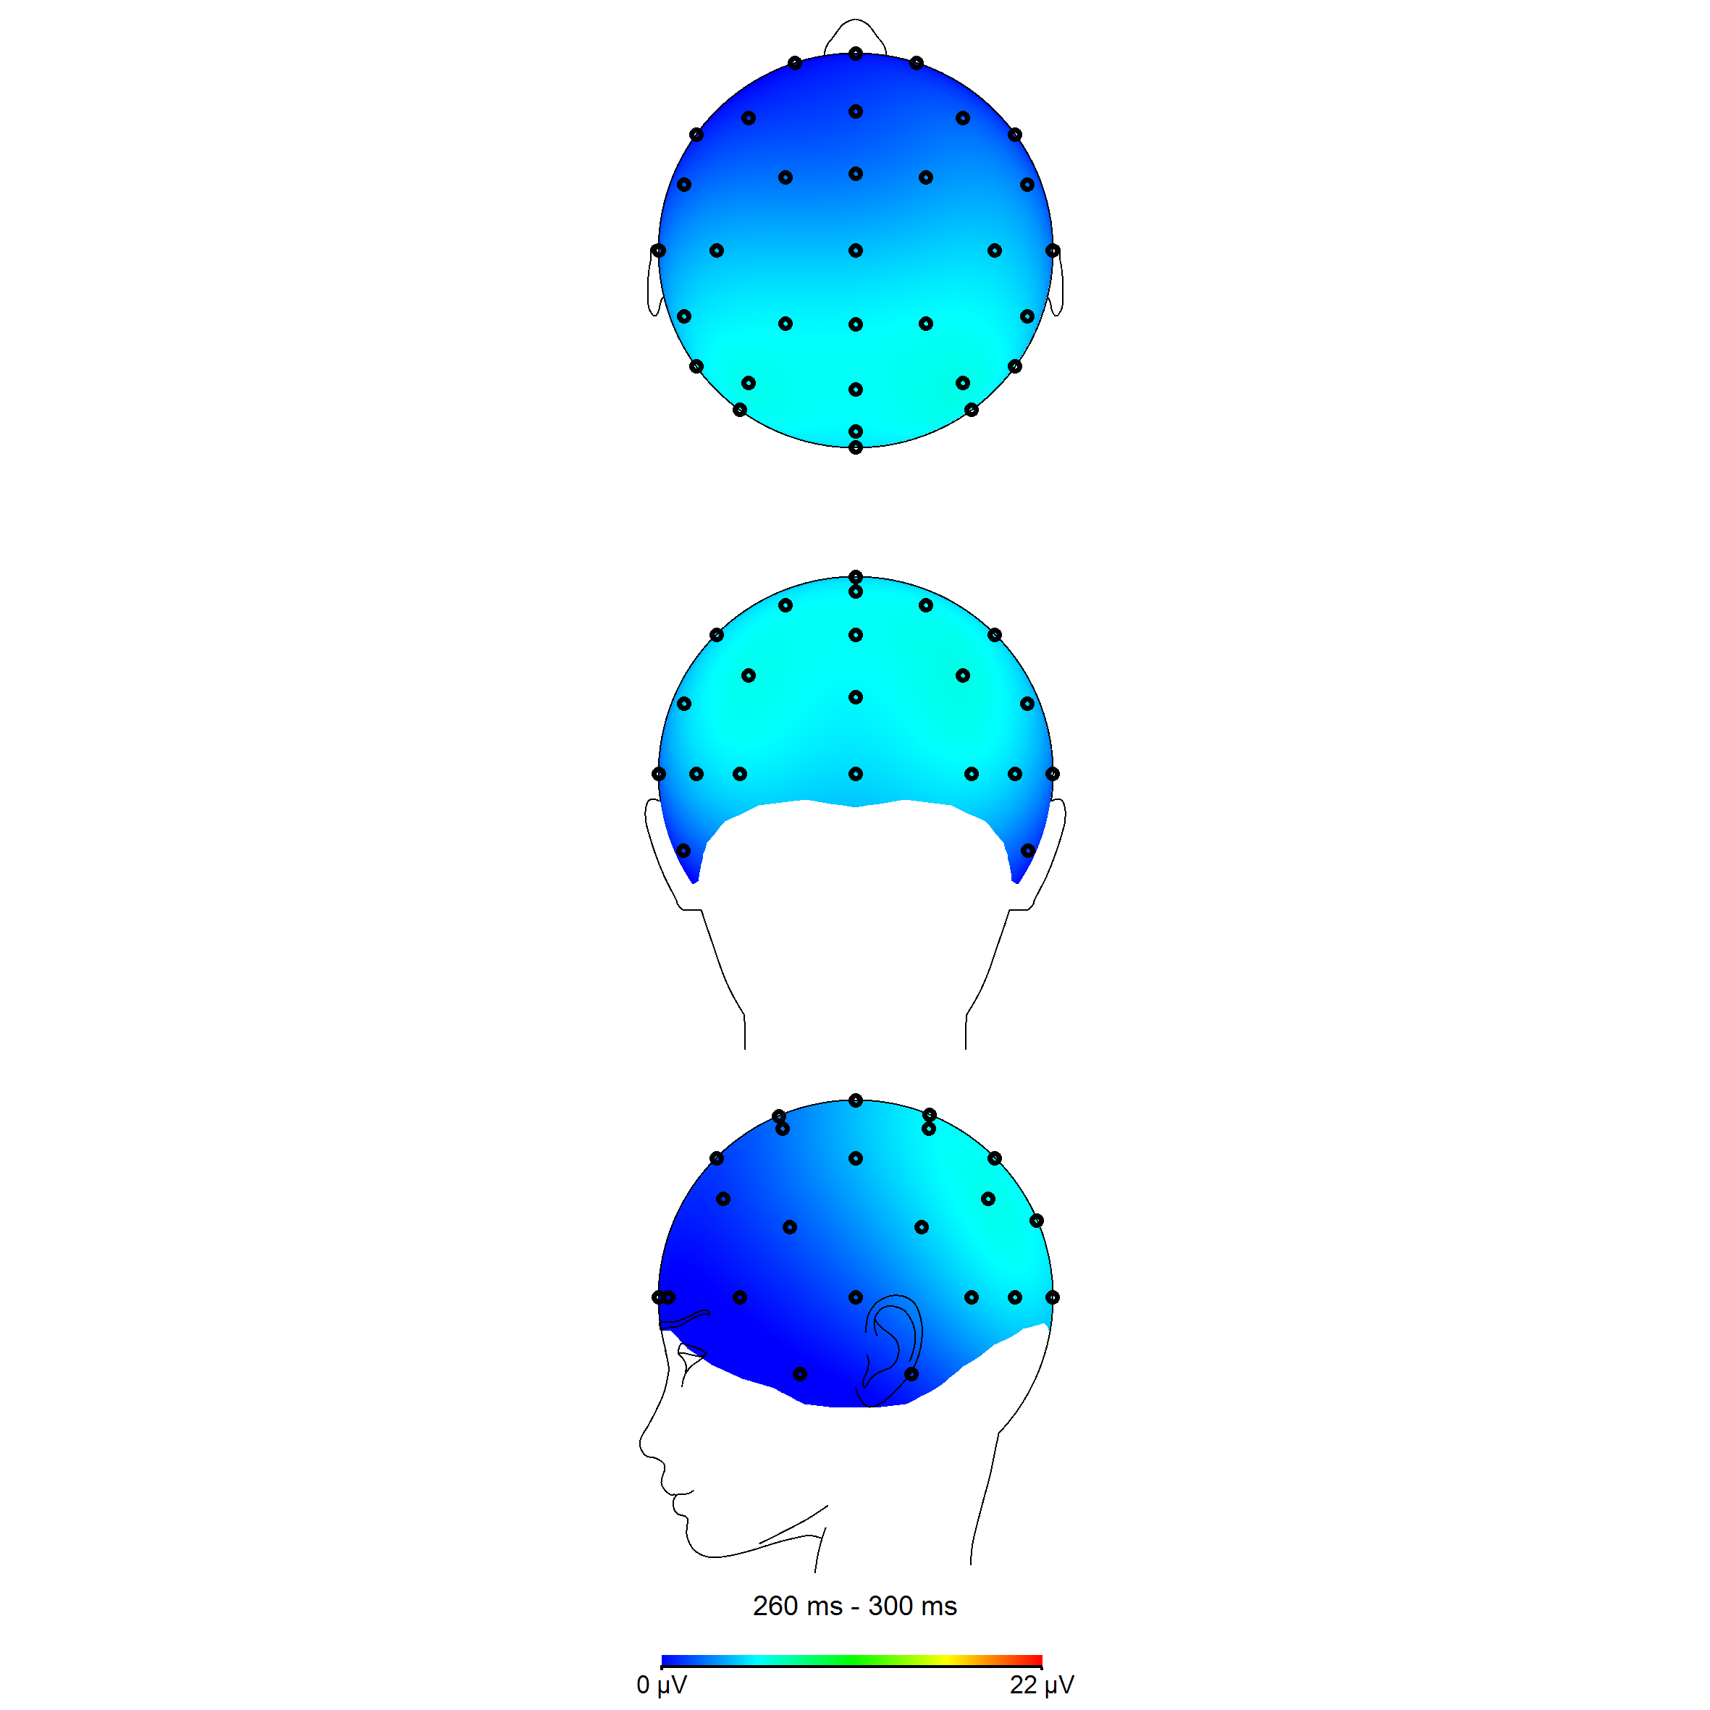
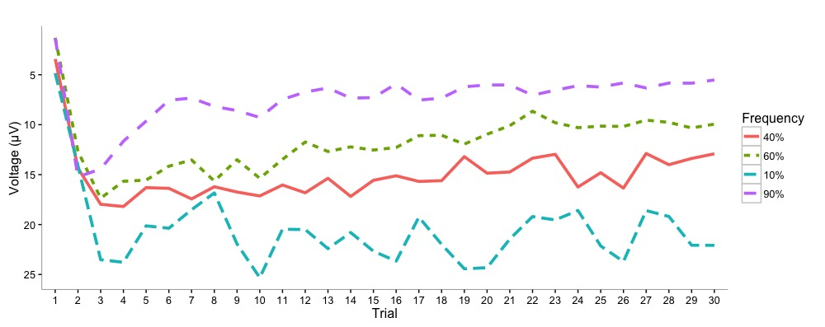
Learning Without Feedback: Does the P300 ERP Component Encode an Implicit Prediction Error
Stephen J.C. Luehr, Francisco L. Colino, Olav E. Krigolson Neuroeconomics Laboratory, University of Victoria
INTRODUCTION
METHODS
University student volunteers (n = 18)
Oddball Task variant
Presented with series of 30 coloured squares and asked to classify based on frequency
Two separate blocks: One with 40/60% frequency pairs, and one with 10/90% pairs.
Keypress responses based on whether they assessed the square as frequent or infrequent
Anterior cingulate cortex used within reinforcement learning systems for optimizing behaviour (Holroyd & Coles, 2002).
However, we also learn without reinforcement.
Less clear what neural structures are recruited in these instances.
The P300 component of the human event-related brain potential (ERP) shown to be used for the processing of novel stimuli (Spencer, Dien, & Donchin, 2001).
All EEG data were then processed offline using standard techniques available on our laboratory website, www.neuroeconlab.com.
Statistical analyses were performed and data were plotted for inspection.
500 ms
Until
response
500 ms
Until
response
500 ms
Until
response
RESULTS
There were two stimulus conditions in this experiment. The first condition had a frequent : infrequent stimulus ratio of 60/40%, while the second had a ratio of 90/10%. Participants were not told these ratios.
40% - Trial 1
60% - Trial 1
10% - Trial 1
90% - Trial 1
RESEARCH AIM
Elaborate on the role of the P300 ERP component in implicit learning of stimulus frequencies – learning driven by the stimulus itself and not reward feedback.
Electrode Pz
HYPOTHESIS
We hypothesised that the amplitude of the P300 ERP component reflected an implicit prediction error – the difference between the expected frequency of a given stimulus and its actual frequency.
Stimulus Onset
40% - Trial 30
60% - Trial 30
10% - Trial 30
90% - Trial 30
Mean P300 Grand Average waveforms time locked to stimulus presentation.
REFERENCES
Electrode Pz
Holroyd, C. B., & Coles, M. G. H. (2002). The neural basis of human error processing: reinforcement learning, dopamine, and the error-related negativity. Psychological Review, 109(4), 679–709.
Nieuwenhuis, S., Aston-Jones, G., & Cohen, J. D. (2005). Decision making, the P3, and the locus coeruleus--norepinephrine system. Psychological Bulletin, 131(4), 510–532.
Spencer, K. M., Dien, J., & Donchin, E. (2001). Spatiotemporal analysis of the late ERP responses to deviant stimuli. Psychophysiology, 38(2), 343–358.
P300 amplitude comparison by frequency for Trial 1
Increased P300 amplitude and differentiation as trial count increases
Peak P300 amplitude by trial
DISCUSSION
Our results suggest that the amplitude of the P300 reflects an expectancy driven prediction error. Specifically, a reinforcement learning process is taking place based on implicit violations of frequency rather than feedback.
Stephen J.C. Luehr
The Neuroeconomics Laboratory
Department of Exercise Science, Physical and Health Education
University of Victoria
Victoria, BC, Canada
Web: www.neuroeconlab.com
Email: sluehr@uvic.ca
P300 amplitude was dependent on stimulus probability, as found in previous studies (Nieuwenhuis, Aston-Jones, & Cohen, 2005).
Trial-by-trial analysis revealed that the first trial in each block for a given stimulus produced extremely similar P300 amplitude for both frequent and infrequent stimuli.
Over the next few trials P300 amplitude began to scale to become representative of the stimulus probabilities.

