Slide 1
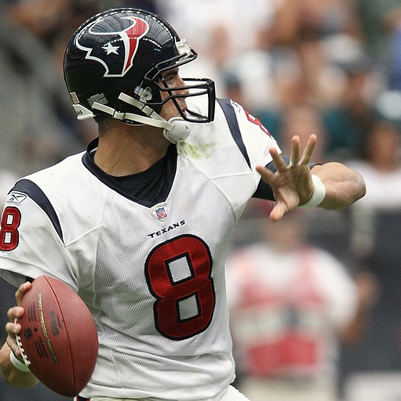
Quarterbacks Of The Future
Stephen Switchenko

Slide 2
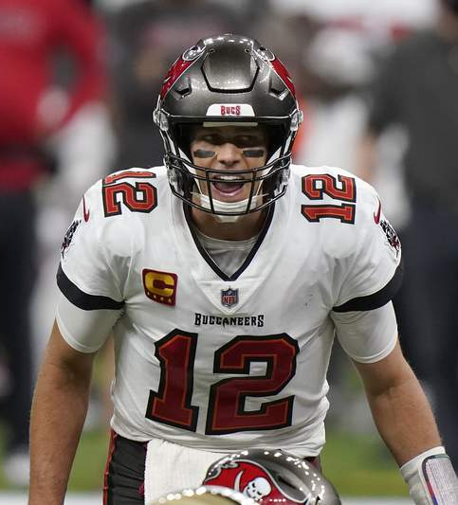
Background
The quarterback position is the most important role in all of sports.
Their performance often indicates whether a team wins or loses.
A variety of metrics are available to measure the performance of quarterbacks.
Stephen Switchenko, a professional data analyst, will analyze a dataset of quarterback statistics to come up with a recommendation to football teams on how to coach their quarterbacks for 2020 and onward.

Slide 3
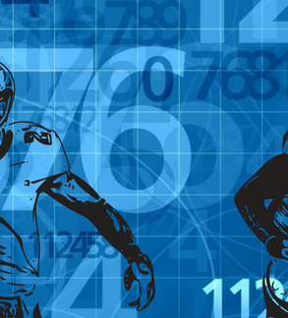
Dataset Summary
A dataset from Kaggle containing the game logs of all players who threw a pass in the National Football League from 1996 through 2016 was used for this project.
The dataset had entries for non-quarterbacks who threw passes and they were first filtered out.
After filtering out the non-quarterbacks, there were data entries with blank fields and special characters which were filled with the averages for the respective column.
Entries were missing fields and averages from the entire dataset were used to fill them.
Littiebrant, J. (2016). Quarterback Stats from 1996-2016, Version 2. Retrieved June 10, 2021 from https://www.kaggle.com/speckledpingu/nfl-qb-stats.

Slide 4

Analysis Approach
Game points and completions were selected as the most important metric.
Correlation and Regression analysis in Microsoft Excel will be used to identify the most important variables.
The identified variables will then be measured to forecast the average performance of quarterbacks in 2017-2019.

Slide 5
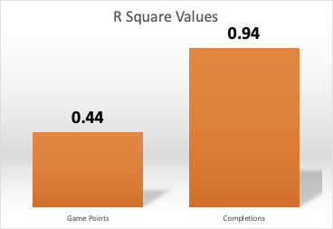
Linear Regression
Two linear regression tests were run on the set of variables .
Game points were the dependent variable on the first test and it yielded an r square value of .44.
Completions were the dependent variable on the other test and it yielded an r square value of .94.
Since completions has a higher r square value, more of its data points fit the regression model.

Slide 6
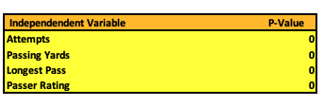
Modifying the Regression Model
The completions regression model yielded four independent variables(attempts, passing yards, longest pass, passer rating) with p-values of 0 which were the lowest in the model.
Since the p-values are less than .05, they are statistically significant and can be included in a regression model.

Slide 7
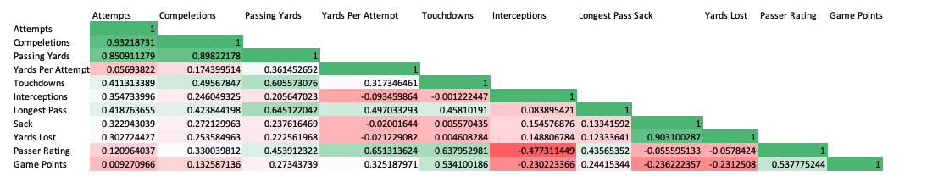
Correlation Matrix
Alternatively, a correlation matrix on the four independent variables in the final model shows that attempts(.93), passing Yards(.90), longest pass(.42), and passer rating(.33) have varying levels of correlation to completions.
Longest pass and passer rating have a much lower level of correlation than compared to attempts and passing yards from the matrix but this is different than linear regression.

Slide 8
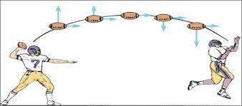
Final Regression Model
A final regression analysis was run with completions as the dependent variable and attempts, passing yards, longest pass, and passer rating as independent variables.
The final regression model yielded a r square value of .94 and p-values of 0.
Completions = .45(Attempts) + .03(Passing Yards) - .07(Longest Pass) + .04(Passer Rating)
(A regression model was run with only passing yards and attempts as the independent variables but it had an r square value of 0.90 and it was not moved forward with.)

Slide 9
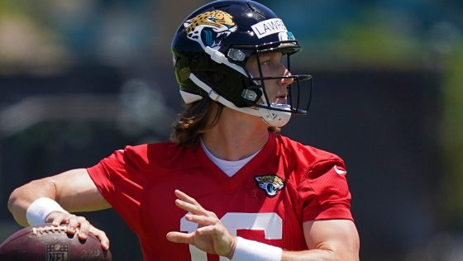
Predicting the Future
Now that we know which variables are most related to completions, we can predict how they will change over the next few years by forecasting.

Slide 10
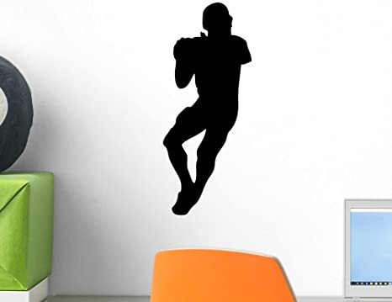
Visualizing Statistics
The visualizations represented are aggregated the average amount of a statistic by year.
The forecasts are generated by Tableau's built-in forecasting functionality.
When comparing the variables measured in the regression model, they all rise over the 20 year time period in the dataset.
https://public.tableau.com/app/profile/stephen.switchenko/viz/Capstone1Story_16235415762980/QuarterbackVisualizations

Slide 11
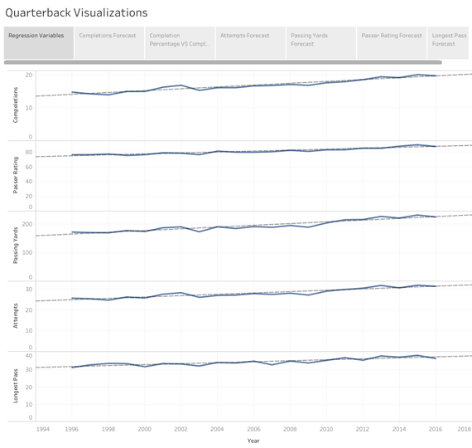

Slide 12
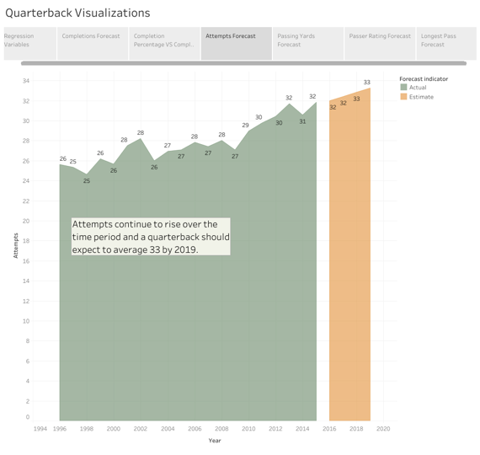

Slide 13
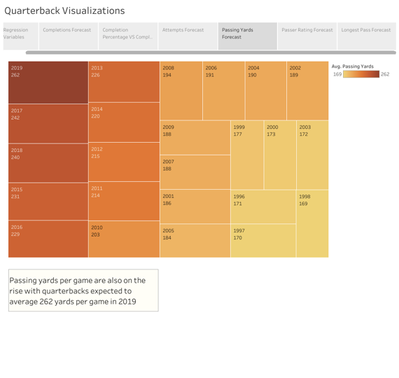

Slide 14
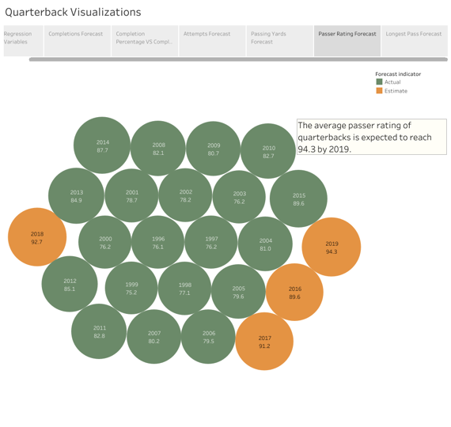

Slide 15
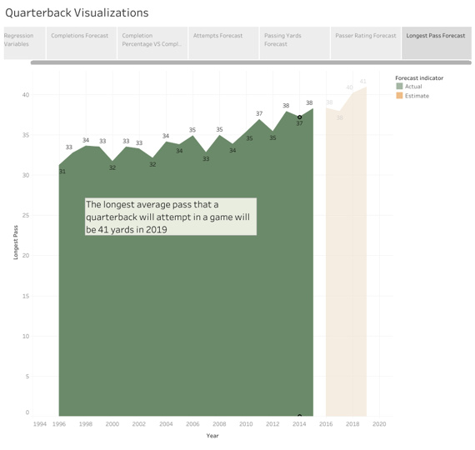

Slide 16
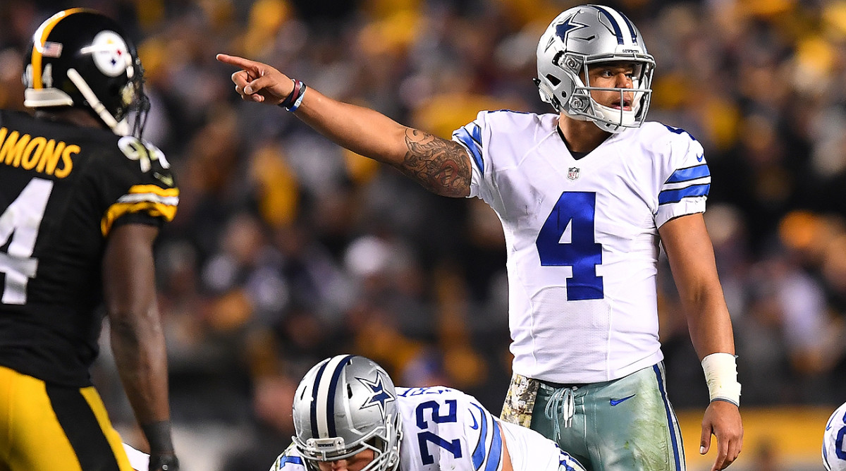
Introducing Completion Percentage
Completion percentage is a calculated field that is measured by dividing completions by attempts and it was added to the raw dataset.
When running linear regressions for completions against the year, an r square value of .90 and a p-value less than .05.
Completion percentage against the year has an r square value of .82 and a p-value of less than .05.
The regression tests suggest that completions and completion percentage are related and rise with the year.

Slide 17
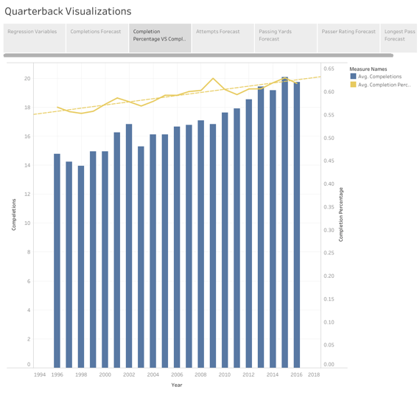

Slide 18
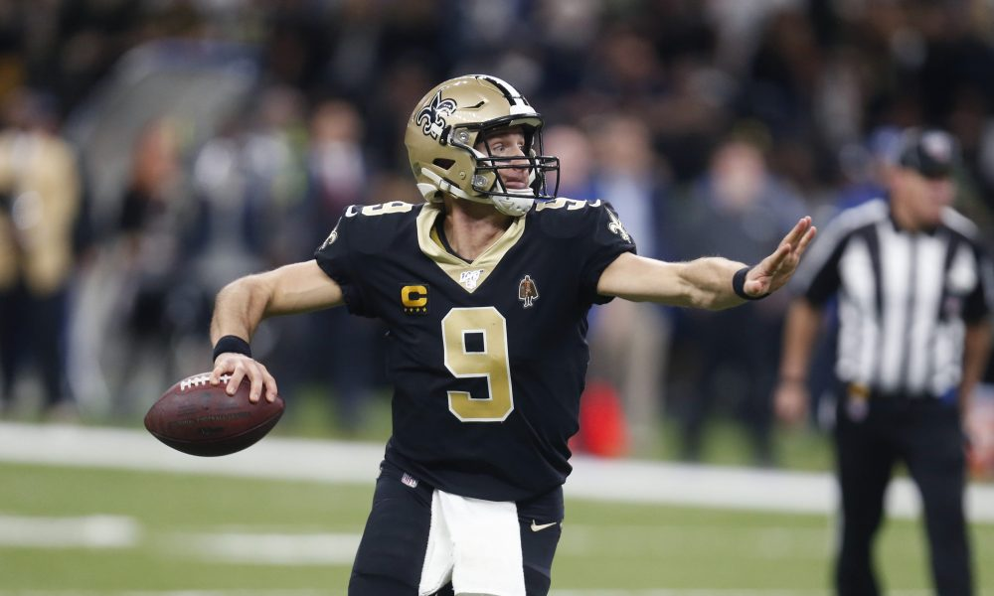
Why Completion Percentage?
In football circles, completion percentage is the first sign of an accurate quarterback and is analyzed heavily in many football circles.
Completion percentages is derived from the dependent variable and an independent variable from the regression model.

Slide 19
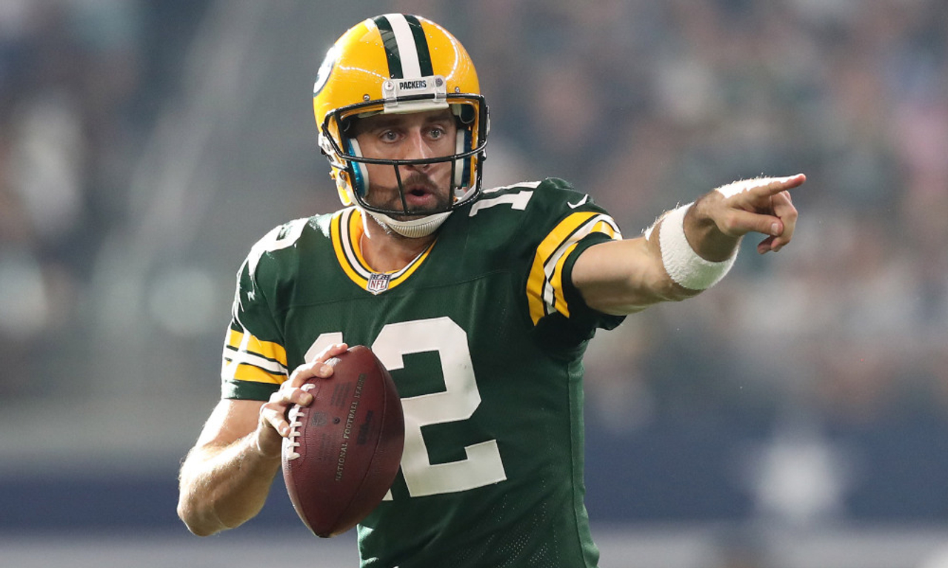
The Future Quarterback
By 2019, Quarterbacks will by completing more passes in the NFL averaging over 250 passing yards per game, more than 31 attempts, post an average passer rating of 94.3, a long pass of 41 yards.

Slide 20
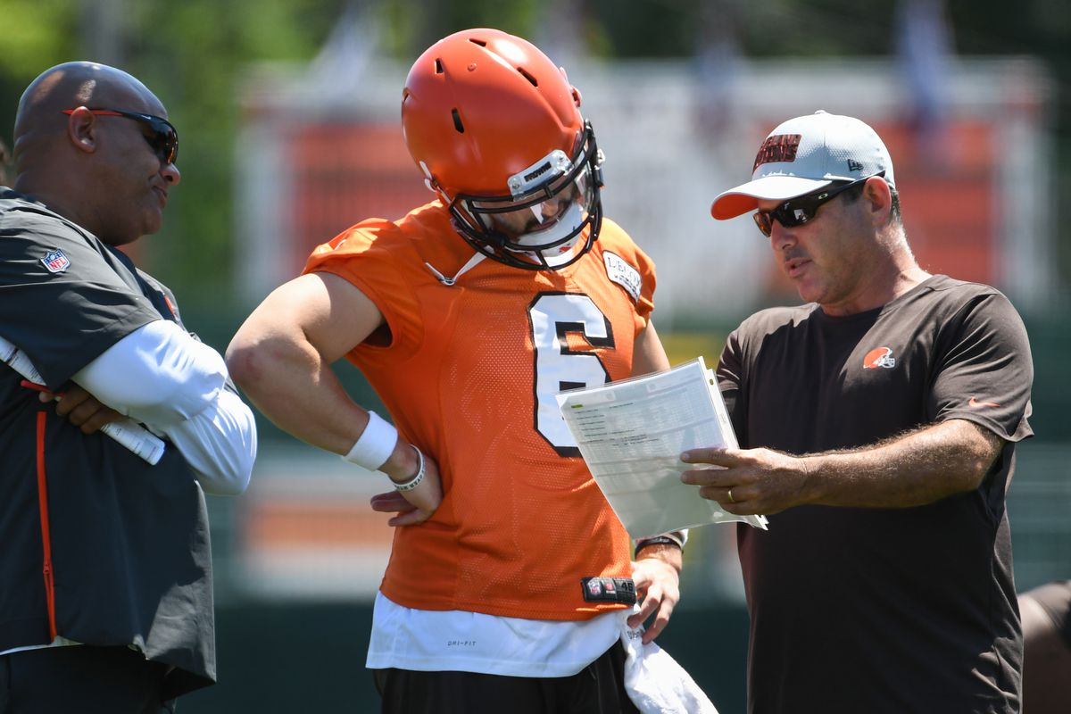
Team Advice
After providing the significance of the regression model and performing forecasts, it is accurate to predict that quarterbacks will continue to improve their performances.
Coaches need adjust their game plans with more passing attempts, more big players, and implement accuracy drills during practice

Slide 21
The End

