Slide 1
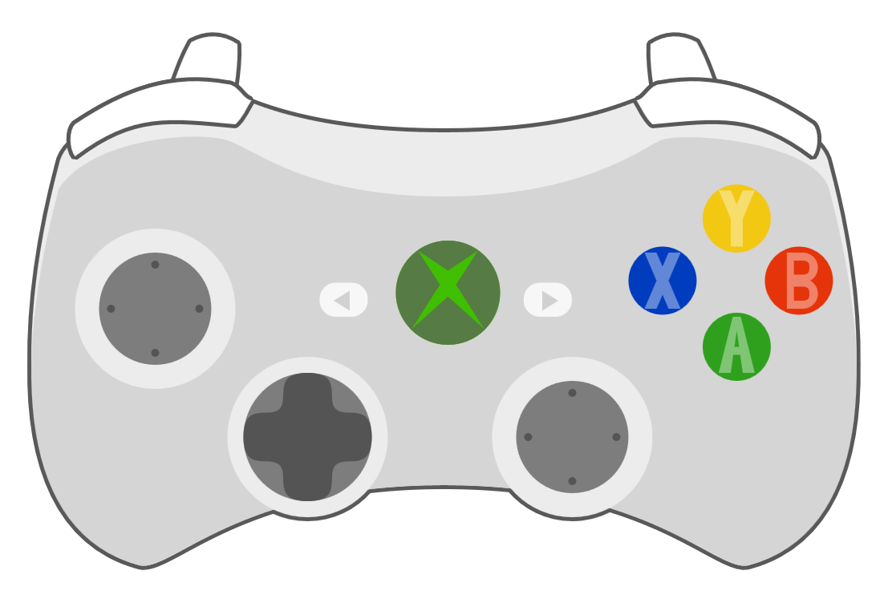
Brake
Emergency brake
Right: Start controlling a train
Left/right: Select train
Up/down: Select track
Up: throttle

