Slide 2
Modeling Plaque Buildup Within a Coronary Artery
Stephon Woodson - Summer of 2025
This slideshow should help serve as an explanation of why certain equations were chosen, and the math behind it.

Slide 3
Bernoulli’s Equation
First, I started with Bernoulli’s Equation to help approach this personal project.

Slide 4

Bernoulli’s equation
Solving for P₂
P₁+p($\frac{1}{2}$)*V₁² = P₂ +p($\frac{1}{2}$)V₂^{2 – Original equation}
P₂ =P₁ + p($\frac{1}{2}$)V₂² – p($\frac{1}{2}$)V₂² – Finished equation

Slide 6
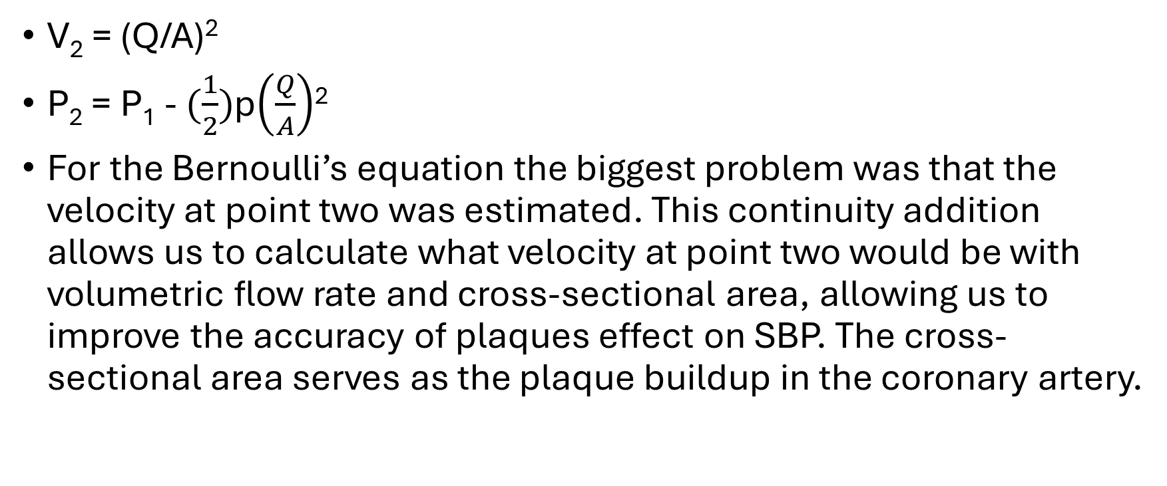
Continuity equation
V₂ = (Q/A)²
P₂ = P₁ - $(\frac{1}{2})$p$\left(\frac{Q}{A}\right)$²
For the Bernoulli’s equation the biggest problem was that the velocity at point two was estimated. This continuity addition allows us to calculate what velocity at point two would be with volumetric flow rate and cross-sectional area, allowing us to improve the accuracy of plaques effect on SBP. The cross-sectional area serves as the plaque buildup in the coronary artery.

Slide 8
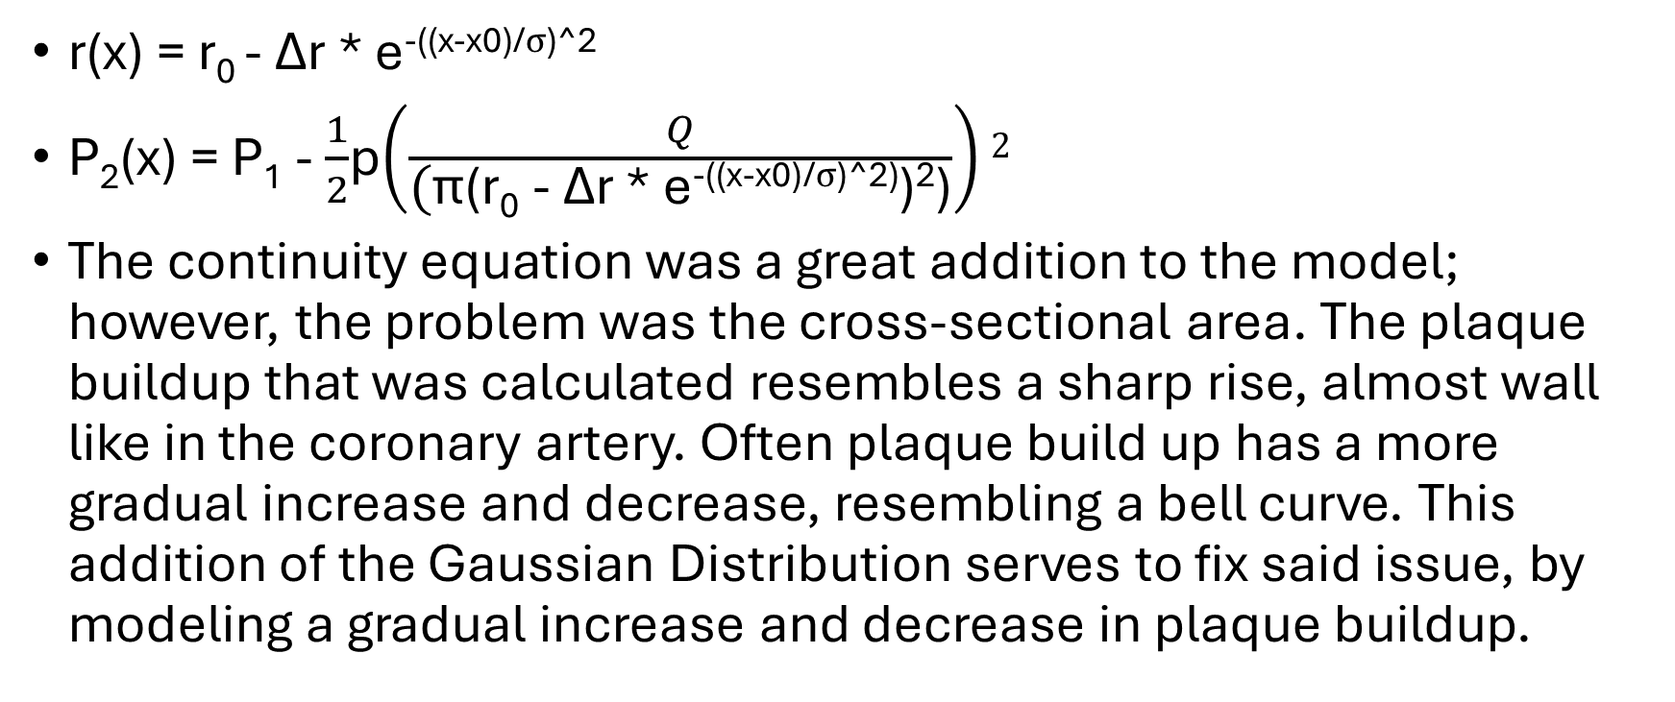
Gaussian Distribution
r(x) = r₀ - Δr * e^{-((x-x0)/σ)^2}
P₂(x) = P₁ - $\frac{1}{2}$p$\left(\frac{Q}{\text{(}\text{π}\text{(}\text{r}\text{0}\text{ − }\text{Δ}\text{r}\text{ ∗ }\text{e}\text{−((}\text{x}\text{−}\text{x}\text{0)/}\text{σ}\text{)^2)}\text{)}\text{2}\text{)}}\right)2$
The continuity equation was a great addition to the model; however, the problem was the cross-sectional area. The plaque buildup that was calculated resembles a sharp rise, almost wall like in the coronary artery. Often plaque build up has a more gradual increase and decrease, resembling a bell curve. This addition of the Gaussian Distribution serves to fix said issue, by modeling a gradual increase and decrease in plaque buildup.

