Slide 1
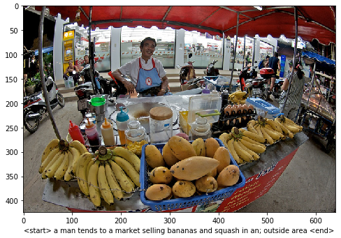
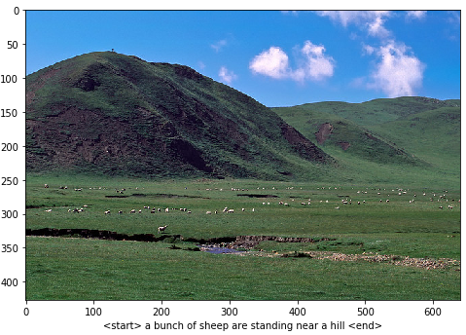
Image TO Caption
IBM Coursera Advanced Data Science Capstone – STEPHANE DEGEYE

Slide 2
PROJECT GOAL
A GENTLE introduction

Slide 3
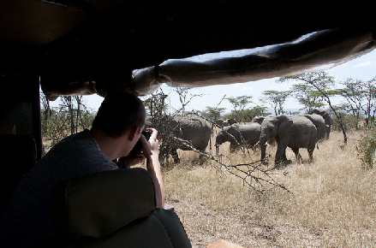
PROJECT Goal
Purpose of this project : from a real-life situation represented by a picture, to predict the caption in order to to describe the situation as well as possible.
A man takes a picture of a herd of elephants from inside a vehicle

Slide 4
Dataset
COCO DATASET

Slide 5

DATASET
As usual for a supervised learning, we need a dataset to train our model.
In our case, the dataset will consist of couples (image/caption) :
Input features are the pixels of images
Target value are the captions (sequence of words describing the picture)
I will use the well-known COCO (Common Object in Context) dataset (2017)
More info can be found here :
http://cocodataset.org/#home
https://arxiv.org/abs/1405.0312
Please read the Terms of Use of COCO Dataset : http://cocodataset.org/#termsofuse

Slide 6
ETL
Extract-TRANSFORm-LOAD

Slide 7
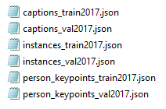
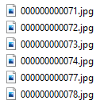
FILE LOADING / Data Extraction
/annotations/
COCO WEBSITE
Extraction of relevant Data from captions_train2017.json
annotations_trainval2017.zip
Unzip
/train2017/
train2017.zip
Unzip
Image Name vector
Train Captions
PS : We use only the Training set (a subdivision will be use for validation)

Slide 8
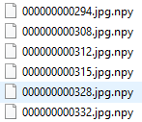
IMAGE FEATURES EXTRACTION (PIPELINE)
Image Name vector
Load image
From disk
Pipeline (map functions, batch implementation)
Decode Jpeg
Channels = 3
Resizing
(299,299)
InceptionV3 Pre-processing
/train2017/
Transfer
Learning
See next slide
Save Image Features

Slide 9
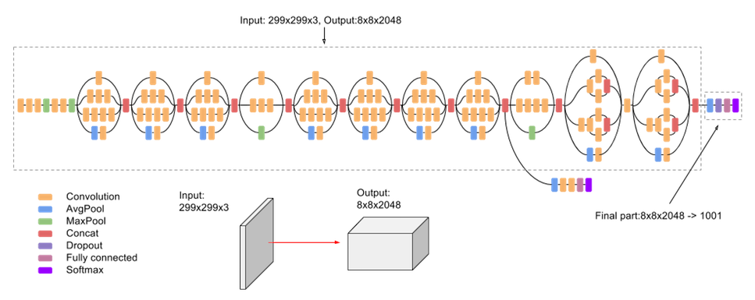
TRANSFER LEARNING (InceptionV3 MODEL)
InceptionV3 Pre-processing
Save Image Features
InceptionV3 has been trained on the huge ImageNet dataset (1,331,167 images)
We don’t use the last layer (softmax) of this CNN

Slide 10
CAPTION PREPROCESSING
Init Tokenizer
(Vocabulary size, oov token, filter)
Train Captions
Fit on Text
(Apply on our data)
Text to Sequence
(List of indexes instead of list of words)
Padding
(Sequence Length Hamonization )
Captions vector

Slide 11
FINAL DATASET
Pipeline (map functions, batch implementation)
Image Name vector
80 %
img_name_train
Load Features
From disk
Captions vector
cap_train
Shuffling
20 %
Prefetching
img_name_val
cap_val
cap_train
img_tensor
Model

Slide 12
MODEL
RNN/ATTENTION

Slide 13
MODELS
CNN Encoder
Bahdanau Attention Model
img_tensor
FC
hidden
State
score = tanh (W1(features) + W2 (hidden))
W2
V
SOFTMAX
∑
TANH
Context Vector
Relu
W1
Attention_weights = softmax ( V (score) )
Give Next Word to RNN (update of dec_input)
RNN Decoder
cap_train
dec_input
Concat
FC
FC
Loss Function
Teacher Forcing
FC
GRU

Slide 14
VALIDATION
BLEU SCORE

Slide 15
BLEU SCORE
BLEU (bilingual evaluation understudy) Score metrics is well suited for our Model Evaluation.
This score indicates how similar the candidate text (captions prediction) is to the reference texts (real prediction) (Values closer to 1 representing more similar texts).
The BLEU score was proposed by Kishore Papineni, et al (2002)
More info on BLEU can be found here : https://www.aclweb.org/anthology/P02-1040.pdf
Real Caption
BLEU
BLEU SCORE (value between 0 and 1)
Predicted Caption

Slide 16
ThAT’S ALL
Thank YOU for WATCHING

