Slide 1
ECG FOUNDATION MODEL VALIDATION
On Unseen PhysioNet Data
August 16, 2026

Slide 2
ECGFOUNDER
AT A GLANCE
MODEL ECGFounder, a 1-D CNN (Net1D, built on RegNet). Multilabel output over 150 diagnostic classes covering rhythm, morphology, and diagnosis.
INPUTS 10-second recordings at 500 Hz. Two variants: a 12-lead model, and a single-lead (lead I) model trained with limb-lead augmentation for wearables.
PREPROCESSING Resample to 500 Hz, 0.5 Hz high-pass, 50 Hz Butterworth low-pass, 50/60 Hz notch, 10-s windows with zero padding, per-segment normalization.
PRETRAINING Harvard–Emory ECG Database - 10,771,552 ECGs from 1,818,247 subjects.
EXTERNAL VALIDATION CODE-test, PTB-XL, and PhysioNet Challenge 2017 (single-lead).
FINE-TUNING MIMIC-IV-ECG (800,035 ECGs, 161,352 patients) for age, sex, CKD, CHD, LVEF, and NT-proBNP; DeepBeat PPG for atrial fibrillation.
OUR VALIDATION SET PTB-XL (Physikalisch-Technische Bundesanstalt), PhysioNet v1.0.3 - 21,799 12-lead ECGs from 18,869 patients. Held out of both pretraining and fine-tuning, so no leakage.

Slide 3
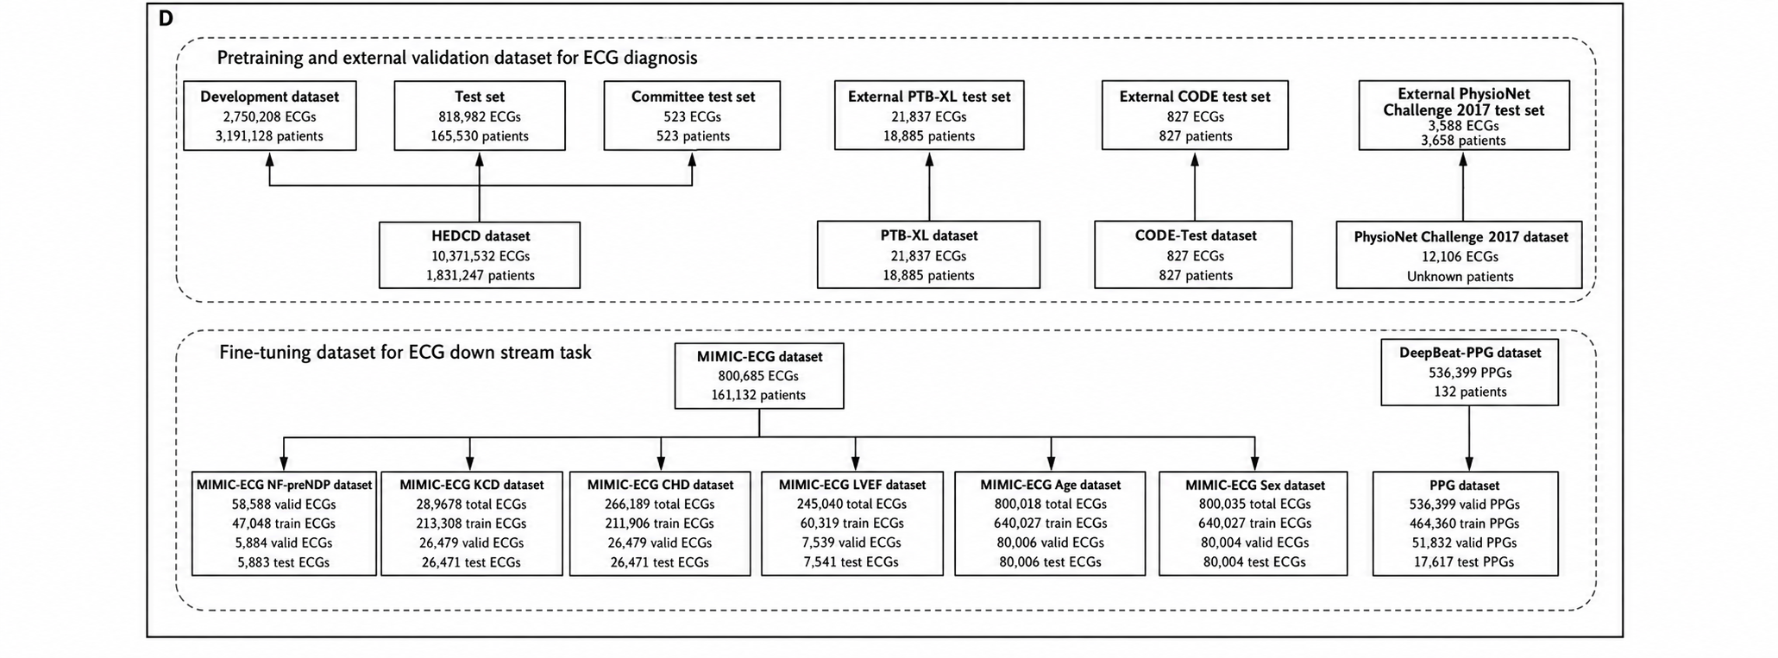
OVERVIEW

Slide 4
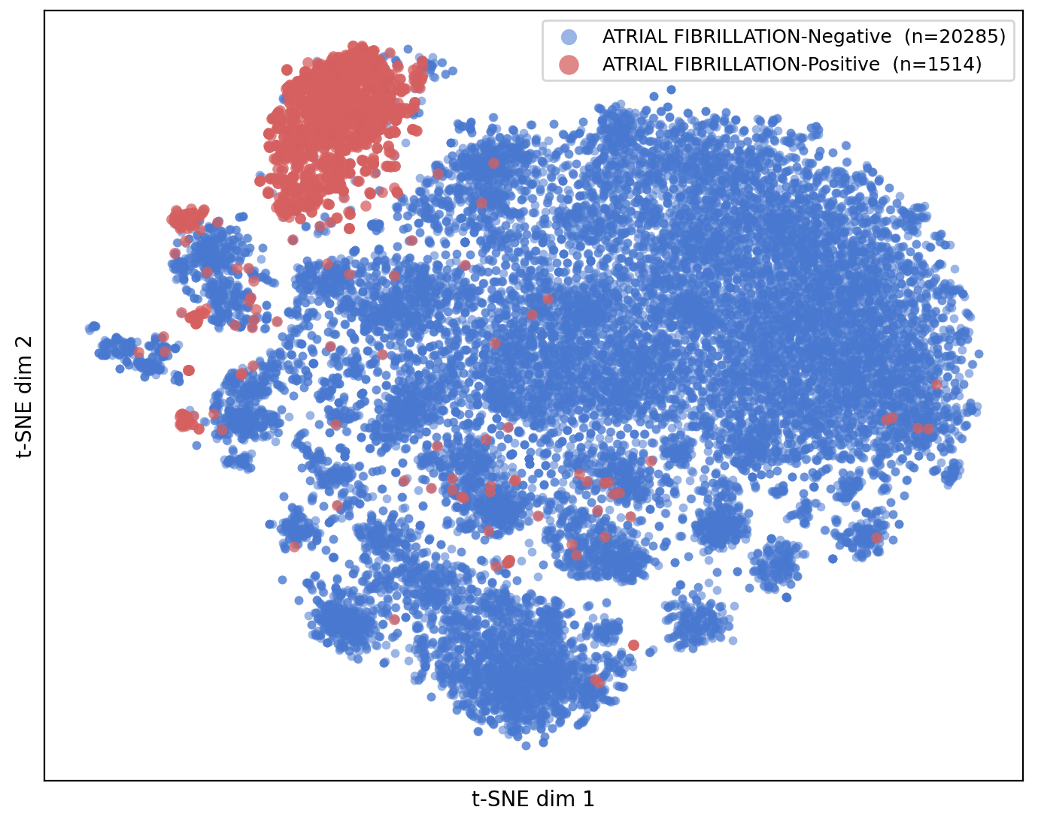
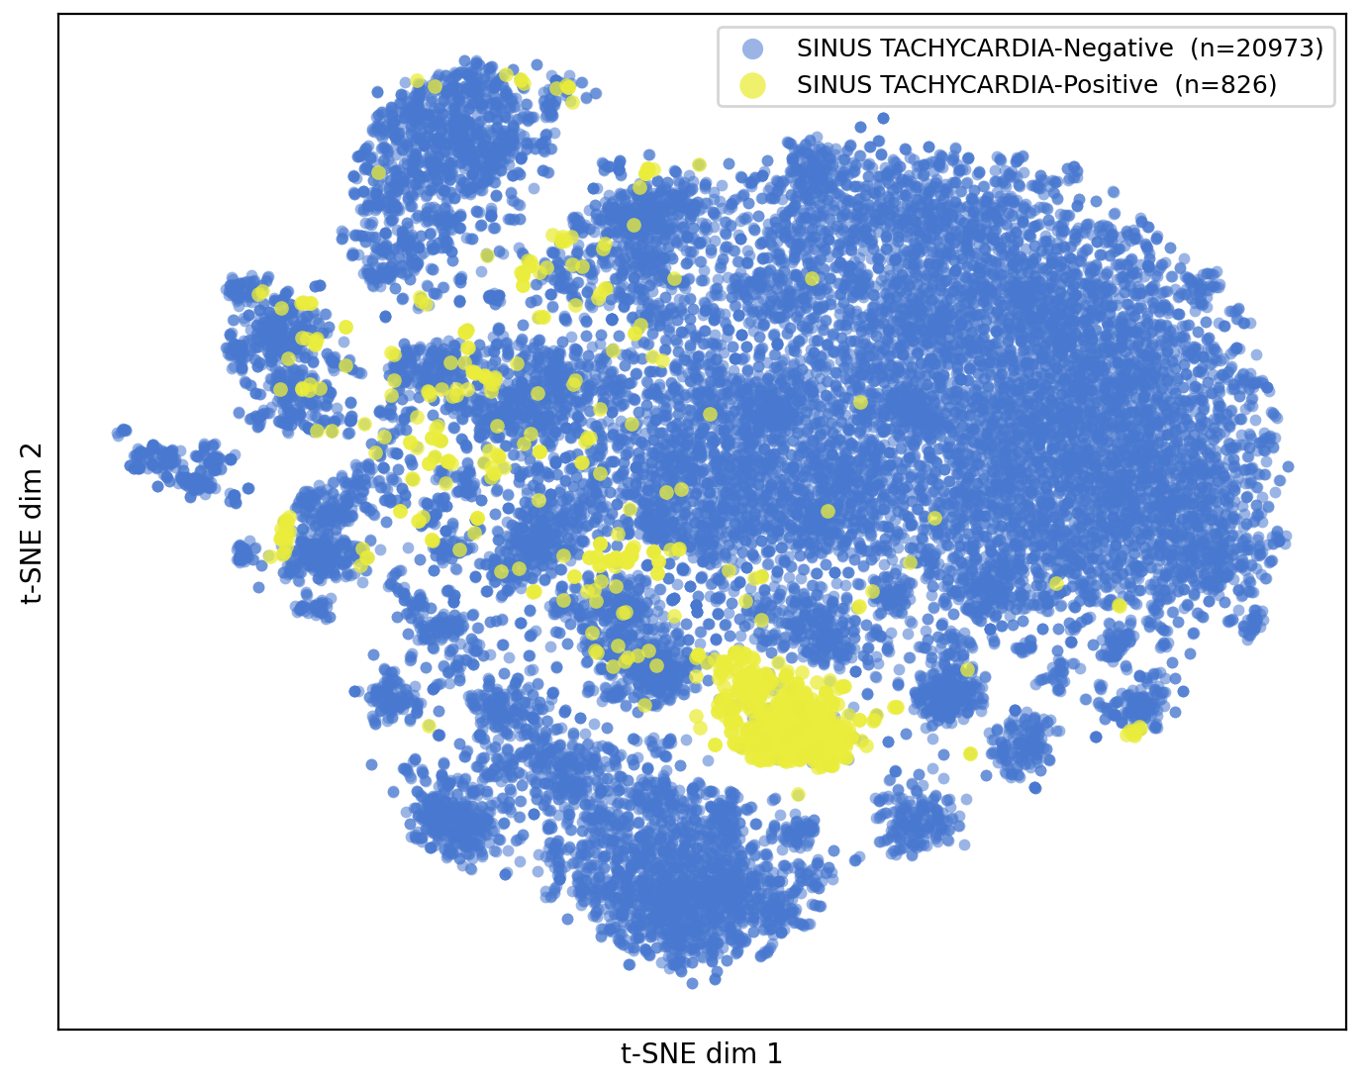
EMBEDDING PROJECTION COMPARISON
ATRIAL FIBRILLATION
SINUS TACHYCARDIA

Slide 5
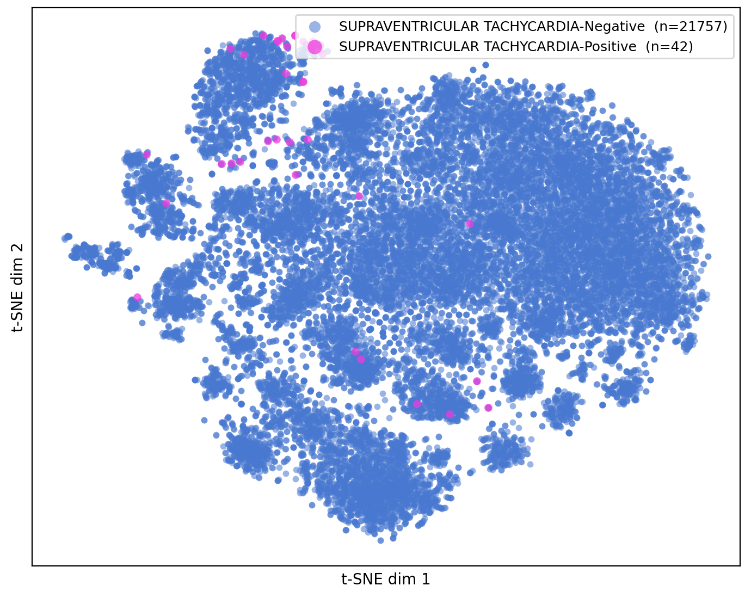
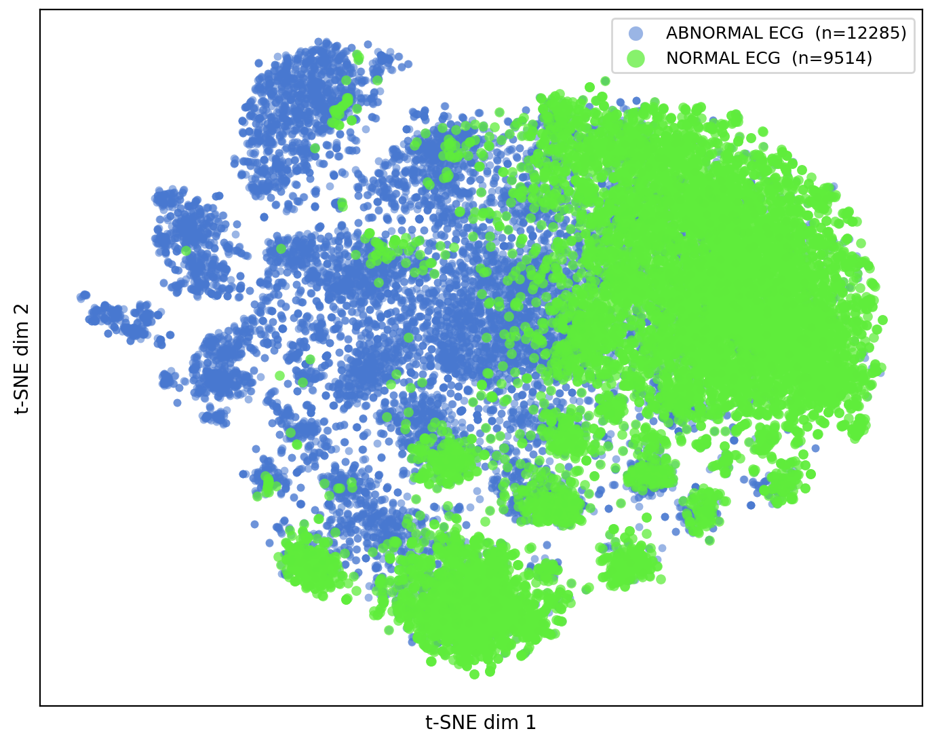
EMBEDDING PROJECTION COMPARISON
SUPRAVENTRICULAR TACHYCARDIA
NORMAL VS ABNORMAL ECG

Slide 6
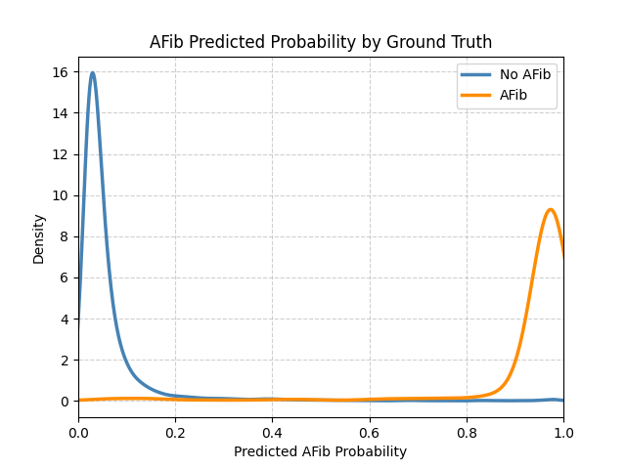
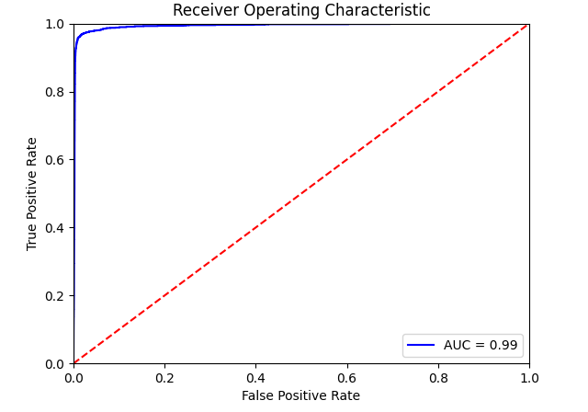
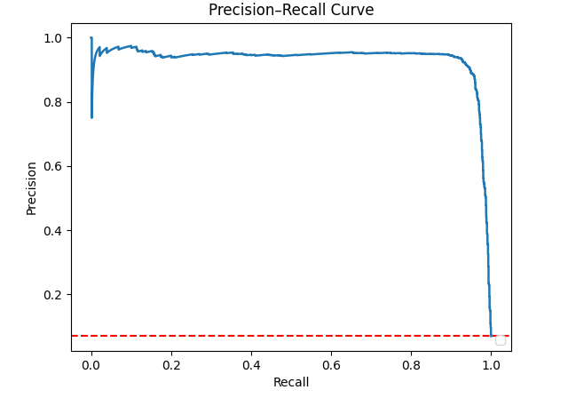
ATRIAL FIBRILLATION
ROC - AUC = 0.99
PRECISION–RECALL CURVE
Prevalence 6.9% (1,514 / 21,799)
Kernel Density Plot

Slide 7
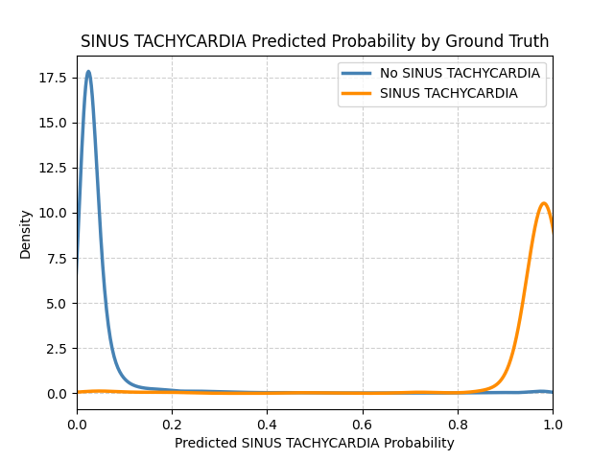
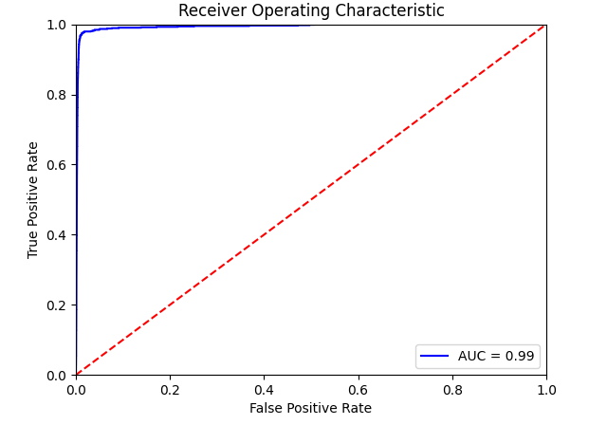
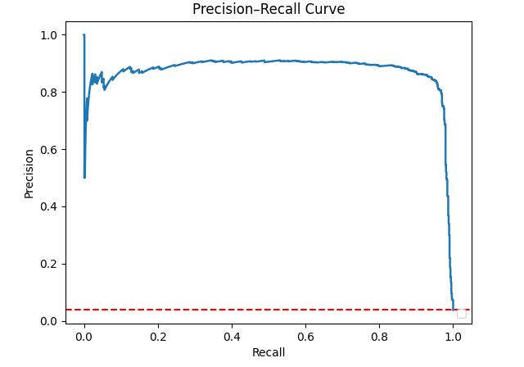
SINUS TACHYCARDIA
ROC — AUC = 0.99
PRECISION–RECALL CURVE
Prevalence 3.8% (826 / 21,799)
Kernel Density Plot

Slide 8
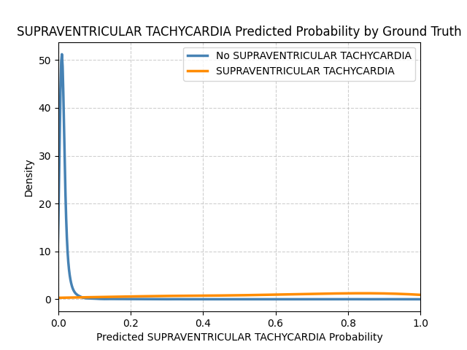
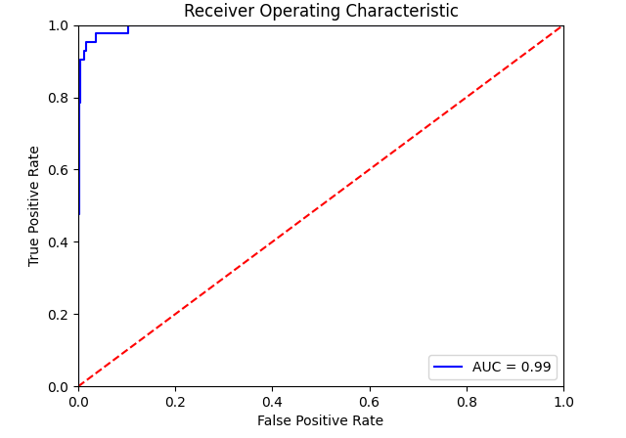
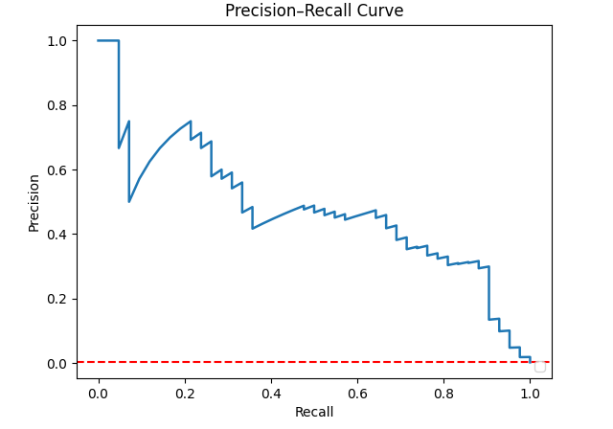
SUPRAVENTRICULAR TACHYCARDIA
ROC — AUC = 0.99
PRECISION–RECALL CURVE
Prevalence 0.19% (42 / 21,799)
Kernel Density Plot

Slide 9
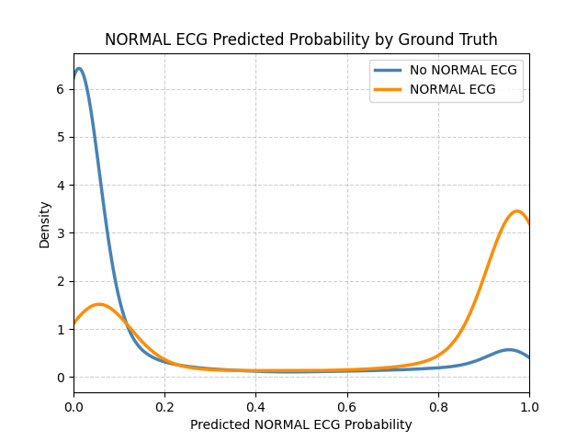
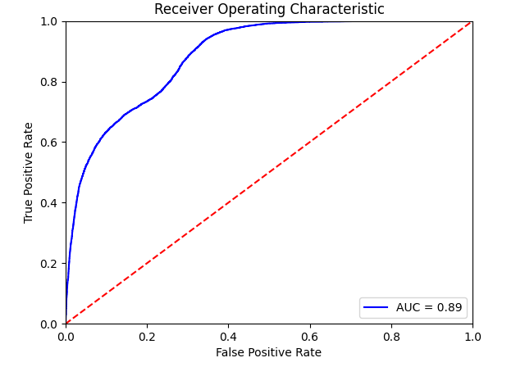
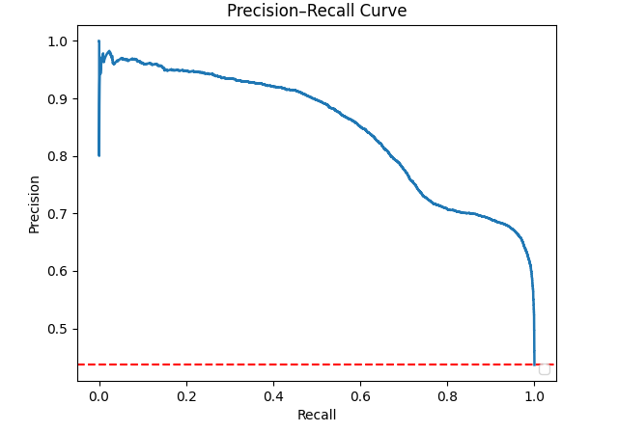
NORMAL VS ABNORMAL ECG
ROC — AUC = 0.89
PRECISION–RECALL CURVE
Prevalence 43.6% (9,514 / 21,799)
Kernel Density Plot

Slide 10
WHAT WE DO NEXT
THE DATASET
A multimodal dataset for coronary microvascular disease biomarker discovery (Li et al., 2025), released on Science Data Bank.
80 female ANOCA patients and 40 age-matched healthy female controls; 97 with complete, analysable data.
12-lead ECG at 500 Hz across rest, stress, and recovery (6 min each) under adenosine.
GROUND TRUTH
CMD confirmed by coronary flow reserve below 2.0 on 13NH3 PET/CT - a label independent of the ECG.
19 CMD(+) and 78 CMD(−) overall.
NEXT STEP
Embedding projection only , no classifier yet. Four groups, crossing symptoms against flow:
ANOCA, CMD(+)
Non-ANOCA, CMD(+)
ANOCA, CMD(−)
Control, CMD(−)
Group sizes to be confirmed from the released labels; the split will be adjusted if a cell is too small.
Li D, Peng X, Hu L, et al. A multimodal dataset for coronary microvascular disease biomarker discovery. Scientific Data 2025;12:990. Data: Science Data Bank.

Slide 11
CAPTUM ATTRIBUTION
In Captum, positive attribution value means an input feature pushes the model's target output higher.
If the resulting score is positive, the feature has a positive correlation with the target class prediction

Slide 12
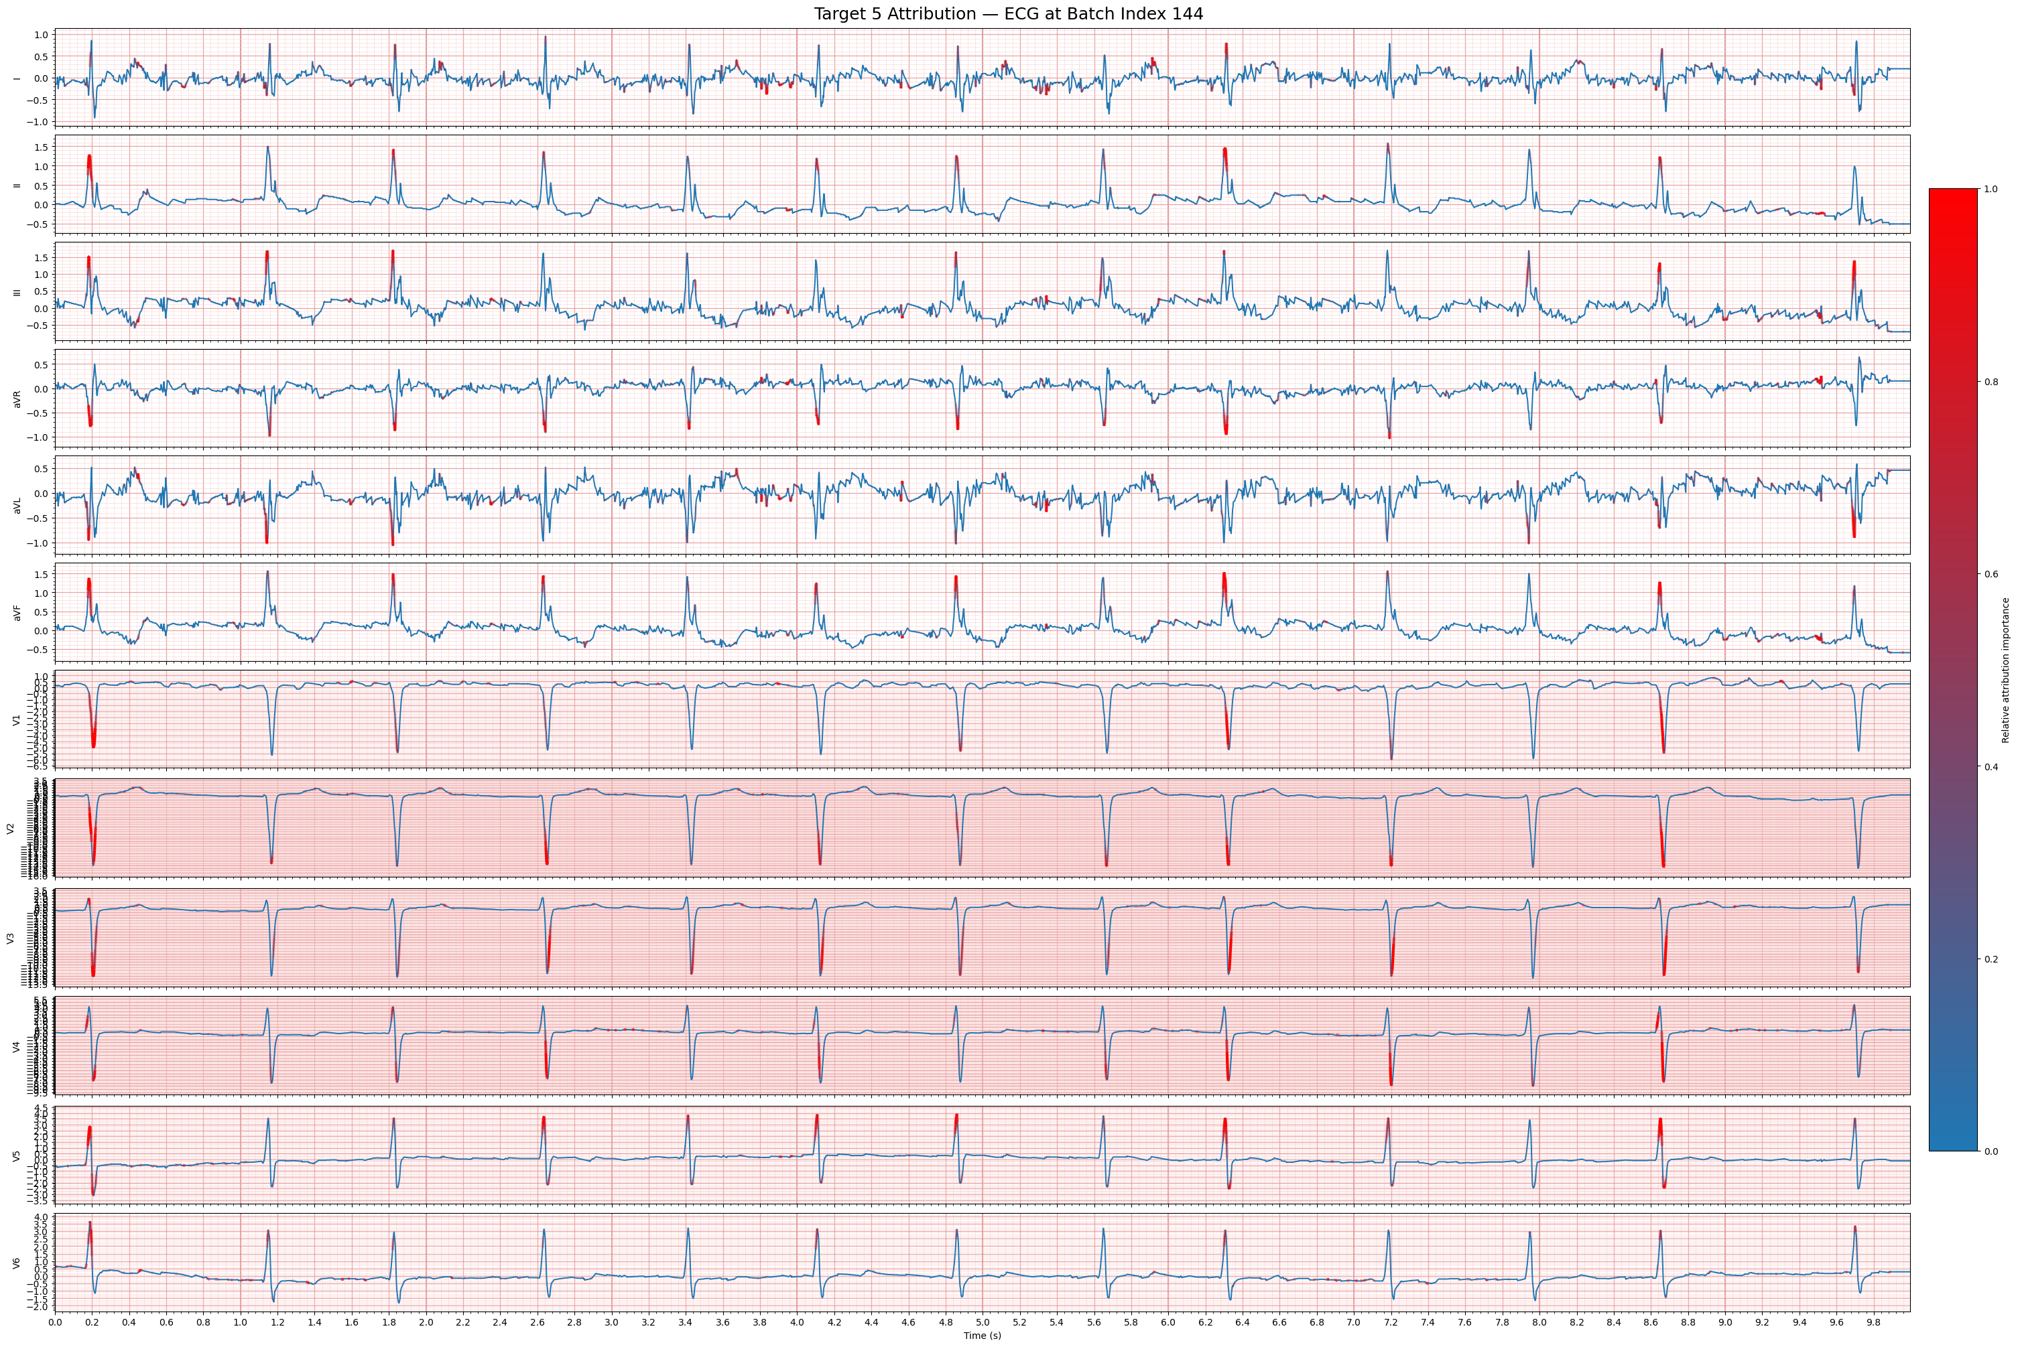
ATRIAL FIBRILLATION ATTRIBUTION
Per Lead Normalization

Slide 13
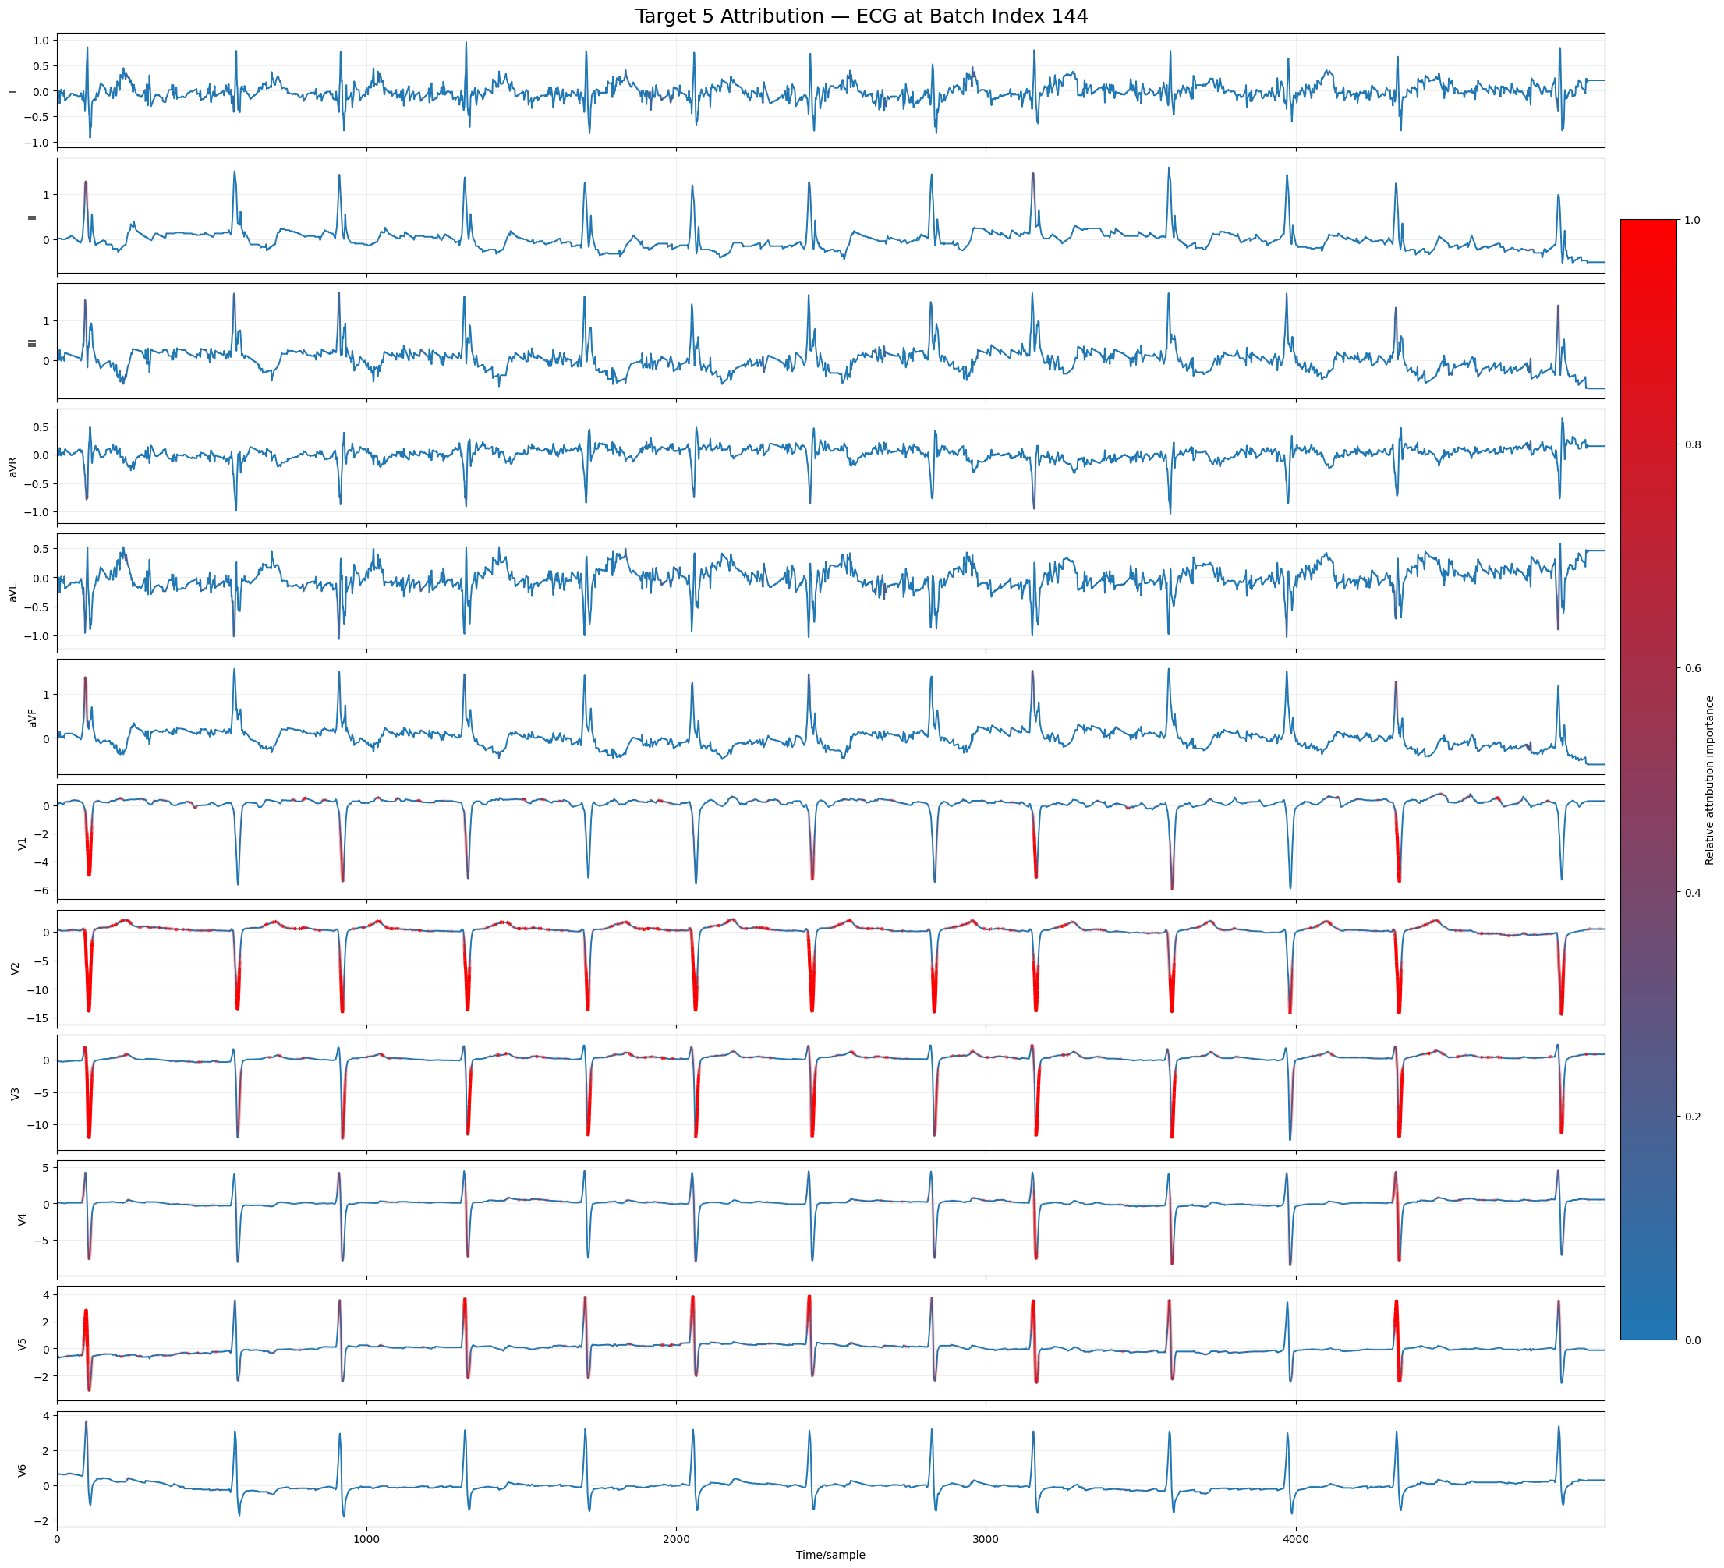
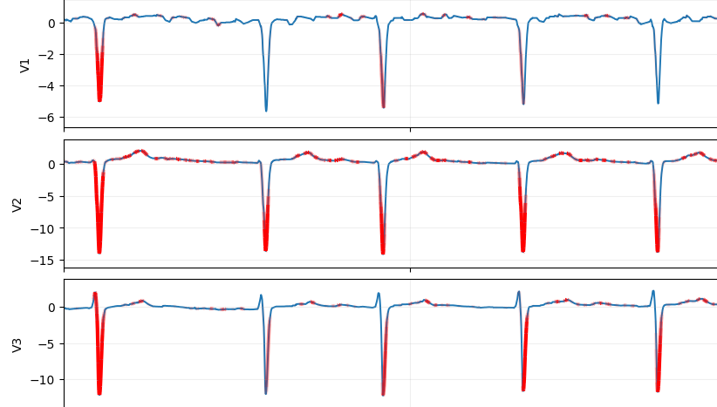
ATRIAL FIBRILLATION EXPLAINABILITY
Global Normalization

Slide 14
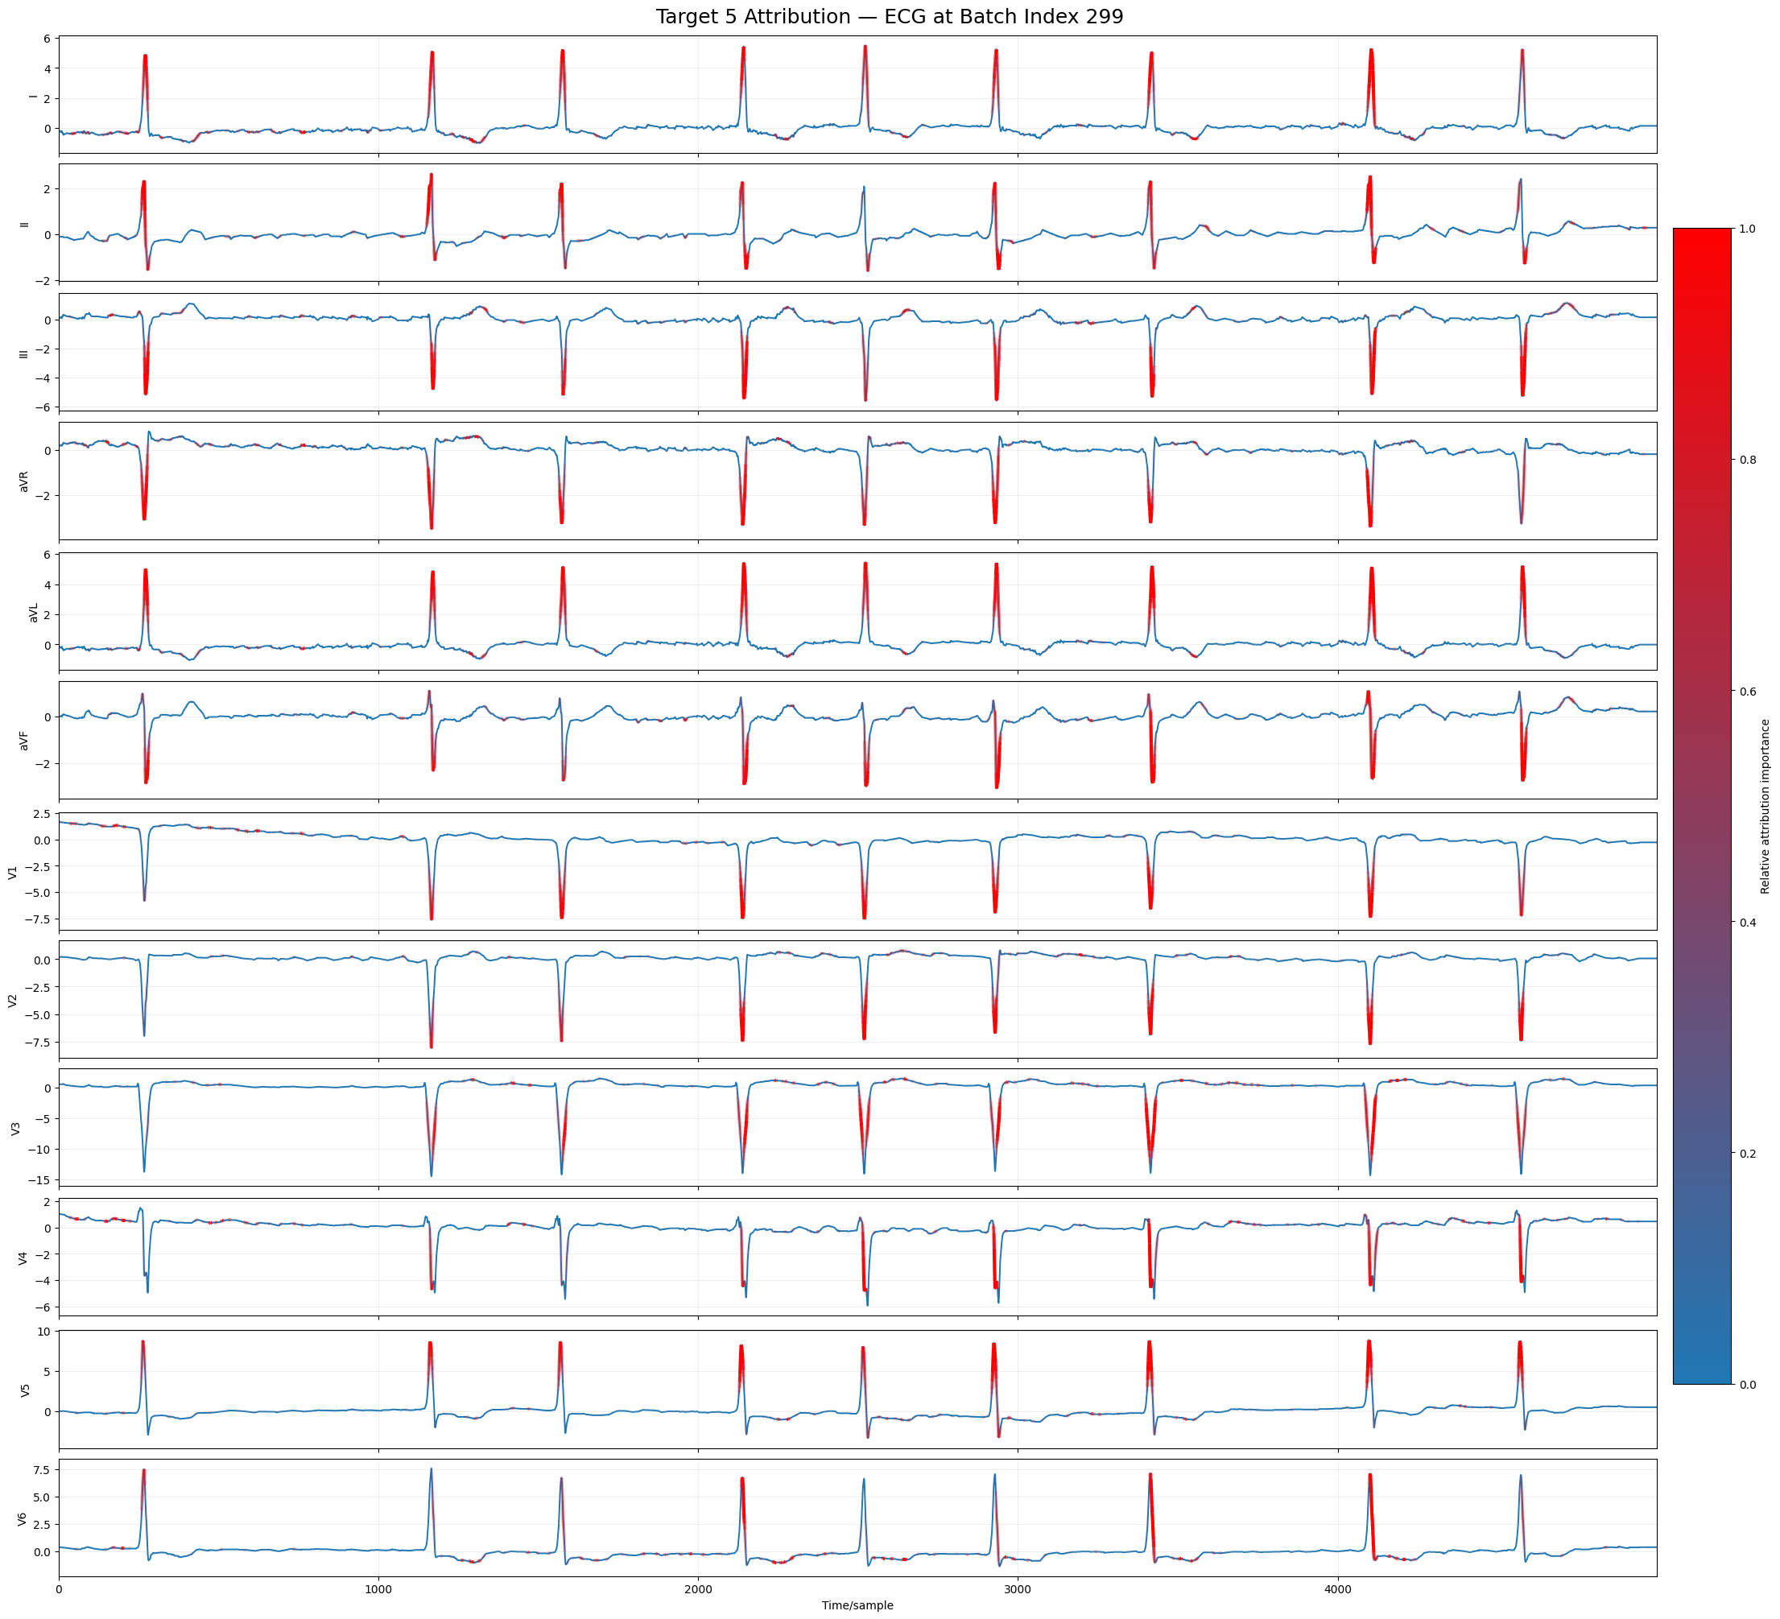
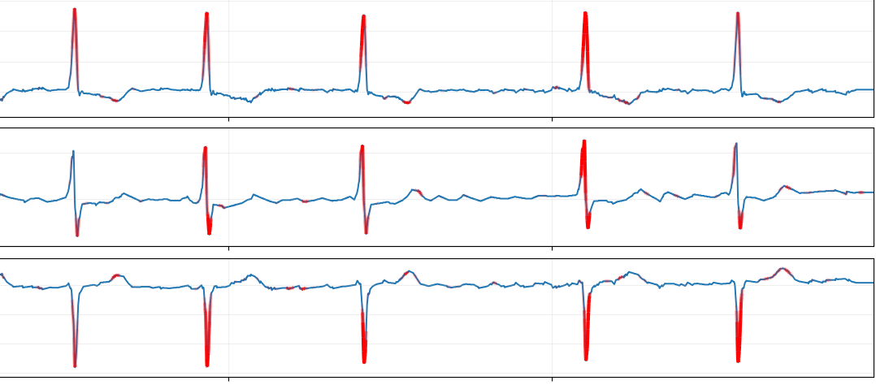
ATRIAL FIBRILLATION EXPLAINABILITY
Per Lead Normalization

Slide 15
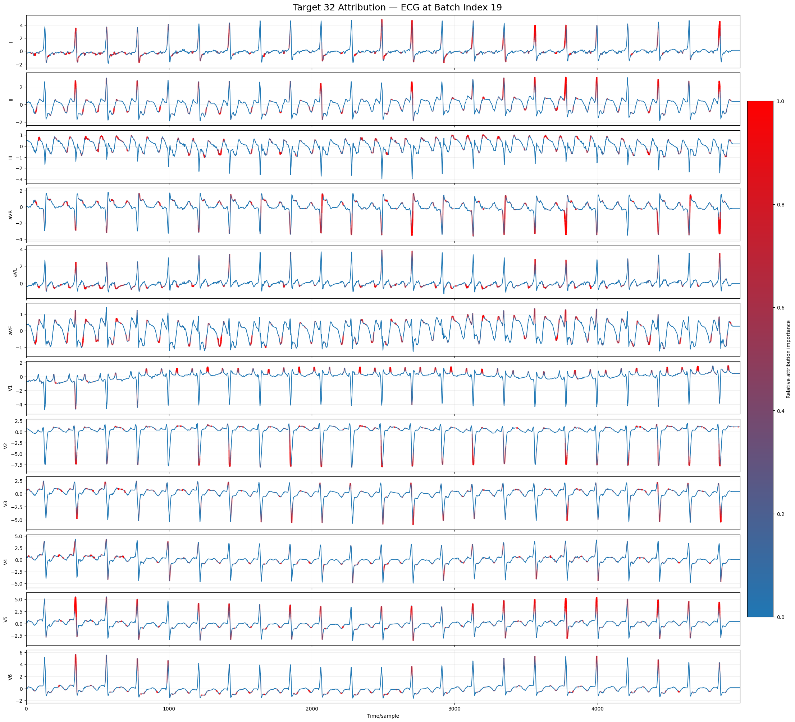
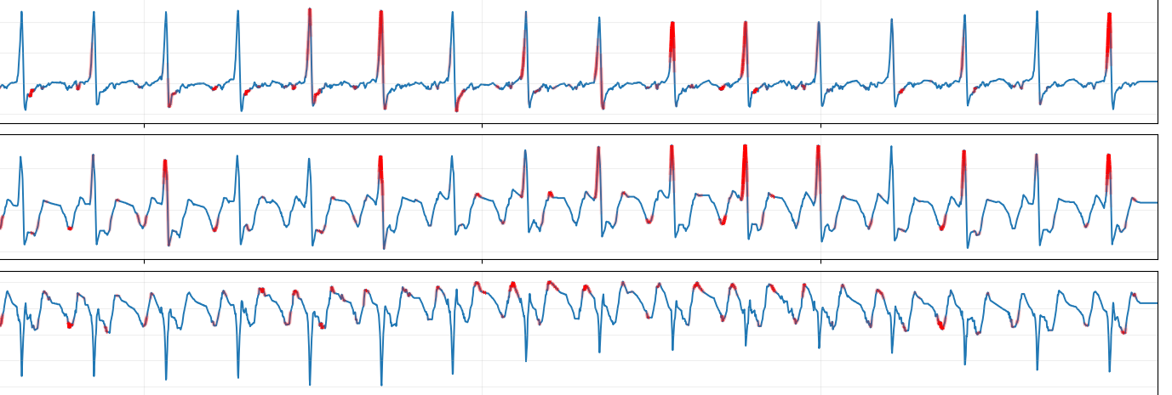
ATRIAL FLUTTER EXPLAINABILITY
Per Lead Normalization

Slide 16
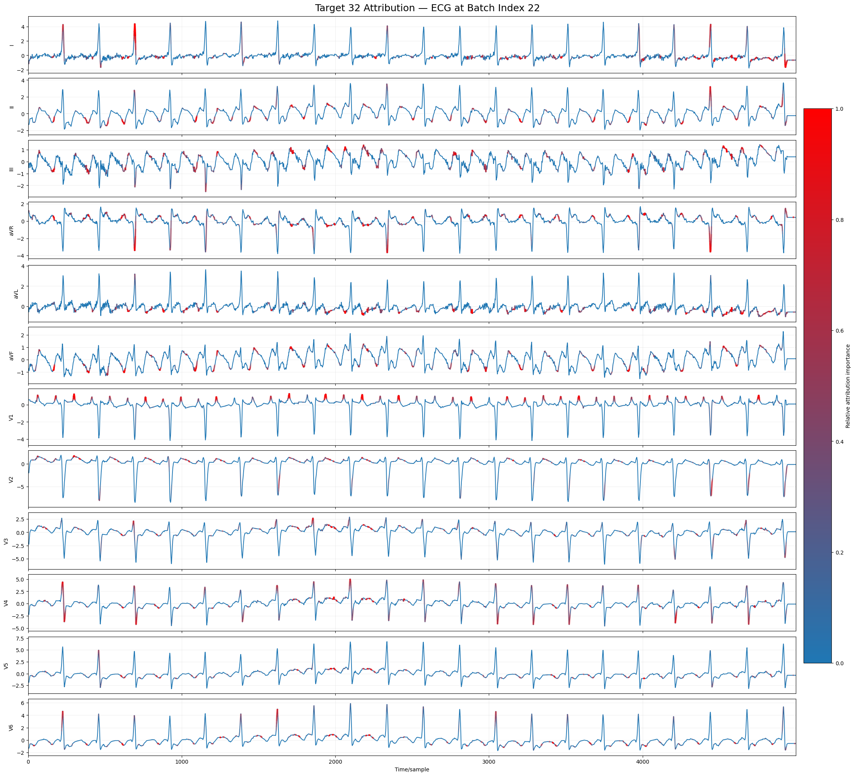
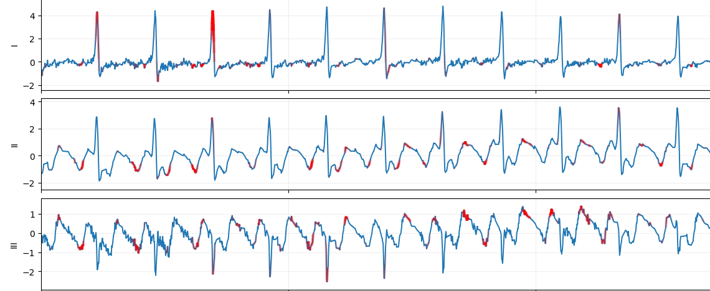
ATRIAL FLUTTER EXPLAINABILITY
Per Lead Normalization

