Slide 1
Large-Scale and Multi-Structured Databases Project Design YuGiOhDeckMaker
Stefano Dugo
Fabiano Pilia
Yuli Tatiana Orozco Amador

Slide 2
Application Highlights
YuGiOh! is a pupular card game with hundreds of thousands of active users in the world.
The application allows an user to create a YuGiOh! deck, giving him access to all the cards in the game, and to share it with the other users.
The user
can build a deck of 40-50 cards, based on the game official ruleset
has to sign up, and he can share the deck(s) he creates with other users
can like and/or save a deck shared by another user
An administrator can add or remove cards

Slide 3
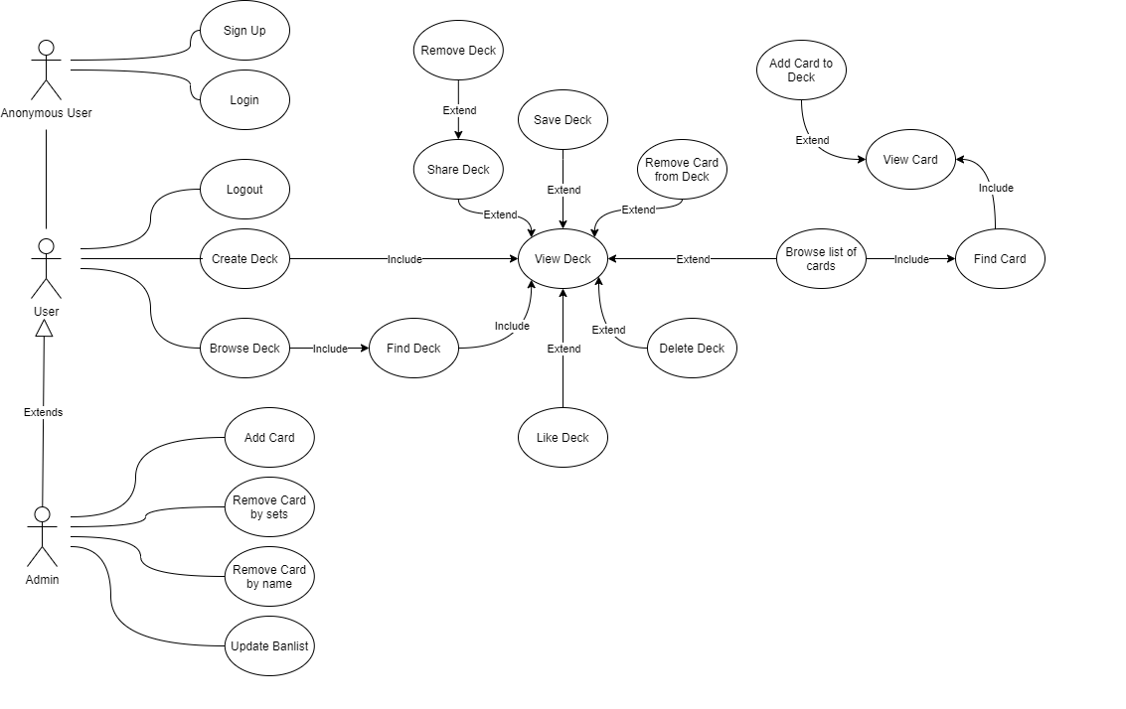
Actors and main supported functionalities

Slide 4
Dataset Description
Source: Github repositories(github.com/KianBennett/Yugioh-Database-Downloaderdata, data extracted with the YuGiOh Api), randomuser.me(https://randomuser.me/), random generated decks (with a Java code)
Description: it contains the cards of the game and the players informations
Volume: 10000+ cards, 150000 users, 100 decks, around 60MB
Variety: json and csv files

Slide 5
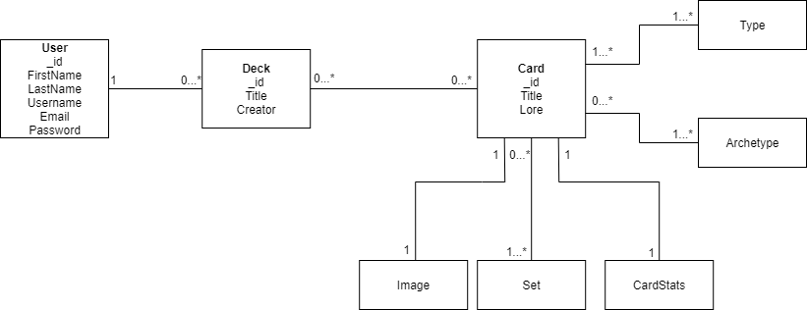
Preliminary UML Class Diagram

Slide 6
Requirements and Entities handled by Document DB
Entities:
Card
Deck
User
Analytics and aggregations:
find x most popular card(s) in saved decks
find card with higher atk statistic/rarest
card for each set
find deck(s) with less number of archetypes
find deck with an average atk statistic
>x (decided by the user)
find deck in which the sum of magic and trap cards is greater than the number of monster cards (or viceversa)
find most popular extra cards for each type in
each deck
Requirements:
create deck
find card by title
find cards by statistics
find cards by set
find deck by card
find deck by user
find deck by title
find user by id/username
replace card in a deck
remove card by title
remove deck by title

Slide 7
Requirements and Entities handled by Graph DB
Entities:
User
Deck
Requirements:
What are the most suggested card in liked deck
What are the most liked deck by your followers
Most followed user who liked your deck
Most liked deck by your followers
View a list of recommended decks
View a list of suggested users based on the like of your decks
Relationships:
User-Deck: like
User-Deck: share
User-User: follow

Slide 8
Software Architecture Preliminary Idea
DBMS
MongoDB
Neo4j
Programming Languages
Java
Frameworks
Maven
randomUser.me
JavaFX

