Slide 1
Software Construction
SCMP 391.00 Special Topic: Software Development
Spring 2017
James Skon

Slide 2
What Is Software Construction?
Problem definition
Requirements development
Construction planning
Software architecture, or high-level design
Detailed design
Coding and debugging
Unit testing
Integration testing
Integration
System testing
Corrective maintenance

Slide 3
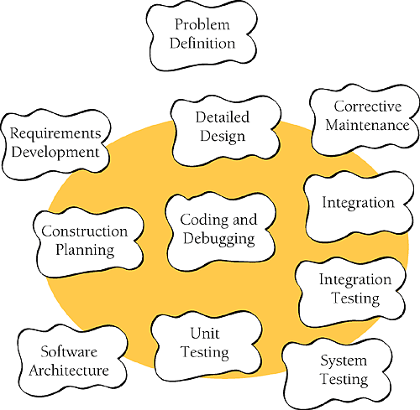
Construction activities

Slide 4
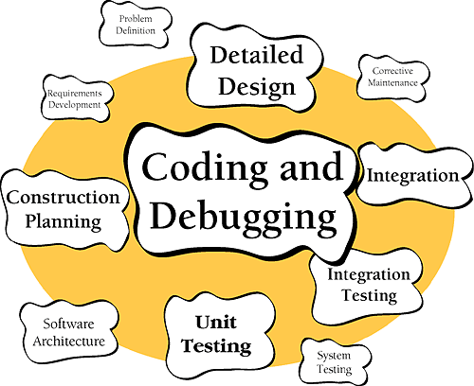
Construction activities
Focus of this course.

Slide 5
Software Construction Tasks
Verifying that the groundwork has been laid so that construction can proceed successfully
Determining how your code will be tested
Designing and writing classes and routines
Creating and naming variables and named constants
Selecting control structures and organizing blocks of statements
Unit testing, integration testing, and debugging your own code

Slide 6
Software Construction Tasks
Reviewing other team members' low-level designs and code and having them review yours
Polishing code by carefully formatting and commenting it
Integrating software components that were created separately
Tuning code to make it faster and use fewer resources

Slide 7
Why Study Software Construction?
Construction is a large part of software development.
  30% - 80% of effort on typical projects!
Central activity in software development
  Programmer productivity varies greatly. (10-20x!)
Source code is often the only accurate description of the software
The one certain activity in Software Development.

Slide 8
Summary
Software construction is the central activity in software development.
The main activities in construction are detailed design, coding, debugging, integration, and developer testing
Other common terms for construction are "coding" and "programming.”
The quality of the construction substantially affects the quality of the software.

