Slide 1

Your DiSC® Management Style
Part I
Module 1
Your Company
123 Main Street
Smithville, MN 54321
612.123.9876
www.yourcompany.com

Slide 2



Successful Managers
Two nametags
Your name
Two characteristics about your favorite manager that were ideal for you

Slide 3
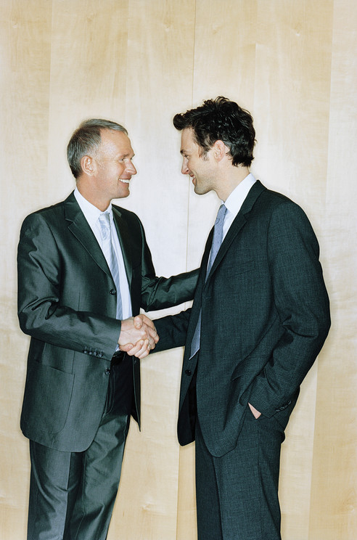

Different Characteristics
Meet someone not from your table
Introduce yourself
Tell about your two characteristics
Switch and repeat

Slide 4
Management Approach
Learn about DiSC® and management
Discover your management style
Explore priorities that drive your style

Slide 5
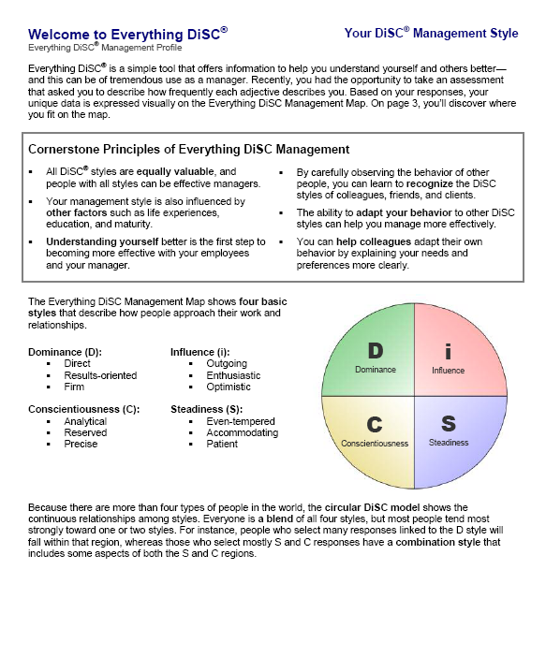
Welcome to Everything DiSC®
Table discussion
What got your attention
Importance of the cornerstone principles

