Slide 1
EVERYTHING DiSC WORKPLACE ®

Slide 2




How You See Yourself
Active
Thoughtful

Slide 3



How You See Yourself
Questioning
Accepting

Slide 4







How You See Yourself
Active
Questioning
Accepting
Thoughtful

Slide 5

Group Discussion
Why did you answer the way you did?
Give examples
Record responses on your flipchart

Slide 6

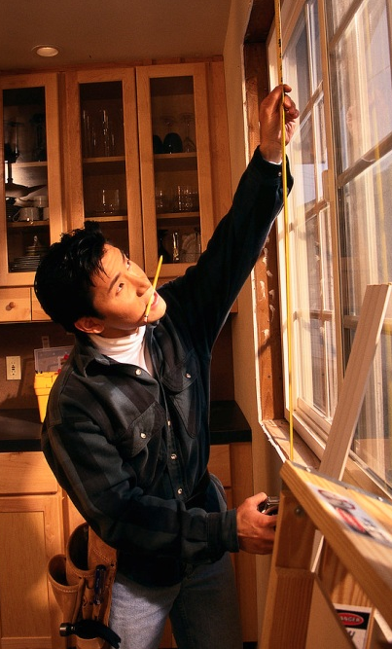

Goals
Learn about DiSC® and the Everything DiSC Workplace® Map
Identify your style and explore the priorities that drive you
Discover similarities and differences among the DiSC styles

Slide 7
Discovering DiSC®
D
Active
i
Questioning
Accepting
C
S
Thoughtful

Slide 8
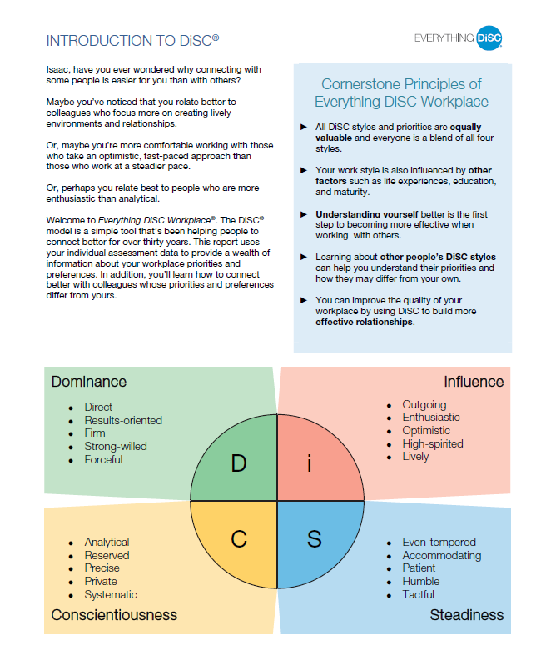
Cornerstone Principles
Everything DiSC Workplace® Profile
Page 2 Introduction to DiSC®

Slide 9
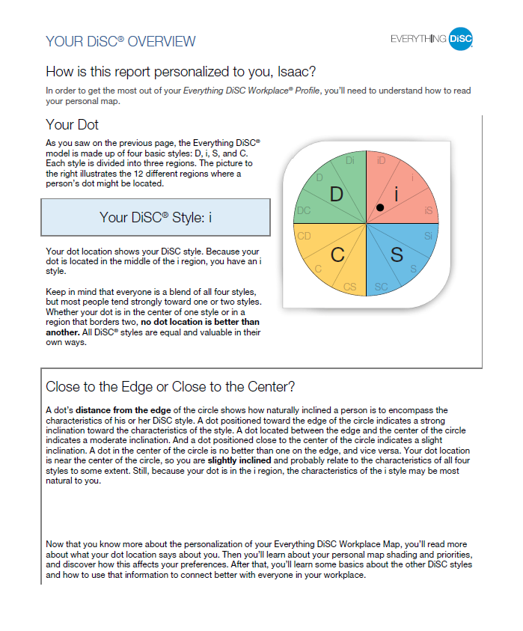
Your DiSC® Style
Profile Page 3

