Slide 1
Work of Leaders: Execution
Module 4

Slide 2


Making the Vision a Reality
execution
Handout 4.2
Think about a leader you’ve had a lot of experience with
Consider that leader’s role when executing on a vision
Make a list of how this person contributes to execution

Slide 3
Manager vs. Leader in Execution
execution
Leadership is a “one-to-many” relationship
Managers guide day-to-day work of execution
Leaders ensure strategies and people are in place to make the vision a reality

Slide 4

Goals
execution
Learn about three drivers of execution
Understand behaviors that characterize each driver and how they may impact effectiveness
Discover how you approach each driver of execution

Slide 5
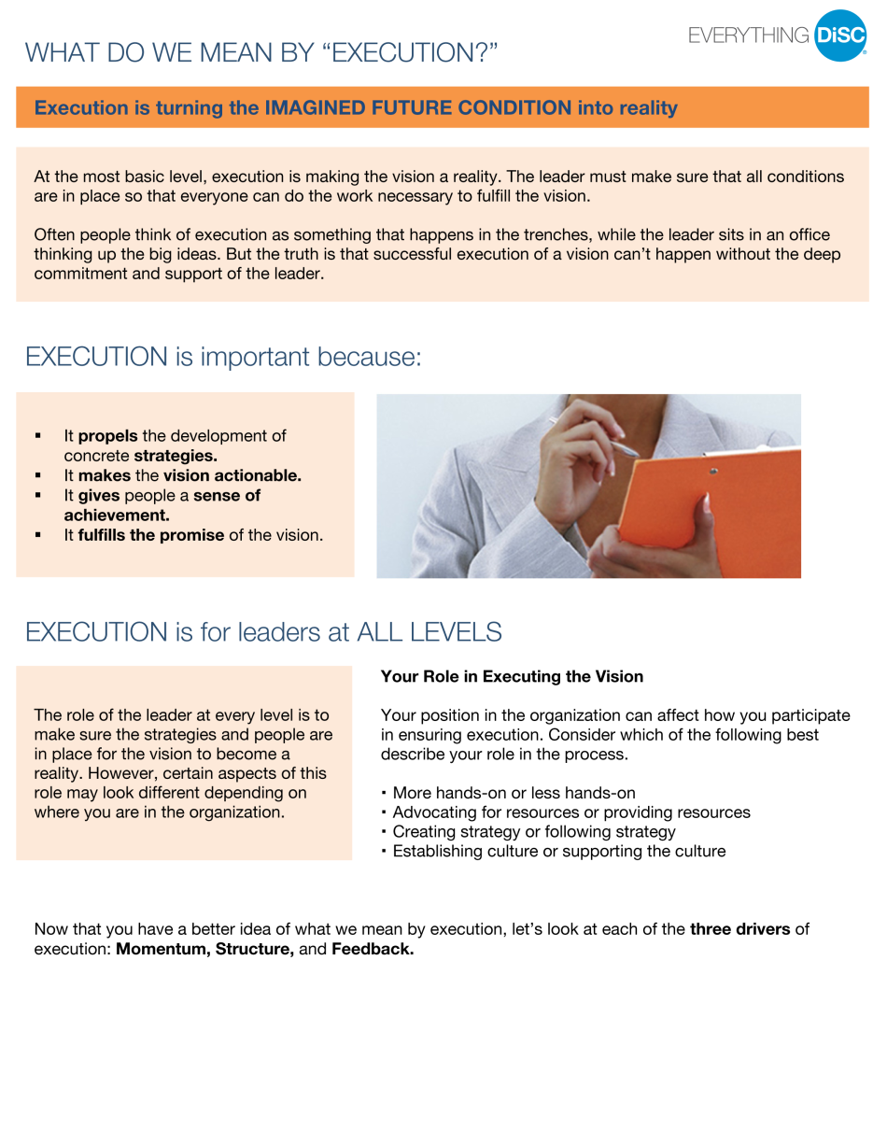
Championing Execution
execution
Profile Page 16
Consider which items on the flipchart align with the profile’s description

Slide 6
Leaders at All Levels
execution
Profile Page 16
Read about the role of leaders at all levels in executing a vision
Talk about the roles relevant to you in your organization

Slide 7
Championing Execution
execution
Three key drivers:
Momentum
Structure
Feedback

