Slide 1
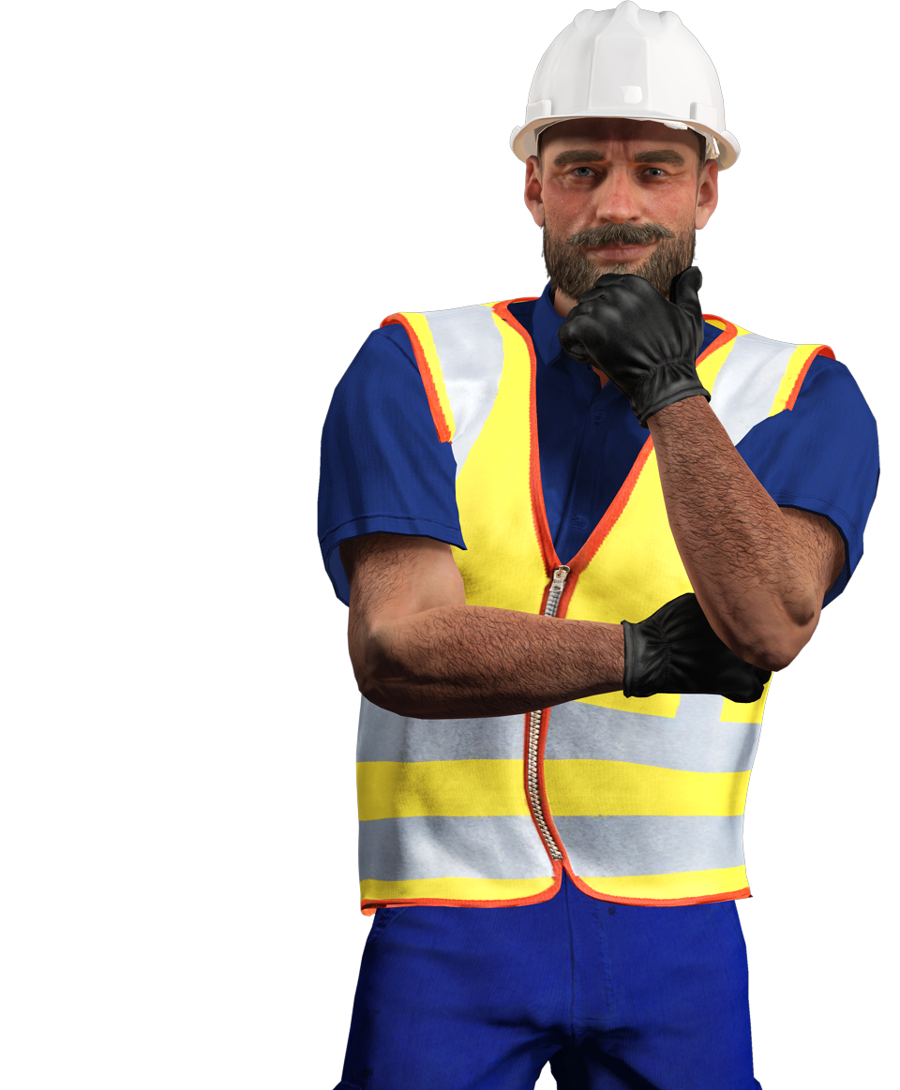

QUESTIONS
POWERED BY

