Slide 1

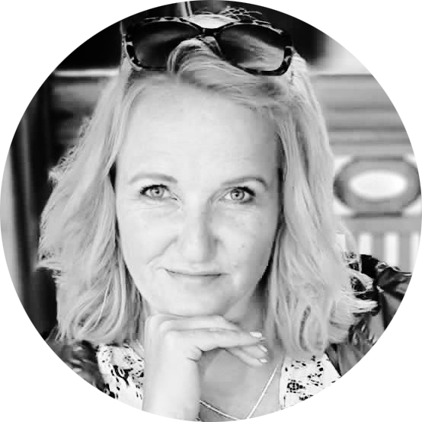

THE BOILER ROOM
Executive Team
Mark Hocker
Lelanie Judeel
Stephan Esterhuizen
CEO Boiler Room
Management Executive: eLearning
Head of Production
Notes:
INTRODUCTION to TBR and Team – Key Stakeholders Mark is the founder of The Boiler Room in South Africa and Australia, a leading 3D animation and Industry 4.0 production company with over 25 years of innovation in eLearning, AR, and VR.
He worked in TV animation and special effects before introducing 3D animation to South Africa and lecturing at major universities.
Meet Lelanie – Our Executive in Learning Innovation Lelanie is a registered Research Psychologist with more than 20 years of local and international experience across education, psychology, and digital learning. She’s passionate about digital pedagogies, instructional design, and how tech can enhance education.
Currently completing her PhD in Educational Psychology and Instructional Design, she’s also a published academic and co-author of three IT textbooks. Lelanie brings both academic depth and real-world insight to every learning solution. Meet Stephan – Head of Production To add info here.
Handing over to meet others ….
OPTION 1: “That’s a little bit about us—now we’d love to hear from you!” “Could we take a moment to meet your team? It would be great to know who’s joining us today, what roles you play, and how you might be involved in the project. It helps us better understand your perspective as we move forward.” OPTION 2
If the group is large, you can guide it like this:
“Maybe we can go around quickly—just your name, role, and anything specific you're hoping to get out of this project or session.”
This keeps it light and time-efficient while still making space for personal introductions and relationship-building.

