Slide 1

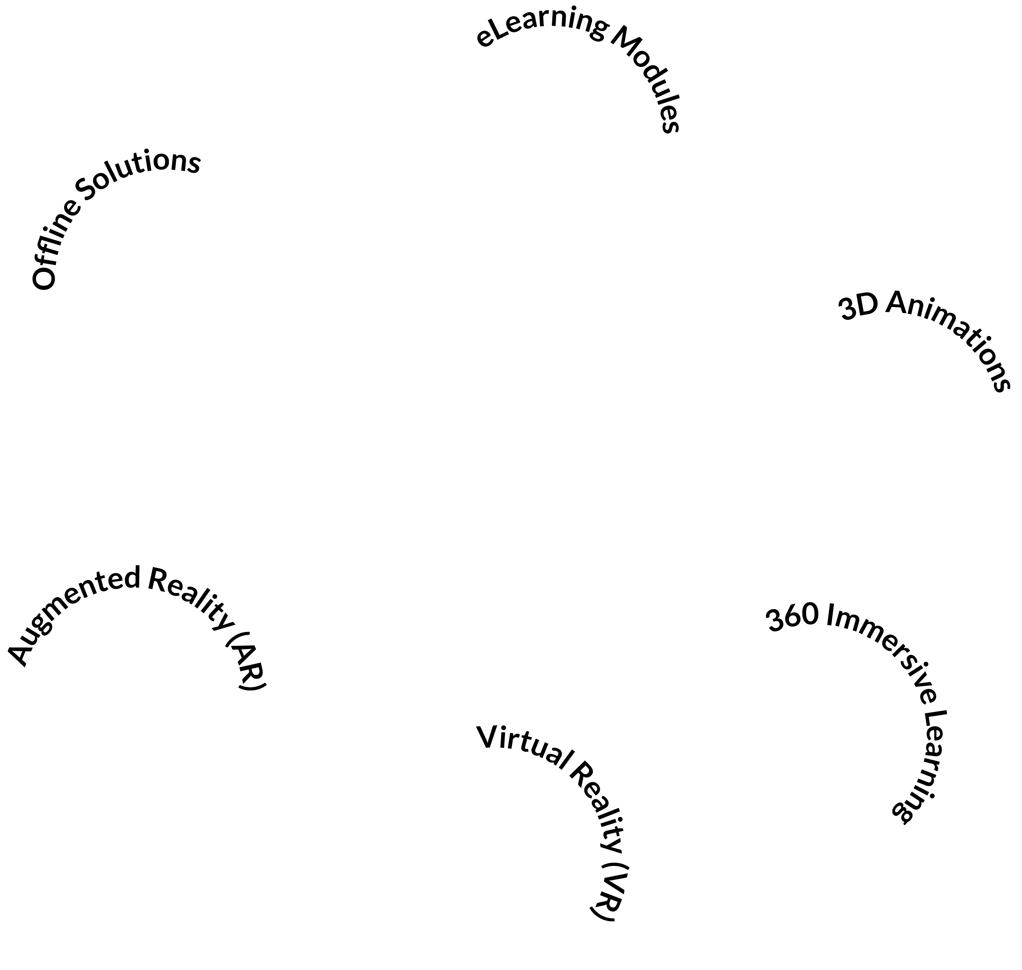







THE BOILER ROOM
Our Turnkey Solutions
Notes:
At The Boiler Room, when we say ‘turnkey solution,’ we’re talking about a complete, ready-to-use learning experience that’s been built specifically for you—but without the heavy lifting on your side. You don’t need to manage the build, figure out tech, or piece things together. We do it all, end to end.
So, what’s included?
Everything—from the initial learning design all the way to the final delivery.
That means we take care of content development, visuals like 2D/3D animations, immersive formats like VR or 360° immersive learning, and even the learning platform integration.
It’s all packaged up, tested, and ready to roll out.
Here’s a quick snapshot of the types of solutions we offer under this model:
eLearning modules,
3D animations,
immersive 360° experiences,
full Virtual Reality or Augmented Reality training,
and even offline solutions like our BoilerBox360 ... which is a portable, plug-and-play Moodle box for areas without internet access.
... click to next slide ...

