Slide 1
Project 3 : 2D Graphene
Ioanna Tampareskou
Nikolaos Zafeiriadis
Basilis Tsioulos
Konstantinos Stergiou

Slide 2
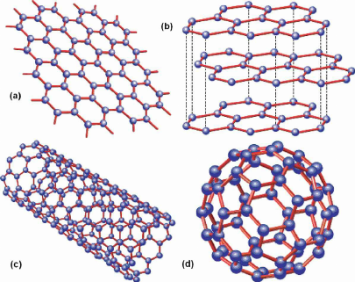
Graphene: Theoretical Background
Single layer of carbon atoms
2D hexagonal lattice structure
Exceptional electrical, thermal and mechanical properties

Slide 3
Graphene Defects Study
Investigating the impact of defects on the structural and electronic properties of graphene.
Why Study Defects?
Defects influence conductivity, mechanical strength, and reactivity.
Critical for graphene applications in electronics, sensors, and energy storage
Types of Defects
Vacancies – Missing atoms disrupt conductivity.
Grain Boundaries – Mismatch in crystal structure affects mechanical properties.
Doping & Oxidation – Alters electronic properties.

Slide 4
Computational Methodology
Software : Quantum Espresso
Parameters:
Pseudopotentials : C, K
Convergence thresholds : E<1e-6 Ry, F<1e-3 Ry/Bohr
Workflow :
→ Preliminary Study
Defining the Primitive Cell
Convergence study to total system energy stabilization
Structural relaxation (vc-relax)
Calculating Band Structure and Density of States
Vacuum optimization
→ Defect study in Graphene
Defining the Supercell
Studying Potassium (K) Doping

Slide 5
Preliminary study - Understanding pristine Graphene
-Defining the Unit Cell
Two carbon atoms
Introducing vacuum gap in the 3rd dimension of graphene.

Slide 6
Convergence Study
Ensure accuracy while optimizing computational cost (-> optimal ecutwfc, k-points, celldm(3))
ecutwfc: Maximum K of the plane waves used to expand the electronic wavefunctions (30 RY)
k-points: Representation of the momentum states of electrons in reciprocal space ( 8 8 1 0 0)
celldm(3): Definition of the geometry of a hexagonal material

Slide 7
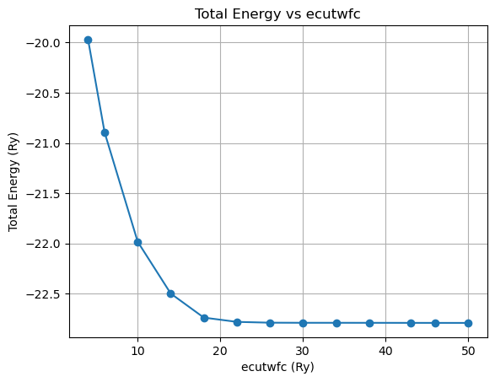

Slide 8
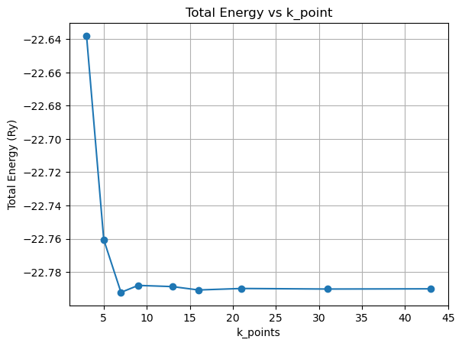

Slide 9
Band Structure
A plot of the allowed energy levels of electrons in a material as a function of their momentum (k) in the Brillouin zone.
Features:
Dirac cones (Valence & conduction bands touch at K-point)
Linear dispersion (massless Dirac fermions high electron mobility)
Defect impact:
Doping (Shifts Fermi level)
Defects (Distort the dirac cone)

Slide 10
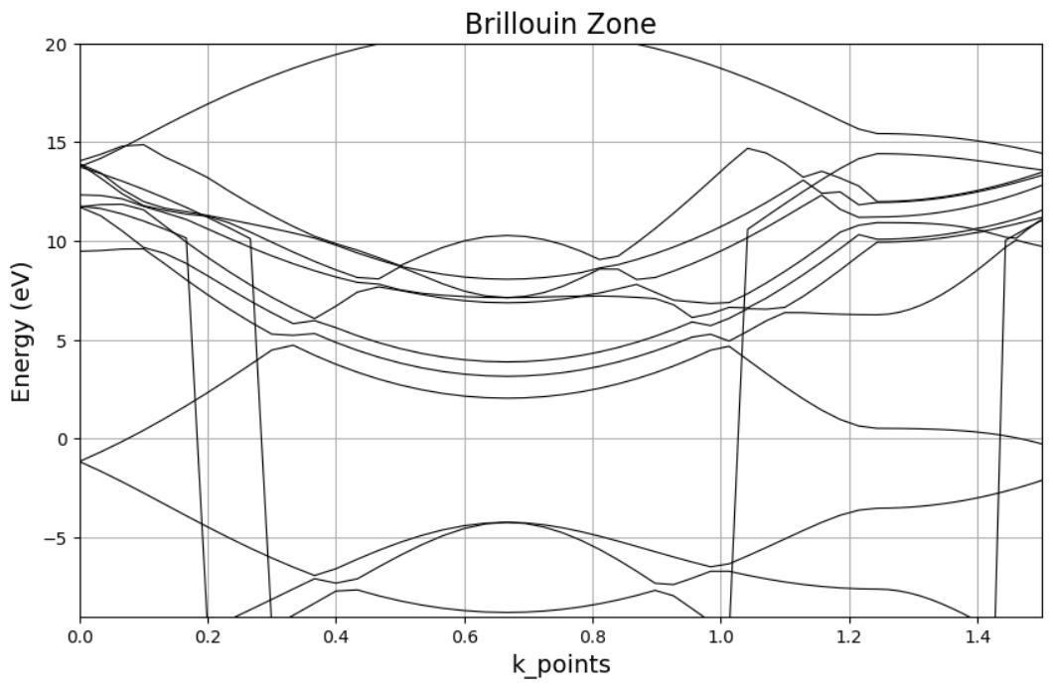

Slide 11
Vacuum Size Optimization
Due to simulation, we require a vacuum layer to prevent artificial interactions.
Too small : Unphysical interactions ( electron tunneling etc.)
Too large : Increased computational cost
Change of celldm(3)
Changes the vacuum thickness in z-direction
Total vacuum = celldm(3) * celldm(1) (celldm(1) : plane-lattice parameter)
Goal
smallest celldm(3) Energy stabilization and hydrostatic pressure ≈ 0

Slide 12
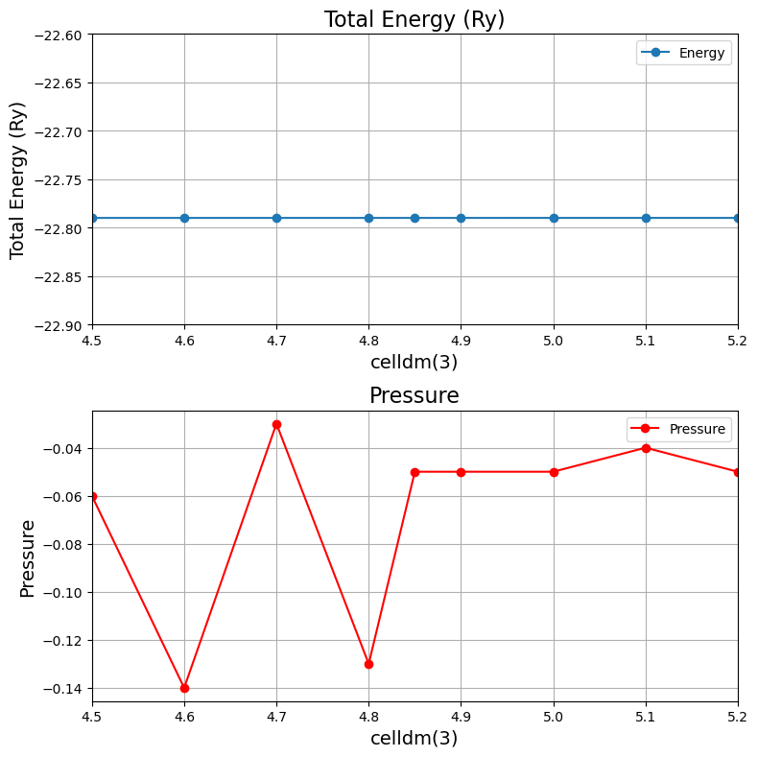

Slide 13
Introduction to Defects
Understanding the impact of defects on graphene: Defects can alter the material's electronic, mechanical, and thermal properties.
The defect analysis involved doping graphene with Potassium (K-doping): Doping graphene with Potassium (K) introduces charge carriers, affecting its conductivity and electronic behavior.

Slide 14
Density of States (DoS)
A plot of the number of electronic states available at each energy level.
Features:
V-shaped DoS (Reflects the linear dispersion)
Zero DoS at the Dirac point
Defect:
Doping (Create finite DoS at fermi level)
Defects (peaks in the DoS near fermi level)

Slide 15
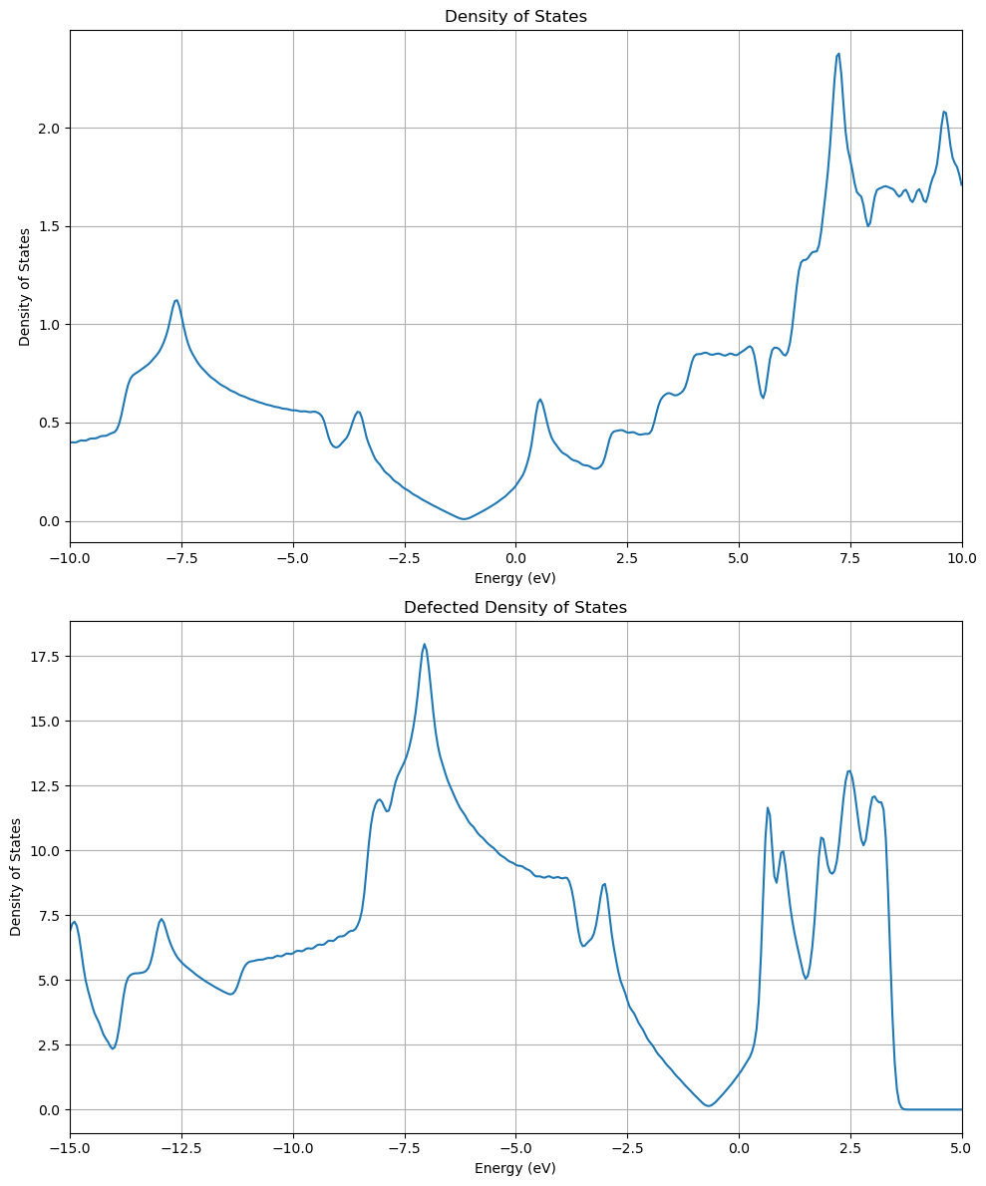

Slide 16
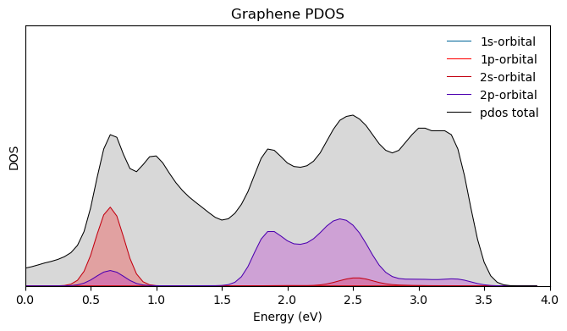

Slide 17
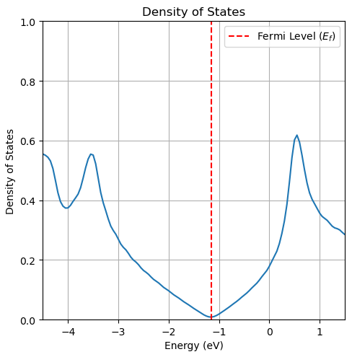
Fermi Level Shift
Not Defected Graphene: Fermi energy is exactly at Dirac Point.
The material is a zero-gap semiconductor.

Slide 18
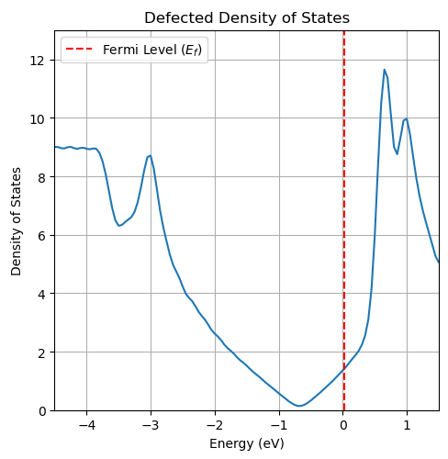
Fermi Level Shift
K-Doped Graphene: Fermi energy is inside the Conduction Band.
The material behaves like a conductor.

Slide 19
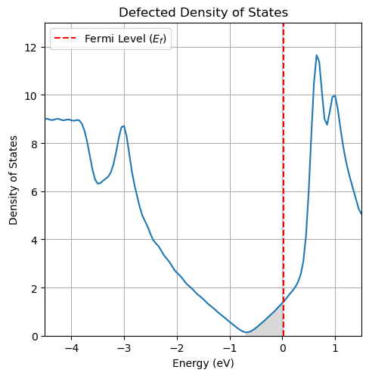
Fermi Level Shift
K-Doped Graphene: Fermi energy is inside the Conduction Band.
The material behaves like a conductor.

Slide 20
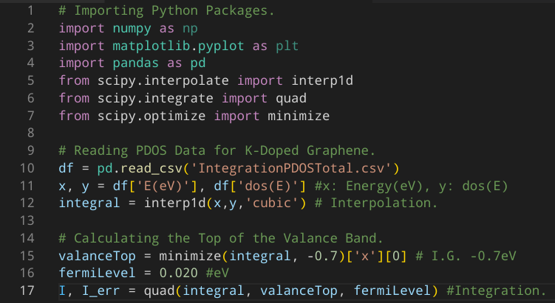
Python Script

Slide 21
Carrier Density
Calculated from the integration, I = 0.4733
So, the charge transfer is quantified, for a 4x4 Supercell of 32 Carbon Atoms + 1 Potassium Atom, as:
0.4733 electrons/supercell
and for the primitive cell (divided with 16):
0.0296 electrons/unit cell

Slide 22
Conclusions
SCF (Self-Consistent Field Calculation)
Graphene: Zero-bandgap, Dirac cone at K-point.
K-Doped Graphene: Electron donation from K shifts Fermi level up (n-type doping).
NSCF (Non-Self-Consistent Field Calculation)
Refines electronic structure for accurate band structure & DOS calculations.
Band Structure
Graphene: Linear bands, Dirac cone at K-point.
DOS (Density of States)
Graphene: Vanishing DOS at Dirac point, linear behavior.
K-Doped Graphene: Extra states near Fermi level, increased carrier density. Also Fermi level shifts up, indicating n-type doping.
PDOS (Projected Density of States)
Graphene: Carbon p-orbitals dominate near Fermi level.
K-Doped Graphene: K s & p orbitals contribute, charge transfer modifies DOS.

Slide 23
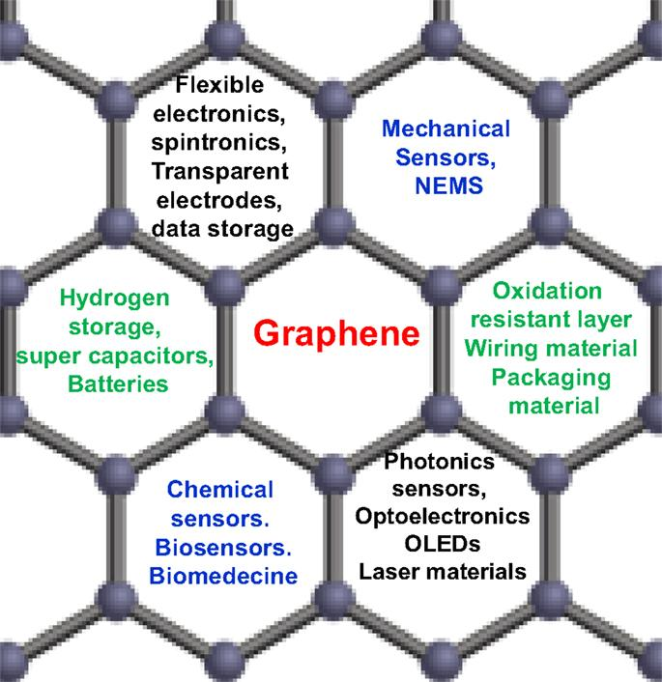

Slide 24
