Slide 1

Person Segmentation
Jacob Brecheisen
Sterling Hayden

Slide 2

Dataset
Switched our dataset from COCO to a different human segmentation dataset due to computational limits
Dataset contains 300 images and their respective segmentation masks

Slide 3
Model Interface
224x224 pixels
RGB
JPG format
Polygon segmentation mask
JSON format
224x224 pixels
Binary
PNG format
Polygon segmentation mask
JSON format

Slide 4
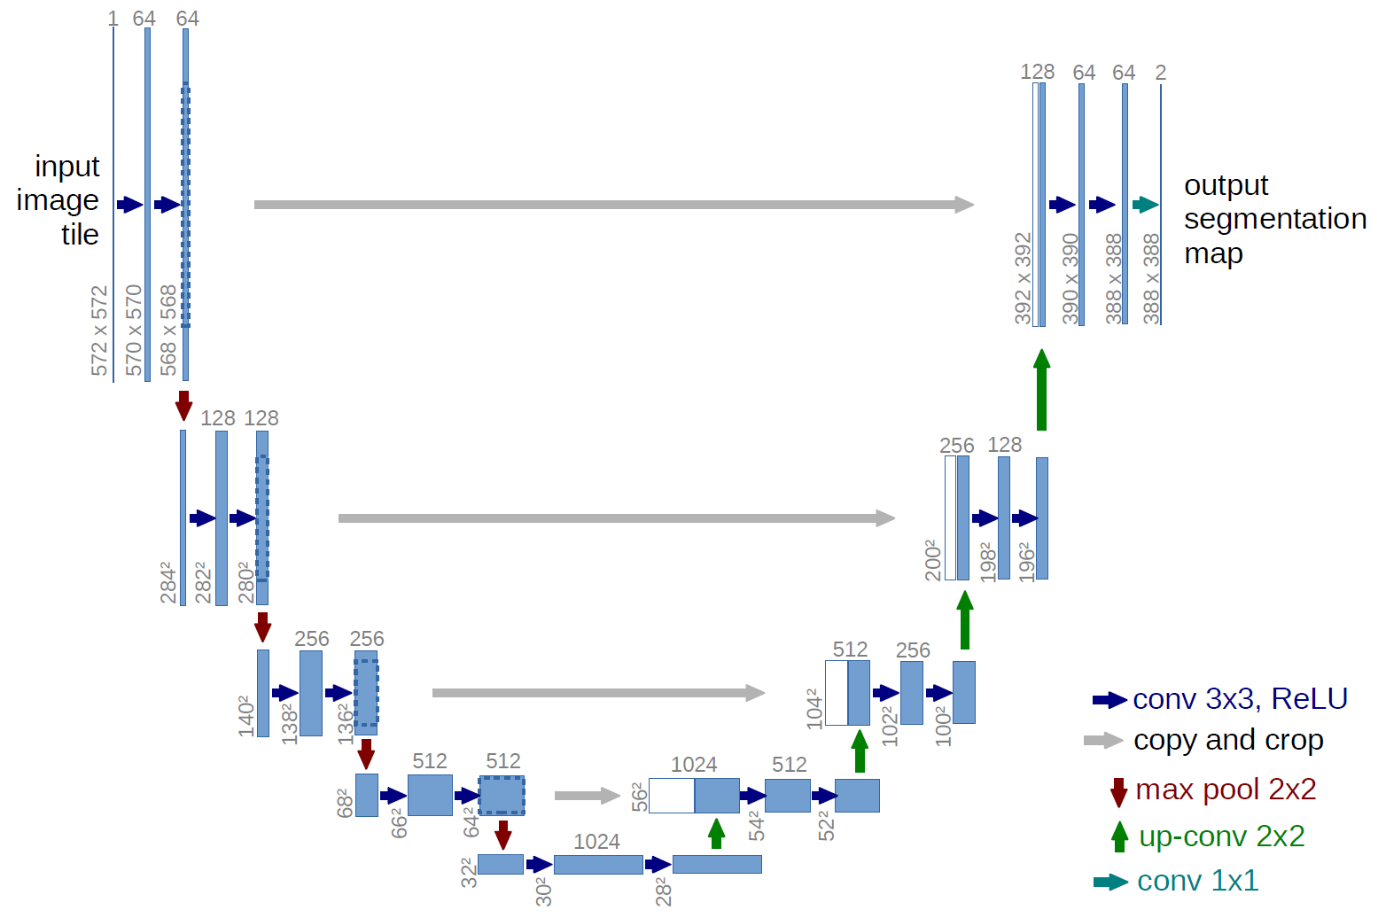
High Level U-Net Architecture
U-Net architecture works in two phases:
Compressing the image to understand the bigger picture and identify the various structures present.
Expanding the image back to its original size, carefully restoring the detail and ensuring that the boundaries of each structure are clearly defined.

Slide 5
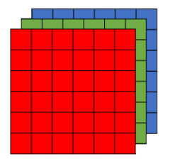
224x224x3 Input Layer
3D tensor of dimensions NxMxC
N: Height of Image
M: Width of Image
C: Channels of image

Slide 6
3x3 Convolution Layer
Used to detect patterns in images
The sliding matrix you see is known as the filter and will be backpropagated
The filter does element-wise multiplication with the pixels, the output is summed and passes through an Activation function
Notes:
Detects patterns such as edges, corners, and/or squares.
These simple and geometric filters come at the beginning of our network
As the model gets deeper the more sophisticated the filters become. Being able to detect eyes, heads, arms, ect.

Slide 7
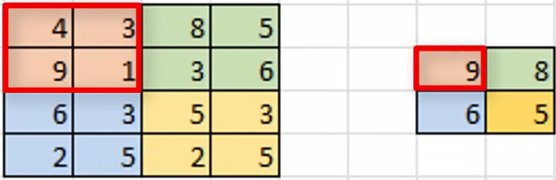
2x2 Max Pooling
Added after individual convolutional layers
Extracts the ‘sharpest’ features of an image
Faster to compute than convolutions
Notes:
the sharpest features are the best lower-level representation of an image.

Slide 8
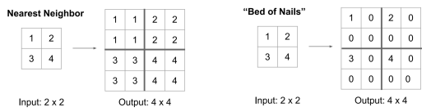
2x2 Upsampling
Upsampling yields an output the same resolution as the input
Upsampling operation is backpropagated
Notes:
The image isn’t the type of Upsampling we are doing but is the easiest to explain.

Slide 9
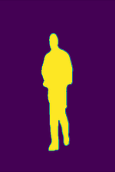
Output Layer
The predicted segmentation mask

Slide 10
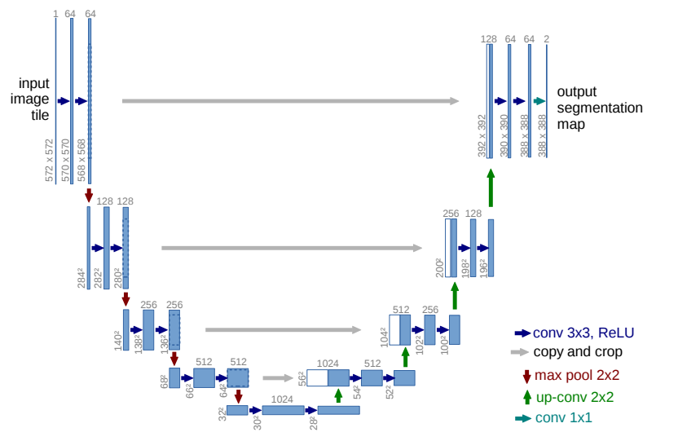
Looking Back

Slide 11
Results
U-Net’s computational complexity and our lack of RAM limited our ability to experiment and iterate effectively
Model converged on a suboptimal solution
Resulted in an accuracy score of ~72%
Model was not able to segment well when tested on a live camera

Slide 12
Competitive Methods
Pretrained U-Net:
Trained using multiple datasets:
Mapillary Vistas Commercial
COCO
Pascal VOC
AISegment Human Matting
Supervisely

Slide 13
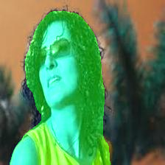
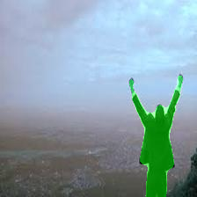
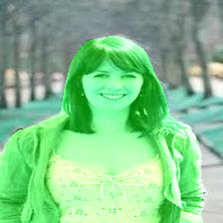
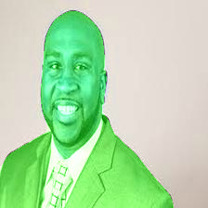
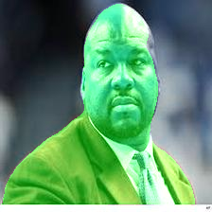
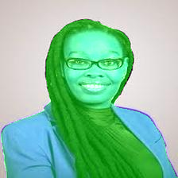
Results

Slide 14
Conclusion
Large amounts of clean data is important
Training times are horrendous for complex models
U-Net can be unstable during the training process

