Slide 1

Big Data Storage
Project group 2
MongoDB in AIRBNB
Group members:
Stefano Sperti 20222246
Vojtech Kolomaznik 20222224
Pedro Bonifácio 20211652

Slide 2
MongoDB in AIRBNB
Flexible schema design.
Scalability.
Real-time analytics.
Geographic queries.

Slide 3
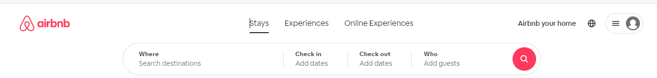
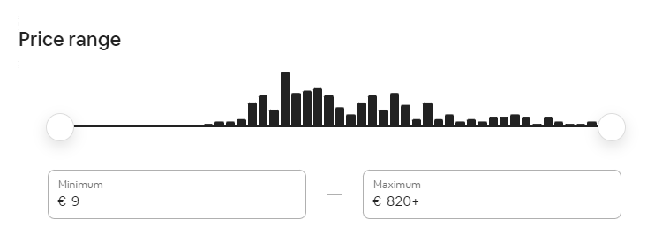
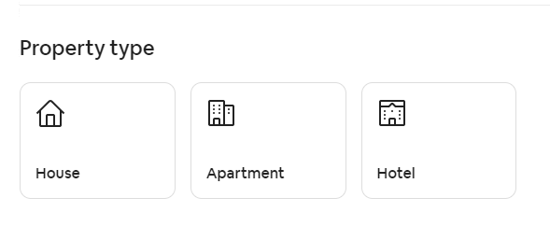
How to collect data

Slide 4

Validation rule

Slide 5
Validation rules
Validation rule 1: "guest_satisfaction_overall" field needs to have a value greater than 0 or less than 100.
Validation rule 2: This rule specifies that the "multi" field is either 0 or 1.
Validation rule 3: "lng" (longitude) value is greater than -180 or less than 180. It ensures that the longitude values fall within a valid range.
Validation rule 4: "lat" (latitude) value is greater than -90 or less than -90. It ensures that the latitude values fall within a valid range.
Validation rule 5: Validate "weekend" is a Boolean.
Validation rule 6: Validate "realSum" is a number greater than zero.
Validation rule 7: Validate "person_capacity" is a number greater than zero.
Validation rule 8: Validate "room_type" is one of the valid options (private room, shared room, or entire home/apartment):

Slide 6
Example of Query

Slide 7
A student
Alex decides to find the perfect Airbnb accommodation for their group of friends (total 4) for some days during the week in Lisbon. In total they have a maximum of 120 euro for each night and they want to find the best solution.

Slide 8
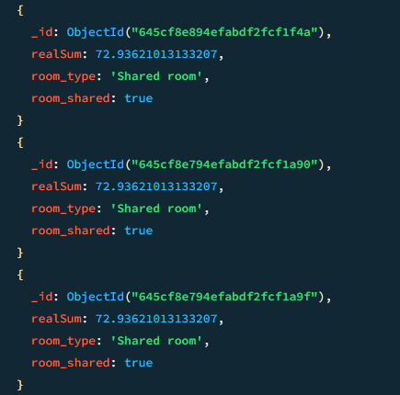
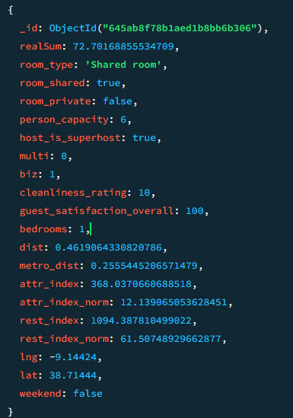
A student
In their quest for affordability, Alex decided to fix the maximum price to 120 and sort the listings by the "smallest price."

Slide 9
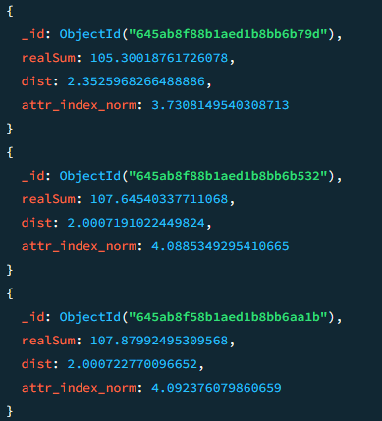
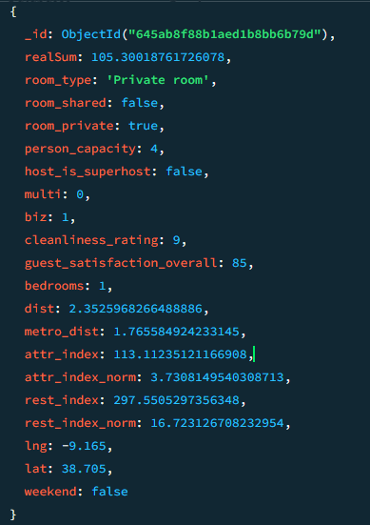
A student
He discovered that many of the rooms had shared rooms and therefore they decided to include the options to only include private rooms. In the meantime, Alex realized that they could reduce their budget to 110 euros they decided to prioritize listings that were nearest to the city center.

Slide 10
Others Query
Story 1: A student
Story 2: A married couple
Story 3: Big group

Slide 11
Indexes

Slide 12
Index on price and number of beds
When looking for an apartment, most people filter by the number of beds and price. This will make the search faster.
db.amsterdam.createIndex({"realSum":1, "person_capacity": 1})
To test this index, we used a query that finds a cheap overnight apartment for two people.
db.amsterdam.find({"realSum": {$gte:80 , $lte: 130}, "person_capacity": 2})

Slide 13
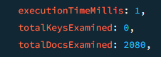
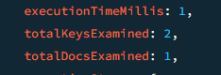
Efficiency
Using .explain("executionStats") we can see that we have to examine 2080 documents without the index. With the index, we only examine 2 keys and one document. We don’t have to unnecessarily search a large amount of documents.
Before the index:
After:

Slide 14
Others Indexes
Index 1: Composite index on price and number of beds
Index 2: Bedrooms
Index 3: guest_satisfaction_overall

Slide 15
Aggregation Query

Slide 16
Aggregation Query Analysis 1: Comparing host and super-host performances in lisbon
Through a comparison of metrics between normal hosts and super hosts, Airbnb gains insights into the influence of superhost status on pricing, cleanliness, and guest satisfaction.
Aggregation query #1:
db.lisbon.aggregate([
{
$match: {
dist: { $lte: 2 }}},
{
$group: {
_id: "$host_is_superhost",
avgRealSum: { $avg: "$realSum" },
avgCleanlinessRating: { $avg: "$cleanliness_rating" },
avgGuestSatisfactionOverall: { $avg: "$guest_satisfaction_overall" },
count: { $sum: 1 }}}])
> Output:
{_id: false,
avgRealSum: 246.17622974790896,
avgCleanlinessRating: 9.239122987324427,
avgGuestSatisfactionOverall: 89.78622816032887,
count: 2919}
{_id: true,
avgRealSum: 278.1615375827691,
avgCleanlinessRating: 9.853629976580796,
avgGuestSatisfactionOverall: 95.96604215456675,
count: 854}

Slide 17
Analysis 1: Comparing Host And Super-host Performances In Lisbon
Aggregation query #2:
db.lisbon.aggregate([
{$match: {
host_is_superhost: true}},
{$sort: { guest_satisfaction_overall: 1 }},
{$limit: 1 },
{$project: {
_id: 0,
realSum: 1,
room_type: 1,
guest_satisfaction_overall: 1,
cleanliness_rating: 1}}])
> Output
{ realSum: 299.953095684803,
room_type: 'Entire home/apt',
cleanliness_rating: 4,
guest_satisfaction_overall: 20}

Slide 18
Analysis 1: Comparing Host And Super-host Performances In Lisbon
The previous query shows us that Airbnb might have to demote some superhosts. Let’s use the following query to see how many low rated superhosts there are in Lisbon:
db.lisbon.countDocuments({
host_is_superhost: true,
$or: [
{ guest_satisfaction_overall: { $lt: 70 } },
{ cleanliness_rating: { $lt: 7 } }
]})
>5

Slide 19
Others Analysis
Analysis 1: Comparing host and super-host performances
Analysis 2 The differences in average price in the city
Analysis 3 Differences in average price between weekends and days of the week
Analysis 4 Price distribution impact on rental characteristics and guest satisfaction
Analysis 5: Average price by room type

Slide 20

Obrigado! Thanks!
Do you have any questions?
Morada: Campus de Campolide, 1070-312 Lisboa, Portugal
Tel: +351 213 828 610 | Fax: +351 213 828 611

