Slide 1
WebInt Project 28/01/2022 Supervisor : Raphael Troncy Students :Stefan weiher , Abdelali Amassaghrou , Harkati Chiraz Rayene

Slide 2

StarLingo

Slide 3
Improve your pronounciation in a foreign language

Slide 4
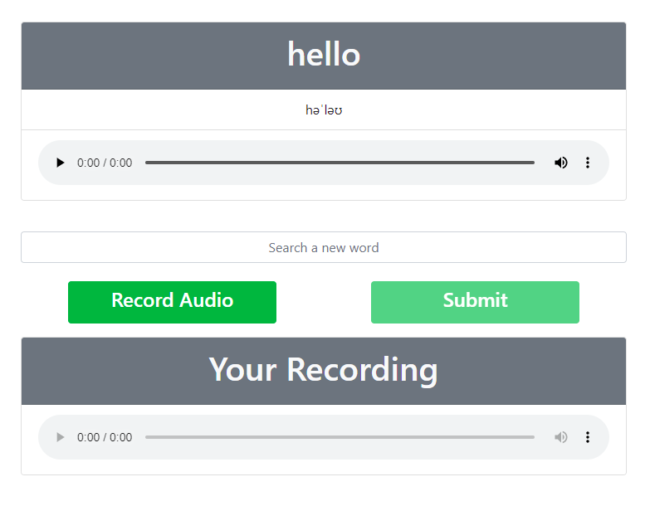
Description
The website proposes words and let’s you listen to the its pronunciation.
Then you make a recording and submit it. If the recording was good, another word gets proposed. (Evaluation not implemented yet). You can also search for the pronunciation of a word to practice

Slide 5
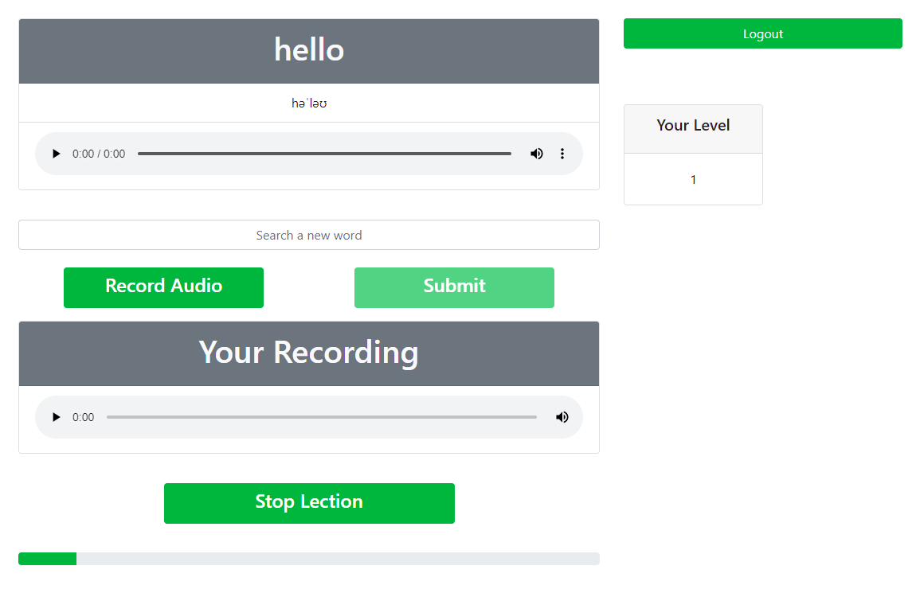
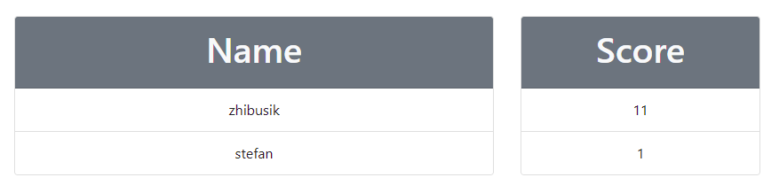
Description
You can login and reach higher levels.
You can also compare yourself with your friends.

Slide 6


Slide 7





What we used?

Slide 8
Sources
API
We use it to fetch our words.
Provides us with 233.645 words including recording and phonetic transcription.
Power the search function
https://dictionaryapi.dev/
3000 most common words in English
We use this list to create the lections and to propose words in general
We do this to avoid niche words
https://www.ef.com/wwen/english-resources/english-vocabulary/top-3000-words/

Slide 9
Contact
Abdelali.amassaghrou@eurecom.fr
Chiraz.Harkati@eurecom.fr
Stefan.weiher@eurecom.fr

