Slide 1
WebInt Project 28/01/2022 Supervisor : Raphael Troncy Students :Stefan weiher , Abdelali amassaghrou , Harkati Chiraz Rayene

Slide 2

StarLingo

Slide 3
Speech To text Website

Slide 4
Description
A website that converts speech to text after user registration . The conversion is done in levels where level I+1 is unlocked after passing the level I .
And at each step , the user has the ability to save his previous records to asses his progress

Slide 5
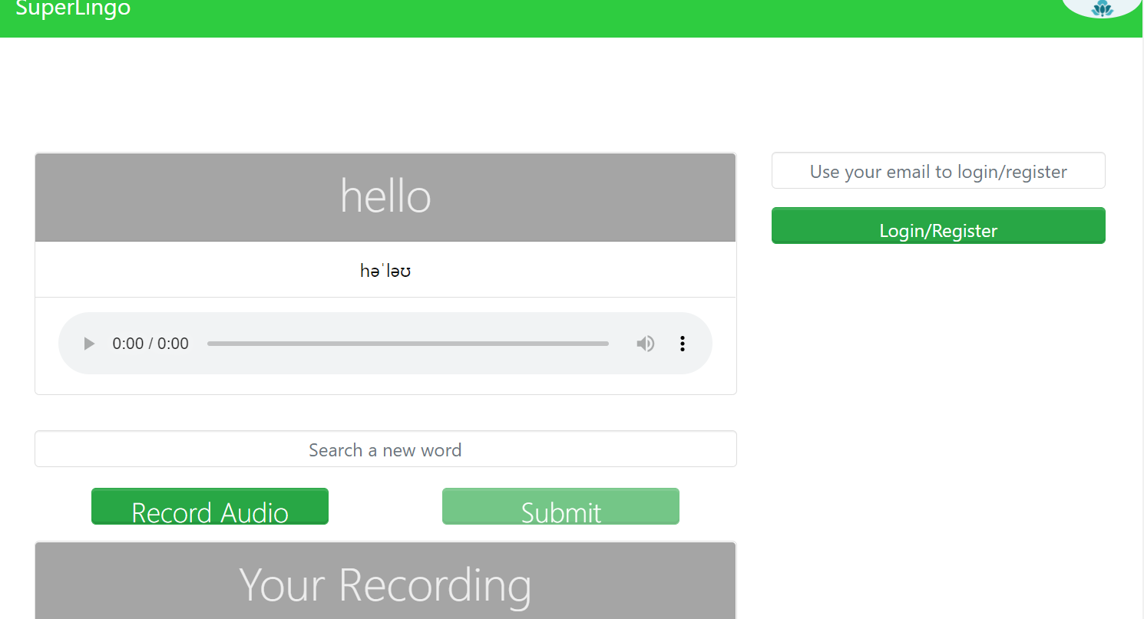
Our Website

Slide 6


Slide 7



What we used?

Slide 8
Two Types of grammar we used
All words Grammar
Here we check if the word is not in important words Grammar
Size : 233645 words
Important words Grammar
We check here first since its size is too much small .
Size: 3000 words

Slide 9
Contact
Abdelali.amassaghrou@eurecom.fr
Chiraz.Harkati@eurecom.fr
Stefan.weiher@eurecom.fr

