Slide 1
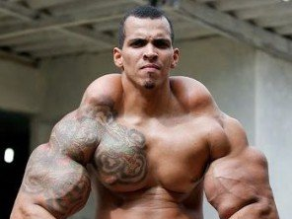
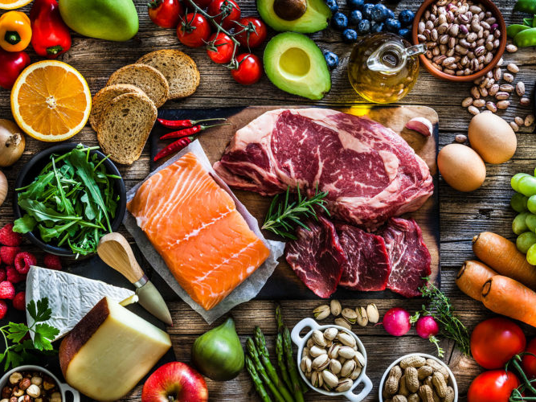
Overview
Organic Food
Facts
Examples
Rules
Keeping Fit
Facts
Examples
Lifestyle

Slide 2
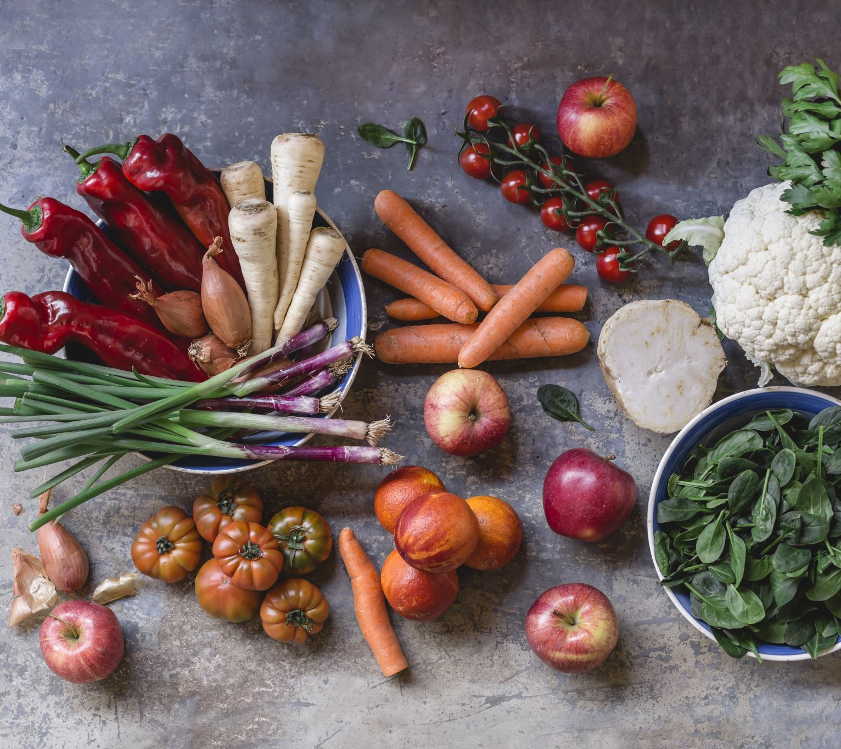
Organic Food
Stevan Vlajic

Slide 3
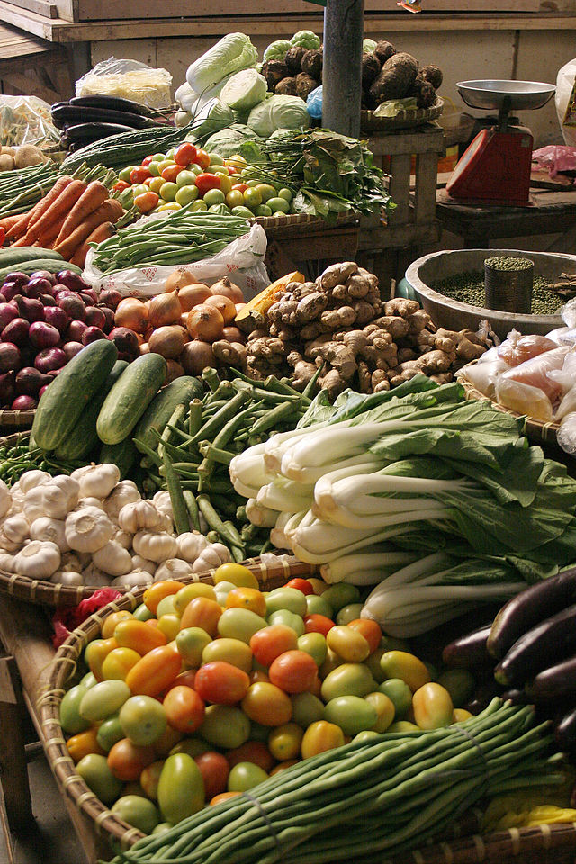
ORGANIC FOOD
Food which is following special guidelines
U.S. organic foodproduction began in the 90‘s
Every vegetable and meat
Unmodified plants
Less toxins
Special rules for organic food in the EU
Respecting the nature
Establishing sustainable management systems

Slide 4

Keeping Fit
Feichtmair Tobias

Slide 5
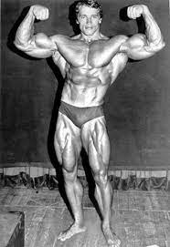
KEEPING FIT
Regular workouts
Prioritize sleep
Stay hydrated
Follow a healthy diet
Be consistant
Find a sport you are passionate about
Stretch

