Slide 1
Lingkod: "The Analysis of Exam Performance by Students"
SDG 4 – Quality Education
Adda, Yasmin
Bajeta, Nicole
Navarro, Steven John
Pesigan, Jean Nessa
Rancap, Jane Mar

Slide 2
Table of Contents
01
02
03
04
Introduction
Statement of The Problem
Performance Of The Class In Each Subject
The effect of parent level of education on the student performance
Relationship Between Gender And Student Performance in Exam
05

Slide 3
01
INTRODUCTION

Slide 4
02 STATEMENT OF THE PROBLEM

Slide 5
(“Performance of the Class in each Subject”)
03

Slide 6
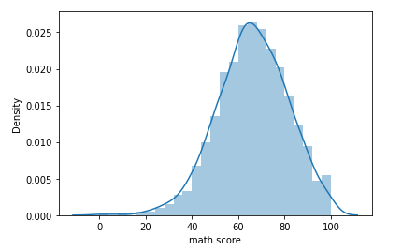
sns.distplot(data[‘math score’])
How many students passed in Math?
Passed 960
Failed 40

Slide 7
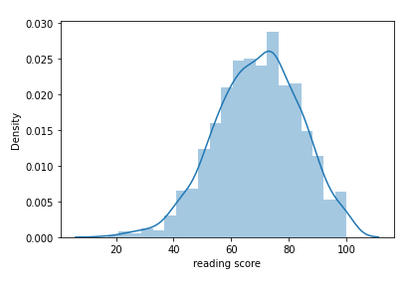
sns.distplot(data['reading score’])
How many students passed in reading?
Passed 974
Failed 26

Slide 8
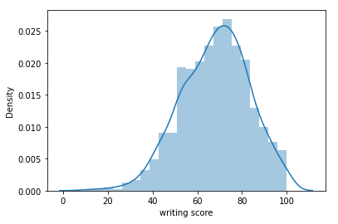
sns.distplot(data['writing score’])
How many students passed in writing?
Passed 968
Failed 32

Slide 9
(“The effect of parent level of education on the student performance”)
04

Slide 10
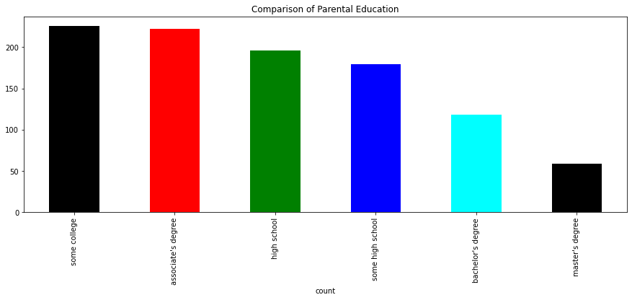
Comparison
45K

Slide 11
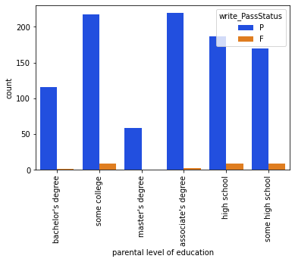
Let's check at the write performance range by degree.

Slide 12
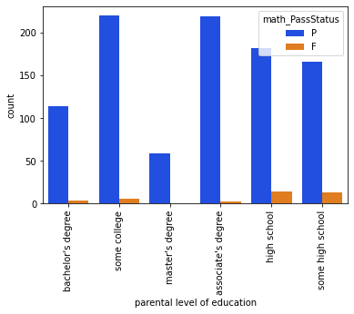
Let's check at the math performance range by class.

Slide 13
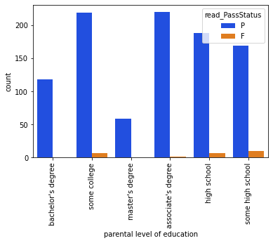
Let's check at the read performance range by class.

Slide 14
(“Relationship Between Gender And Student Performance in Exam”)

Slide 15
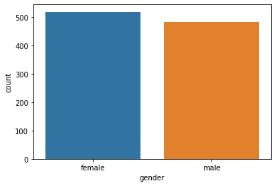
05
sns.countplot(data['gender'])
Identifying the count of gender

Slide 16
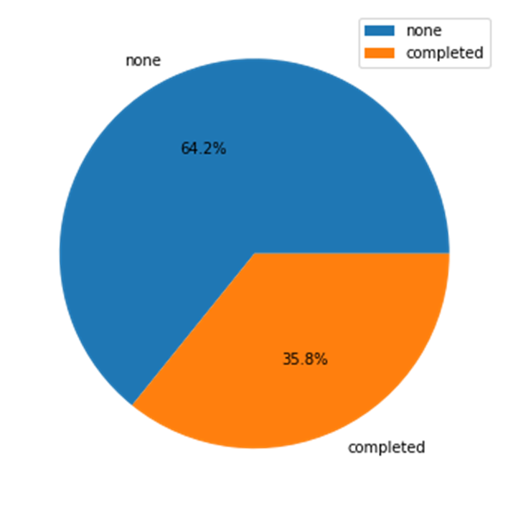
How many of the students take preparatory classes

Slide 17
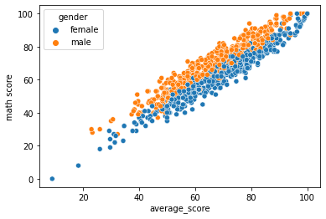
Student performance in subjects based on gender
Math perfomance

Slide 18
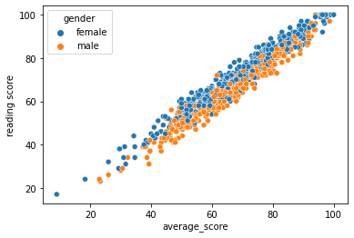
Reading performance

Slide 19
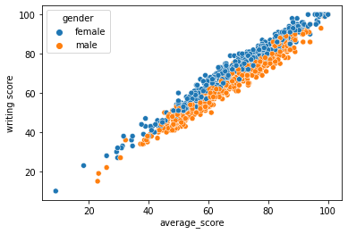
Writing Performance

Slide 20

THANK YOU !!

