Slide 1
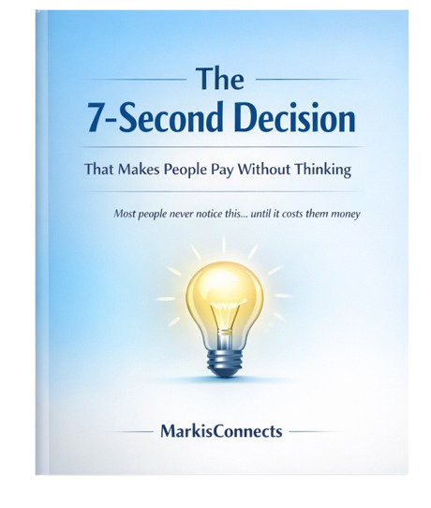

Slide 2
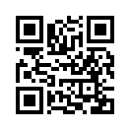
“Ever wondered why you sometimes click ‘Buy’ without thinking?”
There’s a tiny trick your brain does every day, without you realizing it.
It’s so subtle that even experts in marketing and psychology rarely notice it. Yet it’s everywhere even in ads, in apps, even when you buy data online.
This e-book will show you exactly what it is and why it works on you more than you think.

Slide 3
“The 7 - Second Decision”
Here’s the secret:
Your brain is wired to avoid decision fatigue.
When an offer is small, simple, and quick, your mind says:
“It’s cheap, why not?”
THAT’S WHY PEOPLE CLICK, PAY, OR DOWNLOAD ALMOST INSTANTLY. THEY ARE DRIVEN BY:
Curiosity
Low risk (it’s cheap)
FOMO (“I might miss this”)
Even professionals fall for this every day.
It’s not about the product, it’s about the moment.

Slide 4
“Now, here’s what you can do”
Whenever you see something
Small
Cheap
Intriguing
Just notice your brain’s reaction. That’s the 7 - Second Decision in action.
And if you liked this insight, there’s more where it came from.
Just pay GHS 1.00 and get instant access to more micro-eBooks that reveal hidden truths about:
Online behavior
Psychology, and
Small hacks that influence everyday decisions.

Slide 5
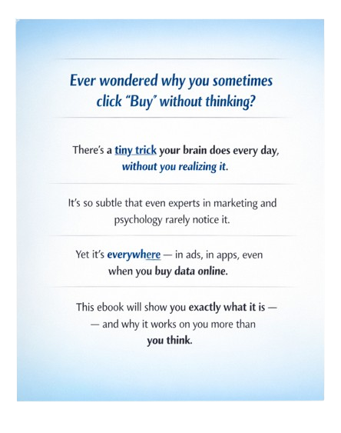
Visit www.markisconnects.com For more Micro eBooks Today

