Slide 1
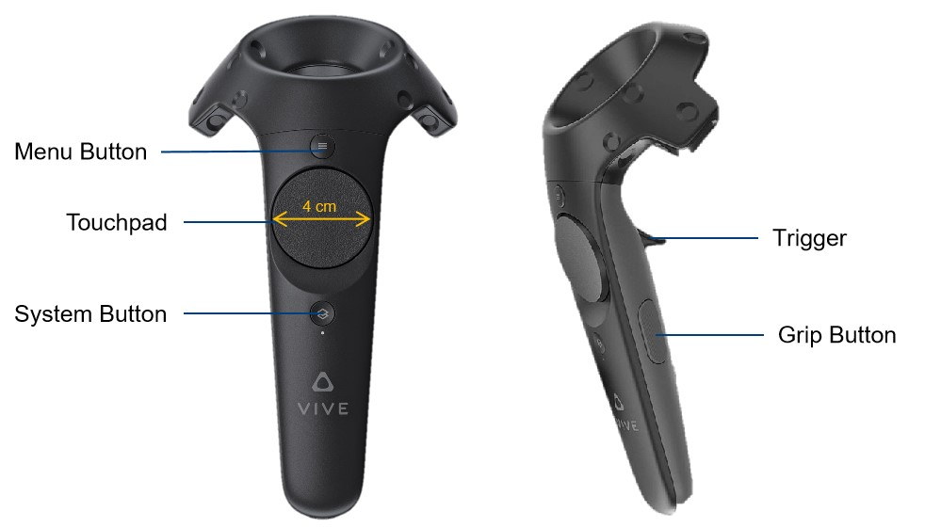
(Backspace)
(Word Correction/
Caret Moving)
(Customize)

