Slide 1

MSU BOOT CAMP Project 2 Data Visualization: Auto Insurance
Steve Freeland
December 23, 2020

Slide 2
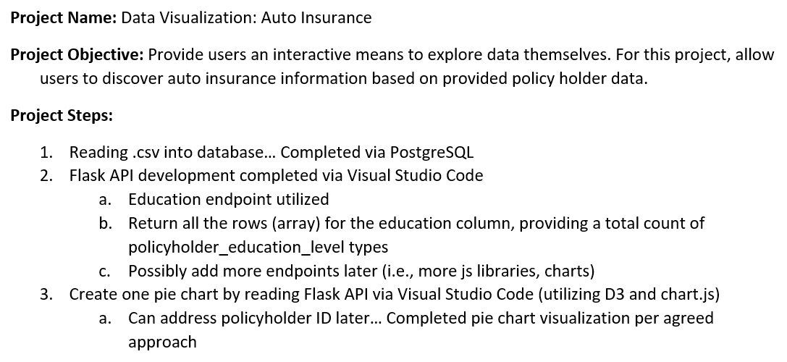

Slide 3
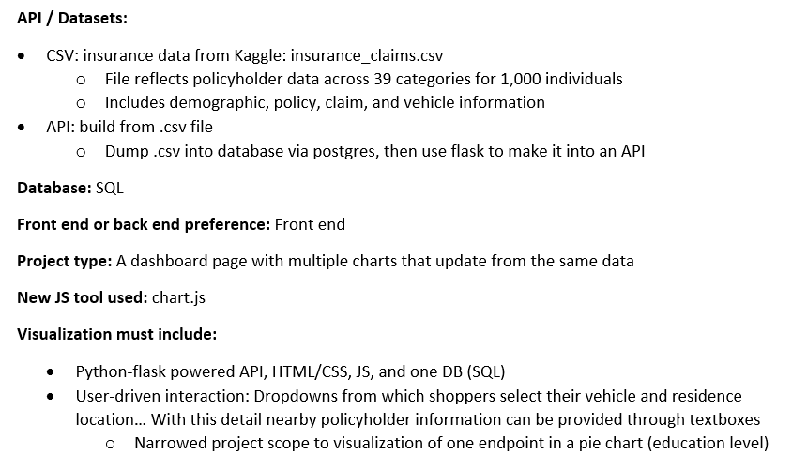

Slide 4


Slide 5
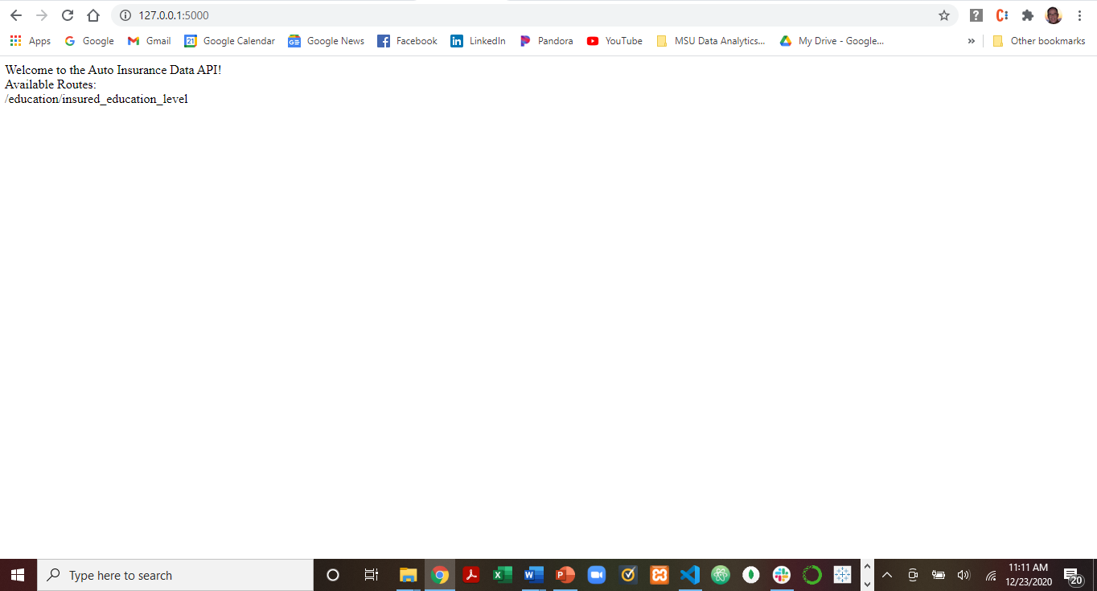

Slide 6
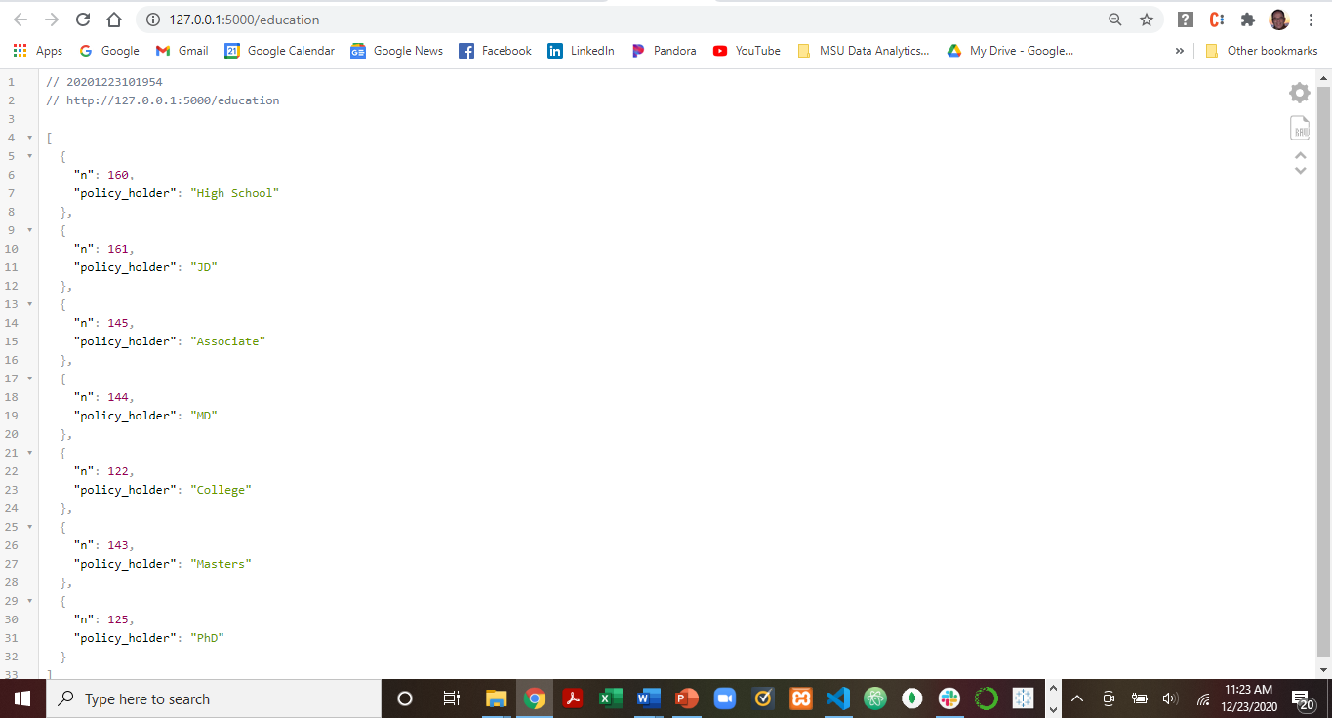

Slide 7
