Slide 1
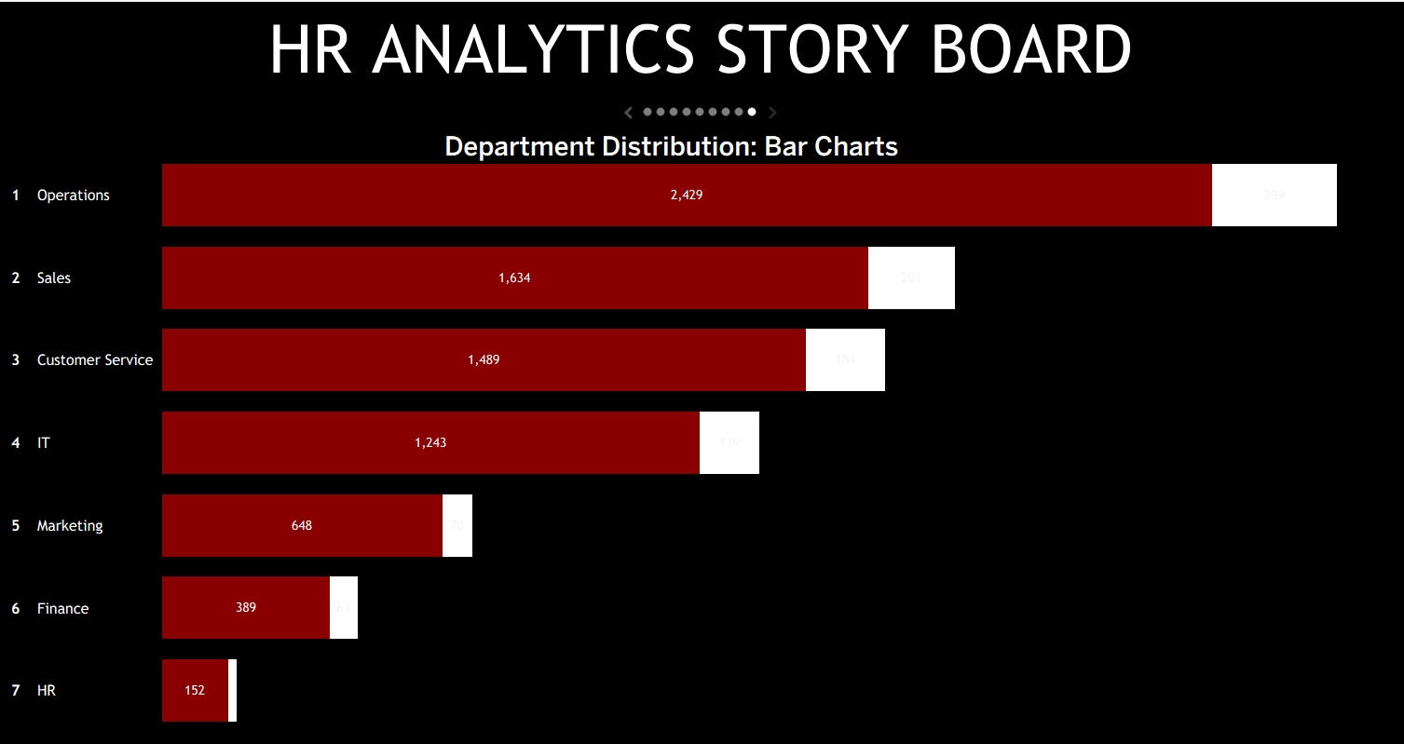
Approve a four-week pilot to standardize HR reporting and prioritize workforce reviews
HR Workforce Analytics Dashboard
Turning fragmented employee data into workforce decisions
Steve Okyere Oduro-Amoyaw | August 2025
Notes:
Time: 0:40
Today I am requesting approval for a four-week pilot that uses a standardized HR data process and a Tableau dashboard to give HR and operations one consistent view of workforce distribution. The goal is not to replace HR systems; it is to make existing employee data easier to review, validate, and use for workforce-planning decisions.

Slide 2
Standardized data and one dashboard can focus HR reviews on the largest workforce segments
SITUATION
Employee records include department, job title, location, salary, performance, and dates.
COMPLICATION
Source data initially stored employee fields as semicolon-delimited text in one column.
QUESTION
How can HR make workforce reporting consistent and actionable using current tools?
ANSWER
Run a four-week Tableau reporting pilot and review departments, roles, locations, and tenure weekly.
So what: Approve a limited pilot using existing Excel and Tableau tools.
Source: HR project workbook, dashboard screenshots, and proposed pilot design.
2
Notes:
Time: 1:00
The situation is that HR has employee-level information that can support planning. The complication is that the source data was not analysis-ready. I cleaned and structured the data, then used Tableau to create views for departments, roles, geography, and employee details. The recommendation is a short pilot that establishes a repeatable reporting rhythm.

Slide 3
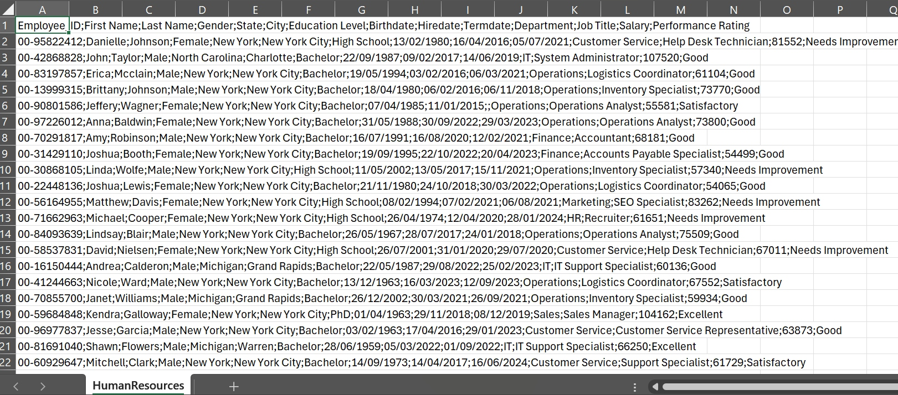
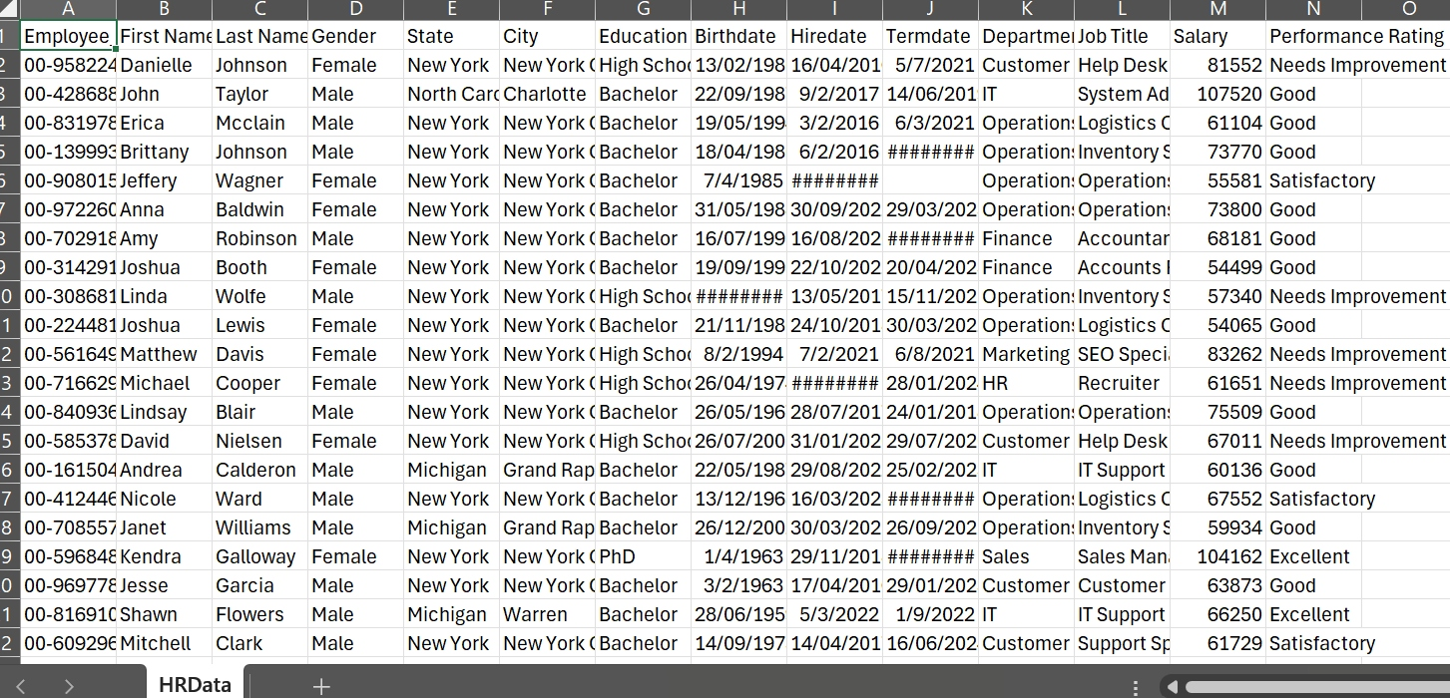
One-column source data prevented reliable workforce reporting until the fields were cleaned , validated and standardized
RAW TEXT
STRUCTURED EMPLOYEE DATA
→
Data preparation enabled analysis
Fields became usable
Dashboard became possible
•Clean , validate and Split semicolon-delimited text into employee fields
• Department, title, salary, Locations, states, dates, performance
• Filters, rankings, maps, and employee detail views
So what: Data preparation was the prerequisite for credible workforce analysis.
Source: HR project source-data screenshots; HR Workforce Analytics Dashboard project.
3
Notes:
Time: 1:00
This slide shows the business problem. The original HR extract contained all employee fields in one text column separated by semicolons. That structure prevents consistent filtering, grouping, and reporting. I transformed it into separate fields such as department, job title, compensation, performance rating, hire date, and termination date. This made the Tableau analysis possible.

Slide 4
Operations, Sales, and Customer Service contain the largest employee populations to review first
Largest populations shown
Operations
2,429
Sales
1,634
Customer Service
1,489
Use workforce size to sequence initial reviews; it does not indicate performance or turnover.
So what: Begin workforce reviews with the three largest employee populations.
Source: HR Analytics Story Board — Department Distribution. Counts shown in project dashboard.
4
Notes:
Time: 1:00
The department view creates a practical starting point. The dashboard shows Operations as the largest population at 2,429 employees, followed by Sales at 1,634 and Customer Service at 1,489. These are workforce-size signals, not claims about performance or turnover. A pilot should start here because any staffing, engagement, scheduling, or retention question affects more people in these departments.

Slide 5
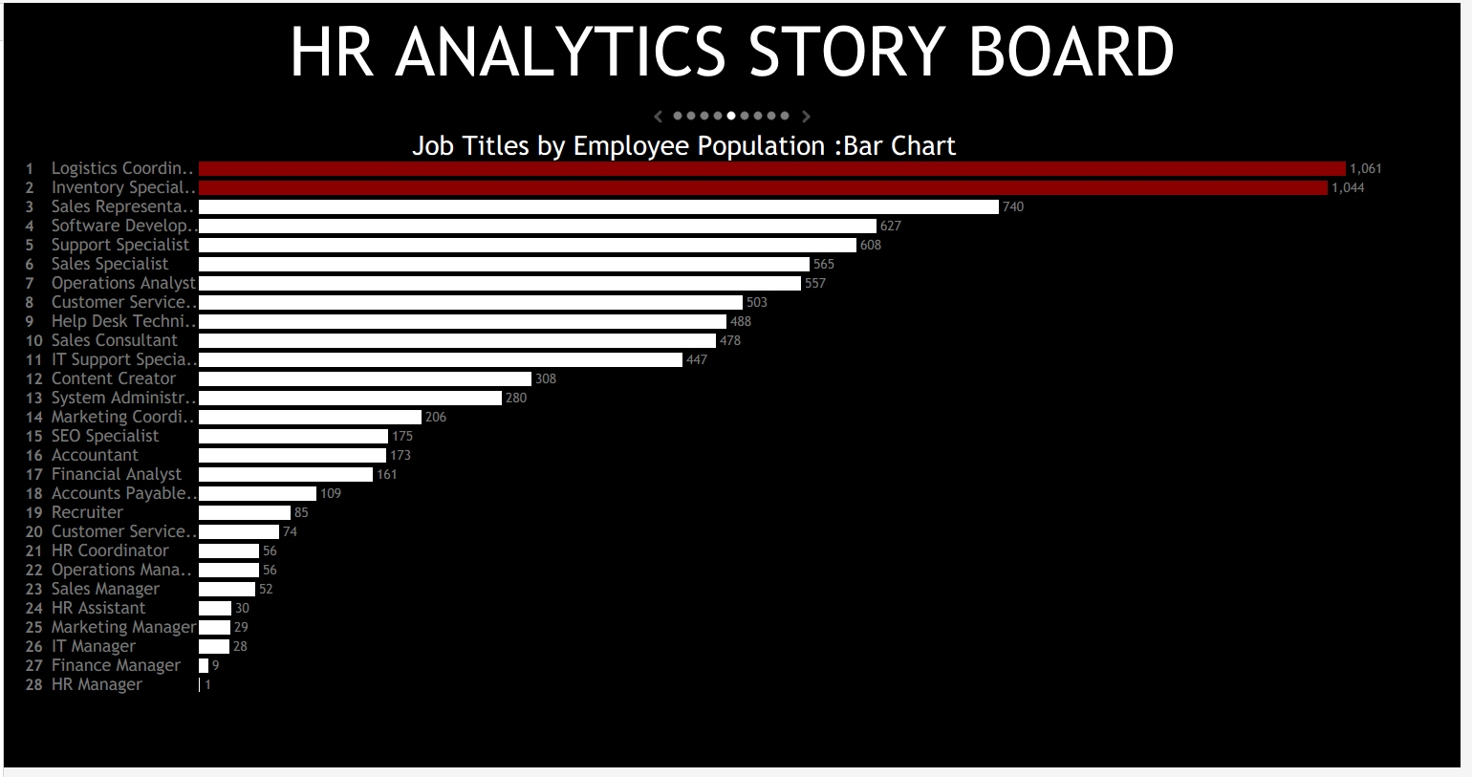
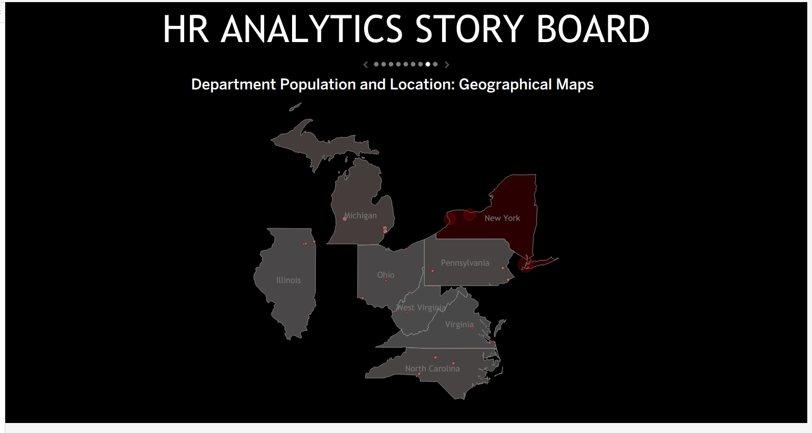
High-volume roles and locations should be reviewed before lower-scale workforce segments
Priority logic
Size: employee volume | Decision relevance: staffing or service implications | Data readiness: complete employee records
Illustrative prioritization: Operations, Logistics Coordinators (1,061), Inventory Specialists (1,044), and New York locations.
So what: Review the highest-volume departments, roles, and locations first.
Source: HR Analytics Story Board — job-title and location views. Priority is illustrative and volume-based.
5
Notes:
Time: 1:00
The dashboard identifies where to start, not the final answer. The role view shows Logistics Coordinators at 1,061 and Inventory Specialists at 1,044 employees. The location map shows a visible concentration in New York. For the pilot, the review sequence should begin with large workforce segments, then add operational data needed to understand staffing, workforce planning, or retention questions.

Slide 6
A four-week dashboard pilot is faster and lower risk than new-system implementation
Option
Cost
Speed
Decision value
Risk
1. Continue ad hoc spreadsheet reporting
Low
Immediate
Low
High inconsistency
2. Run Excel-to-Tableau pilot
Low*
4 weeks
High
Low
3. Buy a new HR analytics platform
High
Months
Potentially high
Medium–high
Recommendation: Choose Option 2 — standardize the current reporting workflow before considering new technology.
So what: Prove adoption and data quality with existing tools first.
Source: Project constraints and illustrative operating assumptions. *Assumes existing Excel and Tableau access.
6
6
Notes:
Time: 1:00
There are three realistic options. Continuing ad hoc spreadsheet reporting is immediate but does not solve consistency. Buying a new platform may be appropriate eventually, but it is expensive and premature before validating the reporting process. The recommended option is a four-week Excel-to-Tableau pilot. It is low-cost if current tool access already exists, fast to deploy, and creates evidence for a future technology decision.

Slide 7
The pilot should combine clear ownership, standardized data, and repeatable Tableau reporting
PEOPLE
PROCESS
TECHNOLOGY
HR analyst owns weekly review
Data-refresh checklist
Tableau dashboard as shared view
HR leader sponsors decisions
Field-validation rules
Excel source-data template
Department leaders validate findings
Weekly review cadence
Role and access controls
Establish a four-week routine: refresh validated data, review priority segments weekly, and document actions or data gaps.
So what: The solution is a team-led reporting routine, not just a dashboard.
Source: Project design and proposed pilot operating model. Ownership assignments are illustrative.
7
Notes:
Time: 1:00
The recommendation is deliberately simple. The dashboard is only valuable if people use it in a repeatable process. HR owns the data refresh and reporting pack. Department leaders validate what the numbers mean operationally. Leadership sponsors follow-up actions. The technology remains lightweight: a standardized Excel input and Tableau output with appropriate access controls.

Slide 8
Approve the four-week pilot and assign HR and operations owners this month
WEEK 1
WEEK 2
WEEK 3
WEEK 4
PREPARE
LAUNCH
MEASURE
DECIDE
HR analyst
HR analyst & HR leader
HR & department leaders
HR Director & Operations leader
Data template and validation checklist
Dashboard refresh and baseline review
Priority findings and data gaps
Continue, refine, or scale decision
Proposed success measures
• 100% of required dashboard fields validated before refresh
• Weekly review completed for the top three departments
• Priority questions and data gaps documented for leadership
DECISION REQUESTED
Approve the pilot and assign an HR owner, operations sponsor, and weekly review participants.
Source: Proposed pilot plan based on existing dashboard capability. Measures are proposed, not historical results.
8
Notes:
Time: 1:20
The ask is to approve a four-week pilot, not a large technology investment. In week one, the HR analyst prepares and validates the source-data template. In week two, the dashboard is refreshed and baseline findings are reviewed. In week three, department leaders validate questions and identify missing data. In week four, leadership decides whether to continue, refine, or scale the process. Success is measured by data readiness, review completion, and a documented set of priority questions.

