Slide 1
So Long Sucker Presentation
COP4331
Processes for OO Software Development
Team 4
Steven Braeger, Sarah Loewy, Andrew Marsh
May 2009

Slide 2
Virtual World

Slide 3
Motivation
    What did you want to learn from the simulation?
    What data does your simulator capture and produce to answer your questions.

Slide 4
Description of the Simulator

Slide 5
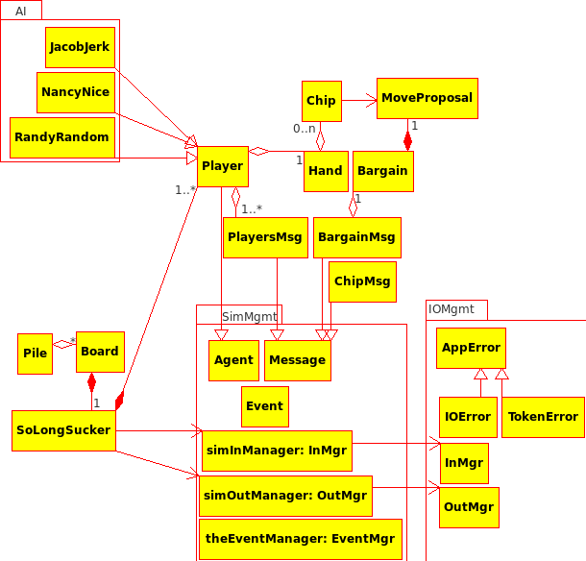
Architectural Model

Slide 6
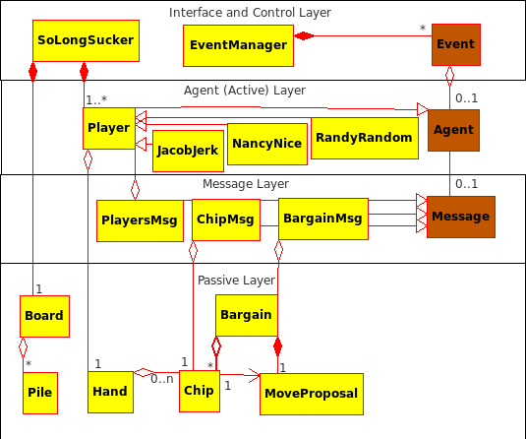
Design Model

Slide 7
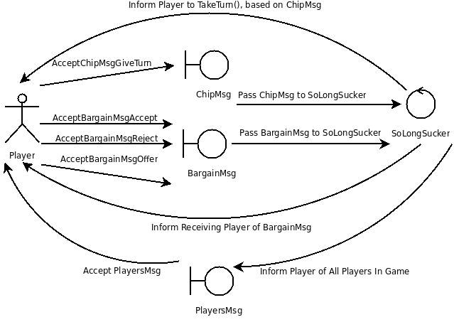
Dynamics of Agent Interactions

Slide 8
Input Description

Slide 9
Project Summary

Slide 10
Team Work Assignments

Slide 11
Summary of Team Effort

Slide 12

Productivity Data

Slide 13
Productivity Tables

Slide 14
Lessons Learned

Slide 15
Demonstration

