Slide 1
So Long Sucker Presentation
COP4331
Processes for OO Software Development
Team 4
Steven Braeger, Sarah Loewy, Andrew Marsh
May 2009

Slide 2
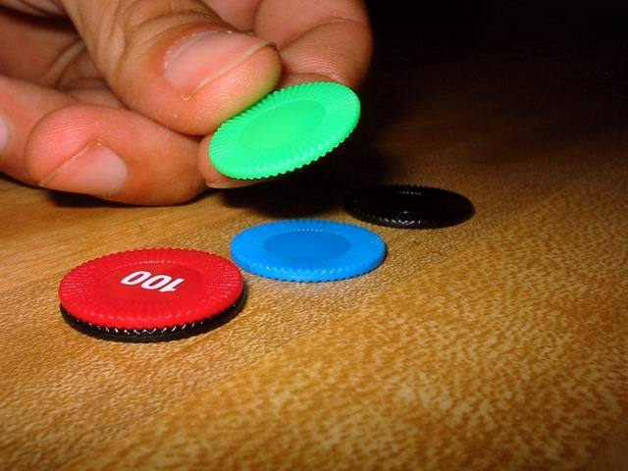
About the Game
Created in 1950 by John Nash
A bargaining/economic strategy game
Often played with 4 players

Slide 3
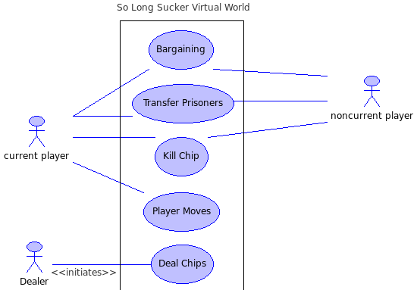
Virtual World
USE CASE DIAGRAM
Deal Chips
  Deal 7 chips to each player
  Only occurs once
Bargaining
  Can occur at any time
  Between any 2 players
  Either accepted or rejected
Transfer Prisoners
  Often follows an accepted bargain
  Between any 2 players
Kill Chip
  Normally involves killing a prisoner
  Special case involves killing one's own chip
Player Move
  Isolated only to current player
  Involves playing a chip
  Rules determine next player to move

Slide 4
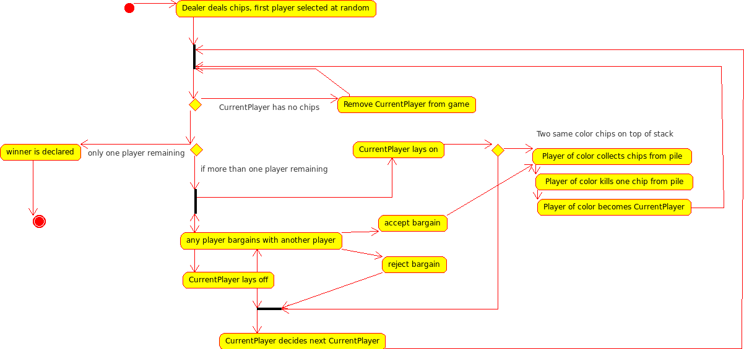
Activity Diagram

Slide 5
Motivation
Initial Presentation
  Complaints from Nash, Inc. about bloated middle management
  Aid middle management in gaining confidence to sift out lesser quality employees
  By training with a simplified bargaining game
  Simulation eventually necessitates compromise of initial alliances
Verification Statistics Gathered
  Turns Passed
  Bargain messages sent
  Winning Player

Slide 6
Description of the Simulator

Slide 7
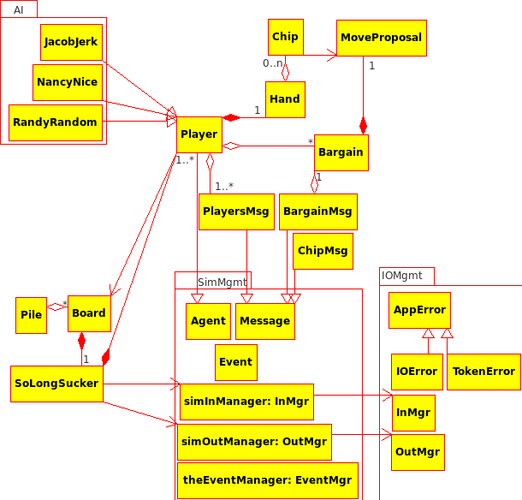
Architectural Model

Slide 8
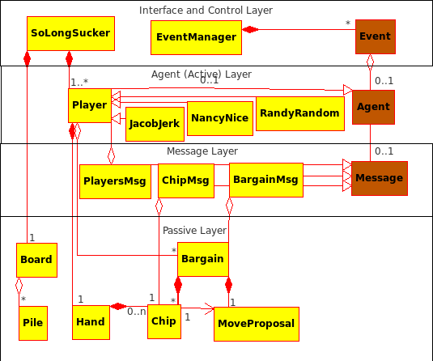
Design Model
Interface Layer
Main game loop
Agent Layer
Players
Message Layer
Communication formats between Agents
Passive Layer
Passive game elements

Slide 9
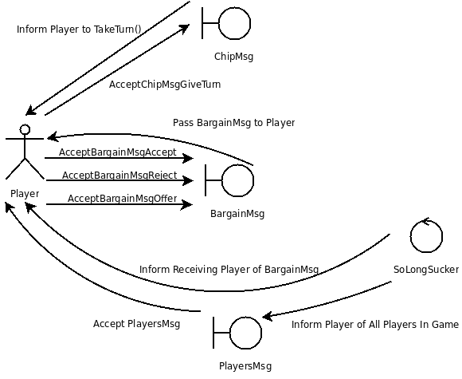
Dynamics of Agent Interactions

Slide 10
Input Description
Players to select from:
AI::NancyNice
Accepts all bargains
Never goes against a bargain
AI::JacobJerk
Accepts all bargains
Never does what was promised
AI::RandyRandom
Randomly accepts/rejects
SoLongSucker{
numPlayers: #
numChipsPerPlayer: #
Player{ }Player
Player{ }Player
Player{ }Player
}SoLongSucker

Slide 11
Project Summary

Slide 12
Team Work Assignments
Andrew:
Virtual World Model
Use Case Model
User Guide
Steven:
Input Output Specifications
Software Design Specification Polish
Code Implementation
Project Management
Sarah:
Architectural Model
Software Design Specification
Code Architectural Framework

Slide 13
Summary of Team Effort

Slide 14
Productivity Data

Slide 15
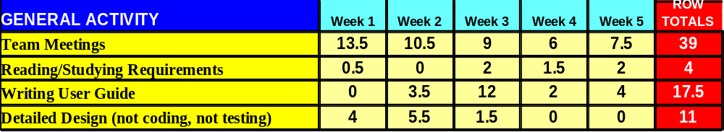
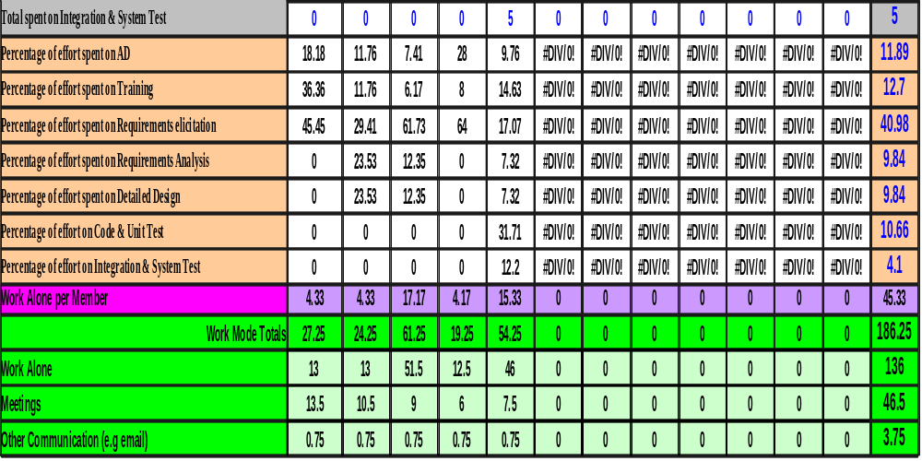
Productivity Tables

Slide 16
Lessons Learned
Deadlines
Design Planning
Democratic Labor Allocation
Crunch Time
Multiple Debuggers
Clearer Requirements + Stated Goals

Slide 17
Demonstration

