Slide 1
So Long Sucker Presentation
COP4331
Processes for OO Software Development
Team 4
Steven Braeger, Sarah Loewy, Andrew Marsh
May 2009

Slide 2
Virtual World

Slide 3
Motivation
  Initial Presentation
  Complaints from Nash, Inc. about bloated middle management
  Aid middle management in gaining confidence to sift out lesser quality employees
  By training with a simplified bargaining game
  Simulation eventually necessitates compromise of initial alliances
Verification Statistics Gathered
  Bargains offered by whom
  Bargains accepted or rejected by player
  Games won by player
  Most frequent winner weighted by input proportion

Slide 4
Description of the Simulator

Slide 5
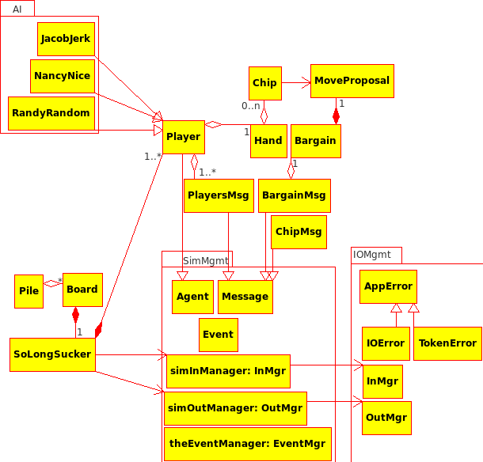
Architectural Model

Slide 6
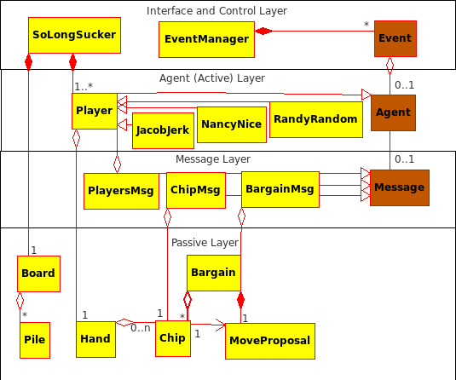
Design Model
Interface Layer
Main game loop
Agent Layer
Players
Message Layer
Communication formats between Agents
Passive Layer
Passive game elements

Slide 7
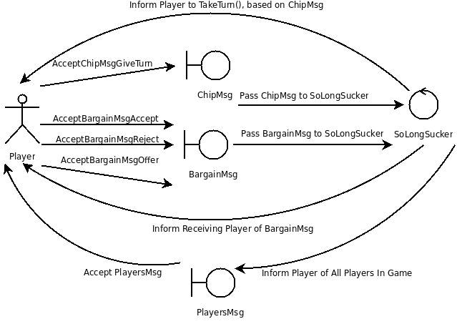
Dynamics of Agent Interactions

Slide 8
Input Description
Players to select from:
AI::NancyNice
Accepts all bargains
Never goes against a bargain
AI::JacobJerk
Accepts all bargains
Never does what was promised
AI::RandyRandom
Randomly accepts/rejects
SoLongSucker{
numChips: #
Player{ }Player
Player{ }Player
Player{ }Player
Player{ }Player
}SoLongSucker
(repeat for number of games)

Slide 9
Project Summary

Slide 10
Team Work Assignments

Slide 11
Summary of Team Effort

Slide 12

Productivity Data

Slide 13
Productivity Tables

Slide 14
Lessons Learned

Slide 15
Demonstration

