Slide 1
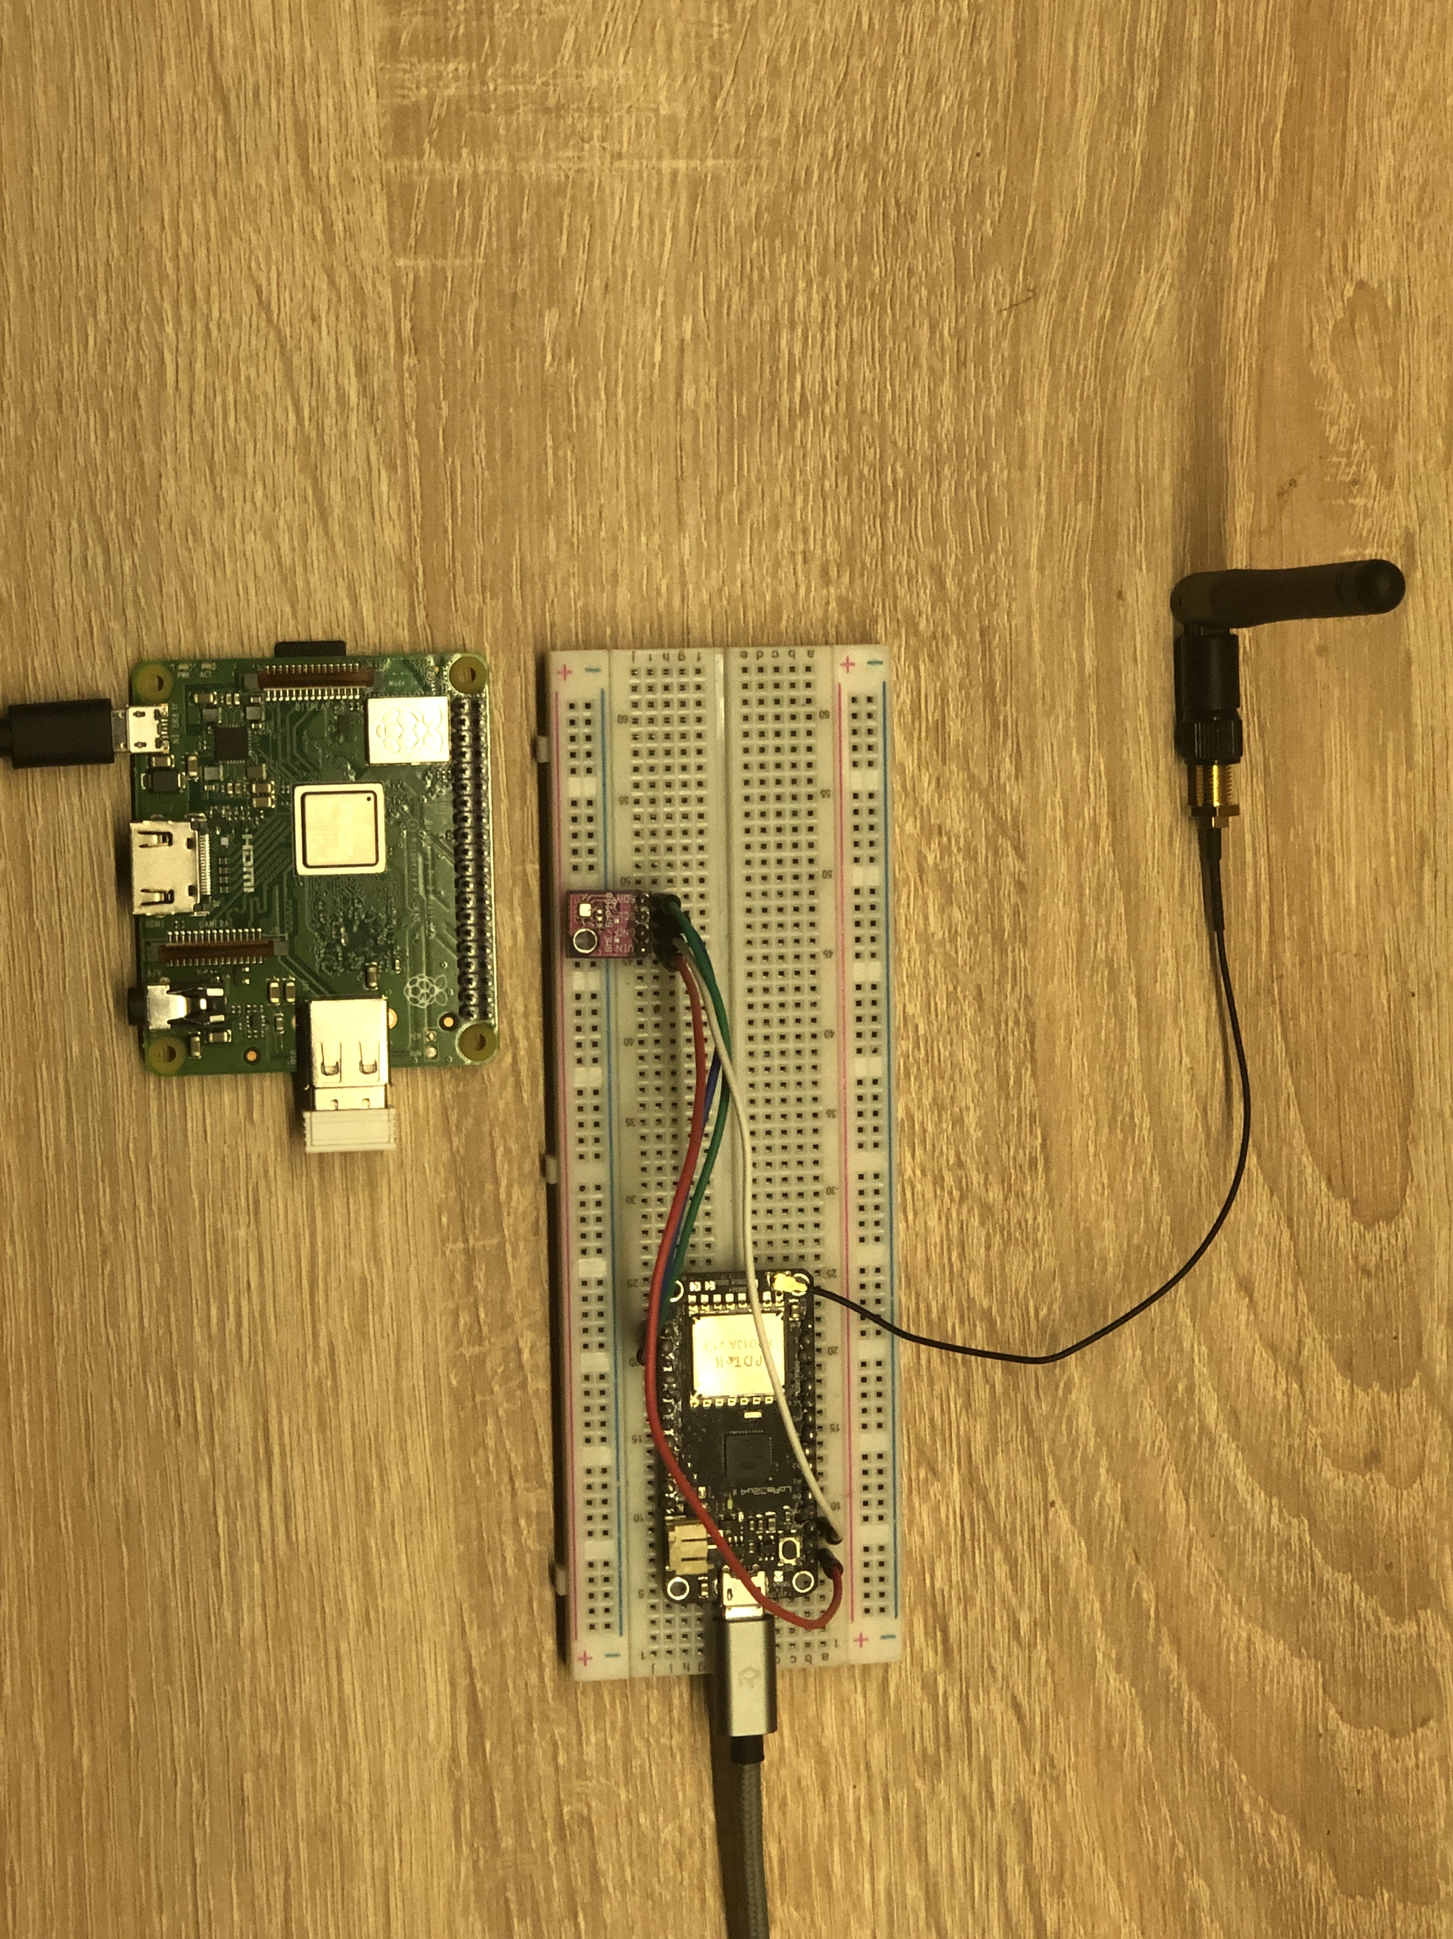
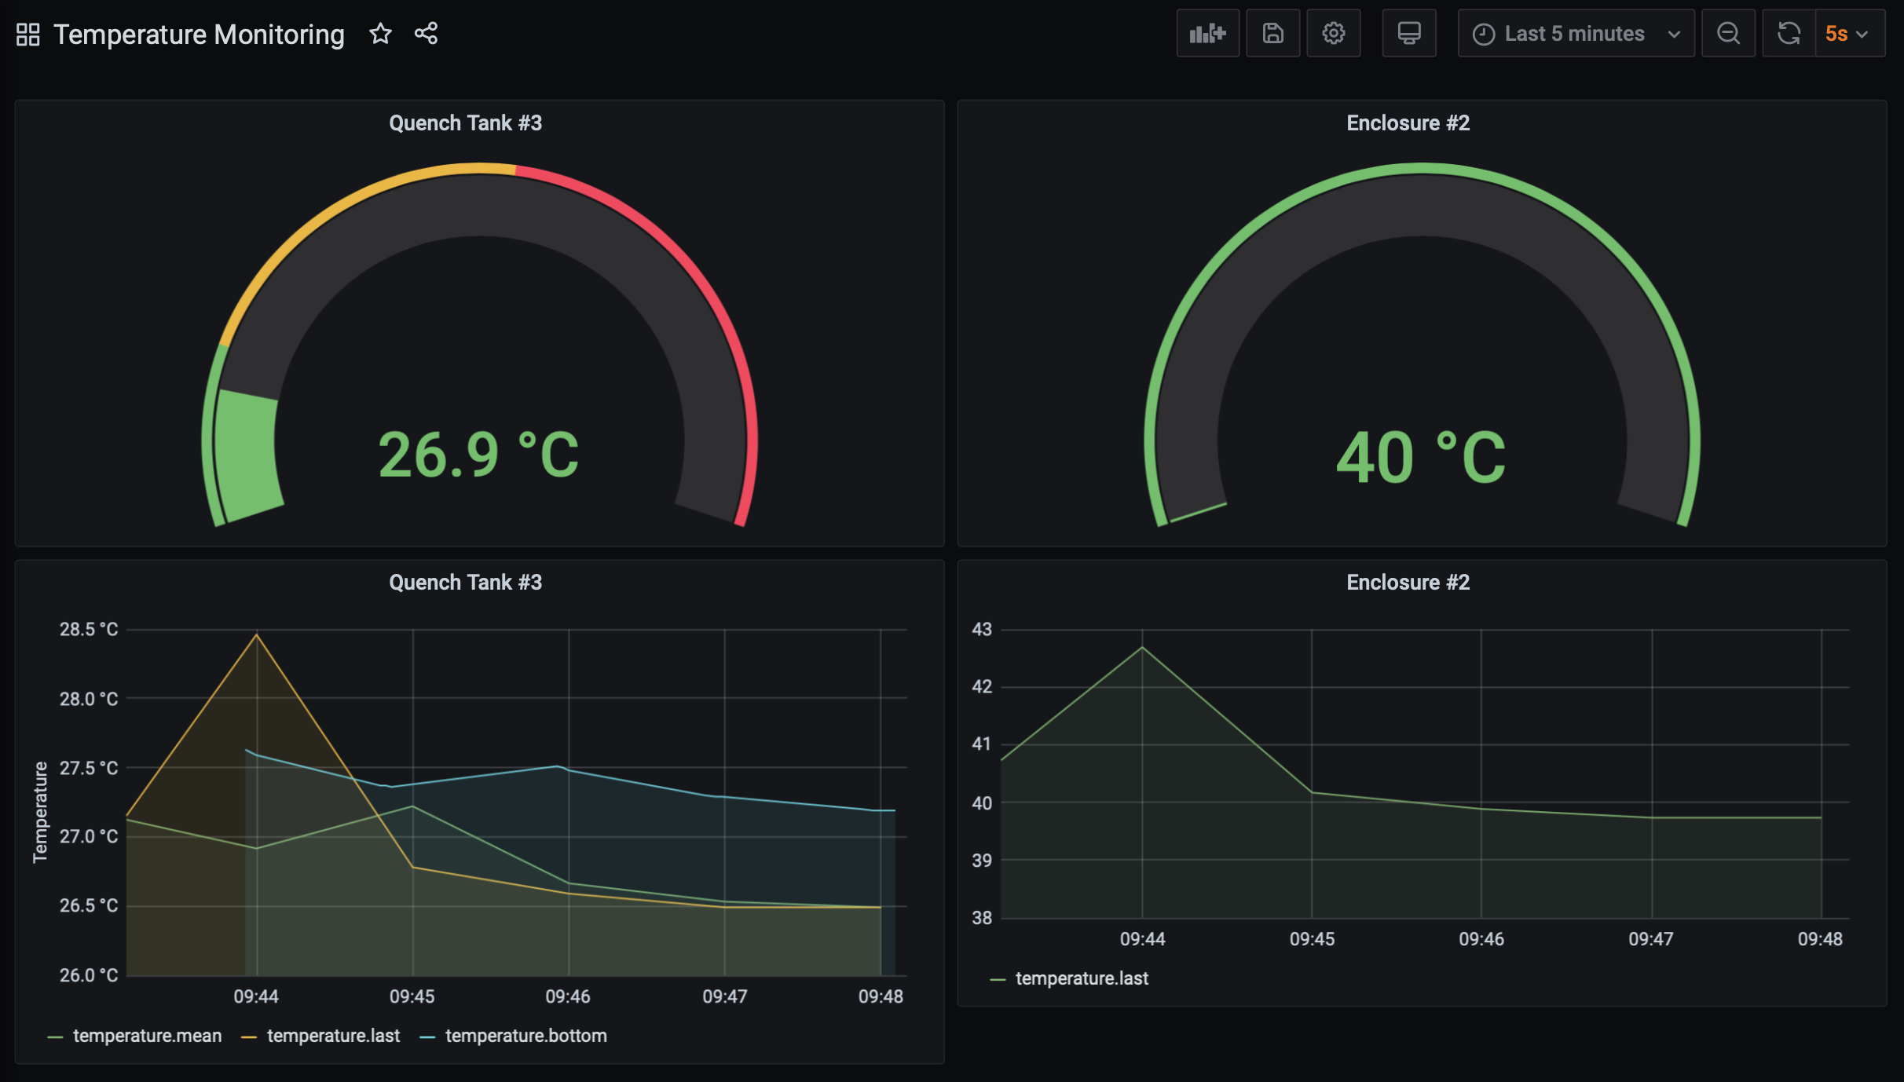

Ahmed Haroun 3rd Year Electronic Engineering Student at The University of Sheffield
‘Wireless Temperature Monitoring Application
Temperature monitoring in electrical enclosures, quench tanks and machinery in industrial environments at Tinsley Bridge.
This mainly creates ease of maintenance and fault detection.
Connected to TTN by sending sensor data to a nearby gateway.
Local MQTT broker retrieves messages from TTN and publishes them onto broker using Python.
Influxdb used to store the sensor data, Dashboard created on Grafana.
The Adafruit board has a JST connector, and putting it to sleep mode in between transmissions drops the surrent consumption to about 300μA from 13mA.
Used with BME 280 sensor which provides more accurate temperature, pressure and humidity than DHT11 sensor.
Hence other applications can include; warehouses, food safety monitoring, agriculture.
Adafruit Feather 32u4II
BME 280 sensor
MQTT broker running Python script

