Slide 1
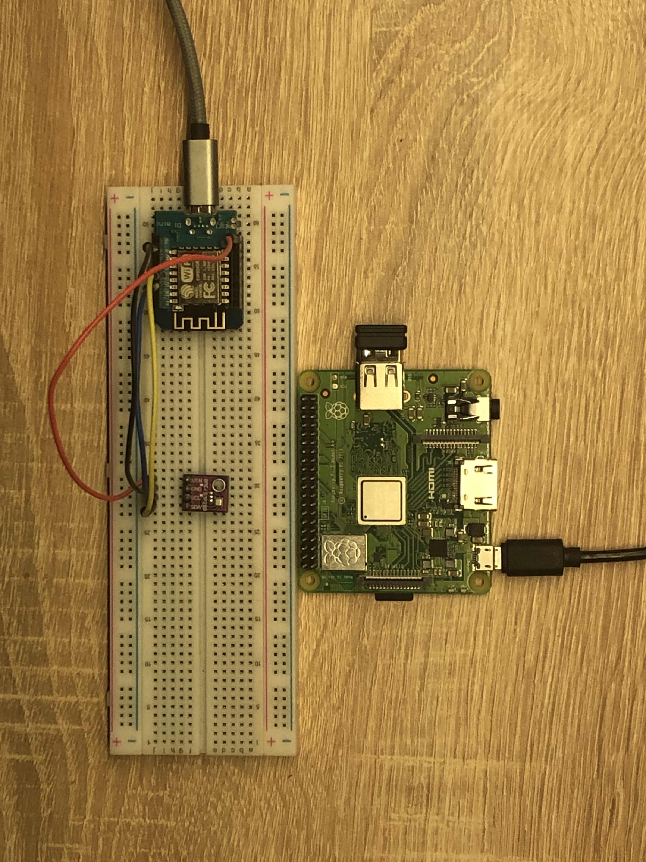
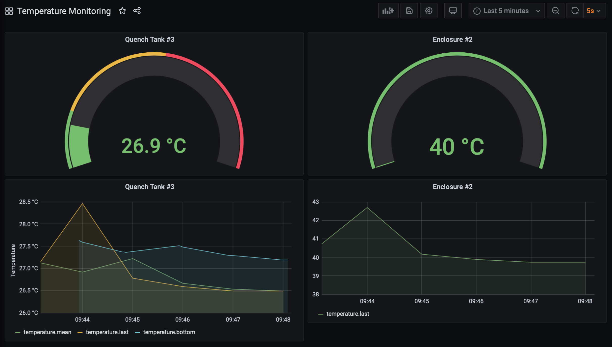
IOT Project Area: Industrial Wireless Temperature Monitoring System
Ahmed Haroun
3rd Year Electronic Engineering student at the University of Sheffield
Monitoring the hardware heat dissipation within electrical cabinets for component operational status.
Monitoring the temperature of quench tanks for ease of maintenance.
LORAWAN saves maintenance time and costs.
This wireless technology creates freedom.
Other applications:
- Alloy Melting
- IT Data Centre energy consumption
Local MQTT created.
Currently sensor data is relayed to MQTT using WIFI to test broker, database management and dashboard display.
LORAWAN will be used instead to send sensor data once the gateway is installed.
Reasons:
Longer range (7 km)
Lower Bandwidth more suitable for this application
Consumes less power (can be battery powered)
ESP8266 standalone
MQTT Broker
InfluxDB
Grafana
BME 280 sensor
sensor

