Slide 1
Media training for start ups
Sarah Rice
Head of Communications
Mxit

Slide 2
What am I going to talk about?
What is PR?
What is the difference between PR, Internal Comms and social media?
Where does the media fit in?
Working with the media
Writing a press article

Slide 3

Me.

Slide 4
Why bother?
The ultimate objective of any marketing is simply to sell more stuff.
If its not selling more stuff – then put your money somewhere else.

Slide 5

What is PR?

Slide 6

And…

Slide 7

And it also…
Notes:
Essentially - it’s the removal of obstacles to success though careful, considered and proactive communication.
PR creates and environment where its easier to do business

Slide 8

PR, Internal comms, social media?
Notes:
For me – its all one thing. Media, internal newsletters, twitter accounts – they are all ways of talking to your audience. All part of the same function – just different channels. The trick is knowing which message via which channel to which audience will give you the business result you need.

Slide 9

When to use what?
Notes:
Starts with you.
What do you want? What is the action?
Then who do you need to talk to – to get the action going?
Who is your audience? What do they need to hear?
What will make a difference?
And how best will they hear it?

Slide 10
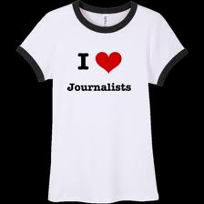
When the media makes sense
Notes:
When its news.
Lets clarify who the media are. Who they work for and why.
The media exist to share relevant stories with their readers, listeners or viewers. That’s it. They don’t exist to tell your story. Unless your story matters to their audience and its your job – or your PR persons job – to find the spot where your story and the journalists’ need for relevant, interesting stories meets.
So lets talk about what constitutes news.

Slide 11








What kind of media do we have?

Slide 12
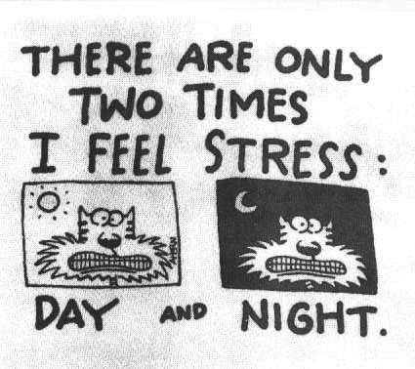
What’s happening in their world?

Slide 13

What is news?
Notes:
Importance/ impact - on readers or listeners
Timelines – immediate, recent or current
Proximity – the closer to home the more newsworthy
Interest – potential to stimulate readers’ emotions
Prominence – big names make big news
Novelty – humour, emotional stimulus
Conflict – surprise, tension, suspense

Slide 14
What to do: You
Be clear on your action objective
Be clear on your message
Be clear on the story to support the message
Do you have one good story to tell
Be able to talk about explain what your company does quickly, confidently and easily
Notes:
Sometimes we get it wrong. Tell them about the Mxit on mxit by Mxit story – too close. There is a story – but my proof point was off.
Sometimes we get it right – launch of Mxit Money.
What business are you in?
Who do you want to talk to? What publications do they read?

Slide 15
What to do: Them
Read the publication
Notes:
What kinds of stories do you have to tell?
Draw up a list of target publications
Go out and find these publications
Read them - read them again
Target the journalist you think if most suited to your story

Slide 16
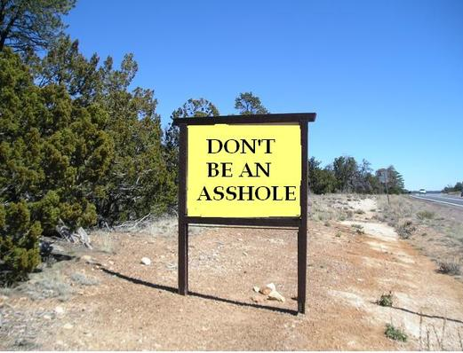
What not to do
Notes:
The marketing spiel/ spin
Arrogant spokespeople
Non-exclusives
Lack of understanding of the readers’ needs
Lack of knowledge about the publication – a definite deal-breaker!
Lack of knowledge generally
Misleading information
Lack of understanding about deadlines

Slide 17

So now what?
Notes:
Phone call is the best way to start:
Make notes of what you want to say – why is this important to their publication and their readers
Elevator pitch: describe your company in less than 30 seconds - clearly!
Have supporting information ready to be emailed - backgrounder/ press release/ written motivation/ good pictures
There are many ways to create a relationship but the best way is to always have something interesting and newsworthy to say
lunches/ coffees/ breakfasts [Note – very few media play golf]
Emails on stories that you have enjoyed - and why - make an observant comment
Exclusives – if they really are exclusives and it is really newsworthy
Constant investment pays big dividends

Slide 18

What to do when there isn’t an angle and you still want to talk about it?
Notes:
Think about how else you can talk to the right people. The great thing about the Internet is that you have lots of ways are reaching your audience – find out where they are and how to get to them.
The media is incredibly useful for building credibility and long term education and awareness raising but they are not the only way.

Slide 19

Writing an article
Notes:
Think like a reader of the publication and not like a marketer
Press releases need to answer a ‘so what?’. Why is this interesting to them. How can you make this interesting? [Note – the more you read the publications the easier this will become]
Press releases should not just be written and sent out – there are some basics. There is a good book called – A press release or Not by Jennigay Coetzee.

Slide 20

Jennigay.co.za
Notes:
Jennigay.co.za

Slide 21
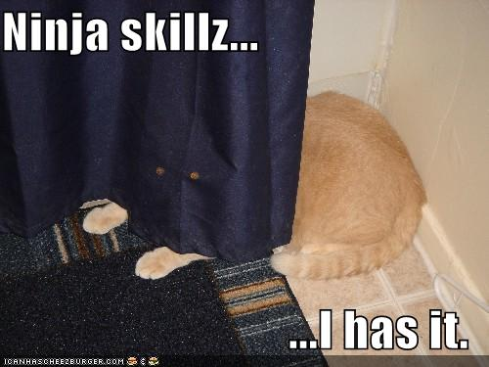
Professionals
Notes:
Pr agencies – they work. They are expensive and remember – PR is fertilizer. Its not the seeds – need to know when you can and when you can’t use it.
Also – PR is a slow burn. Its not one press release and then disappearing until the next time – it’s a consistent push for awareness.

Slide 22

The Communications journey
Notes:
Remember to enjoy it.

