Slide 1
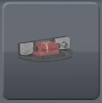
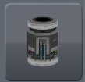
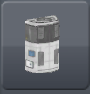
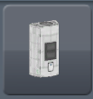

Tier-2+ only!
CrushIns
K&K Stuff Scrounger
Complex Parts
Fertilizer Factory
Shinies Factory
K&K Workshop (Rocket Parts)
Fertilizer Storage
Shinies
Storage
Rocket Parts
K&K Planetary Greehouse
Hungry Kerbals
Snack Storage

