Slide 1


Giacomo Garbarino
University of Genova
Computer Science Degree Course
Academic Year 2020/2021

Slide 2
Summary
Introduction
Code Generation Framework
Framework
C/C++/Java/Javascript sub-modules
Registry
Application Examples
Conclusions

Slide 3
Introduction

Slide 4

What is ThingML?
Thing Modelling Language
A fully open-source tool written in Java to generate code from models automatically
Targeted at distributed reactive systems
IoT systems (from which it got its name)
embedded systems
medical devices
cyber-physical systems

Slide 5



History and License
Originally developed by Franck Fleurey and Brice Morin of the Networked Systems and Services department of SINTEF in collaboration with industry partners
Owned by Tellu, a company specialized in the development of e-health technologies, but it remains fully open-source
Distributed under the Apache 2.0 license

Slide 6
Who was it made for?
Derived from the Model-Driven Software Engineering methodology to reduce the development and maintenance costs of the software and technology developers in a practical setup

Slide 7
ThingML Features
Characterized by three components
a modelling language
a highly customizable code generation framework
a set of tools to support the code generation

Slide 8
ThingML Modelling Language
A language to express a ThingML model which represents the design of the system to implement
Relies on two key structures
Things
Configurations

Slide 9
Things
Define software components
properties
functions
messages
ports
state machines

Slide 10
Things’ Behaviour
Described using
statecharts and components (aligned with UML)
imperative platform-indipendent language
specific constructs targeted at IoT applications

Slide 11
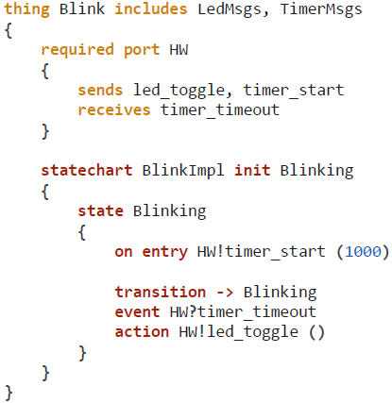
Thing’s Behaviour Example

Slide 12
Configurations
Define Things’ interconnections through instances of defined Things and connectors between two ports of these instances

Slide 13
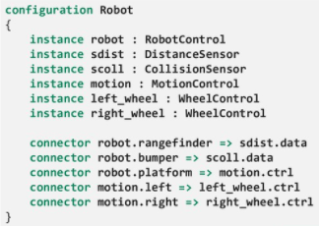
Configuration’s Example

Slide 14
ThingML Code Generation Framework
Generates code in a target language from a ThingML model
Three different target languages
C/C++ for Arduino microcontrollers ,Linux and embedded Linux
Java for computers and smartphones
Javascript (NodeJS)

Slide 15
ThingML Tools
A standalone text editor in which to express a ThingML model
Eclipse plugins
code generation testing framework
graphical exports (aligned with UML)
A parser to validate the ThingML model before the code generation

Slide 16
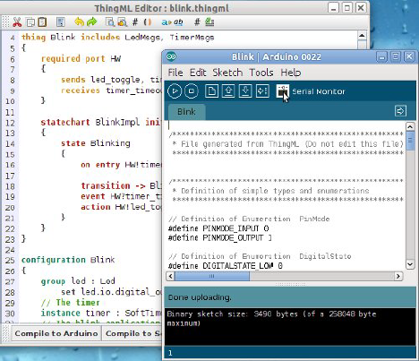
Standalone Text Editor

Slide 17
Code Generation
Framework

Slide 18
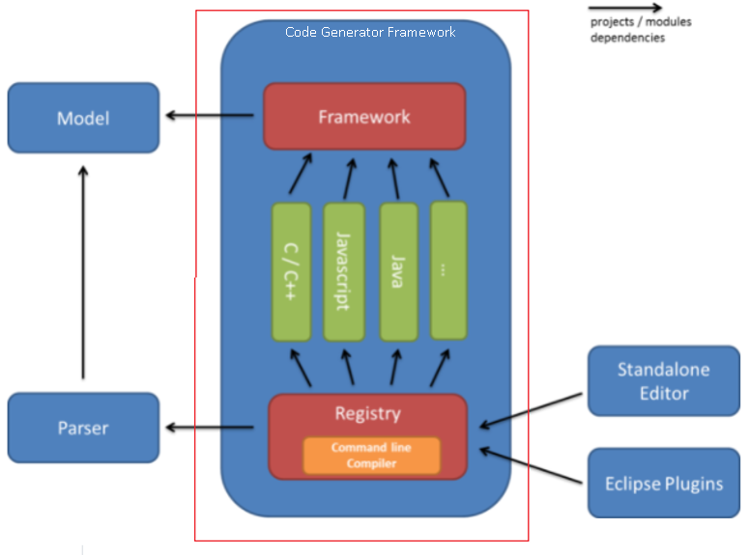
Code Generation Framework Structure
A compilation framework on top which only depends on the ThingML model and captures all the code and helper functions to be shared among the compilers (or code generators)
Individual sub-modules below which implement different families of compilers
A registry sub-module that packages all compilers above and contains a command line interface to call them

Slide 19
Framework

Slide 20
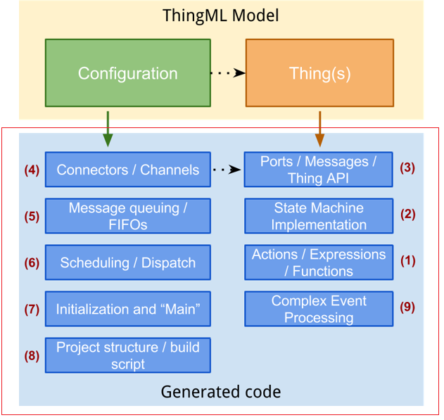
Framework Structure

Slide 21
Extension Points
Nine different customizable extension points separated into two groups
ones corresponding to the generation of code for Things
ones corresponding to the generation of code for Configurations
Each extension point is an interface (or abstract class) with a set of methods responsible for generating code associated with a given model element
Different extension points can share information

Slide 22
Actions/Expressions/Functions
Generates code for actions, expressions and functions contained in the Things
Dependency on the target language (C, C++, Java, Javascript and ecc.)
Implementation
a visitor on the ThingML model
Customization
implementing a new visitor for a new language
inheriting an existing visitor and overriding some of its methods

Slide 23
State Machines Implementation
Generates code from the state machines structures and Event-Condition-Action constructs contained in the Things
Can generate the entire code or rely on an existing state machine framework available on the target platform
Implementation
an abstract state machine code generator
a set of reusable helper functions to calculate states, transitions and events according to the ThingML semantics
Customization
implementation of the abstract state machine generator

Slide 24
Ports/Messages/Thing APIs
Produces manually usable APIs to send and receive messages through ports
Dependency on how Things should be wrapped into reusable components on the target platform
Implementation
a visitor on the Things part of the metamodel
a set of helper functions to collect all the elements of the Things (messages, ports, functions, ecc.)
Customization
implementing a new visitor for a new target language
inheriting from an existing visitor for light customization

Slide 25
Connectors/Channels
Generates code corresponding to the connectors and transporting messages from one Thing to the next
Connectors can connect two local and/or remote Things
Dependency on how messages are transported
Implementation
an abstract generator for serialization, deserialization and transport
Customization
implementing new concrete generators
.

Slide 26
Message Queuing/FIFOs
Generates code to specify how messages are handled when the connectors are linking two Things running on the same platform
Messages stored in queues and dispatched asynchronously
Implementation
a customizable abstract generator
a set of helper functions to calculate the set of messages to be handled (unused messages are pruned)
Customization
implementing the abstract generator
.

Slide 27
Scheduling/Dispatch
Generates code which schedules the activation of state machines of each component and handles the dispatch of incoming messages
Dependency with the target platform
Implementation
a template and a set of helper functions
Customization
creation or the modification of an existing template

Slide 28
Initialization and Main
Generates the entry point and the initialization code for the components and the connectors
Implementation
a template and a set of helper functions providing the set of components and connectors to instantiate
Customization
creation or modification of an existing template

Slide 29
Project Structure/Build Script
Generates the file structure and build scripts
Implementation
an abstract generator with access to the buffers containing all the generated codes
Customization
creation of a concrete generator

Slide 30
Complex Event Processing
Generates code to handle stream of events

Slide 31
C/C++/Javascript
/Java sub-modules

Slide 32
What are they?
Sub-modules which implement the compilers
One module per target language
the C sub-module implements two compilers
one for generating C code for Linux
one for generating C code for Arduino
No dependencies among these sub-modules
New sub-modules can be added

Slide 33
Registry

Slide 34
What is it?
A place to register all different compilers
Dependencies with all compilers
Provides a command line interface to call and use the compilers

Slide 35
Application Examples

Slide 36
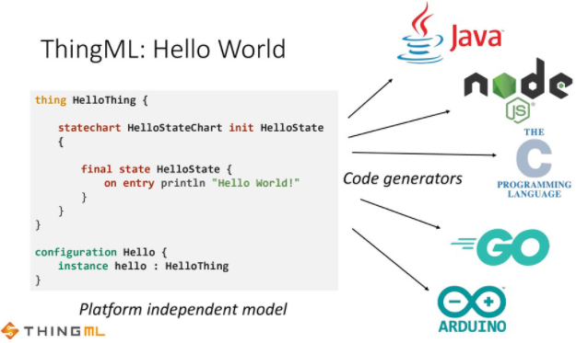
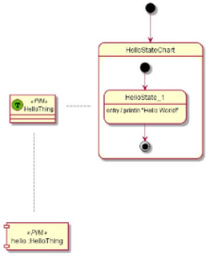
Hello World Program

Slide 37
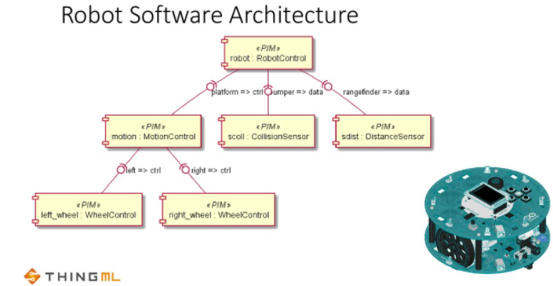
Arduino Robot Motor Microcontroller Software

Slide 38
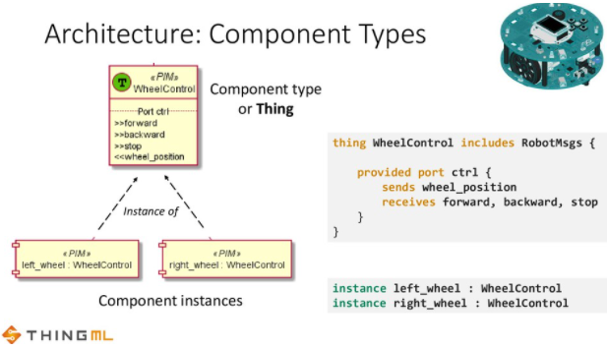
Arduino Robot Motor Microcontroller Software

Slide 39
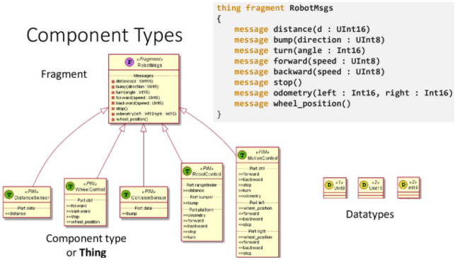
Arduino Robot Motor Microcontroller Software

Slide 40
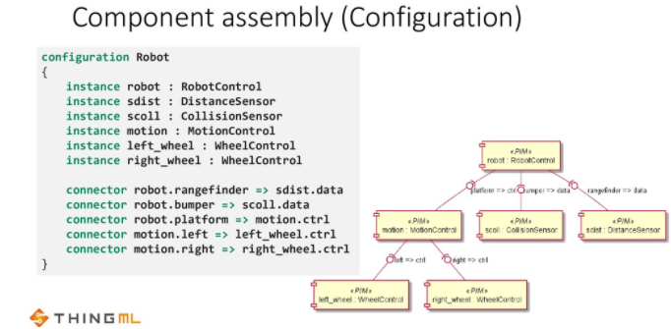
Arduino Robot Motor Microcontroller Software

Slide 41
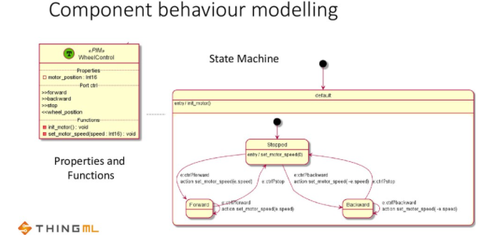
Arduino Robot Motor Microcontroller Software

Slide 42
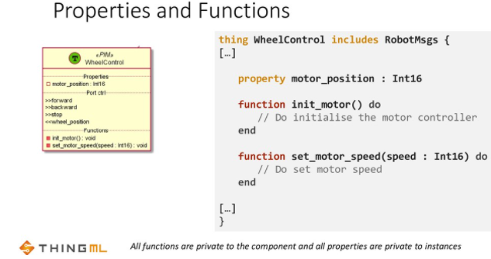
Arduino Robot Motor Microcontroller Software

Slide 43
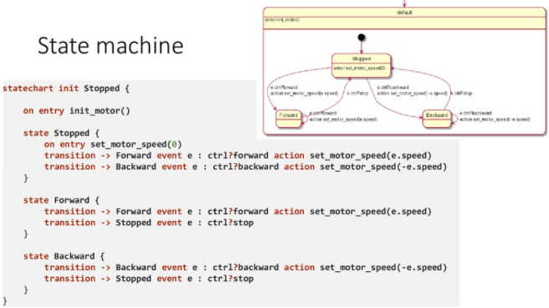
Arduino Robot Motor Microcontroller Software

Slide 44
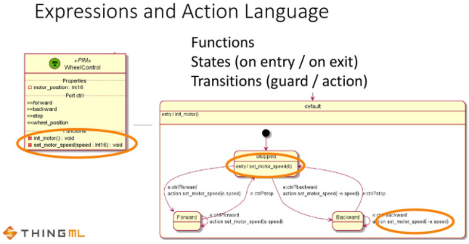
Arduino Robot Motor Microcontroller Software

Slide 45
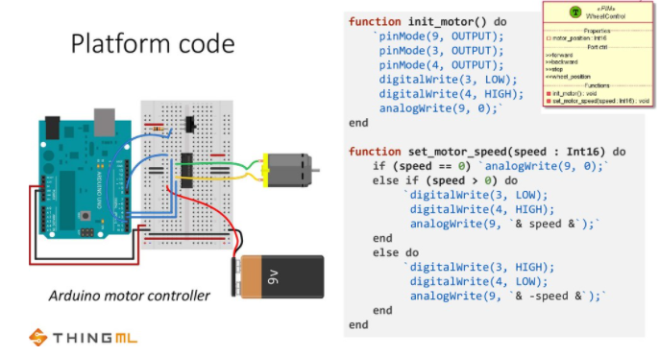
Arduino Robot Motor Microcontroller Software

Slide 46
Conclusions and
References

Slide 47
Conclusions
ThingML is an approach developed as an open-source project to help delevopers to produce better code
Brings typical Model Driven Engineering benefits
reduces development, maintenance and evolution costs
performs verification and analysis on the model
Convenient for the modelling and implementation of distributed reactive systems
Customizable
in the case that the generated code doesn’t fit my needs
Extensible
new compilers can be added
Can deal with microcontrollers
Platform indipendent modelling

Slide 48
References
Franck Fleurey, Brice Morin, Olivier Barais. Taming Heterogeneity and Distribution in sCPS, 2015.
Nicolas Harrand, Franck Fleurey, Brice Morin. ThingML: A Language and Code Generation Framework for Heterogeneous Targets, 2015.

