Slide 1

Climate change and Moon Rabbit

Slide 2

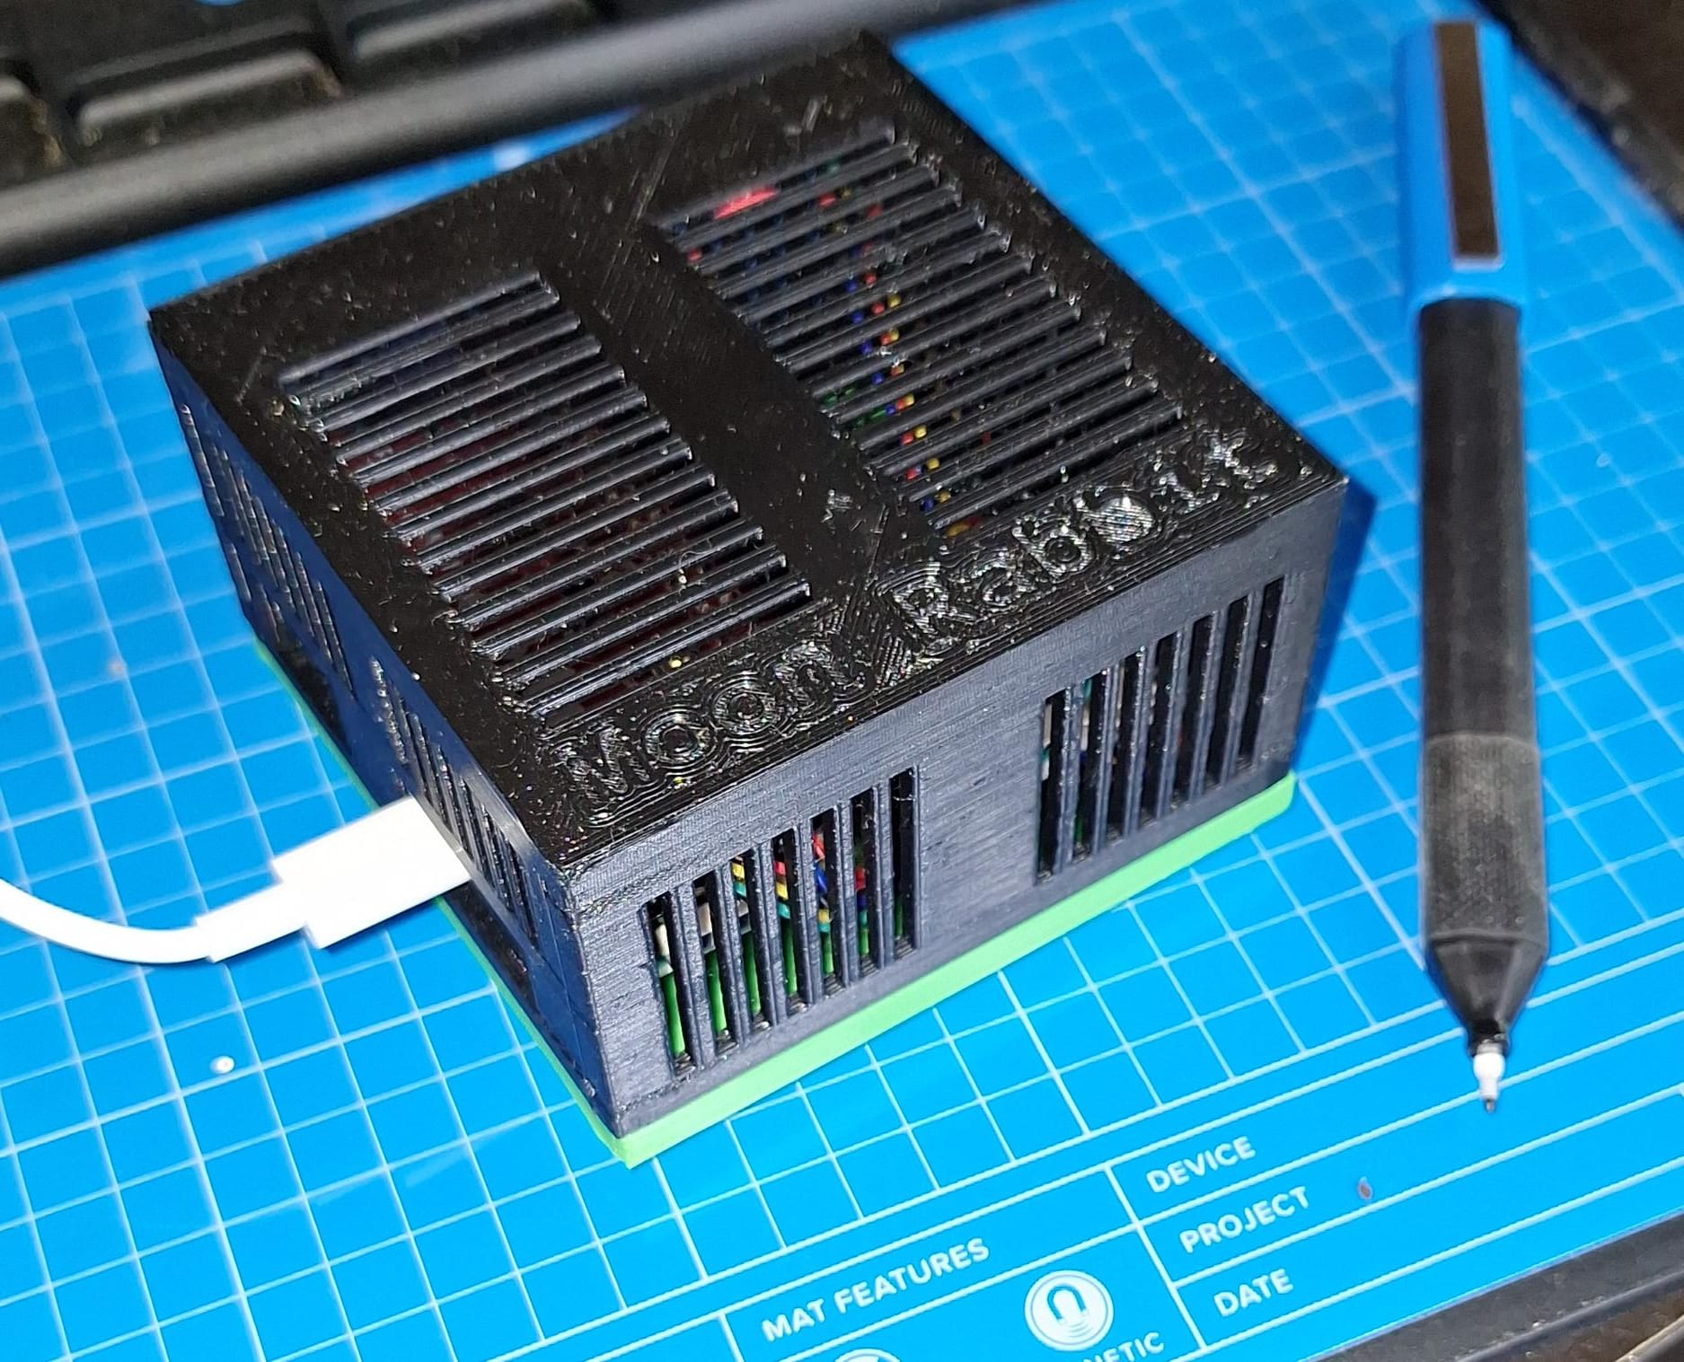
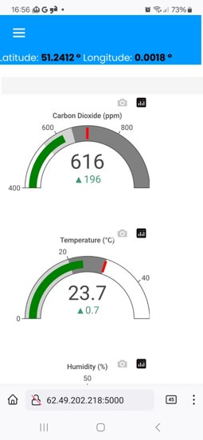
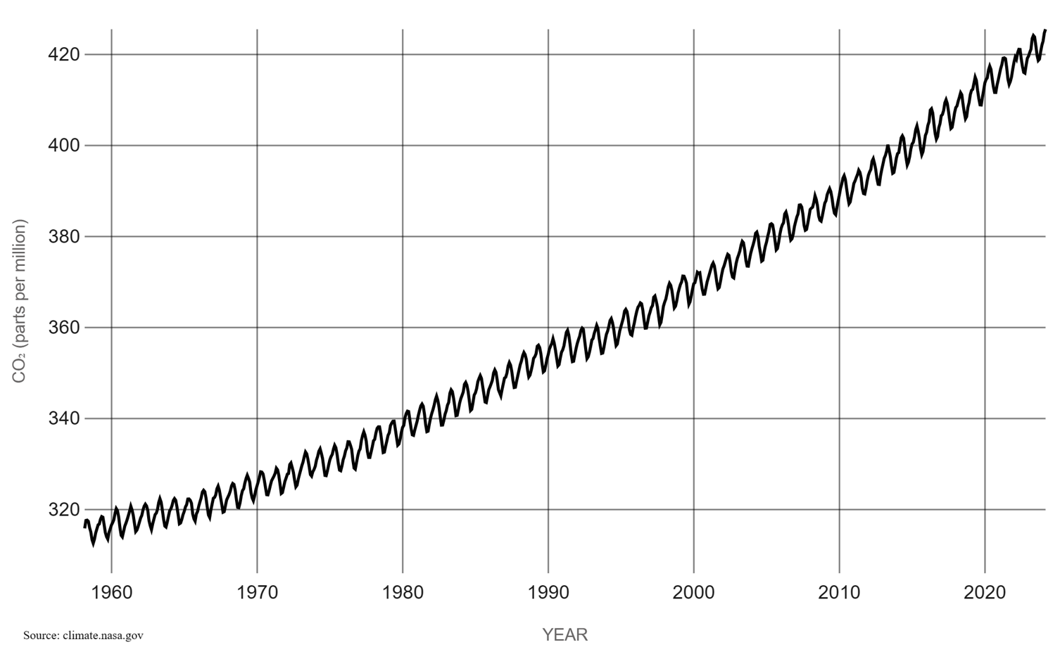
Climate change & Moon Rabbit
Self-built, dynamic real-time CO₂ sensor designed to educate and empower communities worldwide.
Captures CO₂ readings continuously, publishing data to your mobile device or PC and globally via an interactive map to explore in detail.
Moon Rabbit is a programme of self-build, experimentation and self-directed learning, tailored for the education community.
By enabling students, educators and families to build and deploy their own Moon Rabbit devices, the project fosters environmental awareness and hands-on STEM education.
Together, we are building a community-driven, global CO₂ map to inform, inspire, and help shape a more sustainable future.
Kyoto
Protocol
Paris
Accord
Atmospheric
CO₂

