Slide 1
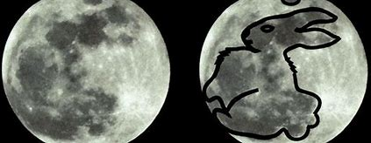
Climate change and Moon Rabbit

Slide 2
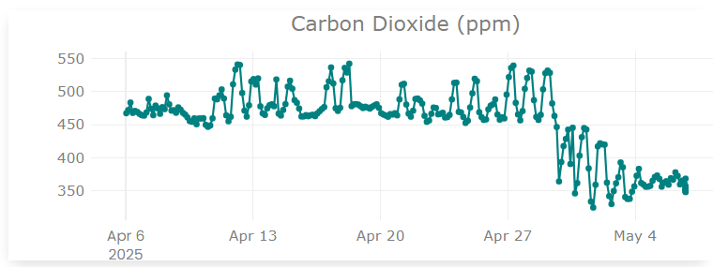
Moon Rabbit Projects
Building Moon Rabbit: Construct and deploy a DIY, Moon Rabbit CO₂ monitors to empower students to collect and analyse environmental data
CO₂ and Learning: Measure classroom CO₂ levels and correlate them with student concentration and test performance over a term.
Traffic and Air Quality: Compare CO₂ levels in classrooms at varying distances from major roads to assess the impact of traffic emissions.
CO₂ and the Daily Cycle: Track diurnal CO₂ changes in school grounds to explore links between photosynthesis, cloud cover and air quality.
Many more...
Skills developed
These projects help students build real-world scientific and technical skills, including 3D printing, coding and electronics (Raspberry Pi), sensor calibration, environmental data collection, data analysis, graphing and critical thinking. They also encourage teamwork, project planning, experimental design, and communication — all while connecting science learning to urgent global challenges like climate change.

Slide 3

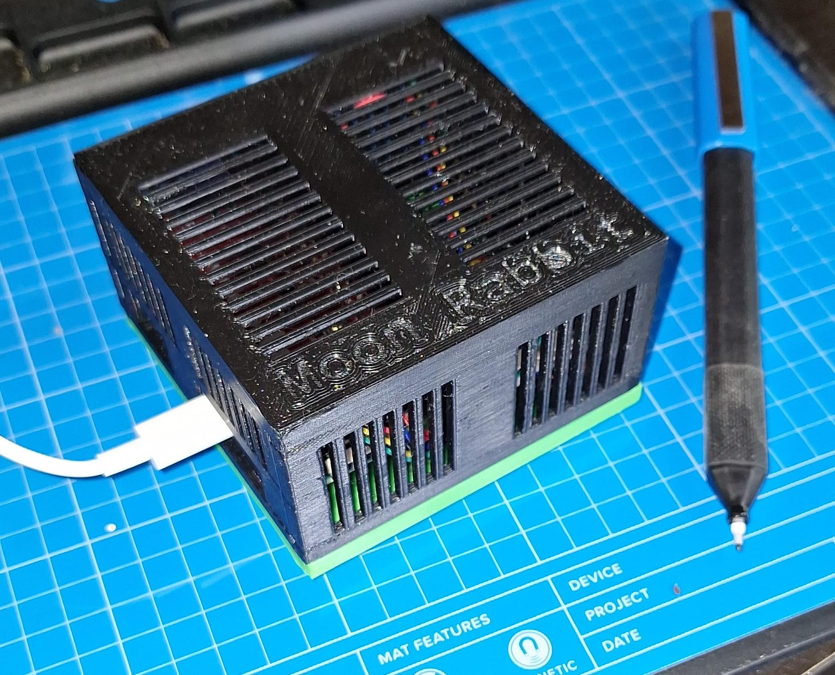
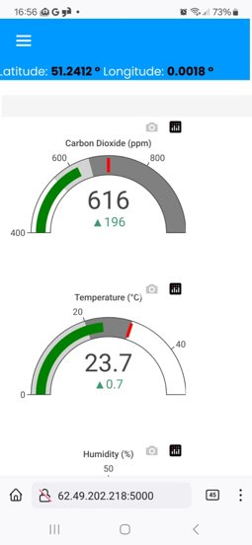
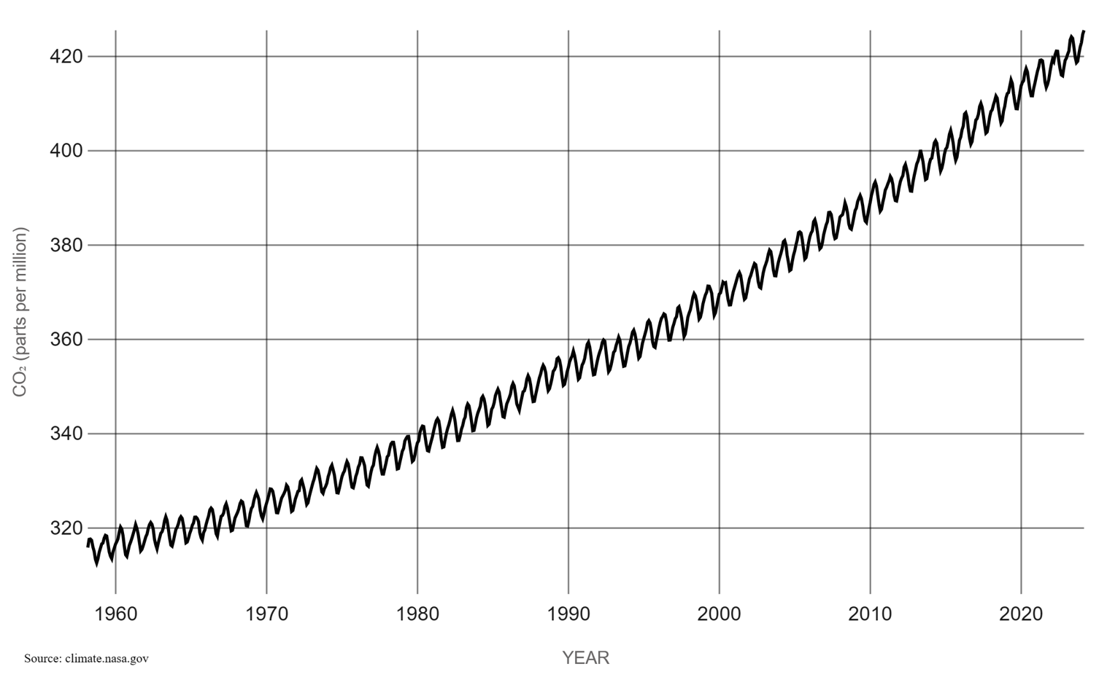
Climate change & Moon Rabbit
Build your own CO₂ sensor to educate and empower
Self-directed learning for the education & STEM community
Enables students, educators & families to build and deploy their own devices
Together, we are building a global CO₂ community to inform, inspire, and help shape a more sustainable future.
Real-time CO₂ data on your mobile or PC
Explore globally via an interactive map
Promotes environmental awareness and STEM education
Kyoto
Protocol
Paris
Accord
Atmospheric
CO₂

