Slide 1


Financial Statistics with Python
Steve Bell DPhil
Royal Statistical Society November 11th-12th November 2023

Slide 2
Course Outline
What is Financial Statistics?
Installation of Python
Review of Python basics: modules, lists, dicts, NumPy, Matplotlib Exercise 1: constructing a communicative chart with Matplotlib
Financial Instruments: bonds, stocks and commodities
Using Pandas: building more complex datasets, data cleaning and preparation Exercise 2: handling noisy data
Data sources: using Pandas DataReader, APIs and pd.read_csv(()
Asset returns and the normal distribution. Exploratory analysis.
‘Stylised’ facts of financial markets: volatility clustering, leverage effect and fat tails. Kurtosis and skew. Exercise 3: Exploring non-Gaussian statistics with a large dataset.

Slide 3
Course Outline (continued)
Financial crises and crashes
Government bond yield curves Dimension reduction using PCA
Building statistical models with Python statsmodels Exercise 4: Investigating the influence of interest rates on the price of gold
Bibliography

Slide 4
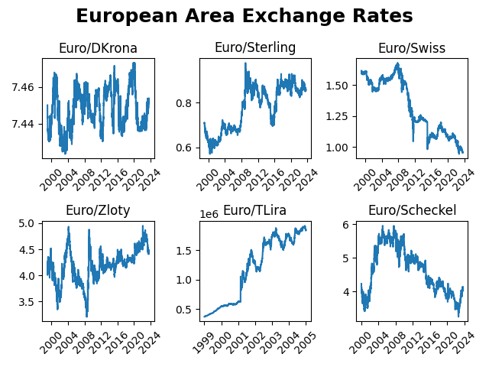
What is Financial Statistics?

Slide 5
European Area Exchange Rates
Plotting out the exchange rate for six countries neighbouring the Eurozone shows the diverse range of possible behaviour for statistical time series. The Danish Krona is tightly controlled in a narrow band, the Swiss Franc has strengthened considerably against the Euro whilst the Turkish Lira has weakened considerably. There is no single pattern. This is the challenge in getting to grips with financial statistics and why a single standard model such as geometric Brownian motion does not suffice.

Slide 6
What is Financial Statistics?
What it’s not: analysis of company balance sheets or profit and loss accounts.
Focus is on price data for tradeable assets such as stocks, government bonds and commodities such as gold, oil and wheat.
The frequency of this data can be anything from microseconds to months or years.
Data sets can be large if portfolios of assets are considered. For example, you might want to study the statistics of the price movements of all of the stocks in the FTSE100,that largest 100 listed companies in the UK.
A key feature of the data is that it is stochastic – random processes play a key role.
Traditional statistical measures such as the mean, standard deviation are important but so too are the higher moments such as skew and kurtosis because of the non-normal nature of financial statistics.
Models can be built (with care) using methods such as regression but understanding volatility and correlations in multivariate datasets is key. Machine learning techniques such as clustering can also be very helpful.

Slide 7
Resources
The GitHub site for this course contains the Python code for the example analysis.
NumPy quick start guide
10 minutes to Pandas
Matplotlib gallery
Stackoverflow for Python programming help.
The Statology website has a good guide for the use of Python with statistics.

Slide 8
Bibliography
Python for Finance, 2nd Edition, Yves Hilpisch, O’Reilly 2018
Quantitative Finance for Dummies, Steve Bell DPhil, John Wiley 2016
Python for Data Analysis 2nd Edition, Wes McKinney, O’Reilly 2017
Theory of Financial Risk and Derivative Pricing, Jean-Philippe Bouchaud and Marc Potters, CUP 2000
Systematic Trading, Robert Carver, Harriman House 2015

