Slide 1


Exploratory Data Analysis
Data Insights: Part 1
A synthesized transaction dataset formed the basis for the analysis.
The data set was cleaned and transformed to reveal useful insights.
Some highlights in the form of max, min (raw data) and average (excluding outliers) values from the data below
Average No. Transactions
Per Month
Average Transaction
Amount
4,014
104
18
30
78
Age
0
104
8,800
Transaction Amount
0
10,500
267,000
Balance

Slide 2
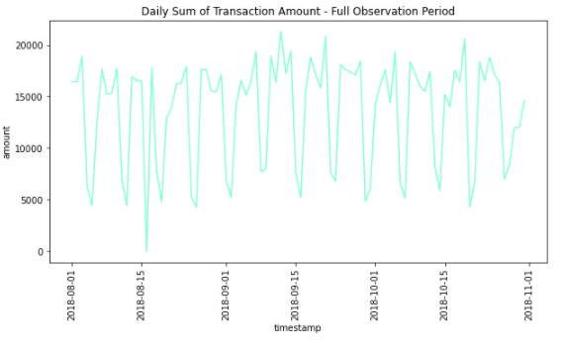
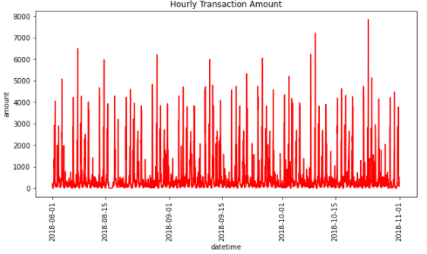
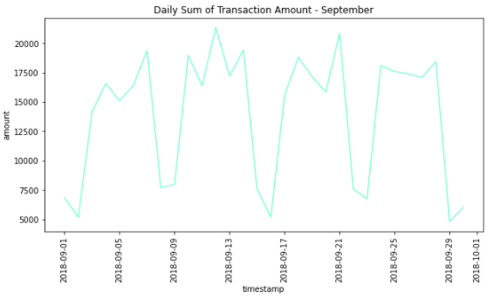
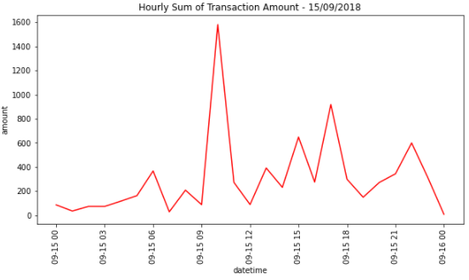
Exploratory Data Analysis
Data Insights: Part 2
Daily – Full Observation Period
Hourly - Full Observation Period
Daily - September
Hourly - September

Slide 3
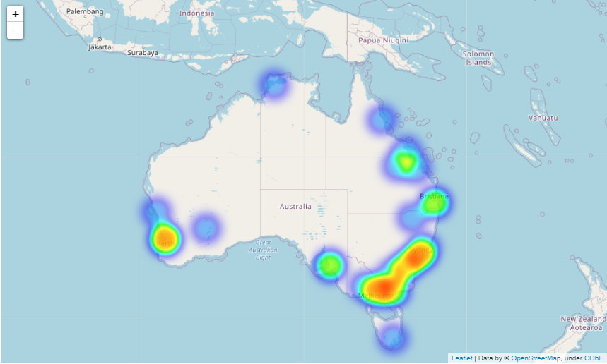
Exploratory Data Analysis
Data Insights: Part 3
Heatmap - Transaction Amount by Location
Figure shows the transaction amount by location as a heat map
This shows that the highest amount is transacted in the South East of Australia
This suggests that transactions are highest in major cities such as Sydney, Newcastle, Canberra and Melbourne.
Other transaction hotspots include the Perth region, the Adelaide region, the Gold Coast & Brisbane region and the Mackay region.

